Slide 1
SWEESH
Every line of a resume,
checkable.
Sweesh is a chain of custody for facts about a person — portable as one badge, verifiable end to end, revealing nothing beyond the answer.
Investor presentation · 2026
Notes:
One-sentence thesis. Lead with the badge idea; do not explain crypto here.

Slide 2
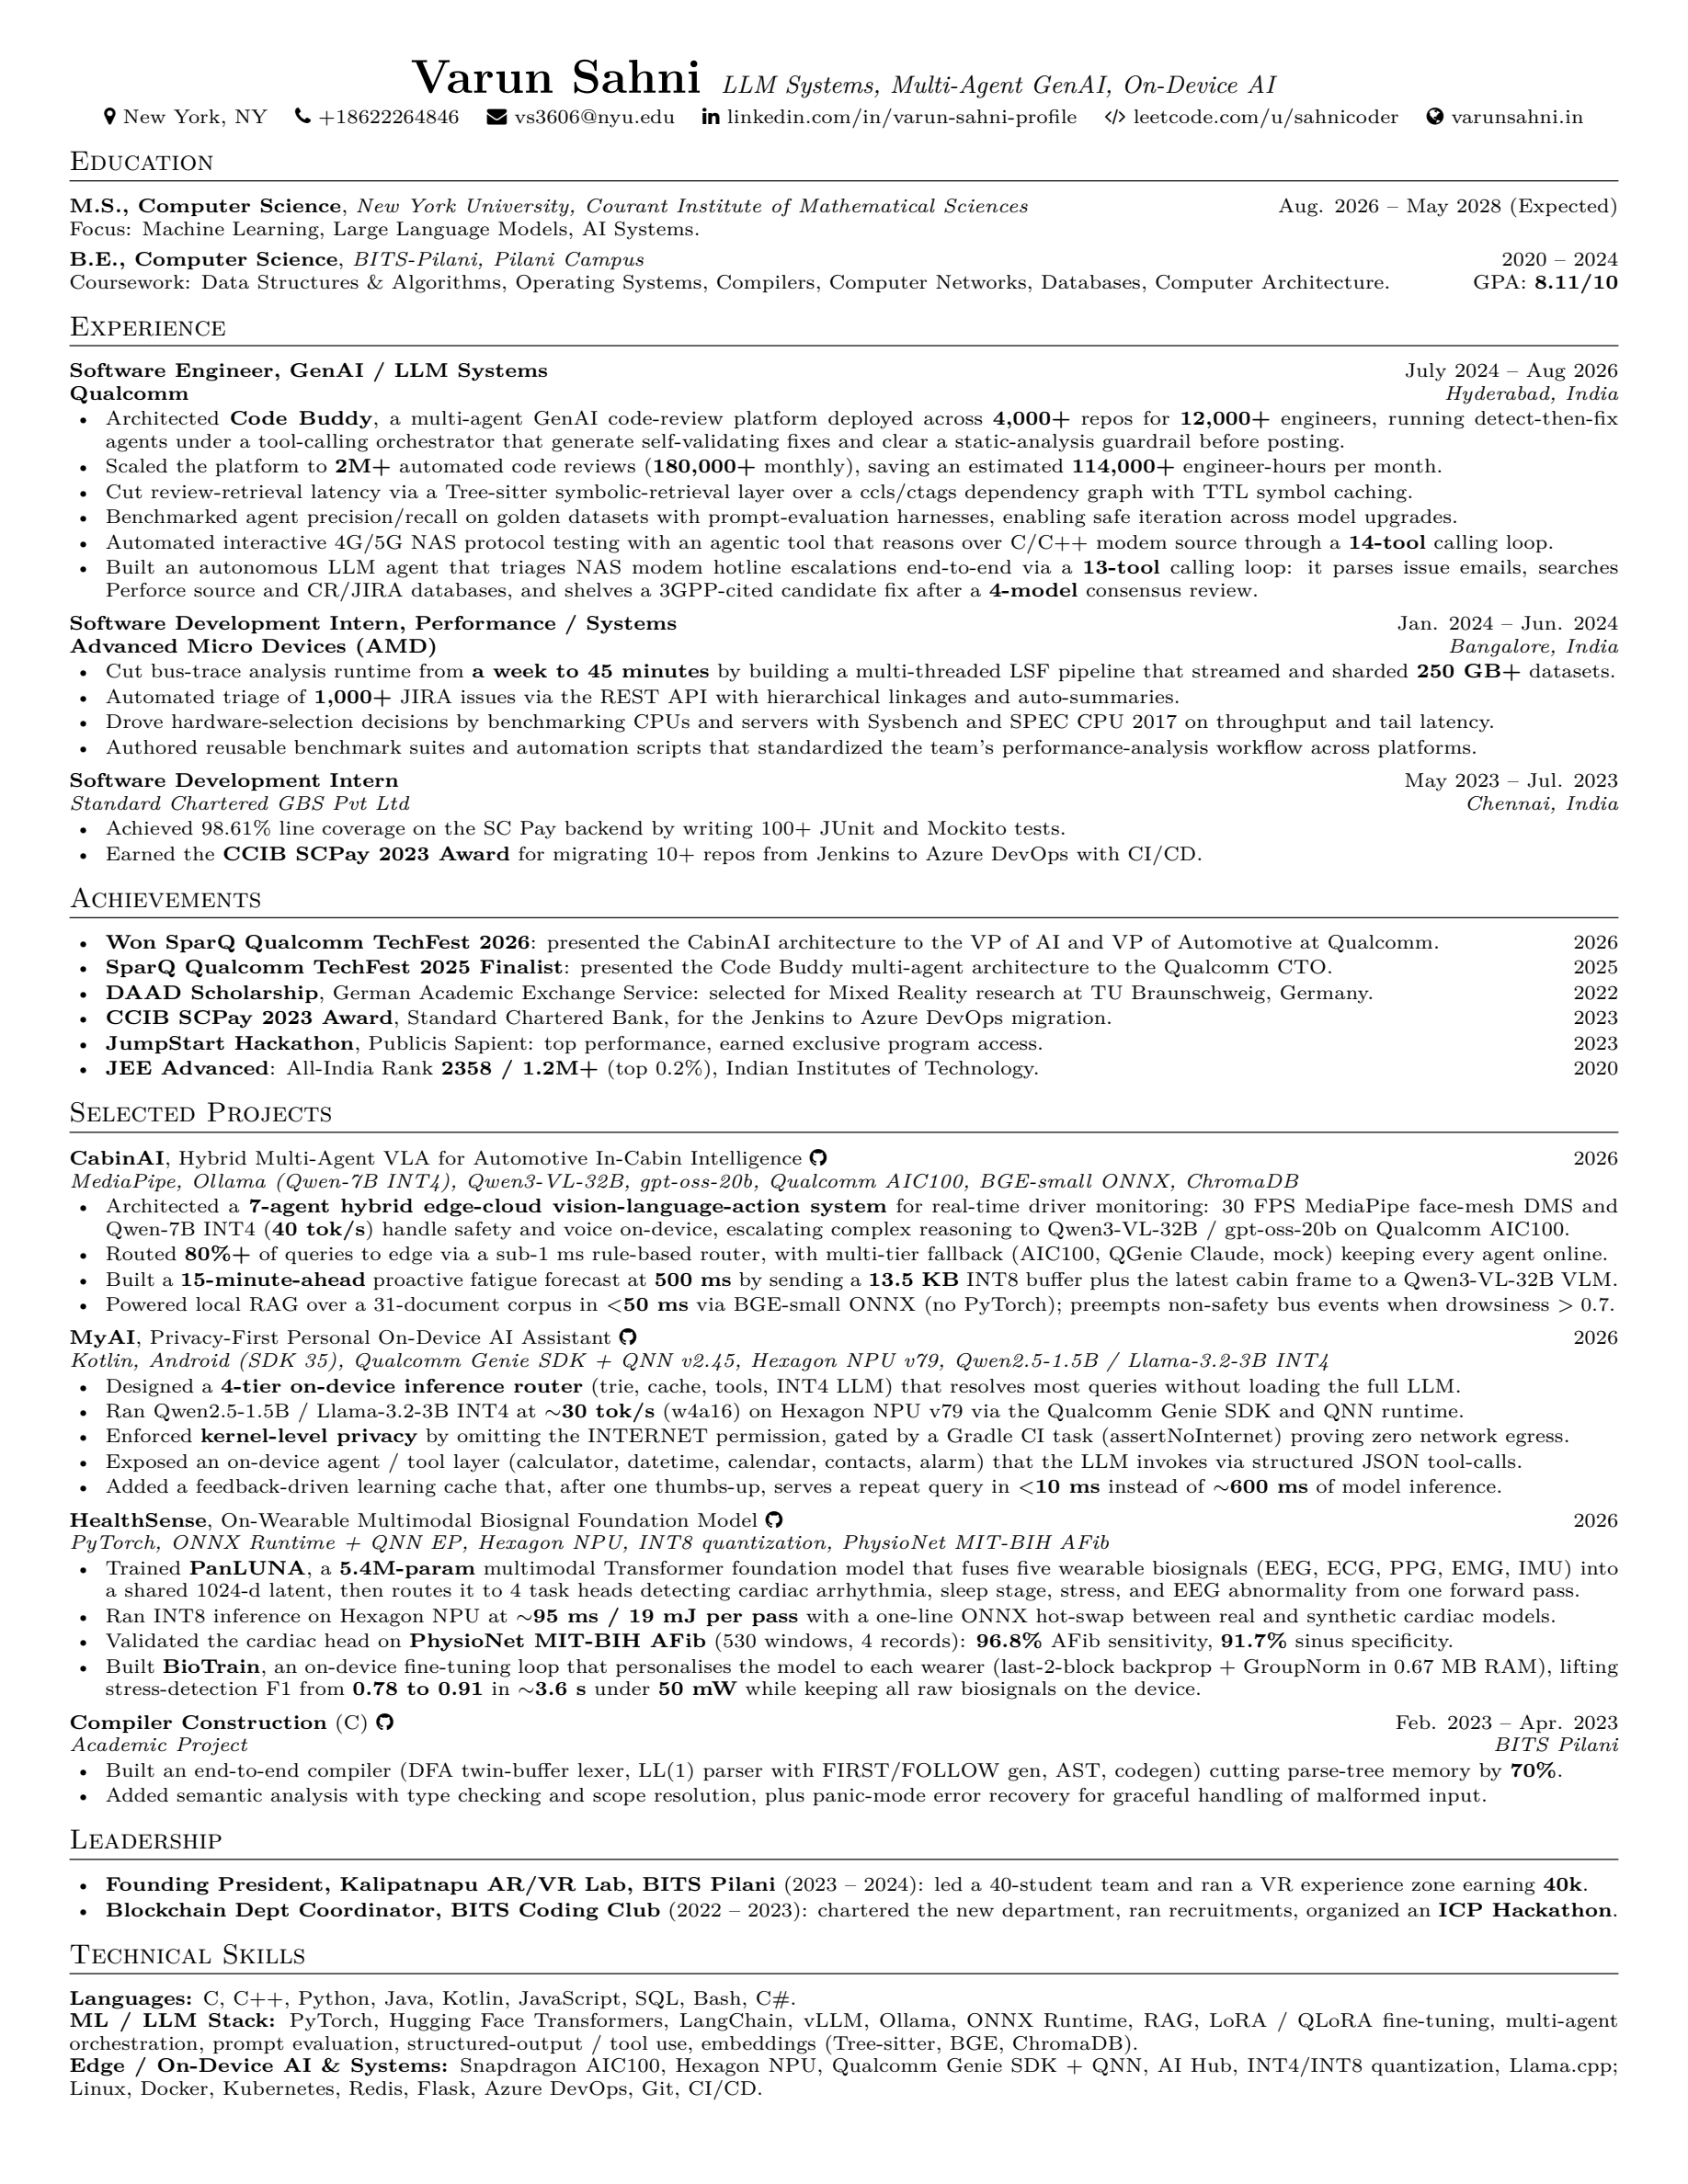
THE PROBLEM — WHAT WE HAVE TODAY
Today, a career is an unverified document.
An employer takes it on faith — or pays a screening firm to phone it in by hand.
Nothing here is signed.
Every line is self-asserted. No registrar, no HR system, no manager has vouched for any of it.
The proof already exists.
It sits in a registrar's transcript, an HRIS record, an old manager's memory — disconnected, never asked.
It all forgets you.
Each system loses interest in you the day you leave — which is exactly the day you need it to answer.
Notes:
Use the founder's own resume. The point is that even a strong resume is unverified.

Slide 3
THE PROBLEM — THE COST
Verification is slow, manual, and expensive.
And the cost sits on the party who captures none of the value.
$30–100
~3 days
$20–65
per candidate
of phone calls
per check
background screening
registrar · HR · old manager
employment / income verification
The employer wants the answer. The registrar or HR team produces it, gets paid nothing, and carries the liability. That asymmetry — not a missing technology — is why this has stayed broken.
Sweesh — Investor Pitch
3
Notes:
Costs from Sweesh Business Summary: screening $30-100/candidate, employment verification $20-65.

Slide 4
THE PROBLEM — WHY IT PERSISTS
Four gaps define our opening.
Payroll knows dates, not contribution
Payroll systems record titles and dates, nothing about what you did.
Manager attestations under delegated authority
Credentials verify, issuers do not
Blockcerts checks the document — not that the issuer is a real, accredited institution.
Recursive authority chains to a verifier-chosen root
Verification costs privacy
Answering a query means revealing the record — and callbacks tell the issuer where you applied.
Selective disclosure + zero-knowledge path proofs
Records die with the relationship
Your work email stops working the day you leave — the day you need it.
Issue once at the moment of truth, prove for life
Sweesh — Investor Pitch
4
Notes:
The last row is the one to internalise: any flow that asks someone to answer later will fail.

Slide 5
THE ANSWER
No resume. One badge.
Every fact is signed once, at the moment it becomes true — by the only party who could have known it.
The person collects those statements and sends one link carrying only what they choose to reveal. No callback. No phone call. No resume.
1
2
3
Issue at the moment of truth
Verify the signers, not just the signature
Reveal nothing beyond the answer
The university signs the degree when it confers it. HR signs the dates at hire and at departure.
A signature means nothing unless you know who signed. Sweesh records authority the same way it records facts.
The employer learns the claim is backed by a root they trust — not who signed it, or anything not deliberately sent.
Notes:
The three pillars. Emphasise pillar 2 — it is the whole idea and the differentiator.

Slide 6
THE ANSWER — HOW IT WORKS
Every claim walks to a root the verifier chose.
Each arrow is an accreditation. If any link is missing, unverifiable, expired, or revoked — the claim does not pass.
EDUCATION
US Dept of Education
root
Accreditor
MSCHE
University
New York University
Registrar
degree conferred
Degree claim
✓
EMPLOYMENT
HR system
dates · title · reporting
Company register
root · Companies House / SoS
Employer
Qualcomm · delegates authority
Work claim
signed, private
Manager
work contribution
Scope only ever narrows. HR grants the manager authority but never sees what the manager writes — so your old employer cannot read what your manager said about you.
Sweesh — Investor Pitch
6
Notes:
The recursive-authority walk. Two chains: education and employment. Emphasise scope narrowing.

Slide 7
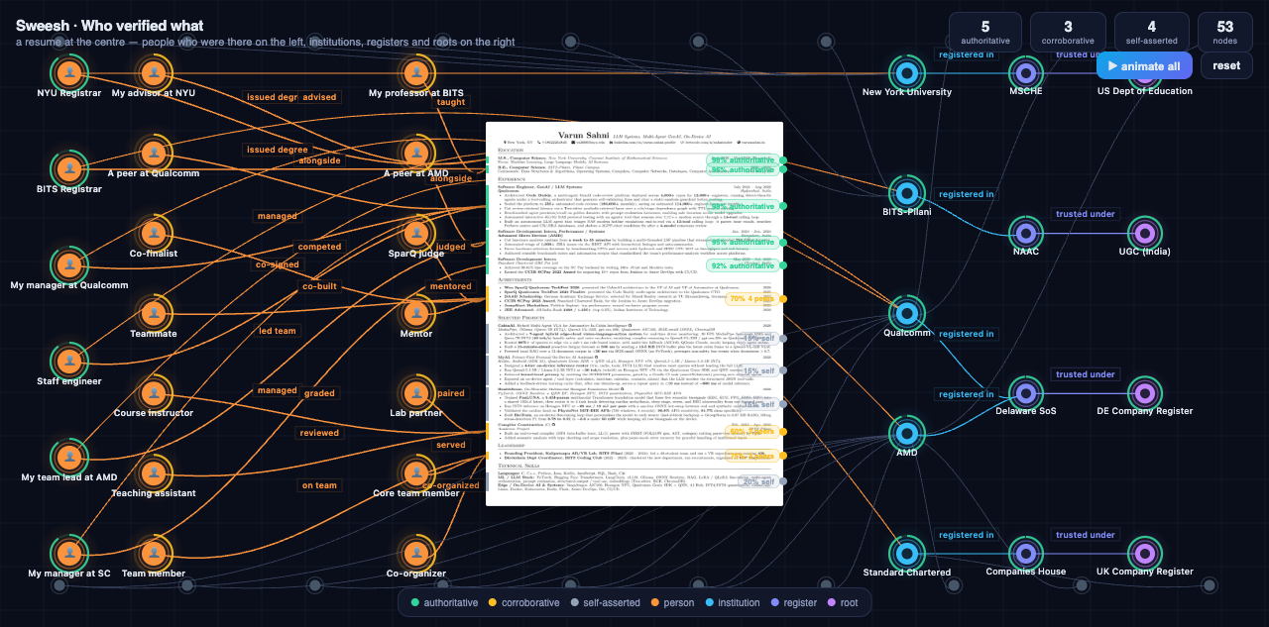
THE DEMO
Who verified what.
Authoritative
Corroborative
Self-asserted
Withheld
complete chain to a root
N peers agree — a count, never a tick
their own statement, bound to them
exists, deliberately not disclosed
Sweesh — Investor Pitch
7
Notes:
Live demo. Resume at centre, people who were there on the left, institutions/registers/roots on the right.

Slide 8
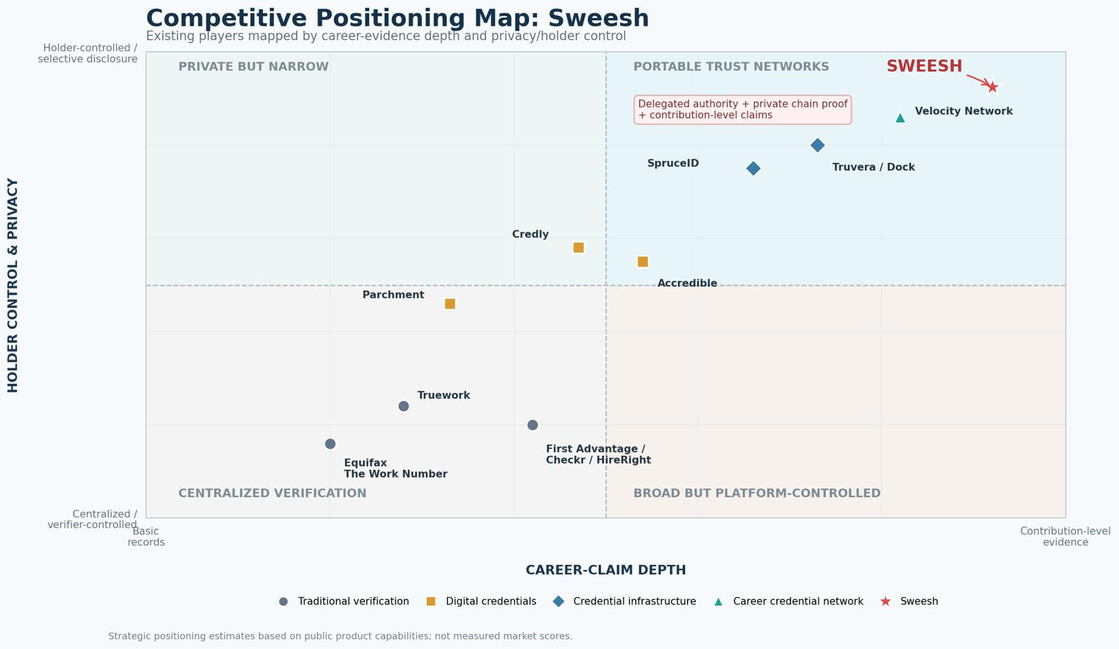
MARKET — POSITIONING
We sit where nobody else is.
Holder control & privacy on one axis, depth of career evidence on the other.
The portable-trust corner. Delegated authority + private chain proof + contribution-level claims — the only player with all three.
Sweesh — Investor Pitch
8
Notes:
Traditional verifiers (Equifax, Truework, Checkr) sit low on privacy; credential platforms (Credly) are shallow. Sweesh is alone top-right.

Slide 9
MARKET — SIZE & PLAYERS
A large, growing market.
Group
Players
Provide
Pay
$24B+
Employment verification
Equifax, Truework
Dates, title, income
$20–65 / check
Background screening
First Advantage, Checkr
Criminal, employment, edu
$30–100 / candidate
adjacent market today
Background screening $14B + digital identity $10B
Digital credentials
Credly, Accredible
Diplomas, badges
Issuer subscription
Career networks
Velocity Network
Career wallet
Network / tx fees
$43–48B
Credential infra
SpruceID, Truvera
Issuance, wallets, APIs
Licence + API
by 2031
screening +6–7%/yr · digital identity +15–18%/yr
Sweesh — Investor Pitch
9
Notes:
Source: First Advantage market presentation, via Sweesh Business Summary.

Slide 10
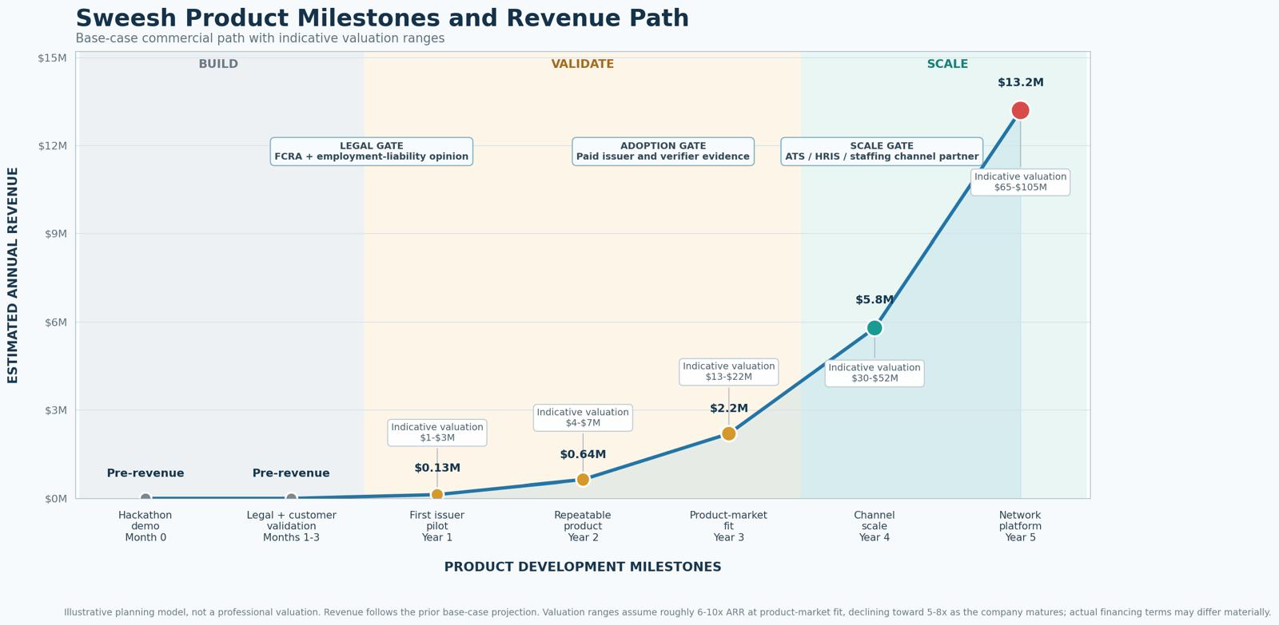
MARKET — REVENUE PATH
From hackathon demo to $13.2M.
Base case: $13M in year five (450 issuers, 200 employer/API customers) · indicative valuation $65–105M. Achievable only with a distribution partner — ATS, HRIS, or staffing platform.
Sweesh — Investor Pitch
10
Notes:
Conservative $4M / base $13M / strong $34M year-five scenarios. Valuation 6-10x ARR declining to 5-8x.

Slide 11
BUSINESS MODEL
Free for candidates. Issuers and verifiers pay.
Basic credential issuer
Free – $1.5k / yr
HR / university issuer platform
$6k – $15k / yr
Enterprise issuer · HRIS / SIS integration
$25k – $75k / yr
Employer verification platform
$12k – $60k / yr
Individual badge verification
$2 – $8 / badge
ATS / background-screening API partner
$50k – $250k / yr + usage
Recurring subscriptions + verification fees. Not a pure per-check model — reusable credentials naturally reduce repeated checks.
Sweesh — Investor Pitch
11
Notes:
Closest competitor is Velocity Network; our differentiator is verifying delegated authority + private chain proofs.

Slide 12
WHY WE WIN
We don't out-cover the incumbent. We out-scope it.
The incumbent: Equifax Work Number
What payroll structurally cannot do
839M+ employee records, fed automatically through payroll, access sold to verifiers. A copy of most of the American workforce's history.
Granular work claims · candidate-controlled disclosure · cross-border · verification without paying per check.
Cold start, answered.
Sell verification-request deflection to registrars and HR teams who field these requests for free today. Credentials enter the network as exhaust — the party who acts first finally captures value.
The honest risk: most employers restrict manager references to dates and title. Our design makes evaluation structurally unrepresentable — factual, scoped attestations with the company as legal attester.
Sweesh — Investor Pitch
12
Notes:
Differentiation is scope, not coverage. Acknowledge the manager-reference risk up front — it reads as competence.

Slide 13
ROADMAP & TEAM
Six weeks to demo. Then the metric that matters.
Week 2
Week 6
Month 3
Month 6
Integration, end to end, with stubs
Demo: live resume → chain → ZK proof
First real issuer on an HRIS / SIS sandbox
Accredited issuers × auto-minted attestations
The metric that matters: accredited issuers × attestations auto-minted per month with zero human touch — and whether that number grows without sales touching it.
Team A — Protocol & core
Team B — Data & graph
Team C — Atlas & demo
3–4 engineers · cryptography
2–3 · data science
2–3 · frontend / WebGL
Attestations, delegated authority, ZK chain proofs.
Real institution graph from ORCID, ROR, DAPIP; edge weighting.
The living map + badge inspector that carry the pitch.
Sweesh — Investor Pitch
13
Notes:
Integration checkpoint is end of week 2, not week 5. The adversarial suite (12 vectors) is the credibility slide.

Slide 14
SWEESH
Every line of a resume, checkable.
One badge. Verifiable end to end. Revealing nothing beyond the answer.
Varun Sahni · vs3606@nyu.edu
Notes:
End on the one-liner. Open the floor.

