Slide 1


Title
Project Name: Helix
Tagline: A real-time financial intelligence system that predicts cash flow, assesses risk, and guides smarter spending decisions.
Team Name: Ocular
Event: DevCraft: Simon’s Command Line (or your event name)
Date: 06/04/2026
Domain: Fintech

Slide 2
Problem Statement
UPI has made transactions effortless, but financial awareness hasn’t kept up
Users only see past spending, not future consequences
No answer to:
“How long will my money last?”
“Can I afford this decision?”
Manual tracking is inconsistent → users eventually stop using apps
Result: People run out of money without warning

Slide 3
Target Audience
Students managing limited budgets
Freelancers with irregular income
Gig workers (delivery, creators, etc.)
Early professionals with poor financial planning
Common traits:
High UPI usage
No structured financial planning
Need simple, actionable insights

Slide 4
Existing Solutions
Walnut
Money View
ET Money
What they do:
Track expenses
Categorize spending
Provide budgeting tools
Limitation:
Focus on history, not future

Slide 5
Gaps & Opportunities
No prediction of cash runway
No decision-making support
Not designed for unstable income patterns
No unified financial risk score
Opportunity:
Shift from “tracking money” → “guiding decisions”

Slide 6
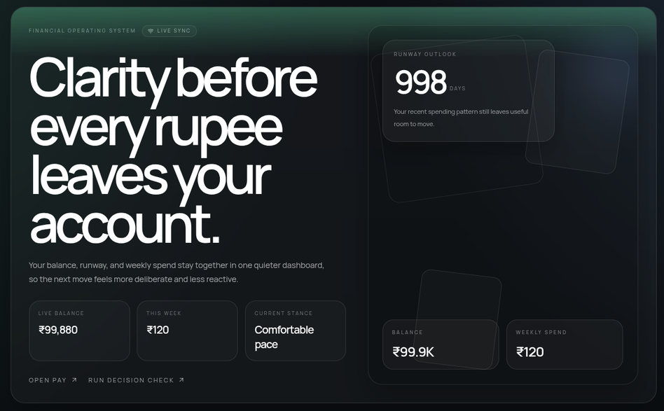
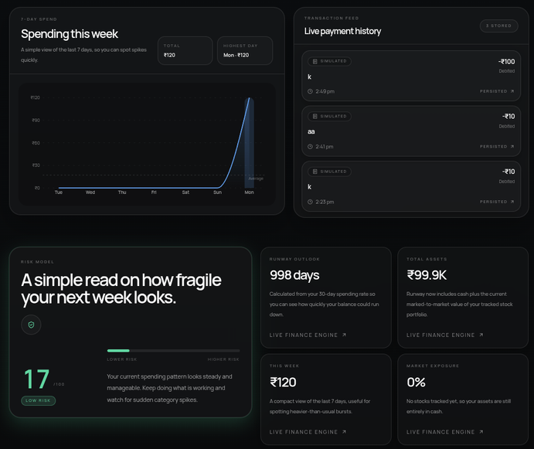
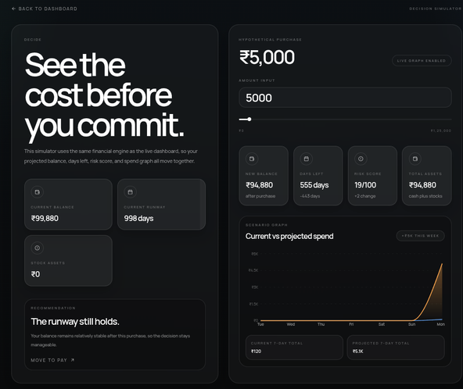
Your Solution
AI Financial Survival Engine
A system that:
Predicts how long a user’s money will last
Calculates a real-time financial risk score
Allows users to simulate financial decisions before making them
Integrates expenses and assets (such as stocks)
Focus:
Financial survival and decision-making, not just tracking

Slide 7
Key Features
Smart Dashboard
Days until money runs out
Risk score (0–100)
Spending trend visualization
Transaction Simulator
UPI-style payment interface
Immediate financial impact
Decision Simulator
Test any expense before making it
Shows updated risk and remaining days
Stock Portfolio Integration
Track investments
Understand impact on financial stability
Real Time Updates
Instant feedback
No manual refresh required

Slide 8
System Architecture
User Action → API (Node.js) → Database (PostgreSQL) → Financial Engine →WebSocket → UI Update
Key Points:
Event-driven architecture
Real-time processing
Modular and scalable design

Slide 9
Tech Stack
Frontend
Next.js
Tailwind CSS
Framer Motion
Backend
Node.js with Express
PostgreSQL with Prisma
Socket.io for real-time communication
AI Layer
Cashflow prediction logic
Risk scoring system
Extendable to machine learning models

Slide 10
Workflow
User performs a transaction or simulation
Data is sent to backend and stored
Financial engine computes:
spending rate
risk score
remaining days
Results are pushed to frontend via WebSocket
UI updates instantly
User adjusts decisions based on insights

Slide 11
Impact
Prevents users from running out of money unexpectedly
Encourages informed financial decisions
Improves financial awareness across diverse user groups
Scales easily without dependency on bank integrations

Slide 12
Future Scope
Integration with UPI and financial data aggregators
Personalized AI financial advisor
Credit scoring for users without formal history
Integration with lending and insurance systems
Advanced behavioral financial analysis

Slide 13
Team Info
Member 1: Shanthan T
Member 2: Varun S

