Slide 1
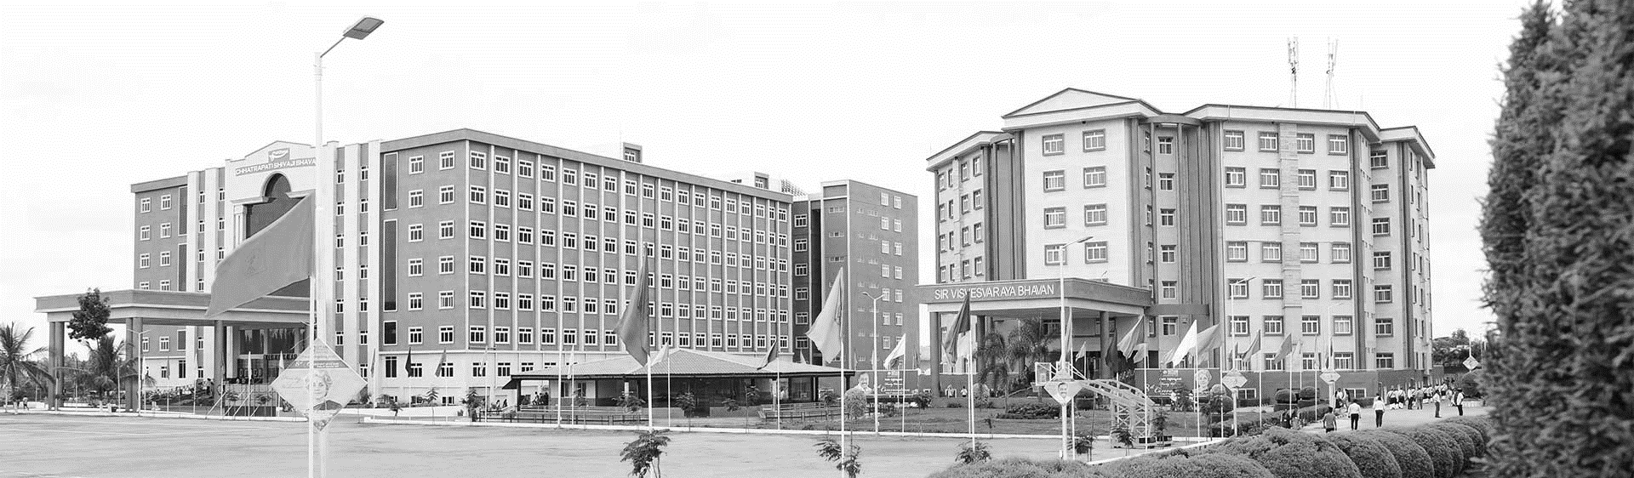

SINGLE AND MULTI-OBJECTIVE OPTIMIZATION FOR REAL WORLD PROBLEMS
AY 2021-25
GITAM UNIVERSITY
Minor Project
Project ID: CS5
A University should be a place of light, of liberty, and of learning.
Department of Electrical Electronics and Communication Engineering
Project Team:
Bu21eece0100108 [V Varun Sai]
Bu21eece0100213 [D Hafeez]
Bu21eece0100474 [U Pavani]
Project Mentor:
Avishek Chakraborty
www.gitamedu.com

Slide 2




Project Group – Details
Photo
Track
Roll No
Name
EECE AI/ML
Bu21eece0100108
V Varun sai
EECE AI/ML
Bu21eece0100213
D Hafeez
Photo
EECE Regular
Bu21eece0100474
U Pavani

Slide 3
Abstract
In the last decade, bio-inspired computation has become one of the most important themes of research into artificial intelligence; it has undergone a very significant increase in research and, as a direct consequence, in publications. The current status of the research in bio-inspired optimization is reviewed hereinafter with a focus on numerical optimization techniques that make up the core of the development of the corresponding bio-inspired solvers. In fact, despite the very fast growth, the field has become extremely controversial and currently, there are no new ideas, so the scientific community is forced to reconsider and redefine the future directions of the research. Especially, it points out several key challenges that need to be met to guarantee the scientific rigor and attraction for both new and established researchers in this domain: scalability, parameter adaptation, and benchmarking of bio-inspired algorithms. The authors propose a standard notation and description of bio-inspired algorithms to enhance readability and consistency among researchers. In the end, it will make communication and cooperation easier among the research community. By dealing with these problems, this research project is creating an environment that will foster innovation in bio-inspired computation. It is thus expected that such renewed focus on the fundamentals of paradigms and rigor in methodology could drive further collaboration and push the discovery of new bio-inspired techniques for solving complex optimization problems. The contribution aims to further develop bio-inspired solvers and increase the impact of bio-inspired computation on artificial intelligence research. These efforts can put the field back on track, continuing its evolution to provide new solutions for some very challenging optimization problems.

Slide 4
Introduction
Single-Object Optimization
Single-object optimization focuses on optimizing a single objective function. This is a relatively straightforward approach where the goal is to find the best solution that maximizes or minimizes a given objective. For instance, a company might aim to maximize its profit while minimizing costs.
Multi-Object Optimization
Multi-object optimization, also known as multi-objective optimization (MOO), deals with problems where multiple objectives need to be optimized simultaneously. These objectives often conflict with each other, making it challenging to find a single solution that satisfies all of them perfectly. An example is designing a car where the engineer might want to minimize weight, maximize safety, and minimize manufacturing cost, all of which can be competing objectives.

Slide 5
Literature Survey
Title | Year | Author/s | Technology used
Bio-inspired computation: Where we stand and what’s next | 2019 | Javier Del Ser , Eneko Osaba , Daniel Molina , Xin-She Yang , Sancho Salcedo-Sanz , David Camacho, Swagatam Das, Ponnuthurai N. Suganthan, Carlos A. Coello Coello, Francisco Herrera | Neural Networks
A methodology to find the elementary landscape decomposition of combinatorial optimization problem | 2011 | F. Chicano, L.D. Whitley, E. Alba. | Mathematical Analysis and Algebra Optimization Techniques Machine Learning
No Free Lunch theorems: limitations and perspectives of metaheuristics, in Theory and Principled Methods for the Design of Metaheuristics | 2014 | C. Igel | Metaheuristic Design and Adaptation Theoretical Frameworks and Models Machine Learning
Multi-population techniques in nature-inspired optimization algorithms: A comprehensive survey | 2019 | Haiping Maa, Shigen Shen , Mei Yu, Zhile Yang, Minrui Fei, Huiyu Zhou | Swarm Intelligence Parallel and Distributed Computing Machine Learning

Slide 6
Literature Survey
Title | Year | Author/s | Technology used
Robust optimization – A comprehensive survey | 2007 | Hans-Georg Beyer , Bernhard Sendhoff | Mathematical Programming Metaheuristics Decision Support Systems
Data-driven robust optimization | 2018 | Dimitris Bertsimas, Vishal Gupta, Nathan Kallus | Mathematical Programming Metaheuristics Decision Support Systems
Survey of quality measures for multi-objective optimization: Construction of complementary set of multi-objective quality measures | 2019 | Maciej Laszczyk, Paweł B. Myszkowski | Metaheuristics Machine Learning Visualization Tools Optimization Frameworks
Multi-Objective Evolutionary Algorithms | 2019 | Kalyanmoy Deb | Metaheuristics Machine Learning Visualization Tools Optimization Frameworks
Key Resources
Google Scholar
IEEE journals

Slide 7
Research Gap
Both single-objective and multi-objective optimization have significant research gaps that need to be addressed to improve their applicability and effectiveness in solving real-world problems. Key areas for single-objective optimization include scalability, handling non-convex functions, and optimization under uncertainty. For multi-objective optimization, gaps include dealing with high-dimensional objective spaces, integrating decision-maker preferences, and improving computational efficiency. Addressing these gaps through innovative research can lead to more robust, efficient, and applicable optimization methods across various domains

Slide 8
Objective and Goals
Objective
In real-world problems, optimization is finding the best solution from a set of possible solutions, subject to certain constraints. There are two types of optimization approaches: single-objective and multi-objective optimization. Here's a breakdown of the objectives and goals for each:
. The primary objective of single-objective optimization is to minimize or maximize a single objective function, which represents a specific goal in the problem.
. The objective of multi-objective optimization is to optimize multiple conflicting objectives simultaneously. Rather than one optimal solution, it seeks a Pareto-optimal set of solutions, where no one solution is better than another across all objectives.
Real-World Applications:
Environmental Engineering: Balancing the minimization of pollution with the maximization of energy production.
Supply Chain: Optimizing cost, delivery time, service quality, etc..
Goals
Solving Various real-world problems in different fields
Finding solutions that are most efficient
Achieve Feasibility
Enhance Decision-Maker Insights

Slide 9
Block Diagram
Single and Multi-object optimization
Literature
Survey
Problem Detection
Model Selection
no
Optimization and Solution Generation
SINGLE AND MULTI-OBJECTIVE OPTIMIZATION FOR REAL WORLD PROBLEMS
yes
Validation and Sensitivity Analysis
no
yes
Implementation and Evaluation
Final Report

Slide 10
Algorithms used in single and multi-objective optimization
Genetic algorithms
A meta-heuristic algorithm that uses randomness to find solutions. Genetic algorithms can be used to minimize equipment costs and the length of a heat exchanger.
Tabu search
A meta-heuristic algorithm that uses a tabu list of recently found solutions to find solutions.
Moth swarm algorithm (MSA)
A single-objective algorithm that has been shown to be superior to over 80 other evolutionary algorithms.
Multi-objective grey wolf (MOGWO)
A multi-objective algorithm that can be used to solve multi-objective optimization problems.
Multi-objective ant-lion (MOALO)
A multi-objective algorithm that can be used to solve multi-objective optimization problems.
Multi-verse algorithm (MOMVO)
A multi-objective algorithm that can be used to solve multi-objective optimization problems.
Particle swarm optimization
Particle Swarm Optimization (PSO) is a powerful meta-heuristic optimization algorithm and inspired by swarm behavior observed in nature such as fish and bird schooling.

Slide 11
Review Phase-2
Analysis –
Why:
The purpose of this project is to solve real-world problems using single and multi-objective optimization. Where optimization is required to find the best solution
What:
We are using different types of algorithms to find efficient solutions for different types of problems
Where:
The initial phase of the project is done in MATLAB and in google collab where we try executing different algorithms in multiple ways. which can be used in many real-world applications

Slide 12
When:
Currently, we are using these algorithms to solve real-world problems that are basic and we are trying to find efficient solutions for the next phase is to find real-world problems that are complex and hard to solve
How:
The project aims to solve optimization problems by leveraging swarm intelligence principles. In a typical optimization problem, the objective is to find the best solution from a set of possible solutions within a defined search space. PSO is particularly effective for nonlinear, multi-dimensional, or non-convex problems where traditional optimization methods may fail or be inefficient.

Slide 13
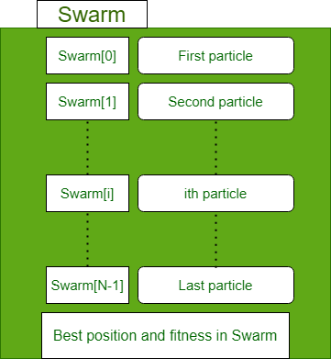
Particle Swarm Optimization (PSO)
Particle Swarm Optimization (PSO) is a powerful meta-heuristic optimization algorithm inspired by swarm behavior observed in nature such as fish and bird schooling. PSO is a Simulation of a simplified social system. The original intent of the PSO algorithm was to graphically simulate the graceful but unpredictable choreography of a bird flock.
Mathematical model
Each particle in particle swarm optimization has an associated position, velocity, and fitness value.
Each particle keeps track of the particle_bestFitness_value particle_bestFitness_position.
A record of the global bestFitness position and global_bestFitness_value is maintained.

Slide 14
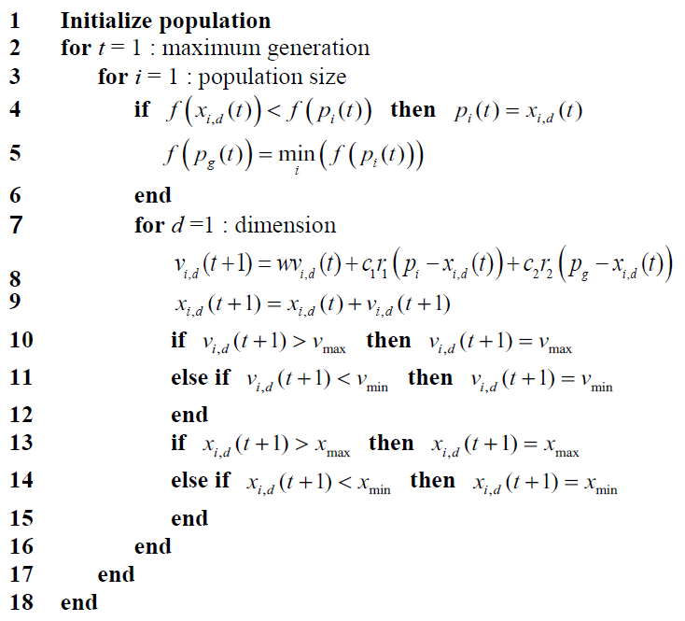
Pseudo code for PSO

Slide 15
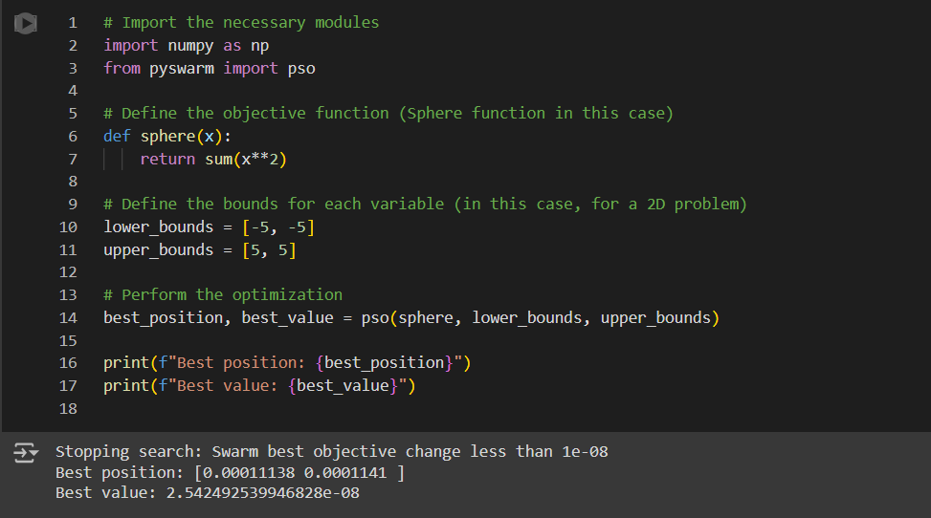
Code 1

Slide 16
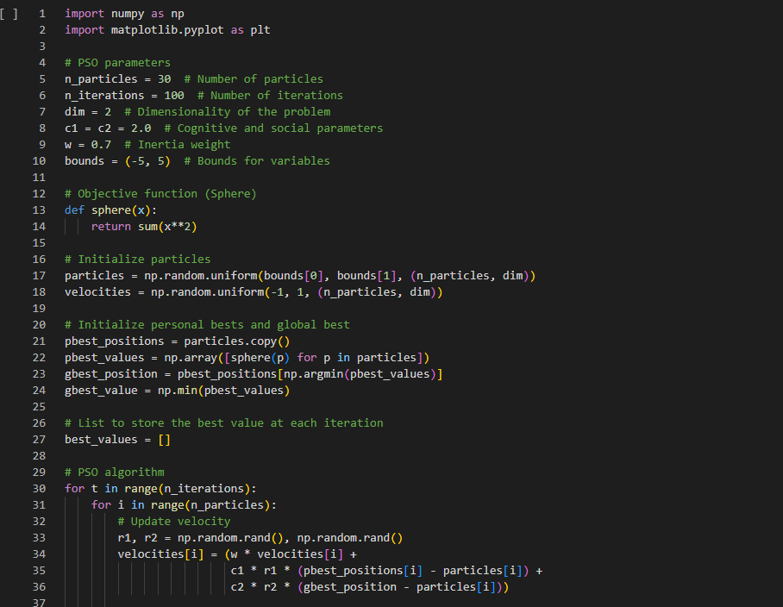

Slide 17
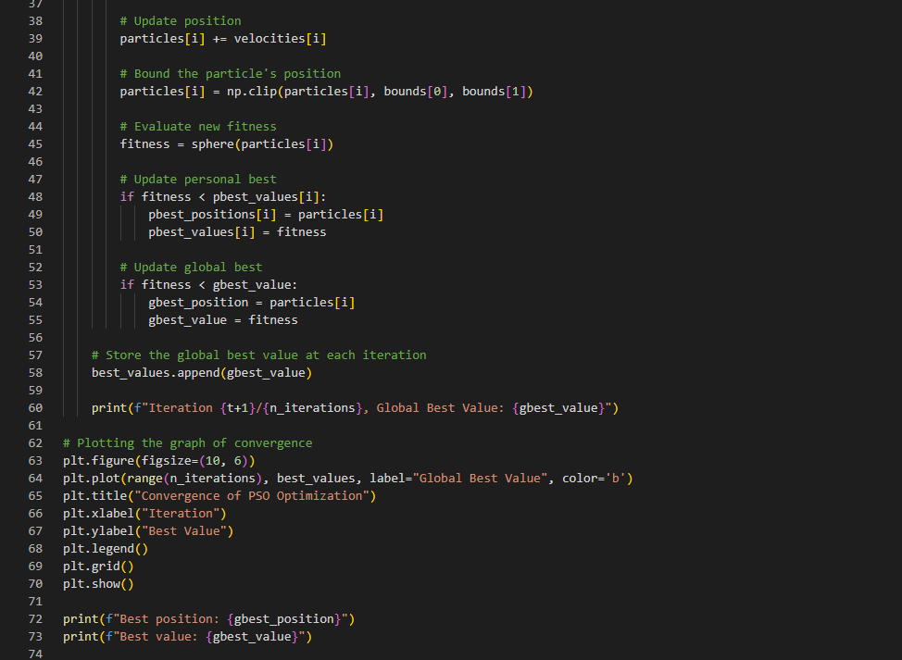

Slide 18
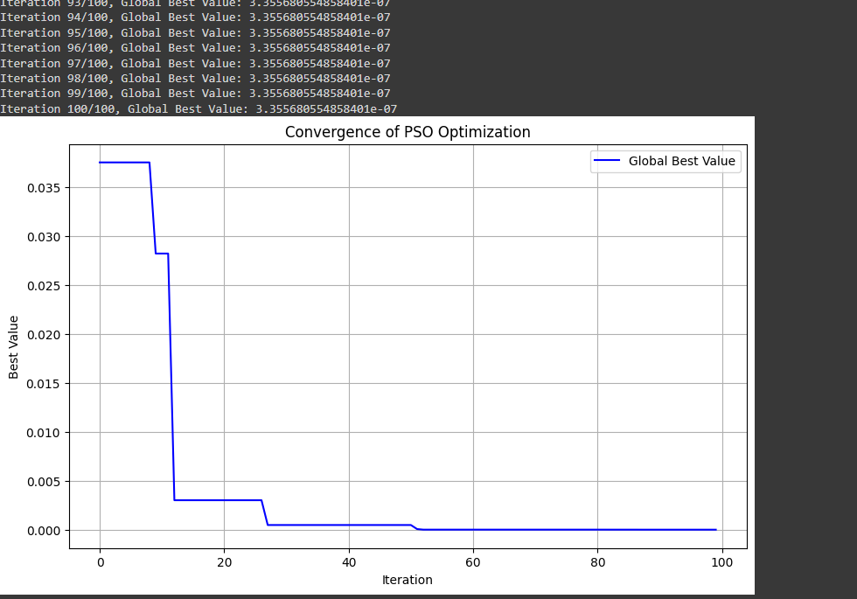
Result

Slide 19
Problem Statement:
A logistics company needs to deliver goods to 50 customers using 5 delivery trucks. Each truck has a maximum capacity, and each customer has a certain demand. The objective is to minimize the total travel distance while ensuring that all customers are served, vehicle capacities are not exceeded, and each customer is visited exactly once.
Step 1: Problem Data (Simplified for explanation)
Number of Customers: 50
Number of Vehicles (Trucks): 5
Vehicle Capacity: Each truck has a capacity of 100 units.
Customer Demand: Each customer has a random demand between 1 and 10 units.
Distance Matrix: The distances between all customer locations (50 x 50 matrix). We will randomly generate these distances, assuming that locations are in a 2D grid.

Slide 20
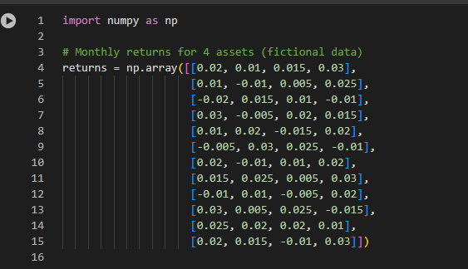
PSO Algorithm:
We’ll use PSO to solve this problem. The particles represent possible solutions, where each particle's position indicates a sequence of customer visits for each vehicle. The PSO will search for the optimal sequence (routing) that minimizes the total travel distance while satisfying the constraints.
DATA

Slide 21
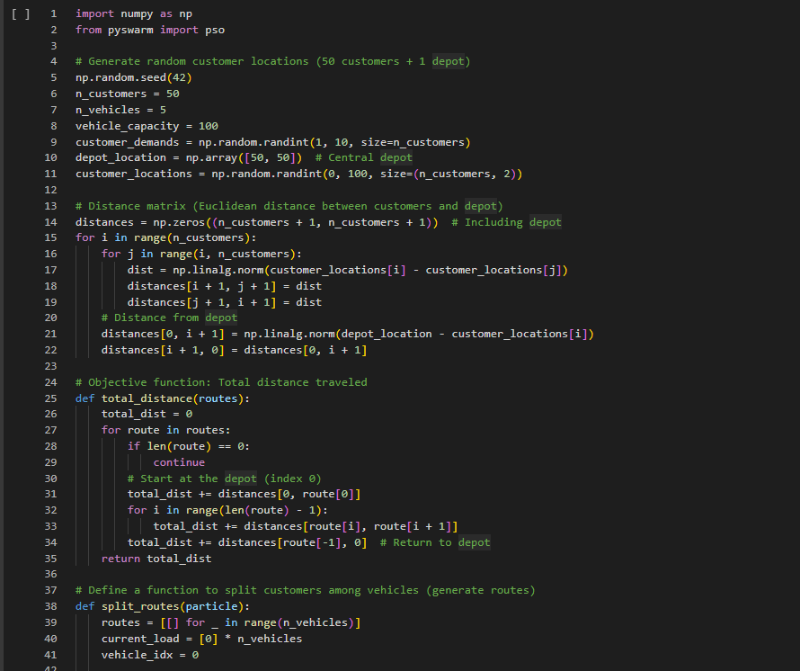
Code

Slide 22
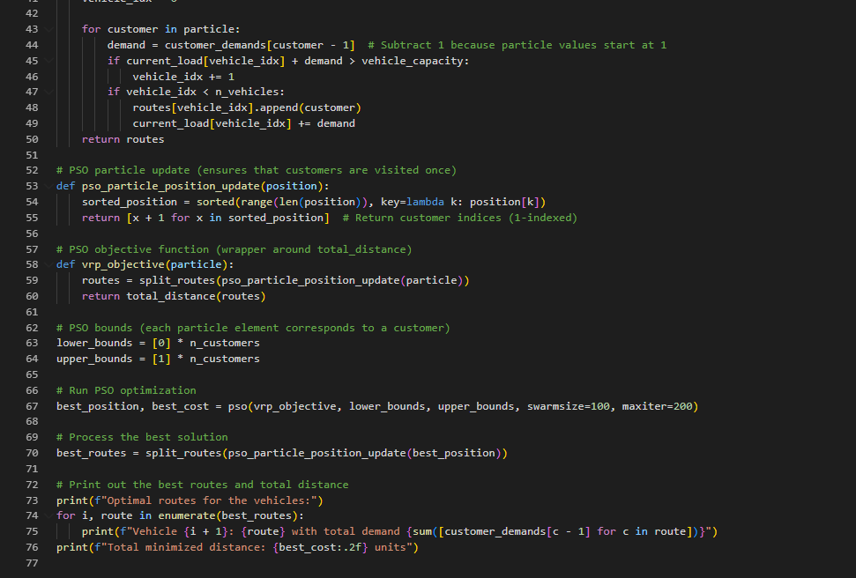
Code

Slide 23
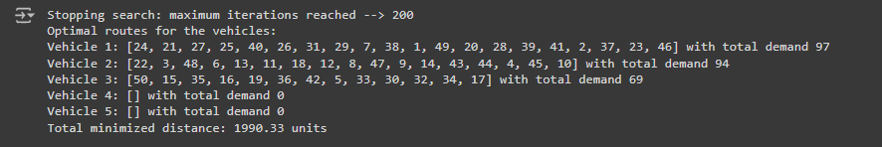
result

Slide 24
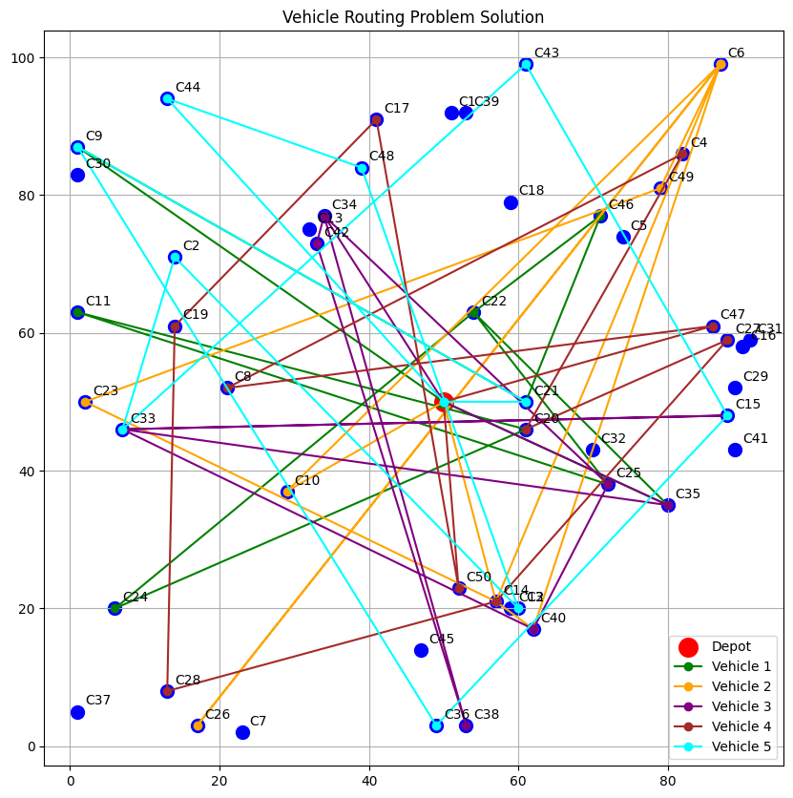
result

Slide 25
Conclusion & Future Work
Summary and Conclusion
In this project, we used Particle Swarm Optimization (PSO) to solve an optimization problem, demonstrating its effectiveness in finding optimal or near-optimal solutions for complex, high-dimensional search spaces. The PSO algorithm, inspired by the social behavior of birds flocking or fish schooling, successfully balances exploration and exploitation to converge towards a global optimum.
The implementation of PSO for solving real-world problems like the Vehicle Routing Problem (VRP), function optimization, and resource allocation highlights its versatility. By allowing particles to share information about the best solutions they have found, PSO efficiently navigates the solution space and avoids getting trapped in local minima.
Future Work:
Future work can explore:
Hybrid Approaches: Combining PSO with algorithms like Genetic Algorithms (GA) or Differential Evolution (DE) to enhance exploration and convergence.
Alternative Algorithms: Testing algorithms such as Ant Colony Optimization (ACO) for routing problems or Simulated Annealing (SA) to escape local optima.
Dynamic Environments: Implementing Deep Reinforcement Learning (DRL) for problems with changing constraints and real-time decision-making.
These approaches aim to improve solution quality and robustness in complex optimization scenarios.

Slide 26
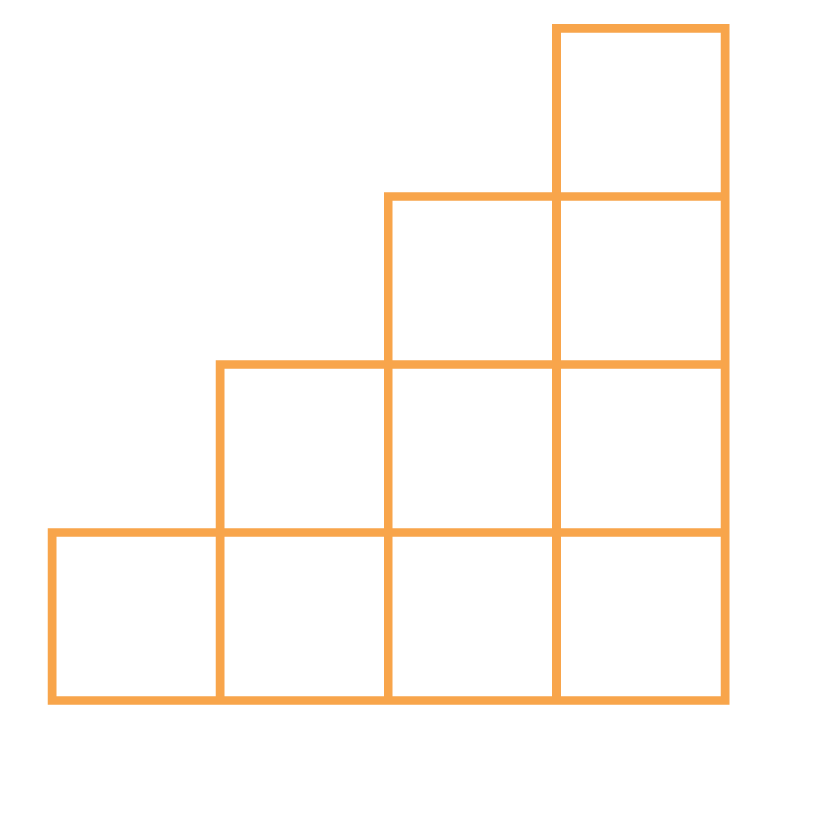
THANK YOU

