Slide 1
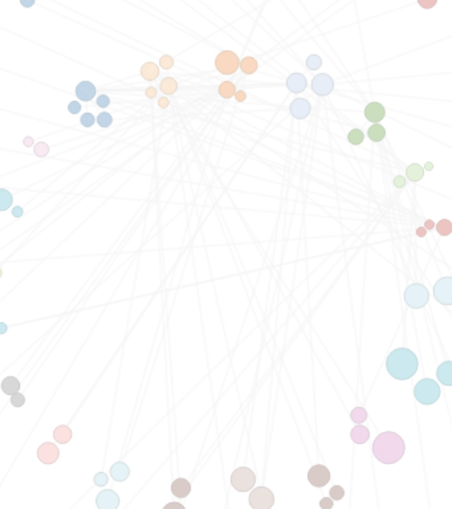
GROUP 4 | WEEK 1 REVIEW
Customer Segmentation Strategy
Business Objectives, Scope, Hypotheses, and EDA

Slide 2

THE CORE PROBLEM
Homogeneous campaigns cause marketing fatigue.
Uniform targeting diminishes ROI and creates unnecessary discount exposure.
Solution framework:
Unsupervised clustering of 2,240 customers into actionable behavioral segments.

Slide 3



STRATEGIC SCOPE
Targeted Commercial Decisions
Promotion Customization
Channel Optimization
Retention Intervention
Allocate marketing spend across web, catalog, and store.
Deploy automated win-back workflows for lapsed targets.
Differentiate high-margin offers from deal-oriented discounts.

Slide 4
Dataset Architecture
2,240
29
$606
Customer Records
Unique Attributes
Average Total Spend

Slide 5
Data Quality Audit Decisions
Missing Values
Zero-Variance
1.07% income data missing. Retained for median/KNN imputation.
Dropped 2 constant columns prior to clustering matrix.
Category Anomalies
Extreme Outliers
Non-standard status values mapped to 'Single/Unknown'.
Birth year and high income capped via IQR clipping.

Slide 6




Exploratory Data Insights
Demographics
Spending Patterns
Median income $51,382. 54% households have children.
Wine and meat drive 78% of all expenditure.
Channel Dynamics
Correlations
Physical in-store shopping leads with 5.8 purchases average.
Income strongly drives spend; deal purchases negatively correlated.

Slide 7
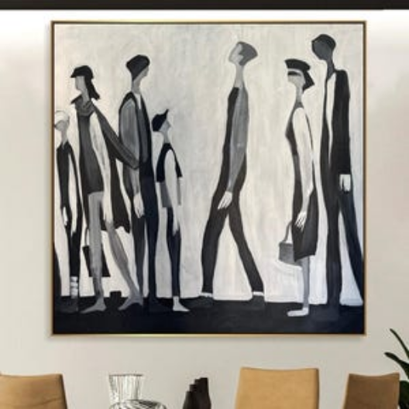
Testable Segment Hypotheses
•
Affluent Connoisseurs: High income, zero children, low deal sensitivity.
•
Budget Seekers: Lower income, larger families, high deal reliance.
•
Digital Shoppers: High web visits, responsive to email promos.
•
Lapsed High-Value: High historical spend, inactive over 60 days.
•
Catalog Traditionalists: Older demographics driving high catalog volume.

Slide 8
Week 2 Execution Roadmap
1
2
3
4
Feature Engineering
Scaling & PCA
Algorithm Suite
Validation Profiling
Derive Age, Total Spend, Children Count.
StandardScaler and explained variance analysis.
Train K-Means, Hierarchical, DBSCAN models.
Calculate Silhouette and build persona tables.

Slide 9
Thank You
Opening the floor for Group 4 Project Q&A.

Slide 10



Image Sources
https://flowingdata.com/wp-content/uploads/2012/07/circular_network.png
Source: flowingdata.com
https://img.magnific.com/free-photo/abstract-blur-furniture-shop-store-interior_1203-8579.jpg?semt=ais_hybrid&w=740&q=80
Source: www.magnific.com
https://i.etsystatic.com/18546753/c/2100/2100/337/0/il/64f618/7328976600/il_300x300.7328976600_rtjv.jpg
Source: www.etsy.com

