Slide 1
Cloudlet Offloading for JavaScript-based Applications
Varun Saravagi
Masters in Software Engineering
ISR/SCS
Supervised by:
Padmanabhan Pillai
Kiryong Ha

Slide 2
Motivation
Speed-up standalone applications using Cloudlet
Different from standard Cloudlet use-case where we bring the server close to the end user.
Leverage the cloud infrastructure
Split the existing code to run in client-server mode.
We selected JavaScript based applications since it is widely used for client-side applications.

Slide 3
Various ways to execute client-side JavaScript

Slide 4
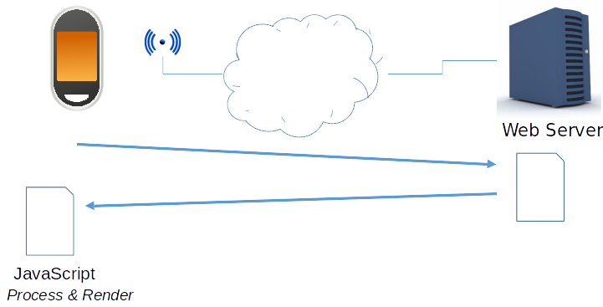
Option 1 (Today’s Default)
Client Processing
Current behaviour, client does all the processing

Slide 5
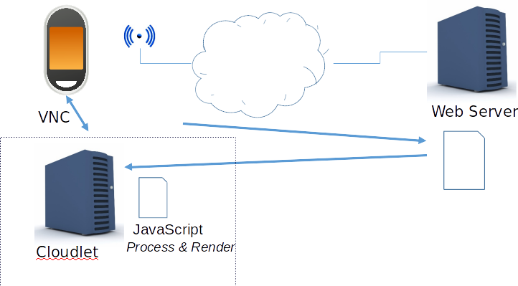
Option 1b (Remote Terminal)
Thin Client Processing
Client displays over VNC.
Actual display happens in Cloudlet

Slide 6
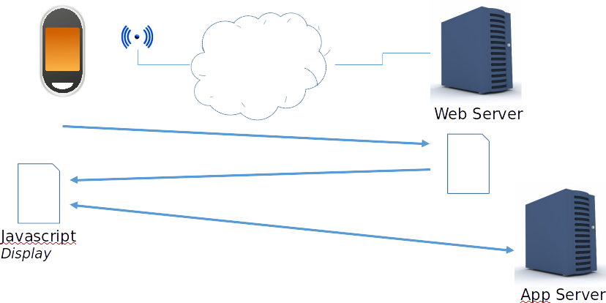
Option 2 (Cloud Offloading)
Backend in Cloud

Slide 7
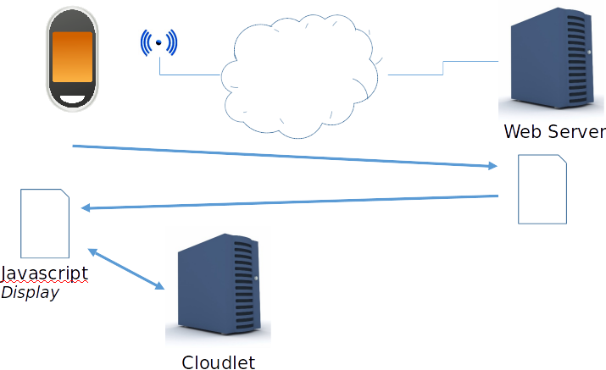
Option 3 (Cloudlet Offloading)
Backend in Cloudlet

Slide 8
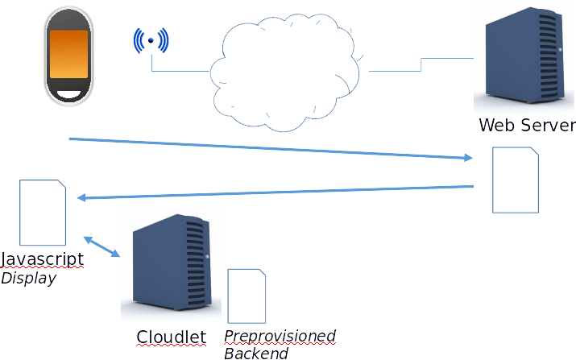
Option 3a
Separate Provisioning
A pre-provisioned backend in Cloudlet

Slide 9
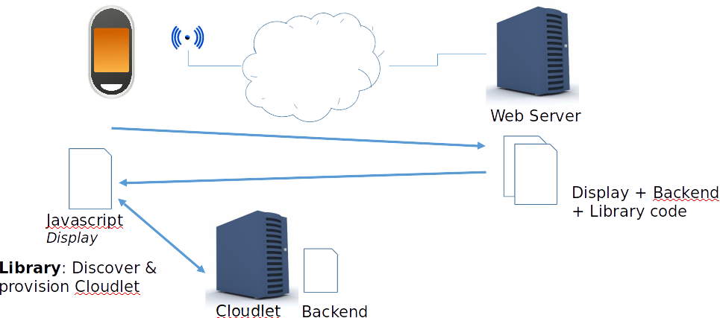
Option 3b
Client-based Provisioning
Client discovers and provisions the Cloudlet

Slide 10
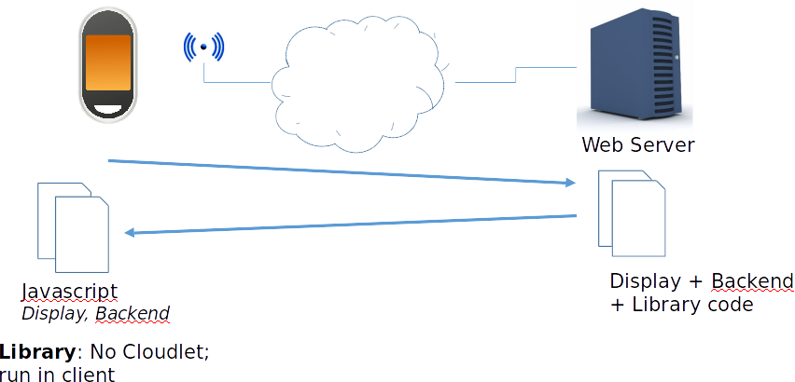
Option 3c (Fallback)
Client-based fallback
Client discovers and provisions the Cloudlet

Slide 11
Status
Did evaluation of all the three options
Run application entirely on Mobile device
Do processing on Cloud and rendering on Mobile
Do processing on Cloudlet and rendering on Mobile
Did not do provisioning as of now.

Slide 12
Application Selection
Constraints
Should be easily configurable
increase computation
increase data size
Should run on mobile devices
Should not use GPU for computation
Non-rendering aspect should be significant

Slide 13
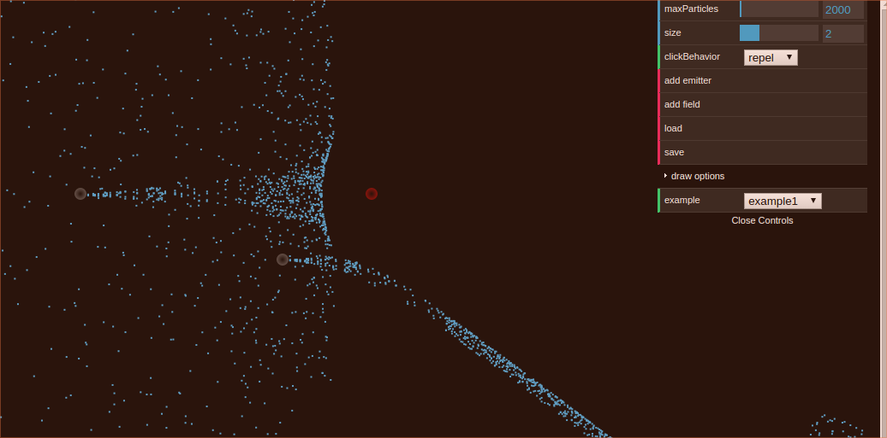
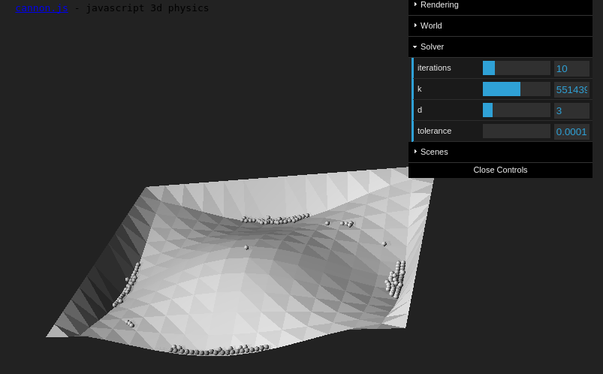
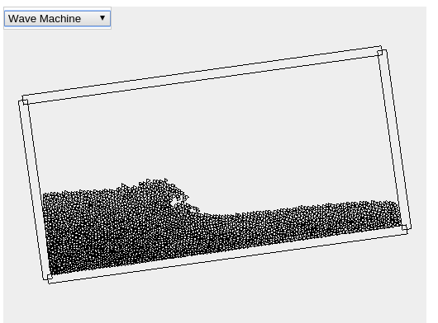
Sample Applications
JavaScript Particle Display
Cannon.js Physics Engine
Not easily configurable
Uses WebGL and 3D
Difficult to learn
Not Mobile compatible
LiquidFun.js

Slide 14

Selected Application
Cloth Simulation (demo)
Simulates the behavior of a hanging cloth
Purely standalone javascript. No external libraries
Easily configurable for computation and data size
Various parameters
Physics Accuracy
Cloth Height and Width
Spacing
Gravity
Tear Size
Mouse Influence
Mouse Cut

Slide 15
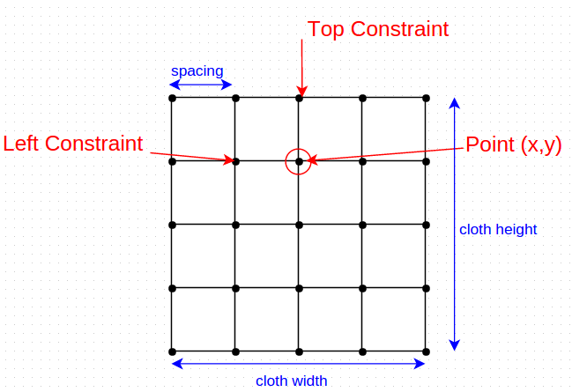
Working of Application
Update the cloth continuously. During each update
Update each point’s position based on a constant (0.016) and gravity applied.
Update the position of the constraint points
Determine tear based on tear distance
Listen for mouse events to simulate movement and tear

Slide 16
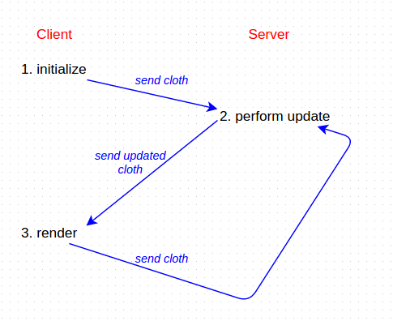
Partitioning
Split the existing code to run in client-server mode
Do minimal change to existing code
Approach 1 (state resides at client)

Slide 17
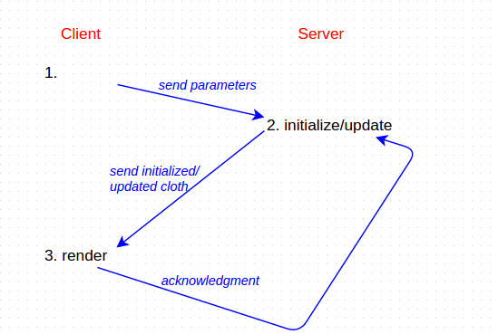
Partitioning
Approach 2 (state resides at server)

Slide 18
Challenges faced
Data Structure
Recursive in nature
Each point had reference to its neighboring constraint point(s) in the form
[[self, constraintPoint1], [self, constraintPoint2]].
Cannot directly serialize recursive data structures for network transmission. (JSON.stringify())
Solution
Change the data structure to remove the recursive nature.
[constraintPoint1, constraintPoint2]

Slide 19
Challenges faced
Data Structure
Stack Overflow
Once recursive nature removed, each point had reference to its neighboring constraint point(s) in the form
[constraintPoint1, constraintPoint2].
Still using object references which made the stack very large.
Solution
Send only the information necessary for rendering.
Coordinates
Use coordinates of constraint points instead of object reference
[CoordConstraintPoint1, CoordConstraintPoint2]
Get the actual point on the client side.

Slide 20
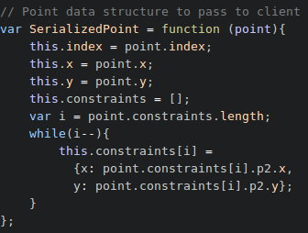
Challenges faced
Network Traffic
Serializing JSON is data intensive
Using JSON.stringify, each point was ~120 bytes
~150 bytes
~120 bytes per point

Slide 21
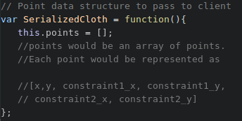
Use MessagePack to transfer in Binary format
~40 bytes per point

Slide 22
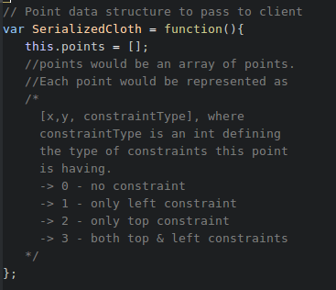
~14 bytes per point

Slide 23
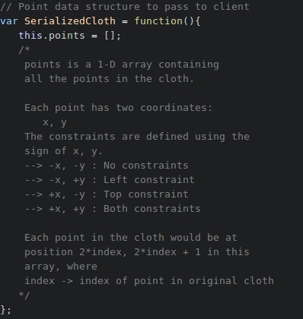
~5 bytes per point

Slide 24
Evaluation parameters
Computation
Increase physics accuracy
5, 25, 45, 65, 85, 105
Data Size
Increase cloth width and cloth height
Also increases computation
For each data size, performed for 3 different physics accuracy.
5, 25, 45.
Server Machines
Cloudlet
AWS (West Coast)
Mobile (One plus one)

Slide 25
Evaluation Parameters
WIdth | Height | Data Size (KB)
80 | 90 | 33
120 | 182 | 110
150 | 244 | 188
210 | 244 | 274
260 | 245 | 346
317 | 260 | 452

Slide 26
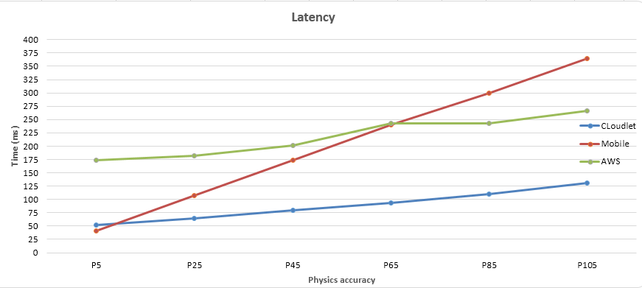
Result set
Computation

Slide 27
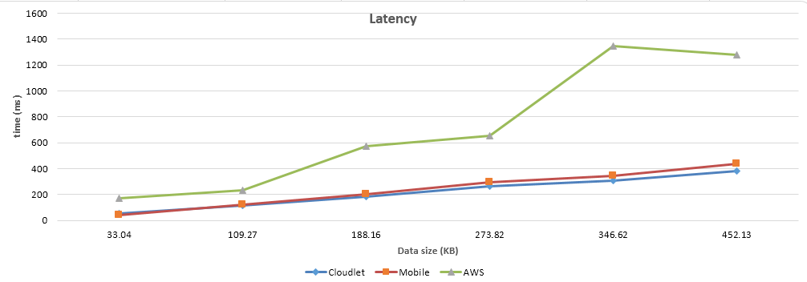
Result set
Data Size 1 (Accuracy: 5)

Slide 28
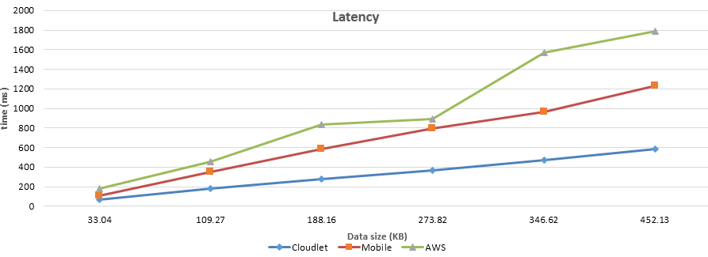
Result set
Data Size 2 (Accuracy: 25)

Slide 29
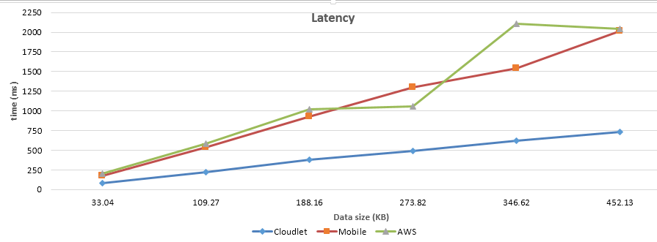
Result set
Data Size 3 (Accuracy: 45)

Slide 30
Demo Video
Cloudlet vs AWS

Slide 31
Demo Video
Cloudlet vs Mobile

Slide 32
Reflections
Network bandwidth is a critical factor in improving performance. The performance improved as we kept on reducing the data size.
Splitting the code is not difficult.
Difficulty lies in making the code efficient.
JavaScript is single-threaded. Can’t leverage all the available cores (parallelism) and distribute work.
The split can be beneficial or not, depending on the type of application.

Slide 33
Future Work
A library script to split the given JS into client and server side.
Transparent offloading
Automatically detect the cloudlet and transfer processing over there.
Transferring the current state on the cloudlet
Continue processing without the user knowing about it.
A model to see the effect of computation and transmission on latency. (WIP)
comp.x + transmission.y + c = latency

Slide 34
Thank You

