Slide 1

CT Image Processing for Lung Cancer Detection using Deep Neural Networks
Project Mentor :
Ms. Anjali Kapoor
Group members :
Varun Sharma (03010402715)
Sanchit Arora (35510402715)
Manish (35210402715)
Rishabh Pundhir (35310402715)

Slide 2
Index
Introduction
Base Paper
Implementation
Dataset
Pre-Processing
Pre-Processing Result
Implementation of Neural Networks
Classification
Results
References

Slide 3
Introduction
In this project, a lung cancer detection method is proposed using
mathematical morphological operations for segmentation of the lung
region of interest, and the high resolution CT images are properly annotated and labeled for classification of cancer by Deep neural networks.

Slide 4
Base Paper
Moffy Vas, Amita Dessai, “Lung cancer detection system using lung CT image processing.” in IEEE Conference 2017 pp 1240-1245.

Slide 5
Dataset
All CT Scan data was provided by The KAGGLE DATASCIENCE BOWL 2017, In this dataset, you are given over a thousand low-dose CT images from high-risk patients in DICOM format. Each image contains a series with multiple axial slices of the chest cavity. Each image has a variable number of 2D slices, which can vary based on the machine taking the scan and patient. The DICOM files have a header that contains the necessary information about the patient id, as well as scan parameters such as the slice thickness.
The database also contains annotations which were collected during a two-phase annotation process using 4 experienced radiologists.

Slide 6
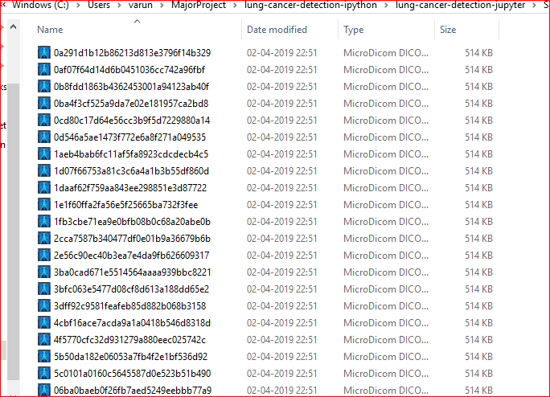

Slide 7
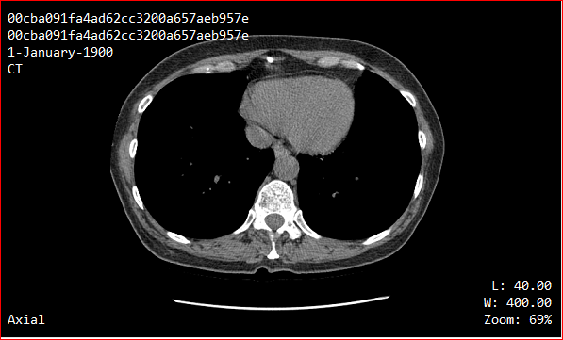
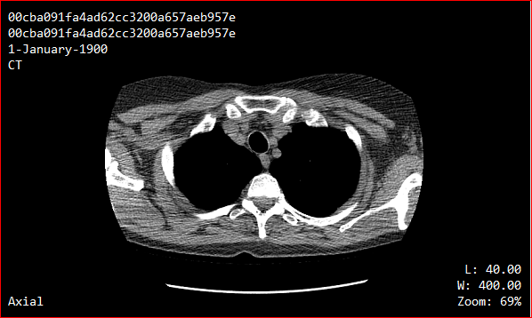
Sample Dataset Used

Slide 8
Implementation
Collection and Extraction of Unprocessed CT Images
Pre Processing and Annotation
Segmentation
Classification using Deep Neural Networks

Slide 9
Pre-Processing
Reading the lung CT image
Resizing the image
Application of Median Filter
Annotations and labeling

Slide 10
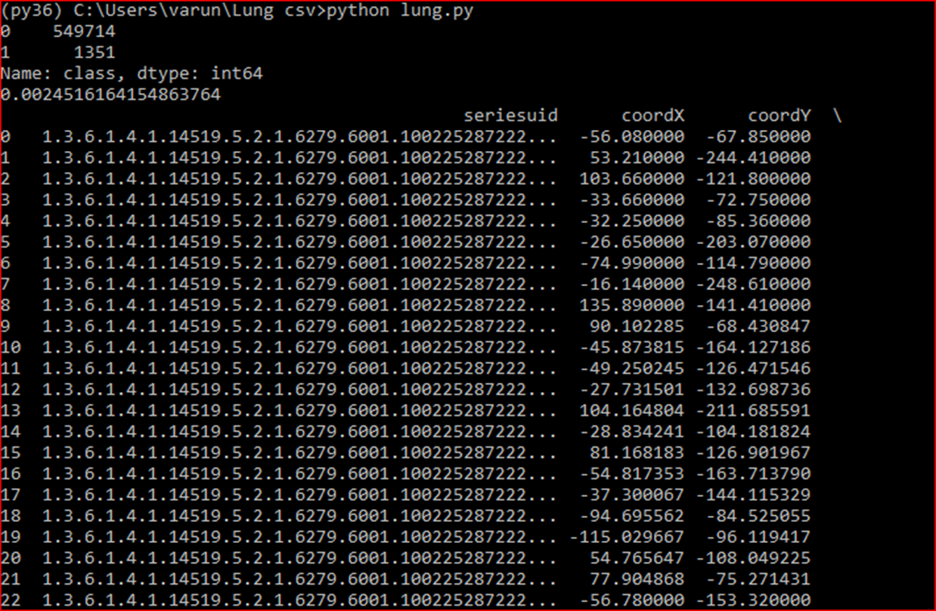
Pre-Processing Result

Slide 11
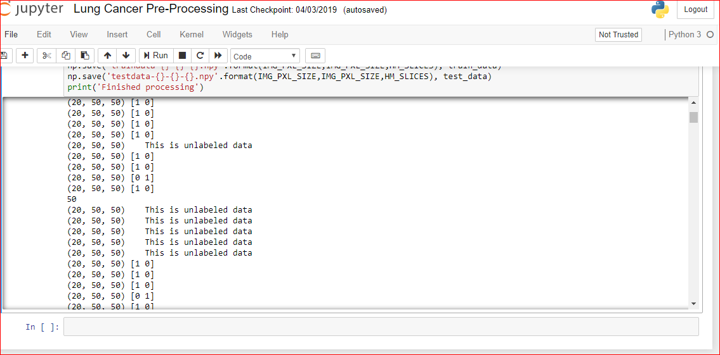
Pre-Processing Result Contd.

Slide 12
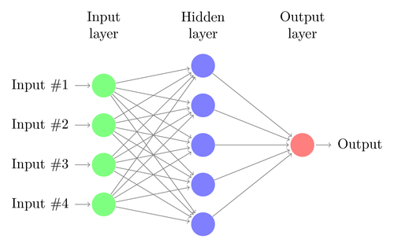
Neural Network
Neural Network is a computational model based on the structure and functions of biological neural. Information that flows through the network affects the structure and learns in a sense based on the input.

Slide 13
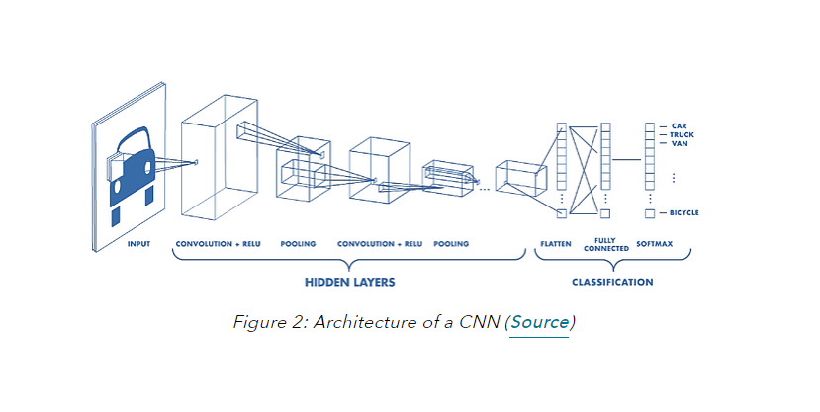
Classification
We have classified the Data Using Deep Neural Network. A deep neural network is a neural network with a certain level of complexity, a neural network with more than two layers. Deep neural networks use sophisticated mathematical modeling to process data in complex ways.
To be more specific, we have used the Convolutional Neural Network.

Slide 14
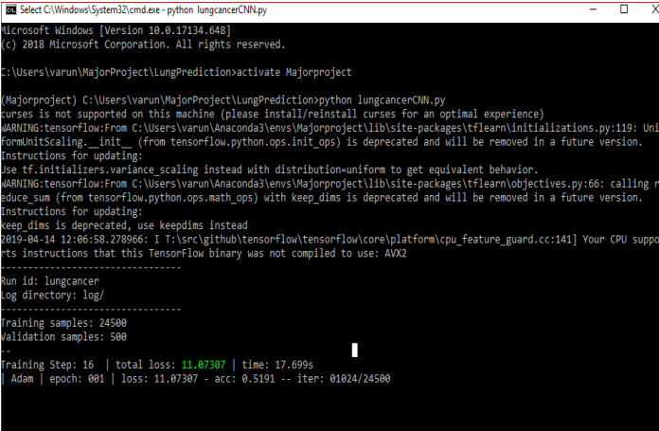
Results
1. Using DNN
Using DNN

Slide 15
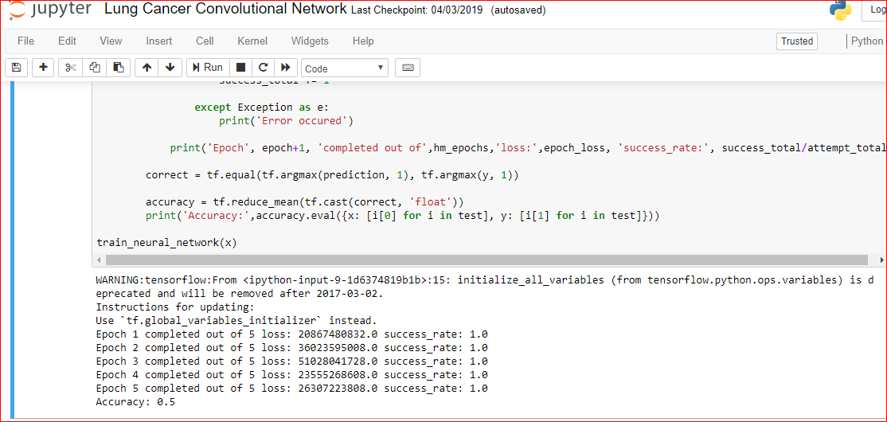
Results Contd
2. Using 3D CNN

Slide 16
References
K.Punithavathy, M.M.Ramya, Sumathi Poobal,"Analysis of statistical texture features for automatic lung cancer detection in PET/CT images", International Conference on Robotics, Automation, Control and
Embedded systems(RACE ),IEEE ,18-20 February 2015.
Robert M Haralick, K.Shanmugam, Itshak Dinstein,“Textural Features for Image Classification” IEEE Transactions on Systems, Man and Cybernetics, 3(6), pp. 610- 621, 1973.

