Slide 1

Industrial Training Report ON PYTHON PRO PROGRAMMING submitted in partial fulfilment For the award of the degree of
Bachelor of Technology In computer engineering
Submitted To: Submitted By:
MR. Pawan Sen Varun Singh
HOD CSE 5th Sem CSE
22EAICS952
Department of computer science & Engineering
Arya institute of Engineering & Technology Jaipur
Rajasthan Technical University Kota (2023-2024)

Slide 2
Introduction to python language
Python is a high-level, interpreted programming language known for its readability and simplicity. Created by Guido van Rossum in 1991, it supports multiple paradigms like procedural, object-oriented, and functional programming.
Python is widely used in web development, data science, AI, machine learning, and automation due to its extensive libraries and frameworks.

Slide 3
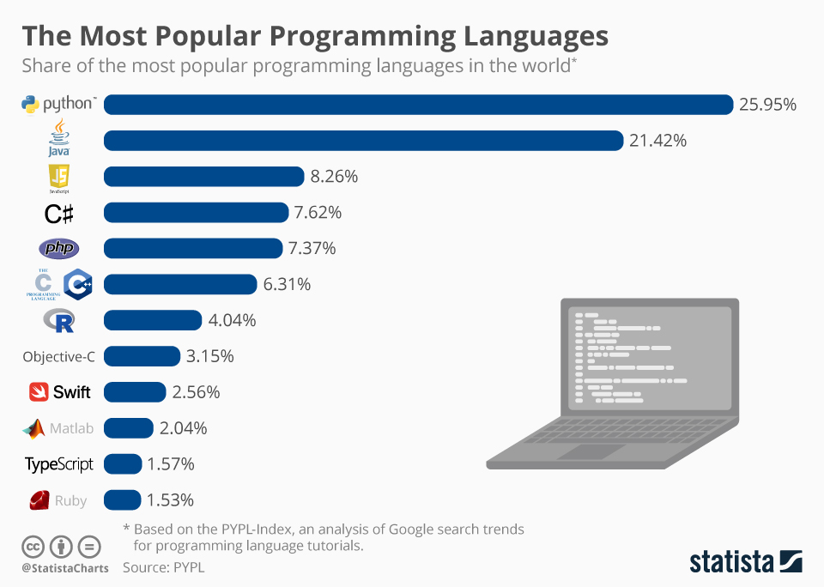

Slide 4
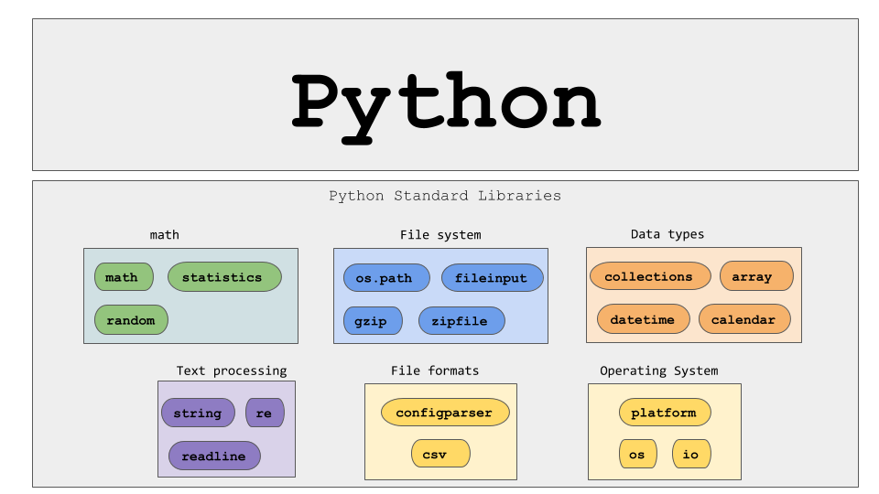
Python supports many libraries:

Slide 5
Project: Bank management system
Task 1
Task 2
Task 3
First task is to properly utilize the system so the user experience is good.
Second task is to perform various task related to banking like account creation, deposit , withdrawals and etc.
Third task is to come up with new schemes and enhancing the user friendly experience, which will give the opportunity to grow.

Slide 6
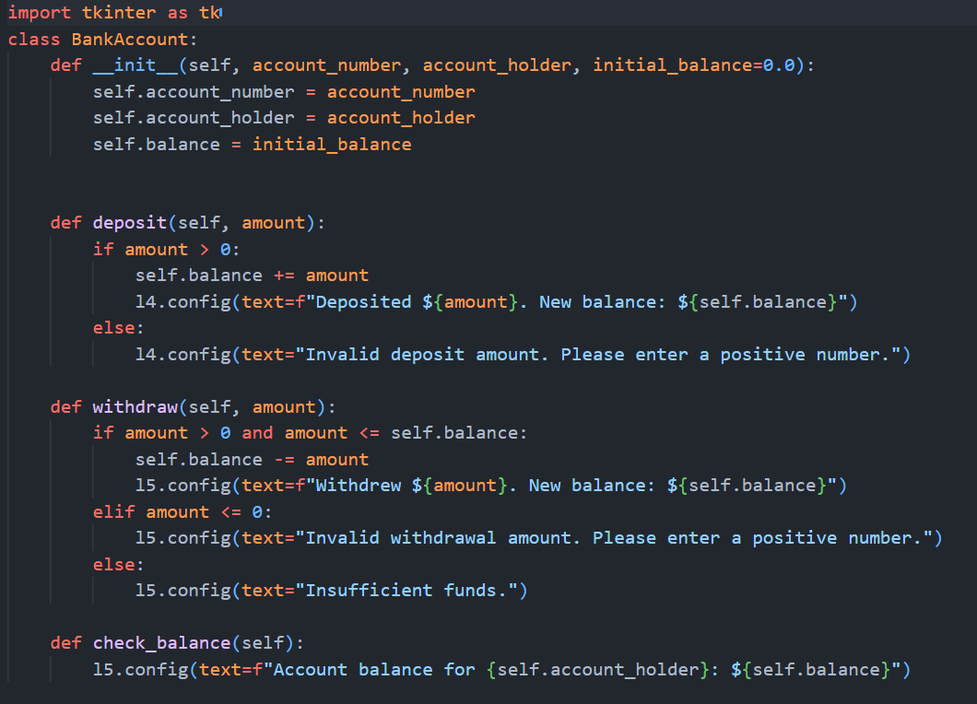
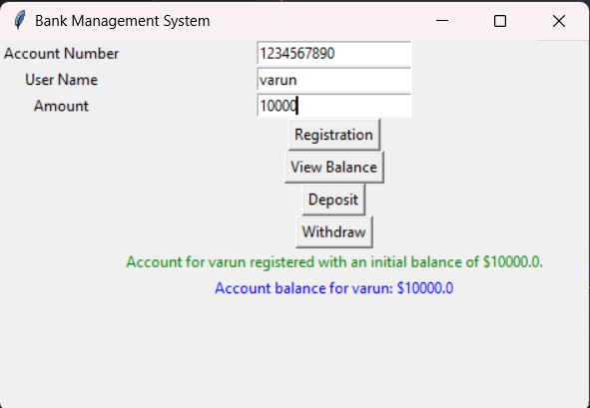
Output:
Source Code:

Slide 7
Conclusition:
The project “PYTHON based Bank Management System” has been successfully designed and tested. Integrating features of a working bank which can perform task like creating account, depositing, withdrawal, dairy entry. It uses the basic of python and libraries, which is understandable easily.

Slide 8

THANK YOU FOR THE OPPORTUNITY

