Slide 1
Network Security Ass2 Project 0
Title - Data Encryption Standard (DES)
By Varun Singhal MT20099
Sachin Kotiyal MT20093

Slide 2
DES
❖The Data Encryption Standard (DES) is a symmetric-key block cipher.
❖DES is an implementation of a Feistel Cipher.
❖It uses 16 round Feistel structure.
❖The block size is 64-bit.
❖Though, key length is 64-bit, DES has an effective key length of 56 bits, since 8 of the 64 bits of the key are not used by the encryption algorithm (function as check bits only).

Slide 3
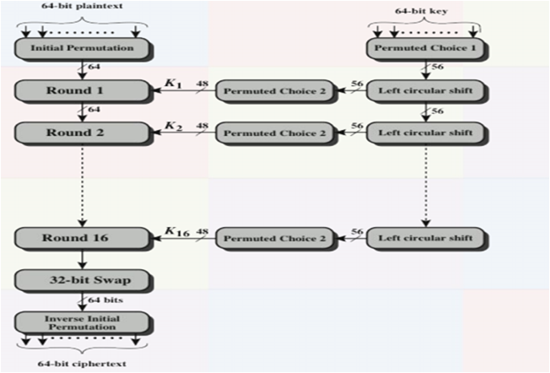
General Structure of Encryption

Slide 4
Design principles of DES
Three aspects to the design of DES:
❖Number of rounds
❖The choice of F functions (or S boxes)
❖Generation of sub-keys for each round (choice of D boxes in sub-key generation)

Slide 5
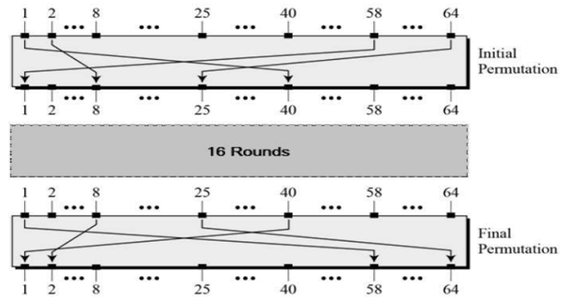
Initial and Final Permutation

Slide 6
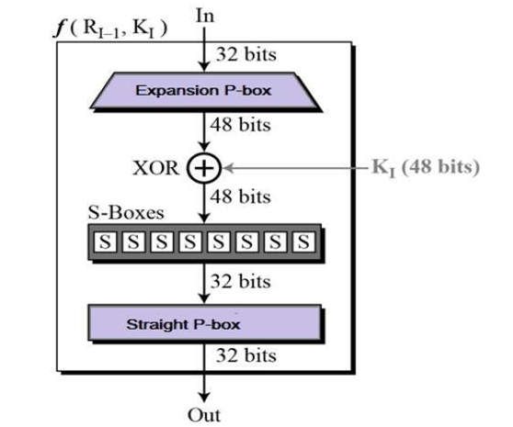
Encrypt the 5 plaintext into ciphertext with the same key

Slide 7
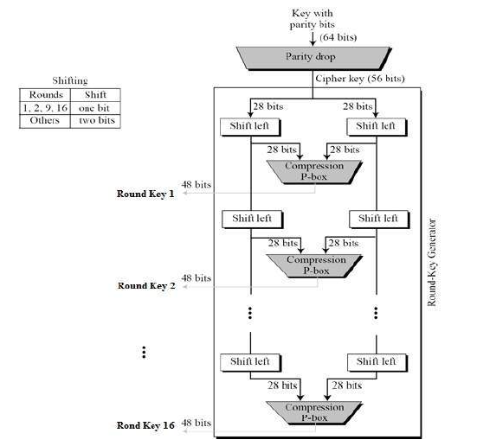
Key Generation

Slide 8
Analysis
The DES satisfies both the desired properties of block cipher. These two properties make cipher very strong.
❖Avalanche effect − A small change in plaintext results in the very great change in the ciphertext.
❖Completeness − Each bit of ciphertext depends on many bits of plaintext.
There are some known “weak” keys, that result in ONE sub-key used in each of the 16 rounds.These keys shall be avoided.

Slide 9
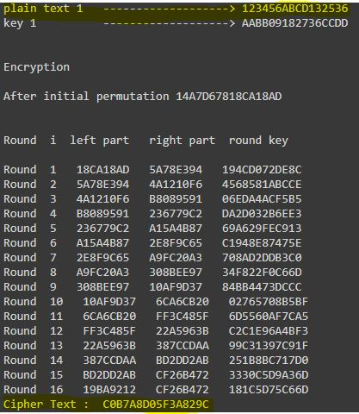
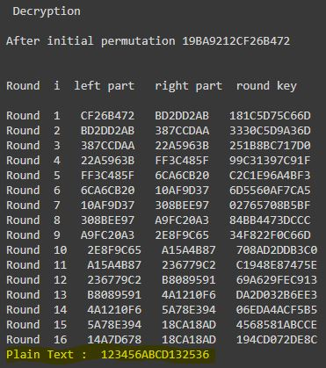
Part a) For 1st pair of plaintext and ciphertext

Slide 10
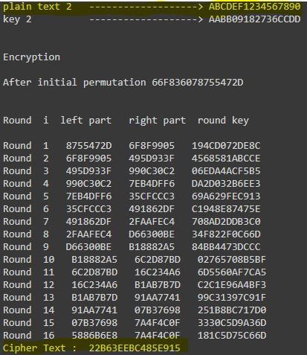
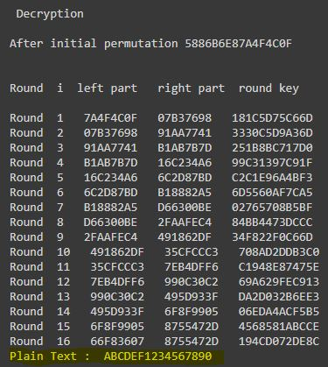
For 2nd pair of plaintext and ciphertext

Slide 11
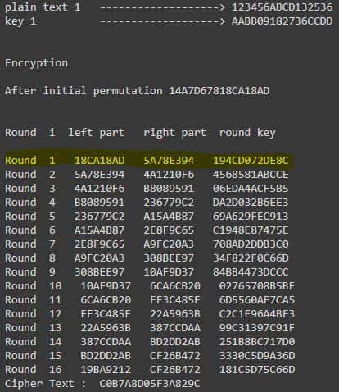
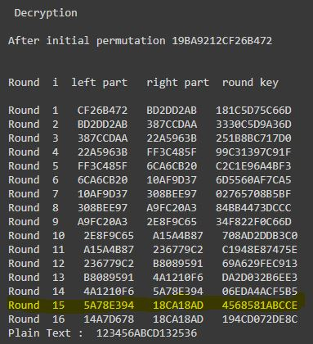
b) o/p 1st encrypt round is the same as the o/p of the 15th decrypt. round

Slide 12
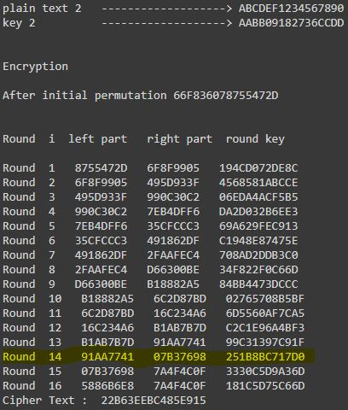
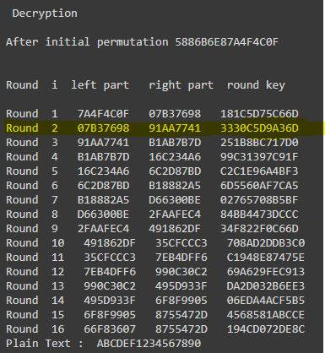
c) o/p 14th encrypt round is the same as the o/p of the 2nd decrypt. round

