Slide 1
Network Security Ass 1 Project 0
Mono-Alphabetic Substitution os a pair
By Varun Singhal MT20099
Sachin Kotiyal MT20093

Slide 2
Steps of Encryption and Decryption of Mono-Alphabetic Substitution with pairs
Initialize a key.
Assume a 5 plaintext.
Add crc (checksum) after the plaintext.
Encrypt the 5 plaintext into ciphertext with the same key.
And then decrypt the 5 ciphertext with the same key.
And then finally do BruteForce attack on the same 5 ciphertext after generating the 9! Keys.

Slide 3
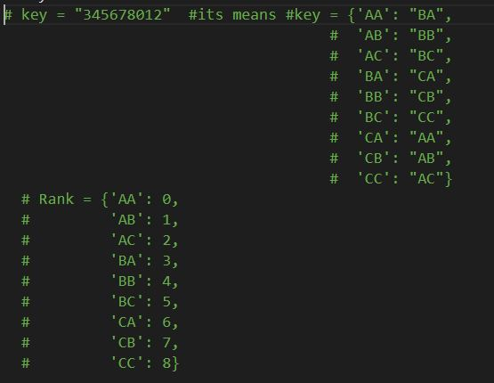
Initialize a key
Here we initialize the as a string that stores the rank of order of pair of <xy> where x ε {A, B, C}
, y ε {A, B, C}. And the index of that string represents the lexicographical order of the pair of <xy> where x ε {A, B, C}, y ε {A, B, C}. It will easy for me to compute all permutation of
a key using this string representation as a key
of order pait <xy>

Slide 4
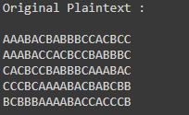
Assume a 5 plaintext
Here we take the five plaintext which contain the character set {A,B,C} only.

Slide 5
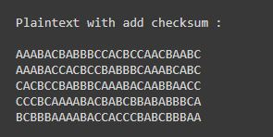
Add crc (checksum) after the plaintext.
First we convert plaintext into the bytes and calculate the checksum and then did mod%3 to generate checksum in the range of {A, B, C} for every plaintext and append with the plaintext (all are in the range of {A, B, C} ).

Slide 6
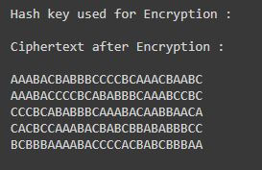
Encrypt the 5 plaintext into ciphertext with the same key
Using the EncryptMessage(plaintext, key) function i will convert the the plaintext into ciphertext using that key value passed and then return the text contain converted ciphertext using monoalphabetic substitution.

Slide 7
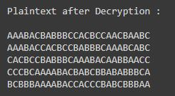
Decrypt the 5 ciphertext with the same key
With the help of the decryptMessage(ciphertext, key) function we decrypt the ciphertext by the same key which is used for encryption.

Slide 8
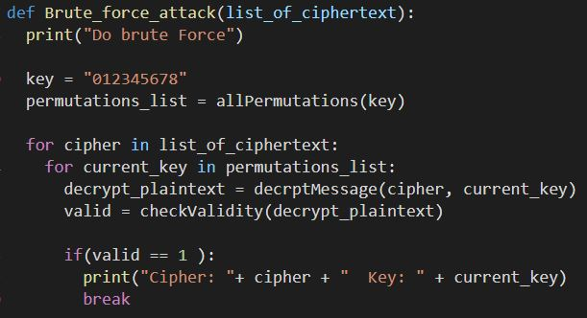
Finally do BruteForce attack after generating the 9! Keys
For BruteForce attack, generate all the permutations of all keys and store them into a list. For every cipher we convert the plain text by the all permutation of the key and check and check if the plaintext is recognizable or not. If it is recognizable then check for other cipher text otherwise check for other key.

Slide 9
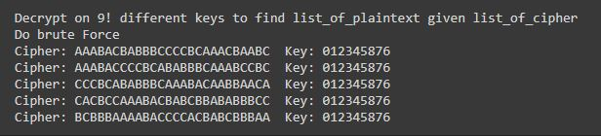
Finally do BruteForce attack after generating the 9! Keys
For BruteForce attack, generate all the permutations of all keys and store them into a list. For every cipher we convert the plain text by the all permutation of the key and check and check if the plaintext is recognizable or not. If it is recognizable then check for other cipher text otherwise check for other key.

Slide 10
Conclusion
Complexity of brute force attack:
No. of possible keys: 9!
Advantage:
It is more secure as compare to mono-substitution without pair because in less computation and less no of keys we can easily attack by brute force.
To make it more secure:
It can be made more secure by trigram, quadgram and so on.

