Slide 1
Network Security Ass3 Project 0
Title - Public-key Certification Authority (CA)
By Varun Singhal MT20099
Sachin Kotiyal MT20093

Slide 2
Certification Authority (CA)
A certificate authority (CA), also sometimes referred to as a certification authority, is a company or organization that acts to validate the identities of entities (such as websites, email addresses, companies, or individual persons) and bind them to cryptographic keys through the issuance of electronic documents known as digital certificates.

Slide 3
Certification Authority (CA)
A digital certificate provides:
Authentication, by serving as a credential to validate the identity of the entity that it is issued to.
Encryption, for secure communication over insecure networks such as the Internet.
Integrity of documents signed with the certificate so that they cannot be altered by a third party in transmit.

Slide 4
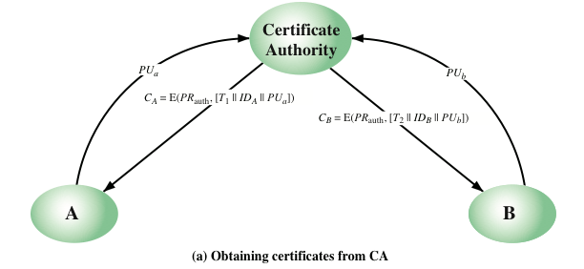
Certification Authority (CA)

Slide 5
Program Architecture
Program has been divided into 3 parts : One server (CA) and two clients.
Server (CA) :There is 2 main component of certification authority.
Receive Request : It is used to receive request or verify request from clients(client i.e.A is requesting public key of B.
Return Certificate : It is used to return certificate for whom clients want to communicate.
Client:There are 3 main functions in client.
Get_PUA : Used to get public key of client1 i.e. B
Get_PRA : Used to get private key of client1.
Send message : Main driver function of the client used to send message to other clients.

Slide 6
Model Working
Suppose client A wants to send message to client B so, he needs to get verified public key of client B.
And we all know verified public key of every client is stored at CA(certificate authority), which acts as the center of trust.
CA provides the public key of client B.
Now client A encrypts the message using that public key and sends it to client B.
Client B receives and decrypts the message with its private key.
Client B send the Acknowledgement to Client A.

Slide 7
Conclusion
We have developed a minimal working model of CA.
The real architecture of CA and the process of verification of domains is so robust that its very hard to break.
In real life, client doesn’t request to CA every time it tries to connect a new domain, instead of that verified certificates of CA are already placed inside the browser.

