Slide 1
Network Security Ass4 Project 0
Time-stamping a document:
By Varun Singhal MT20099
Sachin Kotiyal MT20093

Slide 2
Overall Program Structure
Generate Public and private key of Client server.
Generate Public and private key of Server.
Send doc encrypted data from client to server.
Then add gmt date and time after that data.
And also add hash function value for digital signature.
Send all data from Server to client and finally decrypt that data with gmt time and data at client site and then save that data into new doc file.

Slide 3


Generate Keys for Client and Server
Generate Public and private key of Client server
.
Generate Public and private key of Server.

Slide 4
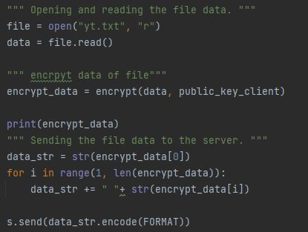
Program Architecture For client
Extract data from doc file and then decrypt using the public key of the client which is generated by RSA algorithm.
Send message : using socket programming used to send messages to the server.

Slide 5
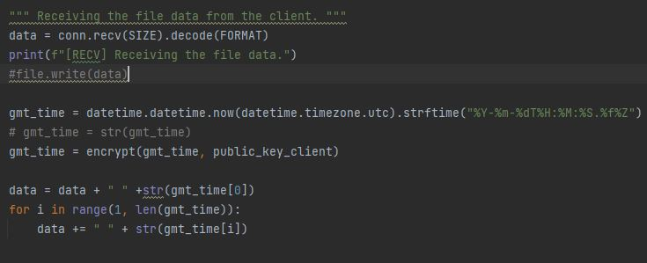
Program Architecture For Server
Receive Request : It is used to receive documents from the client and add GMT date and time stamp into the document.

Slide 6
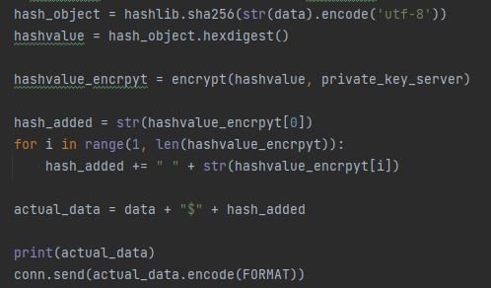
Program Architecture For Server
Digital signature: Calculate the hash of the document using SHA for the document is digitally signed by the server(by encryption using the private key of the server).
Sent message to client: This Function gets the message from the server which included the document, added GMT date and time and hash value. Hash value is appended by the separator $.

Slide 7
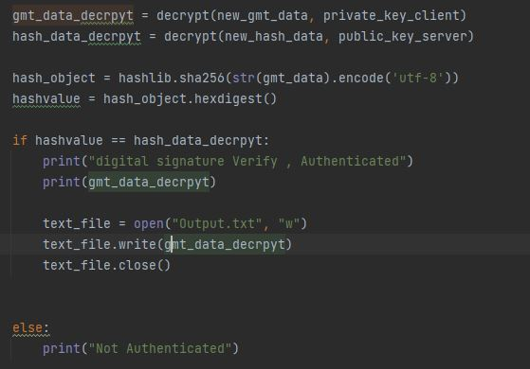
Check Authentication using Digital Signature
Check Authentication: This function first splits the message by $ function and separates the hash value and message. This hash function is compared by the decryption of a message by the public key of the server and calculates the hash value. If it is similar means the document is not modified, otherwise the document is modified.

Slide 8
Summary of our Model Working
Client wants to send a message(document) to the server.
We all know the public key of client and server is known to each other.
Client encrypts the message using his/her public key and sends it to the server.
Now the server adds the GMT Time stamp and encrypts this message using a private key for digital signature and appends a hash value by the separator $.
Client receives the document and checks the similarity of hash value for validation.

