Slide 1
DatasheetQA
AI-Powered Datasheet Intelligence
Varun Swami | Reg. No. 23FE10CDS00449
Data Science and Engineering | Batch F | NLP Project

Slide 2
Problem and Solution
The problem
The solution
Solar panel, inverter and battery datasheets are long PDFs.
Finding one spec (voltage, efficiency, warranty) by hand is slow and error-prone.
A Retrieval-Augmented Generation (RAG) web app.
Upload PDFs, ask questions in plain English, get answers grounded in the document with page citations.

Slide 3
Architecture
PDF Upload
Chunking
(PyMuPDF)
Embeddings
(NVIDIA nemotron-embed)
FAISS Index
LLM
(Llama 4 Scout, NIM)
Answer +
Citations
>
>
>
>
>
User query is embedded, matched against the FAISS index (top-k chunks), and sent with a grounded prompt to the LLM. Gemini is the fallback if NVIDIA is unavailable.
Stack: Python, Flask, FAISS, PyMuPDF, NVIDIA NIM, Google Gemini, HTML/CSS/JS

Slide 4
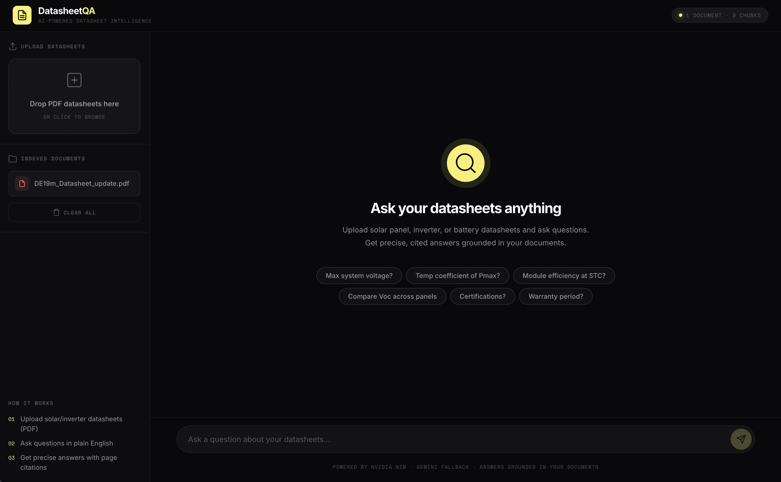
Features
Upload multiple PDF datasheets
Semantic search over document content
LLM answers with page-level citations
Confidence label on each answer
Automatic Gemini fallback
Chat-style interface with history

Slide 5
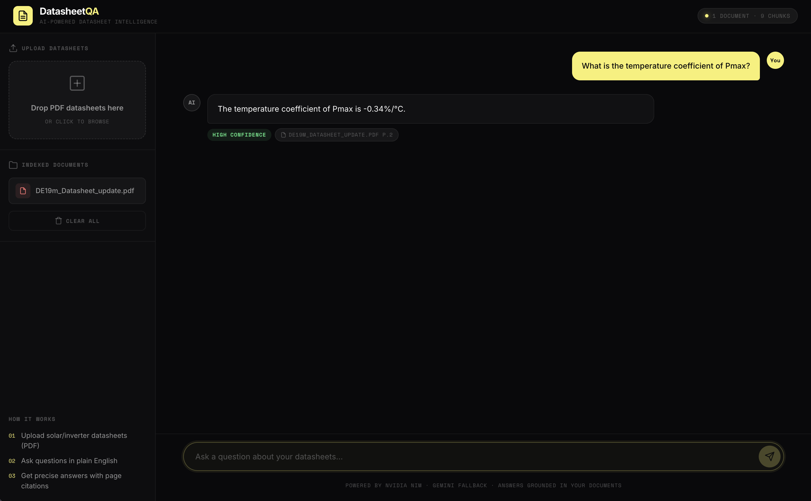
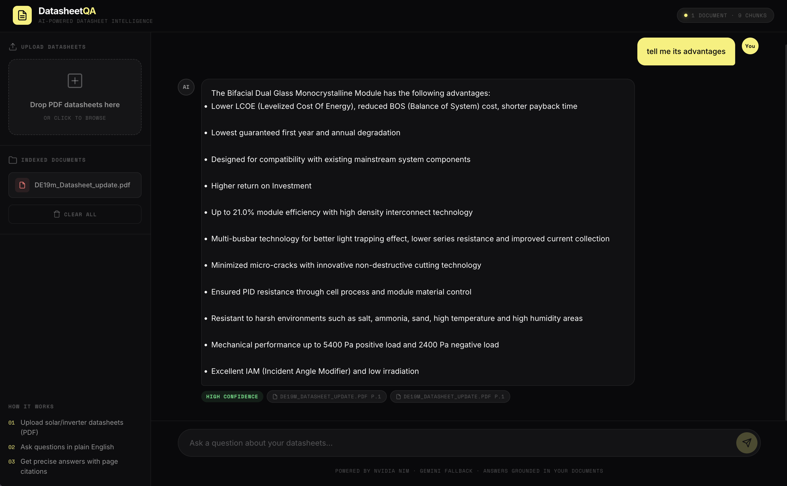
Demo
Q: Temperature coefficient of Pmax? Answer cited from page 2
Q: Tell me its advantages. Answer cited from page 1

Slide 6
Results
Question | Answer | Confidence | Source
Temperature coefficient of Pmax? | -0.34 %/°C | High | DE19m datasheet, p.2
Tell me its advantages | Bifacial dual glass module: up to 21.0% efficiency, multi-busbar, PID resistance, 5400 Pa / 2400 Pa load | High | DE19m datasheet, p.1
Test document: DE19m_Datasheet_update.pdf (1 document, 9 chunks indexed). Follow-up question resolved "its" using the single indexed document.

Slide 7
Learnings and Future Work
What I learned
Future work
Building a full RAG pipeline end to end
Grounding answers with page citations
Using hosted NIM endpoints with a fallback LLM
Structuring a project on GitHub (issues, PRs, branches)
Table extraction from datasheets
Side-by-side comparison across panels
A labeled question set to measure accuracy
Deployment on Render

