Slide 1
Gait Recognition Based on Multi-Layer Convolutional Neural Network
Team Members
Varun Sharma 1806024
Ramesh Kumar 1806027
Bablu Kumar 1806030
Under the Guidance of
Dr. Rajib Ghosh

Slide 2
Problem Statement
Create a gait recognition model that can detect the human with different speeds.
Solution Proposal
We are applying multiple CNN( Convolutional Neural Network) layer for better accuracy.

Slide 3
Introduction
Gait Recognition has received increasing attention as a remote biometric identification technology i.e, it can achieve identification at the long distance that few other identification at the long distance that few other identification technological can work.
Biometrics at a distance is very popular at the present time and provides a valid solution for person identity recognition in surveillance.
Among all biometric features, gait is the most special because it can be perceived at the longest distance without subject cooperation.
Moreover, gait is difficult to conceal because it is unconscious behavior. Therefore, these advantages make gait- based person identity recognition more attractive for many applications, such as surveillance systems, forensics and criminal investigation

Slide 4
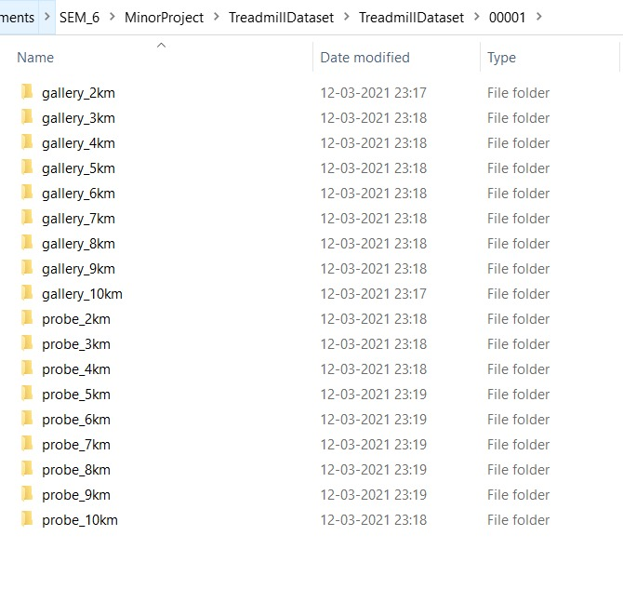
About the Dataset (OU-LP-Bag β)
The Treadmill Dataset is composed of 34 subjects with speed variation from 2 km/h to 10 km/h at 1 km/h interval. Each subject have two sequences of "gallery" and "probe".
The directory structure is as follows:-
TreadmillDataset
-(5-digits subject ID)
-(gallery/probe)_(speed)km
-(8-digits image ID).png
e.g.
./TreadmillDatasetA/00000/gallery_2km/00000001.png
The number of frames for each sequence is as follows:
2km/h: 420
3km/h: 360
4km/h: 360
5km/h: 420
6km/h: 360
7km/h: 240
8km/h: 240
9km/h: 240
10km/h: 300
Fig.1.1 Dataset Folder

Slide 5
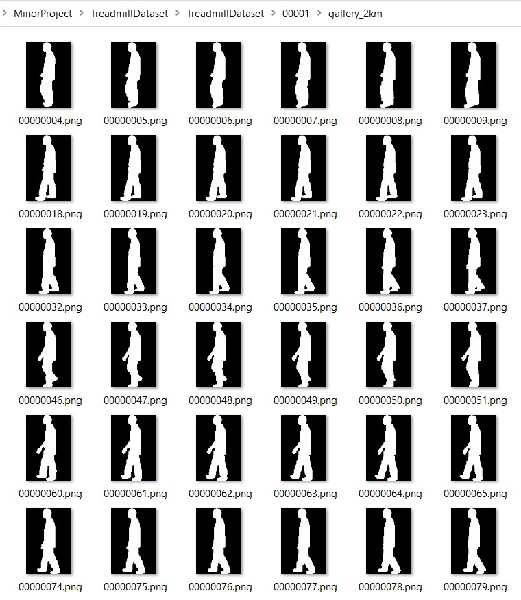
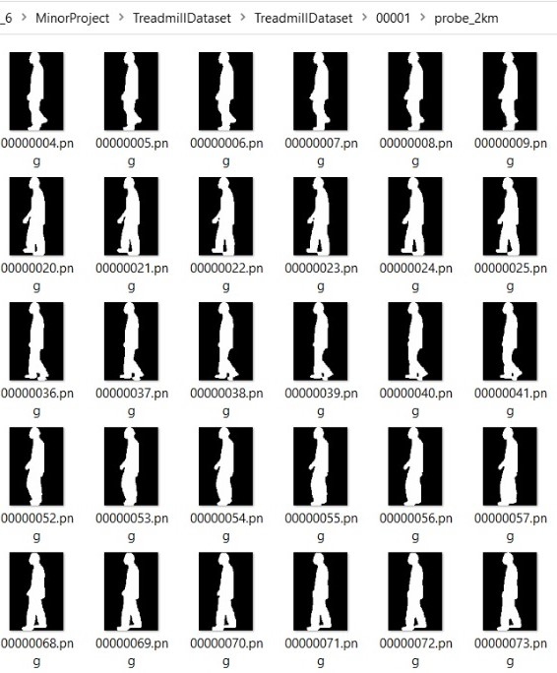
Fig.1.2 Gallery_2km image dataset
Fig.1.3 Probe_2km image dataset

Slide 6

Data Preprocessing
For general video dataset we have to following steps:-
Read in gait video and cut to frames
Temporal median get background image
Background Subtraction
Convert to gray scale
But we already have grey scale images in the dataset.
Data preprocessing done by us:-
We have used 10 classes out of 34 classes in the actual dataset.
From each class we considered 150 images of person in different speed of Gallery and Probe folder.
We use Gallery dataset for training and Probe dataset for testing.
The final preprocessing step for the input data is to convert our data type to float32 and normalize our data values to the range [0,1].

Slide 7
Prerequisites
Keras, Tensorflow, Python, Numpy, Matplotlib, pandas, sklearn
Reading and analysing the research papers
Knowledge of Multi-layer convolutional neural network layers
Trademill Dataset and its ordering and structuring inside the given zip file

Slide 8
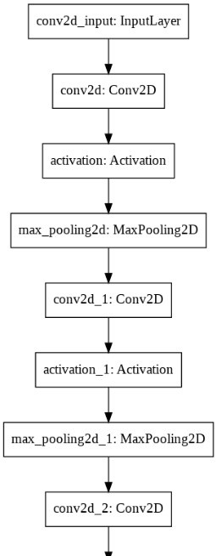
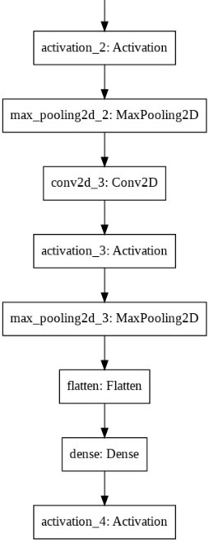

Architecture
Four sequential triplets of 2D convolution, max pooling, activation and flattening, and four subsequent fully connected layers, which outputs a set of similarities to individual training subjects given as an input.
Conv2d_Input: Input Layer
Conv2d : filter - 8
Kernal - 5 * 5
input_shape - 64,64,1
Activation function: tanh
Max_pooling2d: pool_size(2,2) , strides-2
Fig.2.1 Convolutional Neural Network model

Slide 9
Implementation
We considered 10 classes for training and testing.
We took input size of (64 * 64) for training and testing purpose.
We took 50 number of epochs and for each epoch we considered 844 iterations.
Batch size for our training and testing was 16.
Learning rate of our model was 0.001.
We used RMSprop (Root Mean Square propagation) as Optimizer.

Slide 10
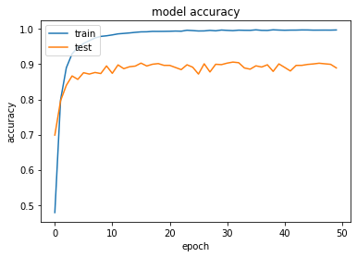
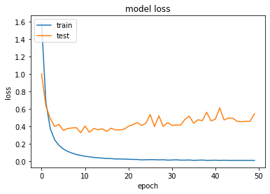
Training & Testing
Fig.3.1 Model Accuracy
Fig.3.2 Model Loss
As we can observe that with increasing no. of epochs model accuracy is increasing.
As we can observe that with increasing no. of epochs model loss is decreasing.

Slide 11
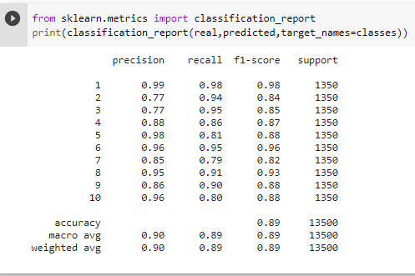
Result
Fig.4.1 Classification Report
From our proposed model, we got average accuracy of 89%.

Slide 12
Conclusion
REFERENCE | APPROACH | METHOD | DATASET | RESULT
1 | ML | Gabor GEI | OU-LP-Bag β. | 46.4
2 | ML | GEI w/ RSVM | OU-LP-Bag β. | 28.3
3 | ML | GERF | OU-LP-Bag β. | 58.3
4 | ML | JI-SML | OU-LP-Bag β. | 57.4
5 | ML | LB | OU-LP-Bag β. | 87.9
6 | ML | diff/2diff | OU-LP-Bag β. | 87.8
7 | ML | JITN | OU-LP-Bag β. | 88.1
8 | ML | Ab-GAN | OU-LP-Bag β. | 91.2
_ | ML | Proposed Method | OU-LP-Bag β. | 89
Our obtained accuracy may vary with increase in no. of epochs, batch size, no. of photos and decrease in the learning rate.
But on our considered parameters we got a comparatively better accuracy.

Slide 13
References
D. Tao, X. Li, X. Whu, S.J. Maybank, General tensor discriminant analysis and gabor features for gait recognition, IEEE Trans. Pattern Recog. Artif. Intell. 31 (2017) 1-40.
R. Martin-Felez, T. Xiang, Uncooperative gait recognition by learning to rank, Pattern Recognition. 47 (12) (2014) 3793-3806.
X. Li, Y. Makihara, C. Xu, D. Muramatsu, Y. Yagi. M. Ren, Gait energy response function for clothing-invariant gait recognition, in: Asian Conference on Computer Vision, 2016, pp. 257-272.
Y. Makihara, A. Suzuki, D. Muramatsu, X. Li, Y. Yagi Joint intensity and spatial metric learning for robust gait recognition, in: Proc. of the 30th IEEE Conf on Computer Vision and Pattem Recognition (CVPR 2017). 2017. pp. 5705-57 15.
Z. Wu , Y. Huang , L. Wang , X. Wang , T. Tan , A comprehensive study on cross-view gait based human identification with deep CNNs, IEEE Trans. Pat- tern Anal. Mach. Intell. 39 (2) (2017) 209–226 .
N. Takemura , Y. Makihara , D. Muramatsu , T. Echigo , Y. Yagi , On input/output architectures for convolutional neural network-based cross-view gait recogni- tion, IEEE Transactions on Circuits and Systems for Video Technology (2018) . 1–1
X. Li , Y. Makihara , C. Xu , Y. Yagi , M. Ren , Joint intensity transformer network for gait recognition robust against clothing and carrying status, IEEE Transac- tions on Information Forensics and Security (2019) . 1–1
Xiang Li , Yasushi Makihara , Chi Xu, Yasushi Yagi, Mingwu Ren Gait recognition invariant to carried objects using alpha blending generative adversarial networks. School of Computer Science and Engineering, Nanjing University of Science and Technology, 200 Xiaolingwei, Nanjing 210094, China. The Institute of Scientific and Industrial Research, Osaka University, 8-1 Mihogaoka, Ibaraki, Osaka, 567-0047, Japan

Slide 14
Thank You!

