Slide 1
Introduction to
SQL
Journey To The Core Of Data Science

Slide 2
Why do we need databases ??
▶ Centralize large data volume
▶ Multiple user access
▶ You get what you need
▶ Extendable data structure

Slide 3
What is SQL?
▶ Structured Query Language
▶ Used for storing, manipulating and retrieving data.
▶ MySQL, MS Access, Oracle, Sybase, Informix, Postgres and SQL Server use SQL as standard database language.

Slide 4
SQL Commands
▶ DDL - Data Definition Language
▶ DML - Data Manipulation Language
▶ DCL - Data Control Language
▶ DQL - Data Query Language

Slide 5
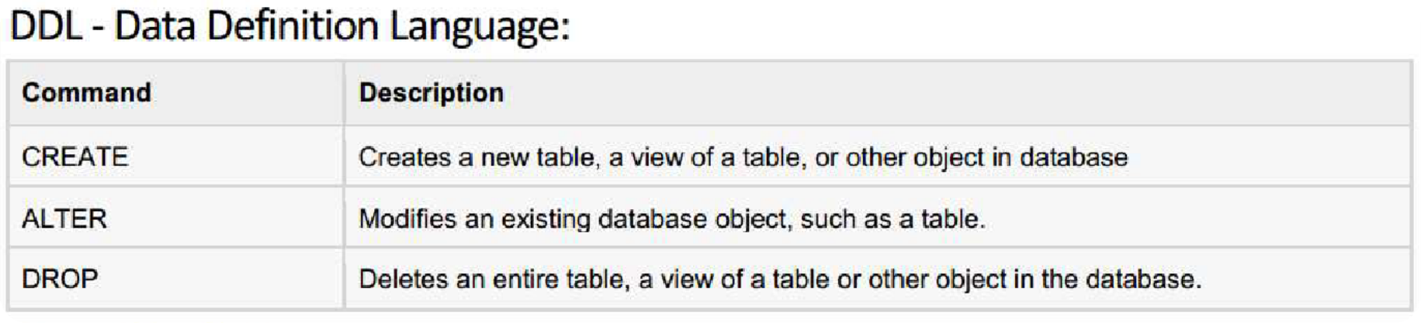

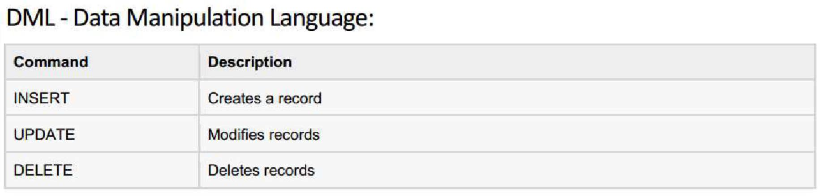
SQL Commands

Slide 6
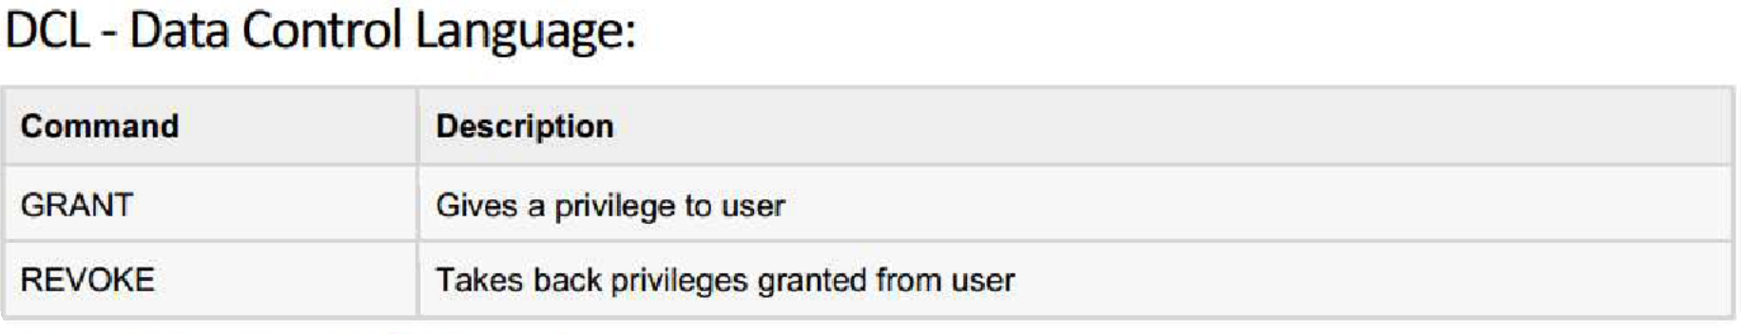

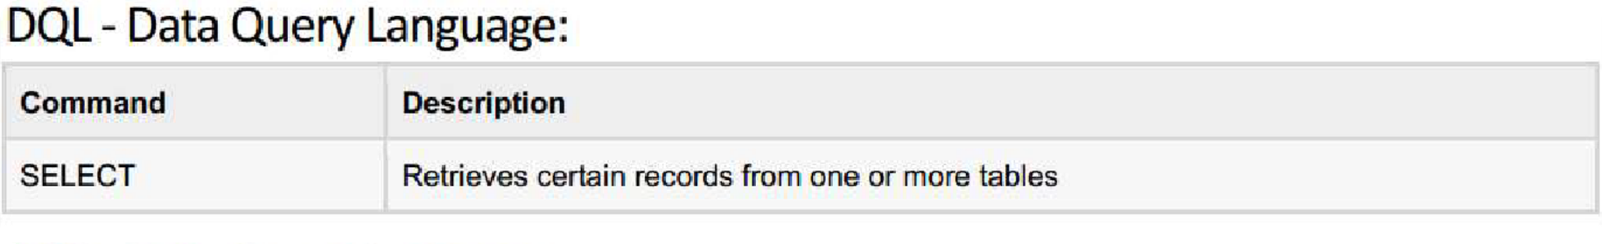

SQL Commands

Slide 7
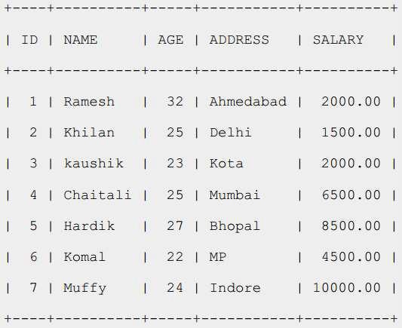
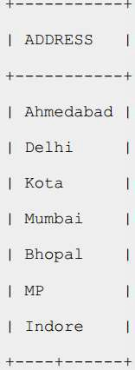
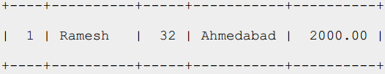
SQL RDBMS Concepts
▶ TABLE
▶ RECORD
▶ COLUMN
▶ CELL
▶ NULL?

Slide 8
SQL RDBMS Concepts
▶ SQL Constraints: (applied on columns)
▶ NOT NULL Constraint
▶ UNIQUE Constraint
▶ PRIMARY Key
▶ FOREIGN Key
▶ CHECK Constraint
▶ Data Integrity:
▶ Entity Integrity: There are no duplicate rows in a table
▶ Domain Integrity: Enforces valid entries for a given column by
restricting the type
▶ Referential Integrity: Rows cannot be deleted which are used by
other records
▶ User-Defined Integrity: Enforces some specific business rules

Slide 9
SQL RDBMS Concepts
▶ Data Types:
▶ Character datatypes:
▶ CHAR
▶ NCHAR
▶ NVARCHAR2
▶ VARCHAR2
▶ Numeric datatypes:
▶ NUMBER
▶ BINARY_FLOAT
▶ BINARY_DOUBLE
▶ Date time datatype:
▶ DATE

Slide 10
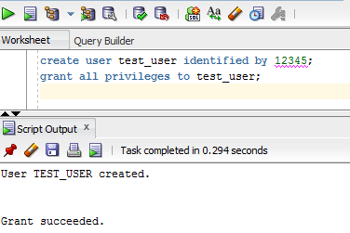
DCL: CREATE USER
▶ 1) Define User with Username/Password
▶ 2) Grants Sufficient Privileges.
▶ Using SQL Developer (UI, Command)
▶ Using SQL *PLUS (Command)

Slide 11
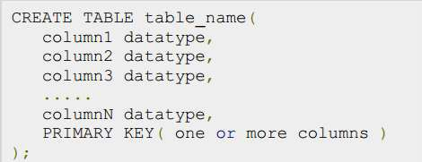
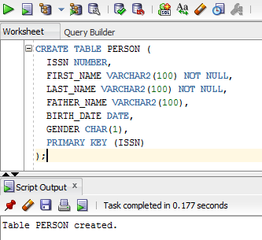
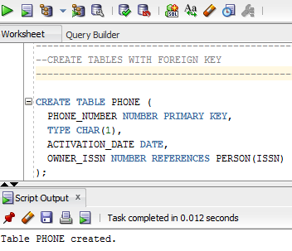
SQL : DDL
▶ Create Table:
▶ COLUMNS
▶ CONSTRAINTS

Slide 12
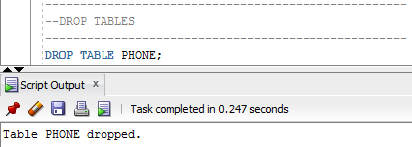
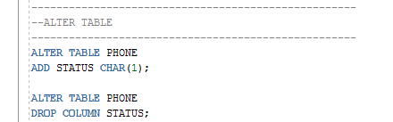
SQL: DDL
▶ DROP TABLE:
▶ ALTER TABLE
▶ OTHER DDL COMMANDS!!!!

Slide 13
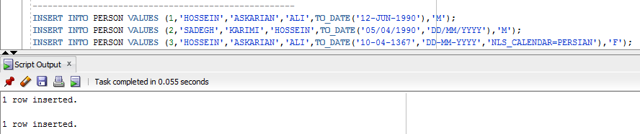
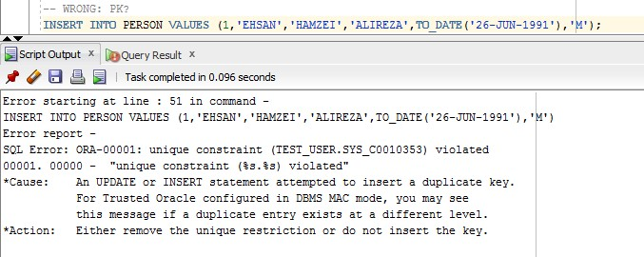
SQL: DML: INSERT
▶ INSERT INTO:
▶ NUMBER, CHAR/VARCHAR2, DATE?

Slide 14

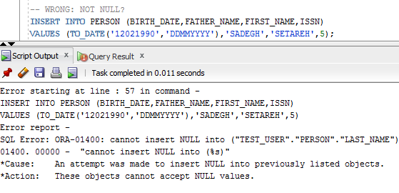
SQL: DML: INSERT
▶ INSERT INTO:
▶ SPECIFIC COLUMNS

Slide 15
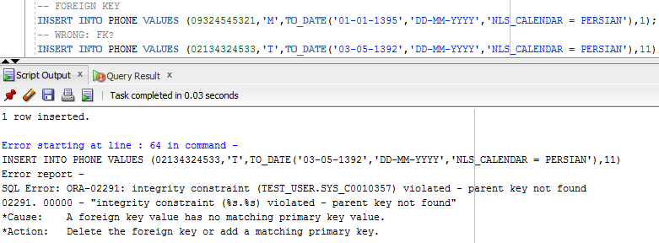
SQL: DML: INSERT
▶ INSERT INTO:
▶ FOREIGN KEY
▶ ALL DML COMMANDS NEED COMMIT

Slide 16
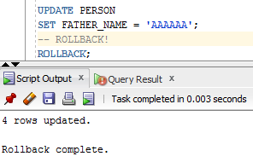
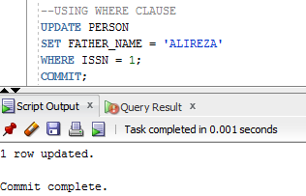
SQL: DML: UPDATE
▶ UPDATE
▶ WHERE CLAUSE

Slide 17
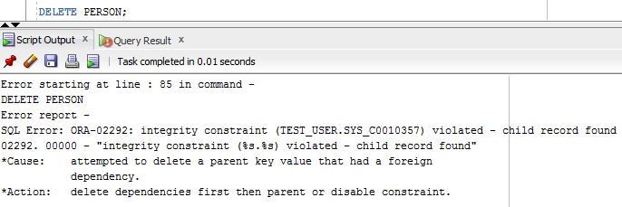
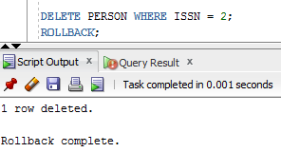
SQL: DML: DELETE
▶ DELETE (DELETE VS DROP????)

Slide 18
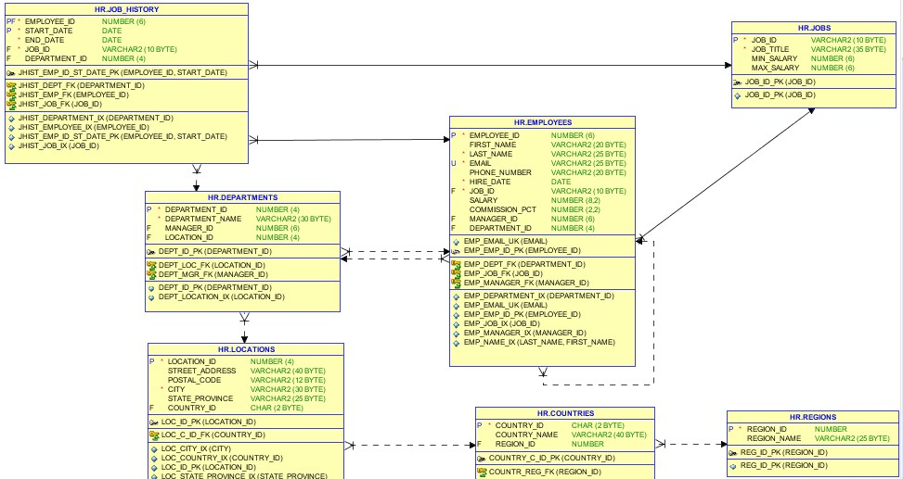
HR-Schema

Slide 19
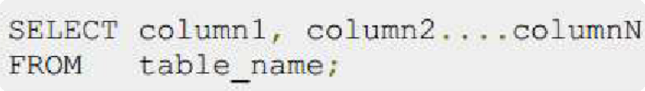

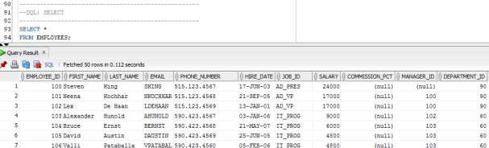
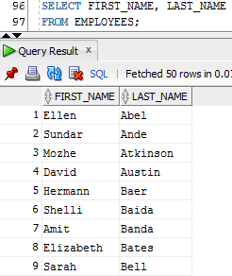
SQL: DQL: SELECT
▶ SELECT
▶ *
▶ SPECIFIC COLUMNS

Slide 20

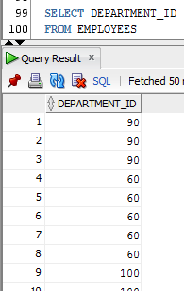
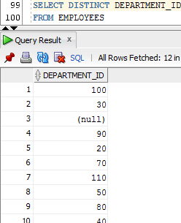
SQL: DQL: SELECT
▶ DISTINCT CLUASE

Slide 21
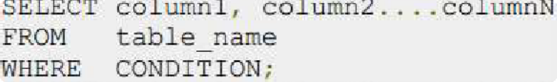

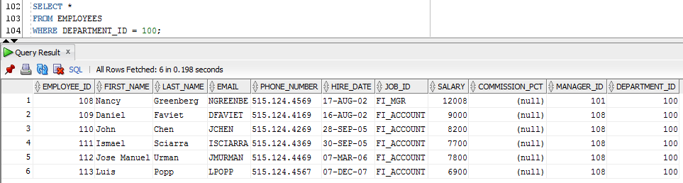
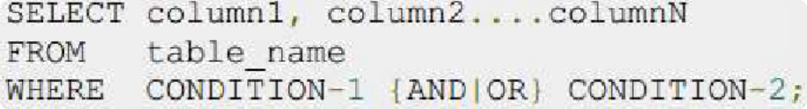

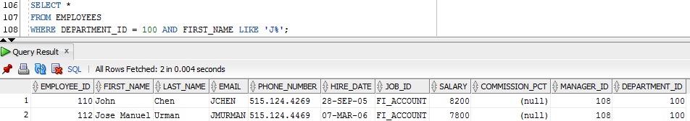
SQL: DQL: SELECT
▶ WHERE CLUASE

Slide 22
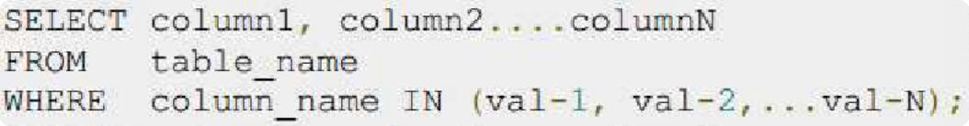

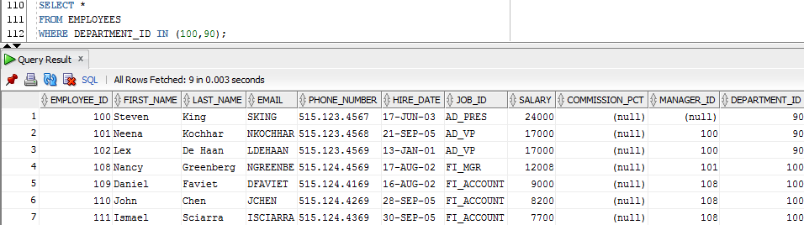
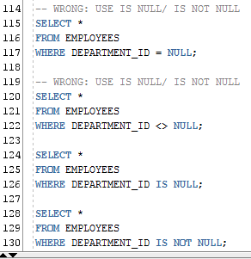
SQL: DQL: SELECT
▶ IN CLUASE
▶ NOT IN
▶ NULL IN WHERE?
▶ IS NULL
▶ IS NOT NULL

Slide 23
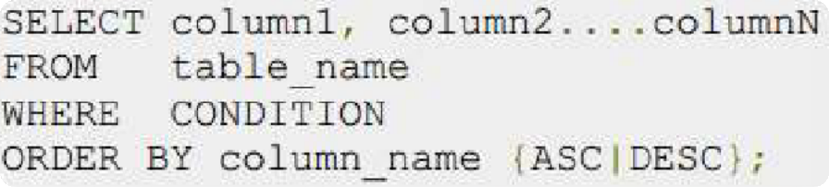

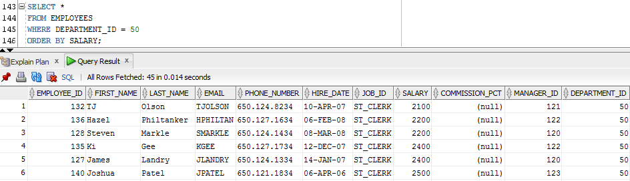
SQL: DQL: SELECT
▶ ORDER BY

Slide 24
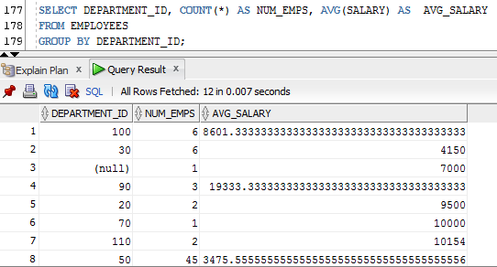
SQL: DQL: SELECT
▶ GROUP BY
▶ AGGREGATE FUCTION
▶ MAX,MIN
▶ AVG
▶ COUNT
▶ SUM
▶ …
▶ HAVING CLAUSE

Slide 25
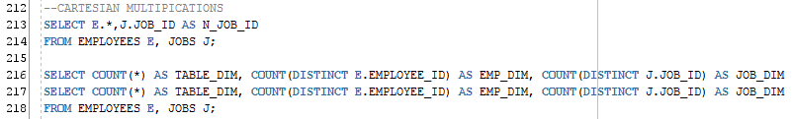
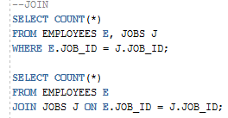
SQL: DQL: SELECT
▶ SELECT FROM MULTIPLE TABLES
▶ CARTESIAN MULTIPICATION
▶ JOIN

Slide 26
Resources
▶ Git-Hub: https://github.com/varuntahin2210/SQLContent

