Slide 1
Introduction to
SQL
Journey To The Core Of Data Science

Slide 2
What is SQL?
▶ Structured Query Language
▶ Used for storing, manipulating and retrieving data.
▶ MySQL, MS Access, Oracle, Sybase, Informix, Postgres and SQL Server use SQL as standard database language.

Slide 3
SQL Commands
▶ DDL - Data Definition Language
▶ DML - Data Manipulation Language
▶ DCL - Data Control Language
▶ DQL - Data Query Language

Slide 4
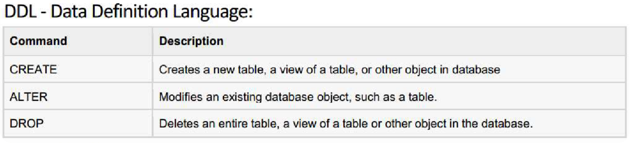

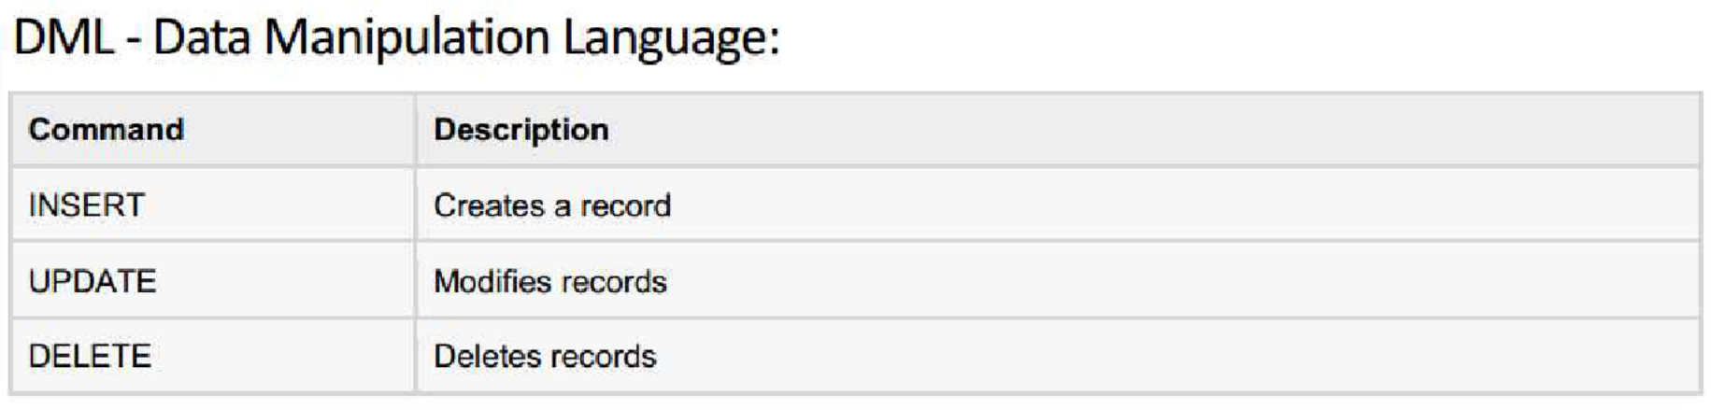
SQL Commands

Slide 5
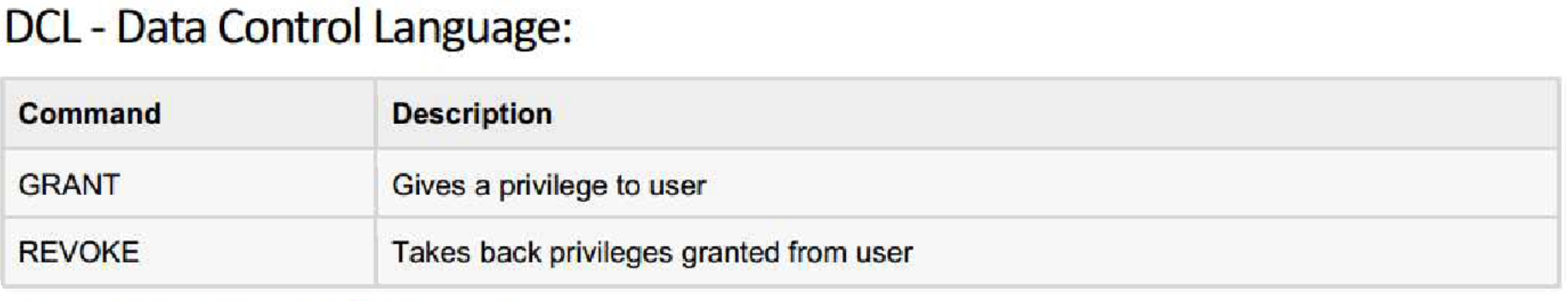
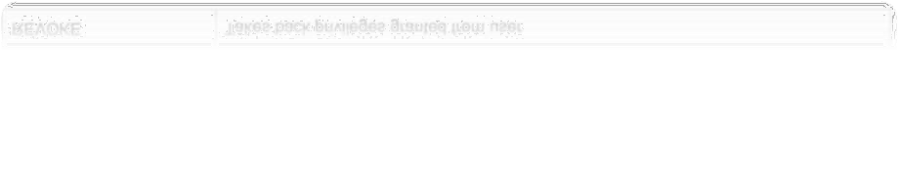
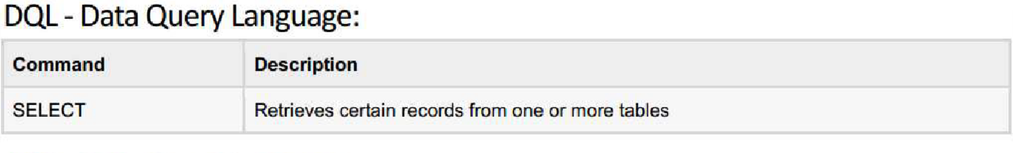

SQL Commands

Slide 6
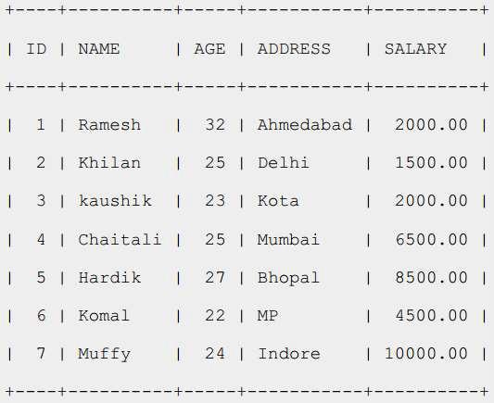
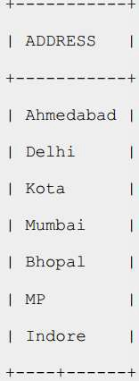
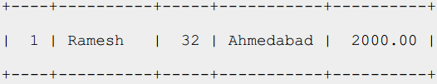
SQL RDBMS Concepts
▶ TABLE
▶ RECORD
▶ COLUMN
▶ CELL
▶ NULL?

Slide 7
SQL RDBMS Concepts
▶ SQL Constraints: (applied on columns)
▶ NOT NULL Constraint
▶ UNIQUE Constraint
▶ PRIMARY Key
▶ FOREIGN Key
▶ CHECK Constraint
▶ Data Integrity:
▶ Entity Integrity: There are no duplicate rows in a table
▶ Domain Integrity: Enforces valid entries for a given column by
restricting the type
▶ Referential Integrity: Rows cannot be deleted which are used by
other records
▶ User-Defined Integrity: Enforces some specific business rules

Slide 8
SQL RDBMS Concepts
▶ Data Types:
▶ Character datatypes:
▶ CHAR
▶ NCHAR
▶ NVARCHAR2
▶ VARCHAR2
▶ Numeric datatypes:
▶ NUMBER
▶ BINARY_FLOAT
▶ BINARY_DOUBLE
▶ Date time datatype:
▶ DATE

Slide 9
Resources
▶ Git-Hub: https://github.com/ehsan-hamzei/

