Slide 1

Aakash’s Acquisition by BYJU’S A case study
By: Varun Tandon

Slide 2
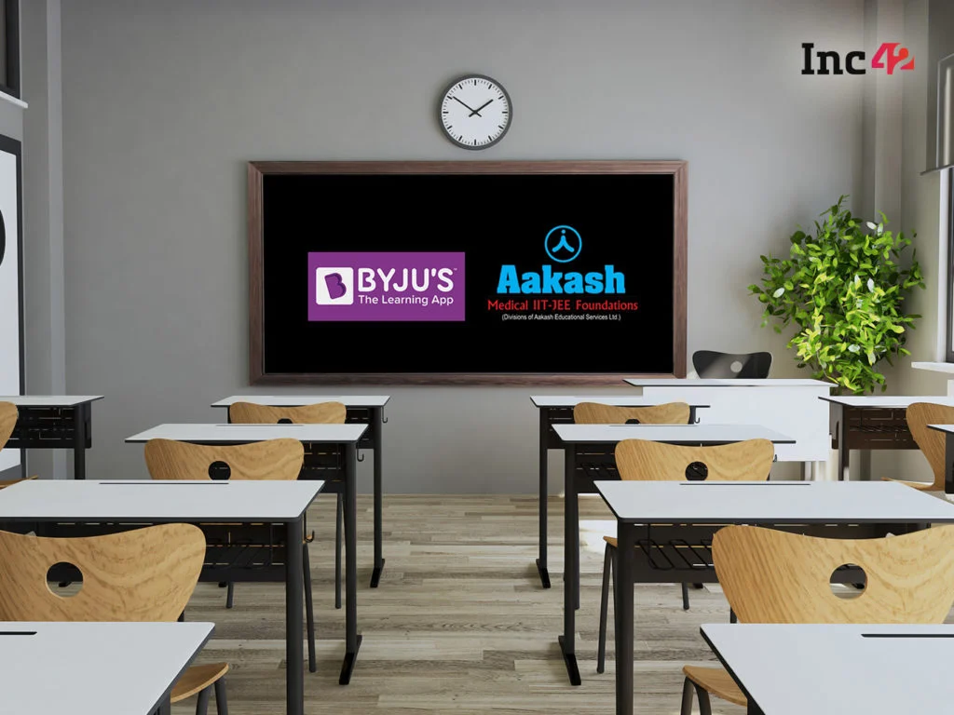
Overview..
Throughout the pandemic, Industrial markets saw great ups and downs, and such assortments and variations bring in opportunities for vitals like Mergers And acquisitions.
Byju’s has acquired tutorial chain Aakash Educational Services Ltd (AESL) in a cash and stock deal estimated at $950 million and is expected to invest further Capital in accelerating Aakash’s progress.
Byju’s will try to integrate Aakash’s expertise in test prep with our content and tech capabilities and develop a hybrid learning model, which is the basis for winning the Ed-tech market.

Slide 3
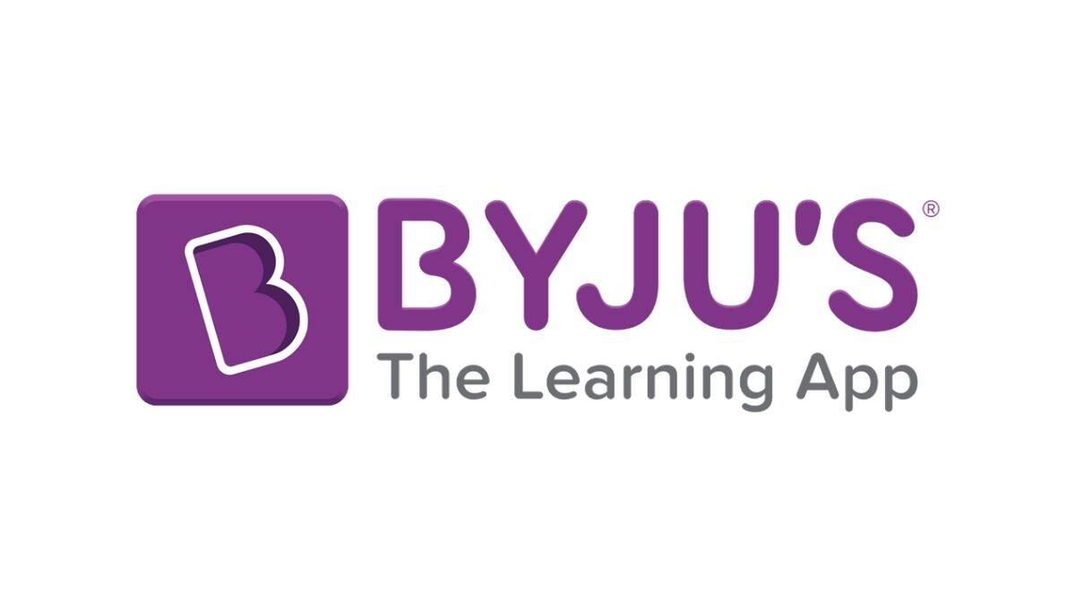
BYJU’S
Byju's app was developed by Think and Learn Pvt. Ltd, a company which was established by Byju Raveendran, Divya Gokulnath and a group of students in 2011.In initial days the company focused on offering online video-based learning programs for the K-12 segment and for competitive exams.
In August 2015, the firm launched Byju's: The Learning App. In 2017, they launched Byju's Math App for kids and Byju's Parent Connect app. By 2018, it had 15 million users out of which 900,000 were paid users at that time.[ In the same year, Byju's became India’s first Ed-tech unicorn.
The company is estimated to have made revenue worth 2300 crs in FY 2021 and is valued at 22 billion dollars , highest for any Indian startup.

Slide 4

Aakash
Blackstone Group-backed Aakash Educational Services Limited (AESL) is a Thirty three year old coaching institute that offers test prep services for medical and engineering entrance exams, school board exams,, NTSE Olympiads, and other foundation level exams to students in classes 8-10 for school boards and junior competitive exams.
These offerings by the offline major are categorized under three brands – Aakash Medical, Aakash IIT-JEE, and Aakash Foundations. It has its presence in more than 200 coaching centers across the country.
In FY 2020 ,The institute clocked an annual turnover of INR 1,200 crs and catered nearly 2.5 lakh students who were enrolled at either for classroom programmes or digital platforms for preparation for respective entrance exams.

Slide 5
Why BYJU’S want to acquire Aakash (Buyer’s perspective)
Indian Ed-tech space is basically composed of 2 segments test-prep and skill development and as Aakash falling under former category has been the leader of offline test prep market ,and this brings in experience and a good market share for Byjus.
The future of learning is hybrid model and this union brings together the best of offline and online learning, as combining expertise of both the firms will create impactful experiences for Students.
Much like we have the Omni-channel phenomenon in the retail space, where E-commerce companies have realized that only digital offerings won’t work, and that they need a combination of both online and offline, similar is the case with Ed-tech too. Byju’s through this deal realizes the importance of Omni-channel model in Indian Ed-tech market.

Slide 6
Why Aakash wants to Sell itself (Seller’s perspective)
Indian Ed-tech market saw a huge whirls throughout the pandemic and thus being just a offline test prep center was not enough to survive the market. Hence, Aakash sought a change in board of governance over policies related to Hybrid model and Byjus a market leader in Digital space served the best option as it brings in advanced technical methodologies and a huge market share in digital space.
Working with Byjus , Aakash would be able to build an Omni-channel learning offering that will accelerate test-prep experience to next level and also help operate at larger scale with multiple delivery channels that can be innovated out of both ecosystems( offline and online).

Slide 7
Strengths
As discussed earlier ,Hybrid model will be the key for conquering the Ed-tech market and with Aakash and Byjus coming together , who are both market leaders in respective markets ( Offline and online) , it is very likely that this acquisition by exploiting their respective expertise will consolidate its position in the market and progress towards great scales of profitability.
Along with the expertise and experience in the field , both the companies has a considerable market share thus providing a already established base for future of hybrid model of learning.

Slide 8
Weakness
Byju’s unlike its competitor (Unacademy) has been primarily focusing on test based prep only with only one investment in skill based prep (Whitehat Jr) and with Aakash having no direct involvement in Skill development , This would force Byjus to invest more capital and time in nurturing skill based prep sector.
Aakash has been market leader in offline coaching centers for 33 years and thus changing suddenly to Hybrid model inorganically with BYJU’S would involve a lot of policy changes accompanied with updating the teaching methodology. This would require lots of effort/time and capital from BYJU’S.

Slide 9
Opportunities
Indian Ed-tech market has been one of the rare markets moving towards consolidation by very few firms unlike other markets. Thus the faster one adapt to Hybrid-model of learning the better it has chances to conquer the market and consolidate its position. With the Acquisition’s foremost goal is to provide multiple channel of delivering the content using innovations in both the ecosystems ( online and offline) , it has an upper edge over other market players.
It also provide an opportunity to increase students engagement over the platforms as students from both the modes ( offline and online) would come to learn from this Omni-channels as a result of acquisition.

Slide 10
Threats
As mentioned in weakness , Big players like unacademy are already investing and nurturing the skill based prep , a vital sector in ed tech space. Unacademy might consolidate its position in the market and end up having a better market share.
Offline coaching leaders ALLEN have seen an organic growth in digital space through their own digital platform ( Allen digital) and have seen Huge increase in market share in newly shaping Ed-tech space. A single governing board over offline and online ecosystem might have an edge over dual board as in case of BYJUS and Aakash.

Slide 11
Conclusions..
From Aakash’s perspective , this deal is a win-win situation that will help them explore the new digital space with backing from BYJU’S in terms of Techical inputs and a considerable market share.
From BYJU’s perspective , This deal will help them consolidate their positon in newly evolving Ed-tech space by conquering Test prep sector through their Hybrid model of learning. But they would also need to look upon Skill based prep sector in order to maintain their position in market for long term like UNACADEMY etc.

Slide 12

Thank you

