Slide 1
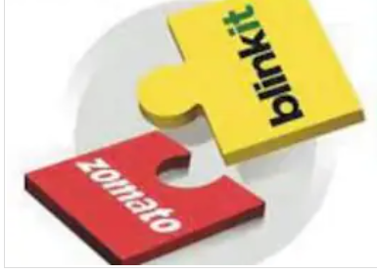
Blinkit Acquisition by Zomato A case study
By – Varun Tandon

Slide 2

Overview..
Merger and Acquisitions are common and vital elements of industrial dynamics , when company come on mutual beneficial terms to discuss the future of companies on paper.
Food delivery app Zomato’s board has approved its acquisition of quick commerce startup Blinkit (formerly Grofers) for 4,447 Cr (about $570 million) in an all-stock deal.
With Zomato growing progressively towards profitability in existing food delivery market , its venturing into next big category hints towards its intent to capture new growing E commerce market that brings in lot of opportunities.

Slide 3
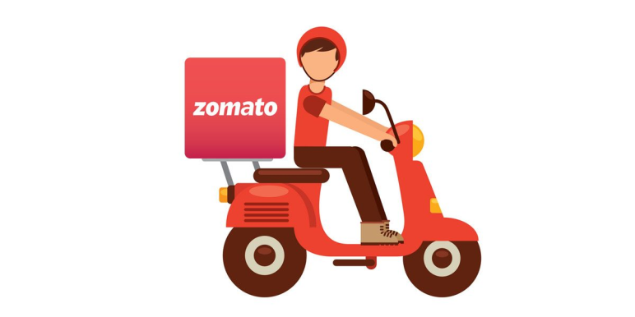
Zomato
Zomato is an app where people can search for nearby restaurants and cafés, order food online, and get it delivered at their doorstep in no time.
Zomato works as a channeling interface between the customers and Restaurants , thus its synergy between restaurant owner , retailers and delivery providers is its basis in the existing market.
In the FY 2022 , Zomato made a revenues worth 4192 crs , and it along with its rival Swiggy owes a whooping 95% share in food delivery market.

Slide 4
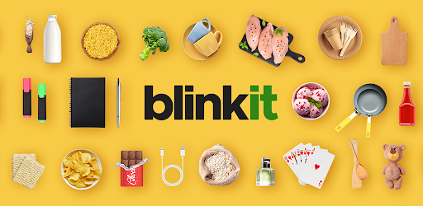
Blinkit
Blinkit is a quick commerce marketplace delivering groceries and other essentials to customers within minutes. It facilitates last-mile delivery of products to customers from the dark stores within a radius of 2 km to ensure faster delivery
.Blinkit was the first company in India to get into quick commerce, which pivoted to 100% quick commerce in Jan 2022, and since then, the business has made tremendous progress as it clocked a GOV (gross order value) of 4082 million INR in May 2022.

Slide 5
Why Zomato want to acquire Blinkit ( Buyer’s perspective)
Zomato is already dominating the food delivery market in India , quick commerce serves as a natural extension for the company as both the businesses are hyperlocal and involve quick delivery of products to the customers.
Acquiring Quick commerce will help them increase the customer wallet share spent on platform and will drive higher engagement from customers.
Blinkit’s proprietary tech platform, scale of business, relationships with third party brands and sellers, and the warehouse & dark store network made it easier for Zomato to grow inorganically, saving considerable time and capital.

Slide 6
And why Blinkit sold itself ? (Seller’s perspective)
Blinkit was witnessing good growth after becoming a quick commerce venture. Thus it needed to bring in an experienced board to govern the company's policies for future regards
.As Zomato already aced the quick delivery of products in the food delivery market, it would be much easier for them to handle the same hyperlocal venture related to quick commerce.
Blinkit would now be able to explore new domains in the market as it has backing and capital from established firms like Zomato.

Slide 7
Risks..
Although Blinkit has seen a decline in loss making , still the losses are huge , thus questioning about the break even capacity of dark stores , and whether they would be able to achieve the predicted profitability mark based on predicted contribution of dark stores in break even.
Zomato itself made losses in FY 21 and FY22 , thus questioning the Acquisition at time when company should try to stabilize one owns scales of profitability and try to restructure the economic policies.

Slide 8
Synergy and Opportunities..
Firstly, Blinkit is already at a higher AOV and that would go at even higher value as the assortment gets wider on the platform due to more customer engagements.
Secondly, the ad sales revenue in quick commerce is higher than food delivery, given the much larger digital ad spend budgets of consumer packaged goods (CPG) brands.
And thirdly, the last-mile delivery cost will be lower than food delivery given the shorter delivery time, leading to a higher number of orders delivered per hour.
Higher revenue per order and lower last-mile delivery cost will make up for additional expenses related to dark stores and replenishment for food delivery business

Slide 9
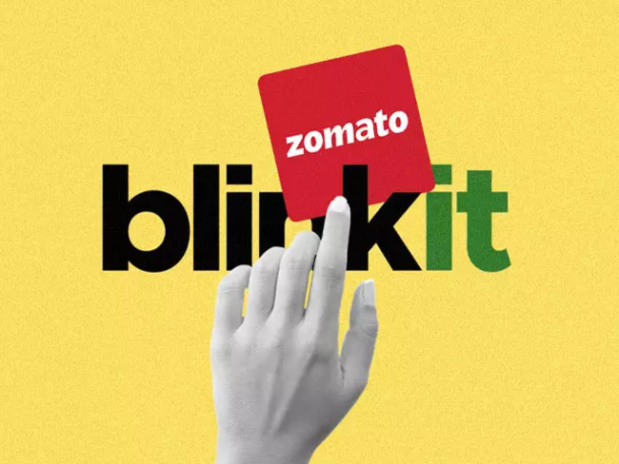
Thank you !

