Slide 1

PREDICTION OF THE COST PER NIGHT FOR THE HOTELS IN ONLINE TRAVEL AGENT PLATFORM
By:
Bhuvanesh
Kumaran
Mohith HP
Nagesh
Rajat
Varun T C
Mentored by
Mr. Romil Gupta

Slide 2

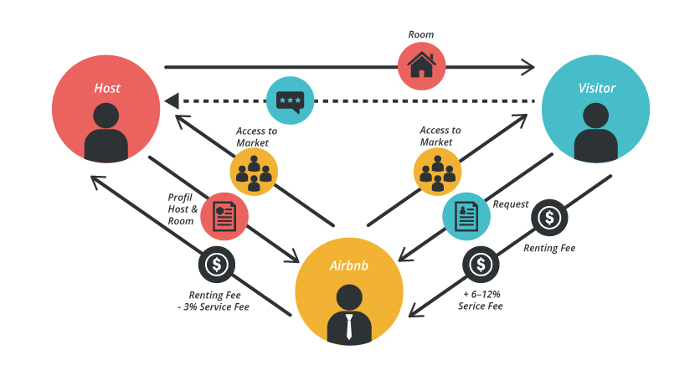
Introduction
A hotel is a managed building or establishment, which provides guests with a place to stay overnight – on a short-term basis – in exchange for money. Due to the modern internet revolution, the reservation of a room in any hotel can be made via online by using the Online Travel Agents (OTA). These agents create search engine applications that acts as middleman between the hotel merchants and customers to process direct online reservations. An OTA acts as commission-free direct bookings agent for the customers; also provide the way to optimize the merchant's sales strategy and maximize profit. The key advantages of having the hotel business in OTA platforms are Increased Exposure (Visibility), Drive Traffic, More Bookings, Right Guests, Better Rankings and Better Reviews.

Slide 3
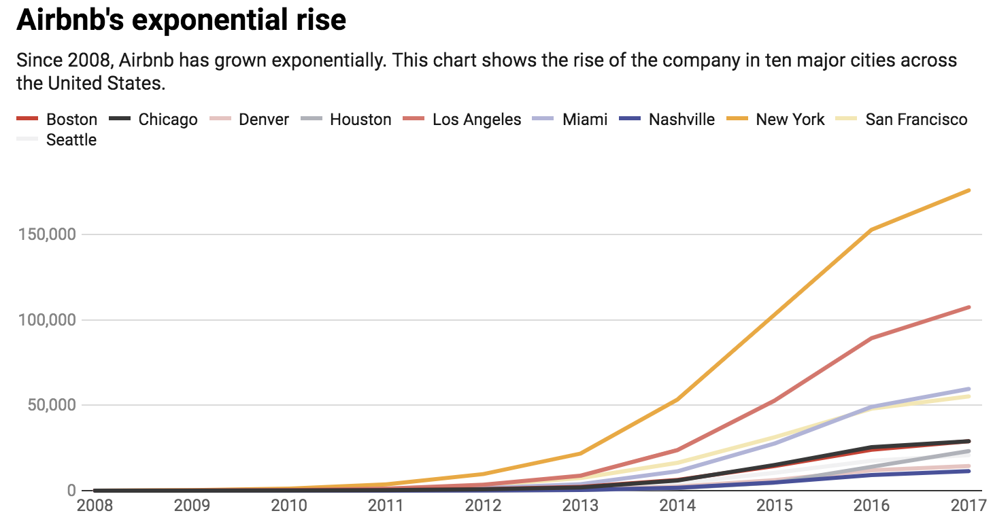
Problem Statement
Airbnb is one such OTA platform acts as the middleman between hotels and customers to book a room; also provides lodging, homestays for vacations and tourism activities. The platform provides businesses an increased opportunity to reach out to a wider customer base and at the same time it empower the customer by providing them with beforehand details of the type of the property, amenities, location of stay and plan out their budget for the trip accordingly. The major part of the OTA platform is to provide an accurate prediction of Cost Per Night to the customers.

Slide 4
DATA INFORMATION
Numerical
Sl. No | Attributes | Dtype | Desicription
1 | id | int64 | Airbnb's unique identifier for the listing
2 | scrape_id | int64 | Inside Airbnb "Scrape" this was part of
3 | host_id | int64 | Airbnb's unique identifier for the host/user
4 | host_listings_count | float64 | The number of listings the host has.
5 | host_total_listings_count | float64 | The number of listings the host has.
6 | latitude | float64 | Uses the World Geodetic System (WGS84) projection for latitude and longitude.
7 | longitude | float64 | Uses the World Geodetic System (WGS84) projection for latitude and longitude.
8 | accommodates | int64 | The maximum capacity of the listing
9 | bathrooms | float64 | The number of bathrooms in the listing
10 | bedrooms | float64 | The number of bedrooms
11 | beds | float64 | The number of bed(s)
12 | minimum_nights | int64 | minimum number of night stay for the listing.
13 | maximum_nights | int64 | maximum number of night stay for the listing.
14 | minimum_minimum_nights | float64 | the smallest minimum_night value from the calender (looking 365 nights in the future)
15 | maximum_minimum_nights | float64 | the largest minimum night value from the calender (looking 365 nights in the future)
The data was made available by Inside Airbnb site and is sourced from publicly available information from the Airbnb site.
The dataset contains record of the hosts who are part if the Airbnb OTA platform.
The records details are as below:
Data Information | Number
Features | 74
Rows | 33000
Independent | 73
Dependent | 1
Numerical | 39
Categorical | 34

Slide 5
16 | minimum_maximum_nights | float64 | the smallest maximum_night value from the calender (looking 365 nights in the future)
17 | maximum_maximum_nights | float64 | the largest maximum_night value from the calender (looking 365 nights in the future)
18 | minimum_nights_avg_ntm | float64 | the average minimum_night value from the calender (looking 365 nights in the future)
19 | maximum_nights_avg_ntm | float64 | the average maximum_night value from the calender (looking 365 nights in the future)
20 | calendar_updated | float64 | Calendar
21 | availability_30 | int64 | avaliability_30. The availability of the listing 30 days in the future as determined by the calendar.
22 | availability_60 | int64 | avaliability_60. The availability of the listing 60 days in the future as determined by the calendar.
23 | availability_90 | int64 | avaliability_90. The availability of the listing 90 days in the future as determined by the calendar.
24 | availability_365 | int64 | avaliability_365. The availability of the listing 365 days in the future as determined by the calendar.
25 | number_of_reviews | int64 | The number of reviews the listing has
26 | number_of_reviews_ltm | int64 | The number of reviews the listing has (in the last 12 months)
27 | number_of_reviews_l30d | int64 | The number of reviews the listing has (in the last 30 days)
28 | review_scores_rating | float64 | The overall review for the stay
29 | review_scores_accuracy | float64 | The accuracy review score for the stay
30 | review_scores_cleanliness | float64 | The cleanliness review score for the stay
31 | review_scores_checkin | float64 | The checkin review score for the stay
32 | review_scores_communication | float64 | The communication review score for the stay
33 | review_scores_location | float64 | The location review score for the stay
34 | review_scores_value | float64 | The value review score for the stay
35 | calculated_host_listings_count | int64 | The number of listings the host has in the current scrape, in the city/region geography.
36 | calculated_host_listings_count_entire_homes | int64 | The number of Entire home/apt listings the host has in the current scrape, in the city/region geography
37 | calculated_host_listings_count_private_rooms | int64 | The number of Private room listings the host has in the current scrape, in the city/region geography
38 | calculated_host_listings_count_shared_rooms | int64 | The number of Shared room listings the host has in the current scrape, in the city/region geography
39 | reviews_per_month | float64 | The number of reviews the listing has over the lifetime of the listing

Slide 6
Categorical
18 | host_neighbourhood | object | The neighbourhood that the host is located
19 | host_verifications | object | Host verification
20 | host_has_profile_pic | object | Host profile picture
21 | host_identity_verified | object | Host identity verified
22 | neighbourhood | object | The neighbourhood as geocoded using the latitude and longitude
23 | neighbourhood_cleansed | object | The neighbourhood as geocoded using the latitude and longitude against neighborhoods as defined by open or public digital shapefiles.
24 | neighbourhood_group_cleansed | object | The neighbourhood group as geocoded using the latitude and longitude against neighborhoods as defined by open or public digital shapefiles.
25 | property_type | object | Self selected property type. Hotels and Bed and Breakfasts are described as such by their hosts in this field
26 | room_type | object | All homes are grouped into the following three room types: Entire place Private room Shared room Entire place
27 | bathrooms_text | object | The number of bathrooms in the listing. On the Airbnb web-site, the bathrooms field has evolved from a number to a textual description. For older scrapes, bathrooms is used.
28 | amenities | object | The various consumable and facilities that come with the room
29 | has_availability | object | [t=true; f=false]
30 | calendar_last_scraped | object | Calendar_last_scarped
31 | first_review | object | The date of the first/oldest review
32 | last_review | object | The date of the last/newest review
33 | license | object | The licence/permit/registration number
34 | instant_bookable | object | [t=true; f=false]. Whether the guest can automatically book the listing without the host requiring to accept their booking request. An indicator of a commercial listing.
Sl. No | Attributes | Dtype | Desicription
1 | listing_url | object | Airbnb's unique url for the listing
2 | last_scraped | object | UTC. The date and time this listing was "scraped".
3 | name | object | Name of the listing
4 | description | object | Detailed description of the listing
5 | neighborhood_overview | object | Host's description of the neighbourhood
6 | picture_url | object | URL to the Airbnb hosted regular sized image for the listing
7 | host_url | object | The Airbnb page for the host
8 | host_name | object | Name of the host. Usually just the first name(s).
9 | host_since | object | The date the host/user was created. For hosts that are Airbnb guests this could be the date they registered as a guest.
10 | host_location | object | The host's self reported location
11 | host_about | object | Description about the host
12 | host_response_time | object | The Time the host take to respond to a booking
13 | host_response_rate | object | The rate at which a host responds booking requests.
14 | host_acceptance_rate | object | The rate at which a host accepts booking requests.
15 | host_is_superhost | object | [t=true; f=false]
16 | host_thumbnail_url | object | Url for host thumbnail
17 | host_picture_url | object | Url for host pictures

Slide 7
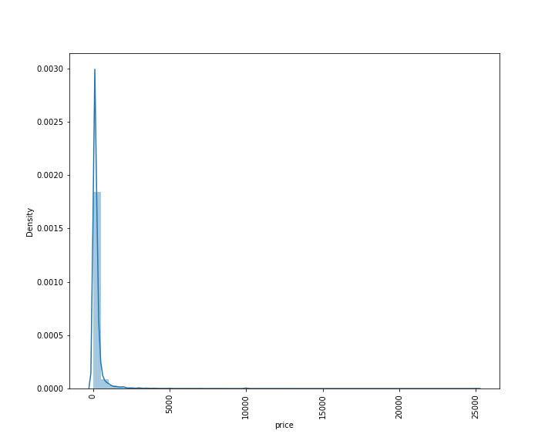
Target Variable
The target variable of the above dataset is price. We have to predict the daily price for the stay.

Slide 8
Data Pre-Processing:
From here we observe that host_response_rate, host_acceptance_rate and the target variable ‘price’ are numerical data but are stated as object. We need to convert them to numerical data.
Attributes | O_Dtype | N_Dtype
Host_response_rate | Object | Float64
Host_acceptance_rate | Object | Float64
Price | Object | Float64
Removal of unwanted attribute
After checking the dataset in detail, we can see the several of the categorical have 100% unique variable or are urls which will not provide any value to the predictions, hence we can drop these variables.
Similarly numerical variable like id, host_is and scrape_id will not provide any value to the predictions; hence we can drop these variables also.
Variables with 100% missing values such as calendar_updated and bathrooms can be dropped.
After dropping the irrelevant columns and correcting the data_type of the attributes we have 6 categorical variables, 37 numerical variables and the target.

Slide 9
Missing Value Treatment
Sl. No | Attributes | Null Value Percentage | Dtype
1 | host_response_time | 32.59 | object
2 | host_response_rate | 32.59 | float64
3 | host_acceptance_rate | 30.97 | float64
4 | host_is_superhost | 0.02 | object
5 | host_total_listings_count | 0.02 | float64
6 | bathrooms_text | 0.19 | object
7 | bedrooms | 11.24 | float64
8 | beds | 5.43 | float64
9 | minimum_minimum_nights | 0.01 | float64
10 | maximum_minimum_nights | 0.01 | float64
11 | minimum_maximum_nights | 0.01 | float64
12 | maximum_maximum_nights | 0.01 | float64
13 | minimum_nights_avg_ntm | 0.01 | float64
14 | maximum_nights_avg_ntm | 0.01 | float64
15 | review_scores_rating | 24.03 | float64
16 | review_scores_accuracy | 25.02 | float64
17 | review_scores_cleanliness | 25.01 | float64
18 | review_scores_checkin | 25.04 | float64
19 | review_scores_communication | 25.02 | float64
20 | review_scores_location | 25.05 | float64
21 | review_scores_value | 25.06 | float64
22 | reviews_per_month | 24.03 | float64
The next step of data pre-processing is to handle missing data in the datasets. If our dataset contains some missing data, then it may create a huge problem for our machine learning model. Hence it is necessary to handle missing values present in the dataset.
We can observe that 22 attributes have missing values in them.
The categorical variable were imputed with proportional imputation.
All numerical variables with missing values are highly skewed hence the best approach was to impute them with median over mean
Check for outliers:
Data has outliers present in each of the numerical columns. For making the base model, we do not perform any outlier treatment and retain all the rows present in the data.

Slide 10
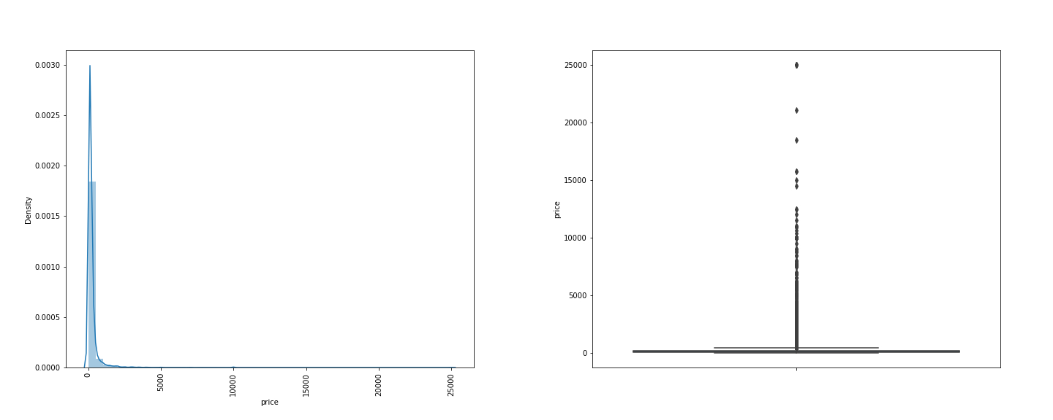
UNIVARIATE ANALYSIS:
Numerical:
a. Price
Price is right skewed with is indicating that most of the price range in the data set is between 0 and 2000.
It is Leptokurtic, and narrow tailed showing how densely the price value is concentrated in this range.
IQR lies between 0 and 2000 just as shown by the distribution plot .
We have Outliers present in the target which could have influence on the predictive model..

Slide 11
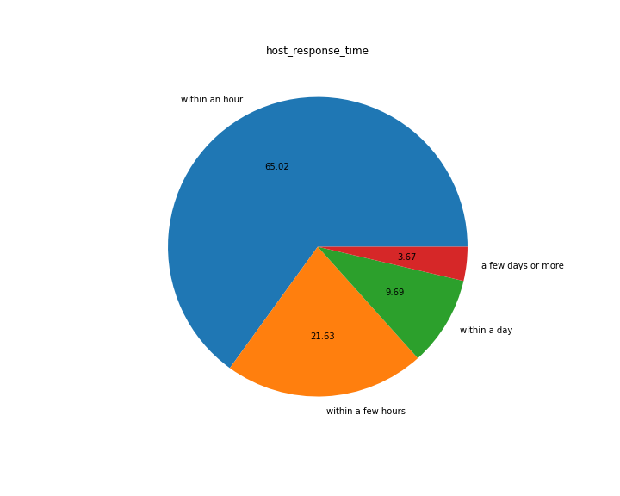
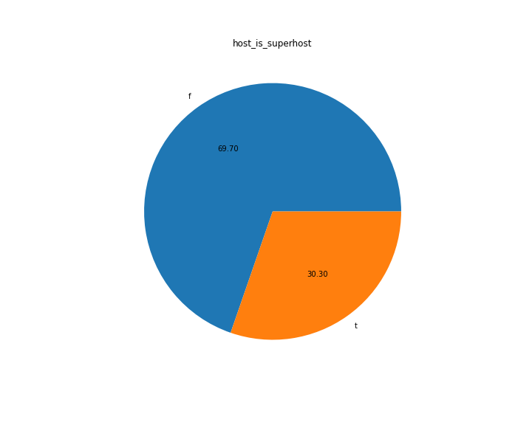
Categorical:
Host_response_time
Host_is_superhost
Inference: 65.02% of the host response time were handled within an hour followed 21.63% are handled within a few hours from the time of call.
Inference: Among the host of the properties, 69.70% is super host and 30.30% are not super host.

Slide 12
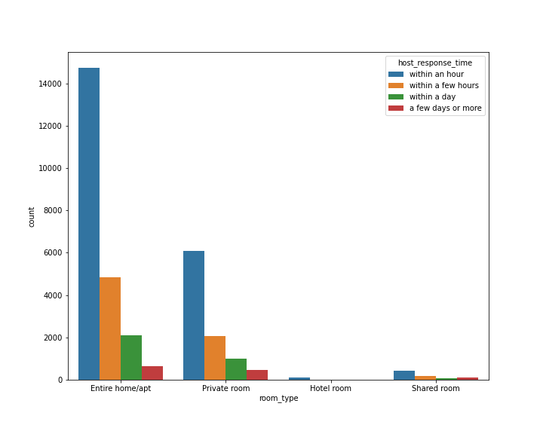
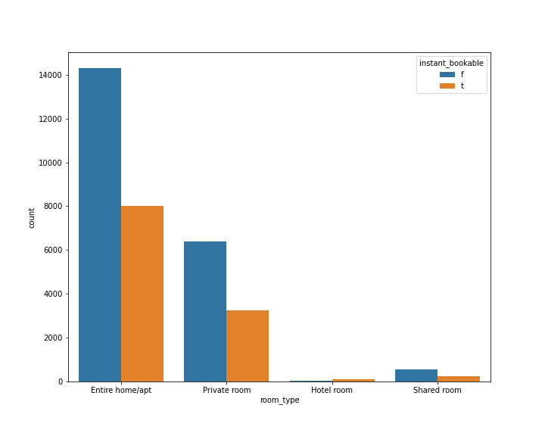
BIVARIATE ANALYSIS:
Room_type vs instant_bookable:
Room_type vs Host_respose_time:
Inference: From the above bar plot, we could interpret that the category of Entire/Apt and Private rooms are booked highly at an instant basis compare to hotel rooms and shared rooms.
Inference: From the above bar plot, we interpret that the high calls were made for entire home/apt and private rooms categories compare to hotel room and shared room. Most of these calls were handled within an hour and few hours from the time of calls.

Slide 13
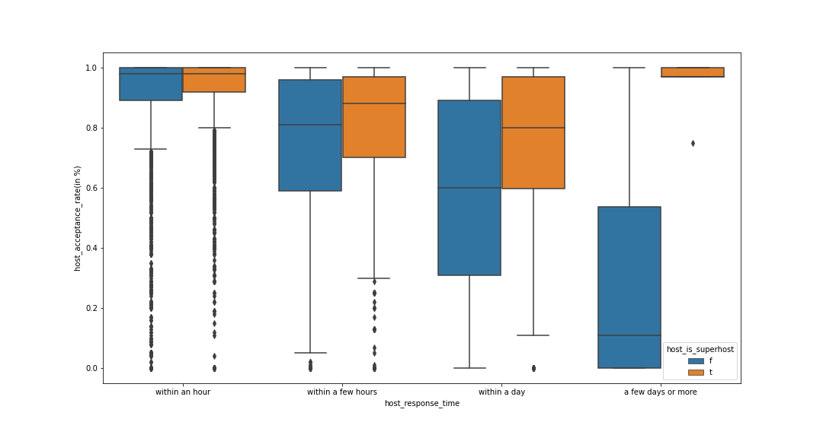
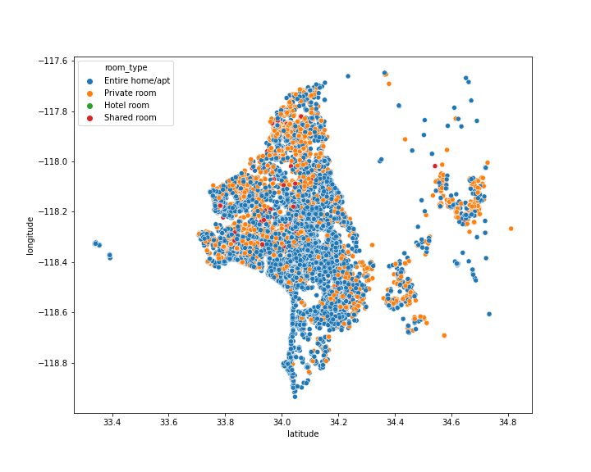
MULTIVARIATE ANALYSIS:
Host_acceptance_rate vs Host_response_time vs Host_is_superhost:
Latitude vs Longitude vs Room_type:
Inference: From the above graph, we could interpret that both Super host and non-Super host mostly took a day to accept the bookings and sometimes the super host also took few days to accept bookings. Whereas the acceptance rate within an hour and few hours are very less compare to with a day and few days categories.
Inference: From the above graph, we could interpret that most of the host are hosting majorly the entire home/apt followed private room and very negligible amount of hotel and shared room.

Slide 14
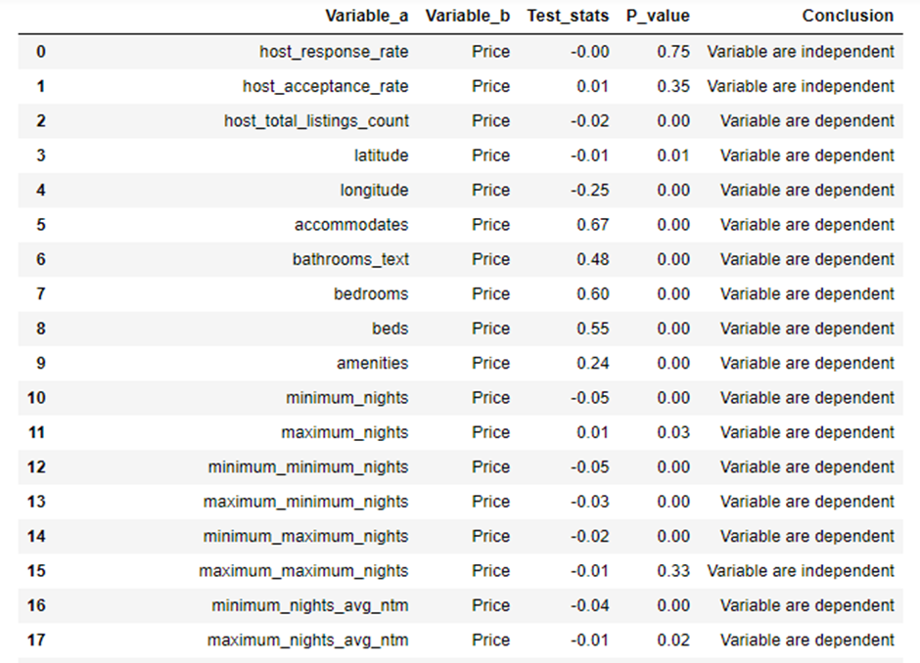
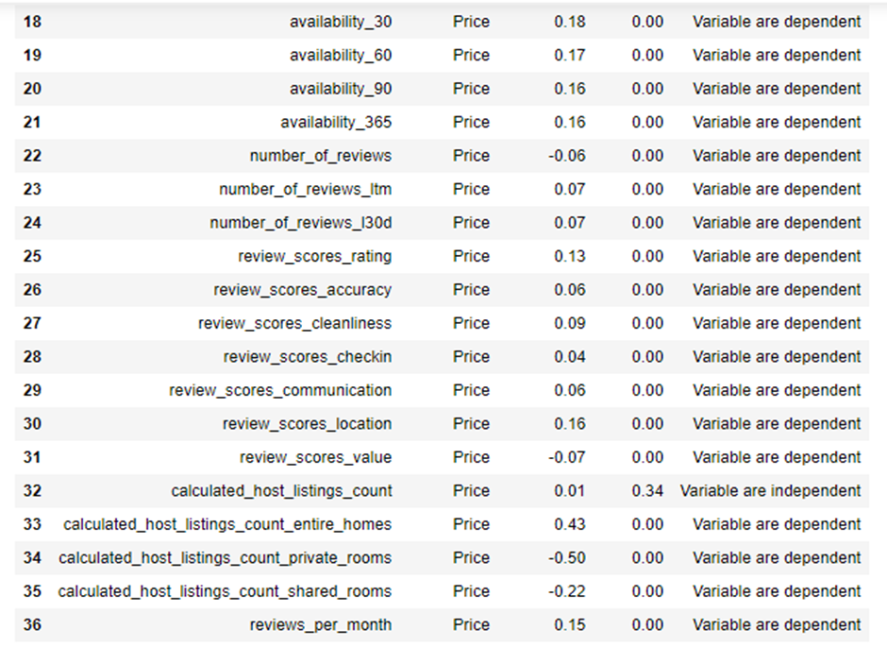
Summary of Correlation test:
STATISTISTICAL TEST:
NUMERICAL VARIABLE VS TARGET
Hypothesis for SpearMan and Pearson correlation test:
H0: The target variable is independent of the variable.
HA: The target variable is dependent on the variable.

Slide 15
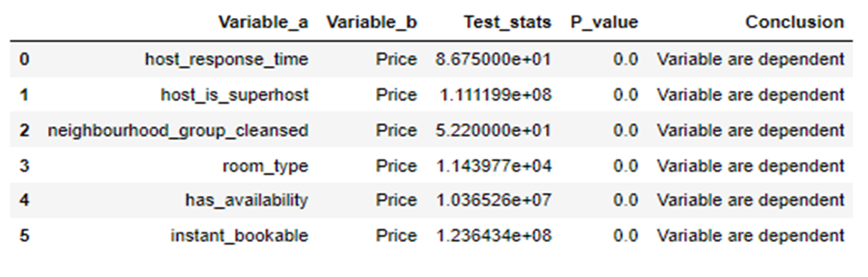
Summary for Categorical Statistical analysis:
CATEGORICAL VS TARGET:
Hypothesis for Mann-Whitney and Kruskal-Wallis test
H0: The target variable is independent of the variable.
HA: The target variable is dependent on the variable.

Slide 16
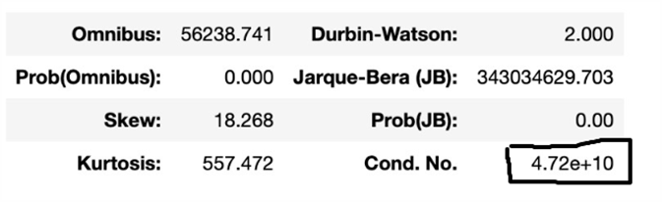
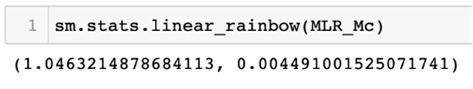
ASSUMPTIONS OF LINEAR REGRESSION:
Multi collinearity model check:
From the base model, we have got the condition no of 4.72e+10 and it is greater than condition no of 1000. Thus, states clearly that the independent features from the model have very strong relationship among them.
Linearity Check:
Test Statistics and P_value:
Rainbow test assumption of hypothesis:
H0: It is good linear model
HA: It is not good linear model
Conclusion:
From the test statistics, we have got the pvalue as 0.004 and it is lesser than alpha value of 0.05. Hence, we are agreeing to reject the null hypothesis and concluding that the independent variables are not having linear relationship with the target variable.

Slide 17
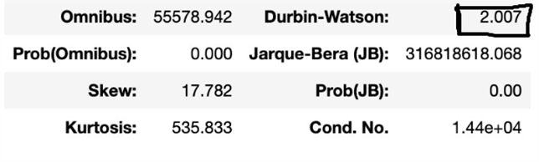
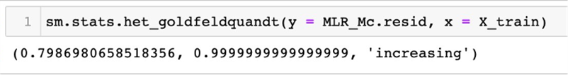
Hypothesis_for_goldfeld_test:
H0: Heteroscedasticity is not present
HA: Heteroscedasticity is present.
Conclusion: From the test statistics, we have got the p-value as 0.99 and it is greater than alpha value of 0.05. Hence, we are agreeing to accept the null hypothesis and concluding that the residuals have same variance.
Auto-correlation check
Conclusion:
From the OLS model, we have derived the score of Durbin-Waston as 2.007. Hence, we can conclude that there is no auto-correlation between the residuals.
Homoscedasticity Check:
Test Statistics and P_value:

Slide 18
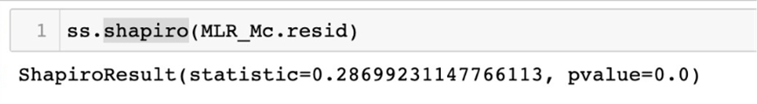
ASSUMPTIONS INFERENCE:
Normality of the residue:
Test Statistics and P_value:
Normality of the residue check:
We can check the normality of the residue assumption by using the shapiro test.
Hypothesis for Normality
H0: Residue is normal HA: Residue is not normal
As, three assumption checks are violating and fitting the above data in the linear model is strongly not recommendable. Hence, we can go-ahead and start using the non-linear models for the prediction.
From the above statistical approach, we could observe that non-violated and violated assumptions are enlisted below.
Non-Violated Assumption:
Homoscedasticity,
Autocorrelation.
Violated Assumption:
Multicollinearity,
Linearity,
Normality check of the residuals.

Slide 19
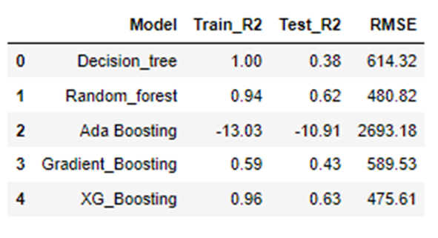
Inference from the non-linear model:
Non-Linear Model:
From the five non-linear model performed we can come to the conclusion that all the model are under performing and is influenced by various features of the data. We can improve the perform of these non-linear model by doing the following:
Treating the multi-collinearity in the data.
Treating the outliers in the data.

Slide 20
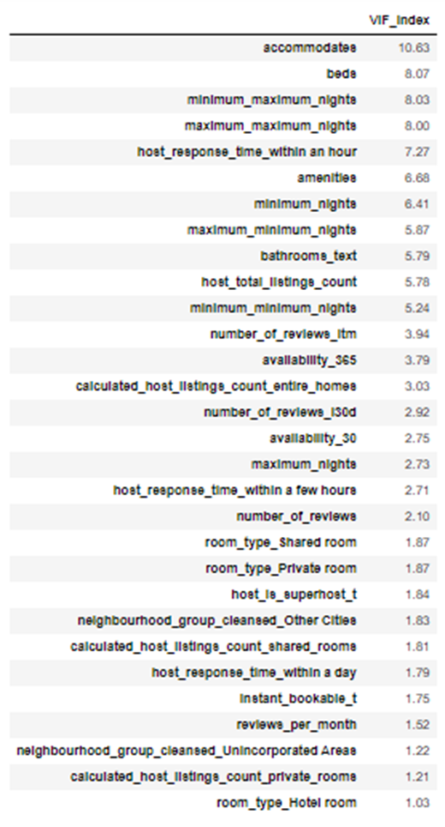
Treating the multi- collinearity:
We can reduce the multi-collinearity using the VIF, removing the variable with VIF threshold greater than 11.
We are left with 30 attributes as shown by the above table.

Slide 21
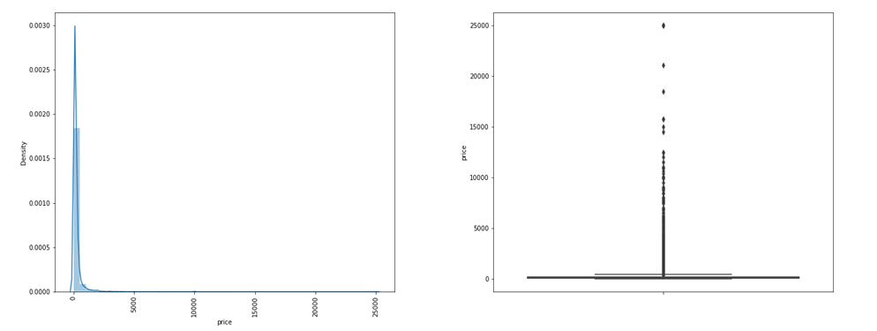
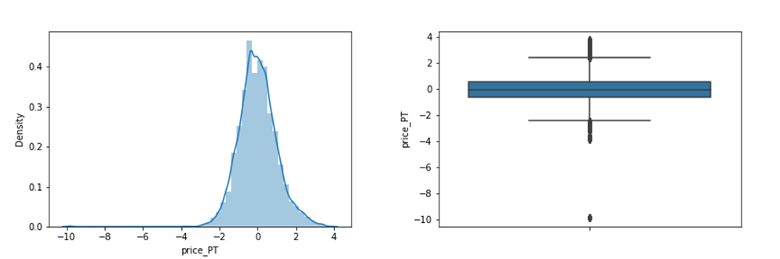
Transforming the target:
Also we can have outliers is 28 out of the 30 variables left hence transforming all the variable is not a good practice. Therefore we can try and transform only the target variable and run the non-linear model again.
Price distribution before and after transformation:

Slide 22
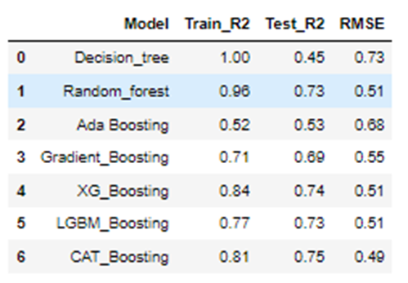
Inference from the non-linear model after treating outlier and multi-colinearity:
Non-Linear Model after treating multi-collinearity and outliers
From the above evaluation table we can see that the performance for all the non-linear model after treating the multi-colinearity and the transforming the target has significantly improved. Among the six non-linear model we can see the Random forest, XG Boost and the CAT Boost model perform the best.
These base model performance can be further improved by fine tuning the hyper parameters of these algorithms using the GridSearchCV.

Slide 23
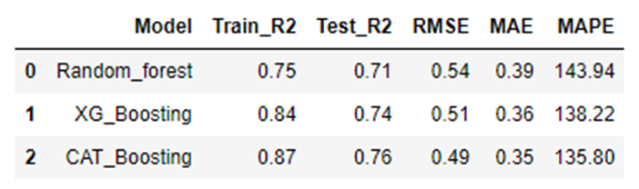
Hyperparameter Tunning:
Random forest, XG Boost and the CAT Boost model have been chosen and a set of parameters has been considered for fine tuning.
Using these set of parameters we have used Grid Search Cross Validation technique for Hyper parameter tuning the models where the Cross Validation method considered is 5- Fold Cross Validation.
Evaluation of the tuned model:
From the above evaluation matrix, we can see that the tuned CAT Boost regressor is the best performing model on all the evaluation parameter.

Slide 24
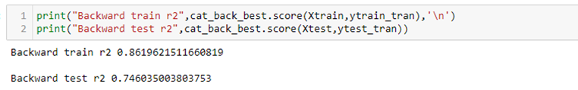
Using Backward Feature Selection:
Since the analysis shows that the CAT boost regressor has the best overall performance from all the previously deployed base and tuned models, it will be considered for deriving the final set of features affecting the ML algorithm using the backward selection model.
The Backward selection process was carried out and the best 23 feature that have significant impact on the target was identified.
['host_response_time_within a day', 'host_response_time_within an hour', 'neighbourhood_group_cleansed_Other Cities', 'neighbourhood_group_cleansed_Unincorporated Areas', 'room_type_Hotel room', 'room_type_Private room', 'room_type_Shared room', 'instant_bookable_t', 'accommodates', 'bathrooms_text', 'beds', 'amenities', 'maximum_nights', 'maximum_minimum_nights', 'maximum_maximum_nights', 'availability_30', 'availability_365', 'number_of_reviews_ltm', 'number_of_reviews_l30d', 'calculated_host_listings_count_entire_homes', 'calculated_host_listings_count_private_rooms', 'calculated_host_listings_count_shared_rooms', 'reviews_per_month']

Slide 25

Output:
Final Prediction Model (CostPrediction_CATBoostModel):
Overall R2 for the CATBoost Model for train data : 0.86
Overall R2 for the CATBoost Model for test data : 0.75
Root mean squared error for the CATBoost Model: 0.50
Mean absolute error for the CATBoost Model: 0.36
Mean absolute percentage error for the CATBoost Model: 139.78

Slide 26
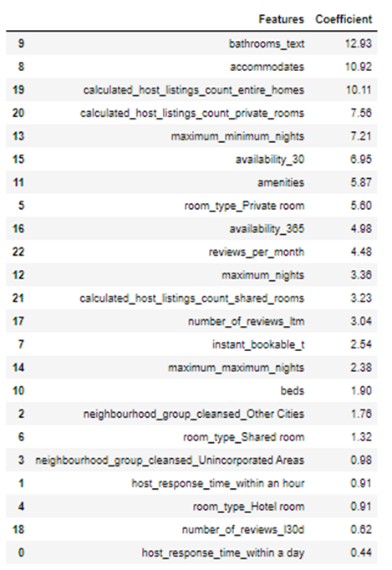

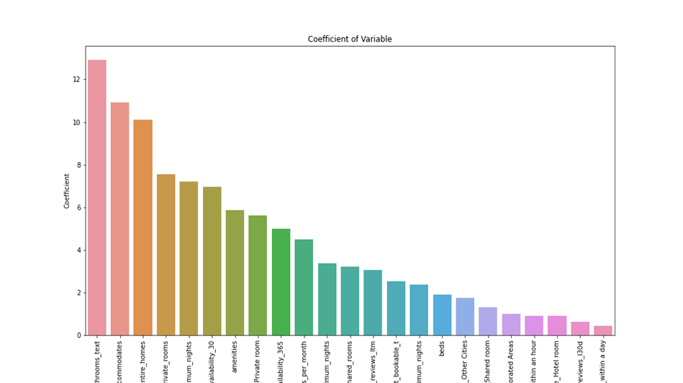
The Significant variable and the coefficient are:

Slide 27
INFERENCES AND RECOMMENDATIONS:
Inference – Some of the important features are bathrooms_text (no_of_bathrooms), accomdates,calculated_host_listings_count_entire_homes,calculated_host_listings_count_private_homes, maximum_minimum_nights, availability_30, amenities,room_type_private, reviews_per_month, beds and etc.
The no of accomdates helps to predict and also increase the cost of the property for a night.
The no of bathrooms tends to predict and increase the cost of the property for a night.
The amenities tends to predict and the increase of the property for a night.
Types of rooms – entire home has high price for the property for a night.
Types of rooms – private rooms has lesser price than compare to entire homes of the property for a night.
The maximum and minimum night’s feature helps to predict the price of the property for a night.
Previous number of reviews helps to predict the price of the property for a night.
Instant_Bookable feature helps to predict the price of the property for a night.
The more cleaner neighbourhood tends to increase the price of the property for a night.

Slide 28
Limitations & Challenges
High cardinality results in huge training effort in model tuning due to increase in model complexity (i.e. more number of features)
We also faced challenges on robust model tuning on all the models. Due to computational limitations, we are limited to very limited hyper parameters tuning technique using Grid Search.
Scope
We can approach the same concepts, using PCA as more than 60% of features having multicollinearity. Explanation of the each feature contribution’s is not feasible.
Can perform much more hyper parameter tuning for the CatBoost model. Due to lower processing power of our laptops, we couldn’t approach that.
Reference
[1]: https://www.mygreatlearning.com/blog/introduction-to-multivariate-regression/
[2]: https://www.investopedia.com/ask/answers/033115/how-does-law-supply-and-demand-affect-prices.asp
[3]: https://www.kaggle.com/airbnb/seattle/
[4]: https://scikit-learn.org/stable/tutorial/machine_learning_map/index.html
[5]: https://catboost.ai/

Slide 29

Thank You

