Slide 1

On-device AI that stays cool
−44%
battery used
LOOM splits any AI app into virtual chiplets and a runtime that balances them against the phone's real heat and battery.
same phone, same AI job,
15 minutes each
iQOO Hackathon 2026 · built and measured on the iQOO 15
Notes:
Every phone maker is racing to put AI on the phone. But after five minutes the phone gets hot, Android throttles the chip, the AI slows down and the battery drains. We built LOOM, a runtime that sits between the phone and any AI model and keeps it cool, fast and efficient. On this iQOO 15, running the same AI job, LOOM used 44% less battery than an ordinary app, and it stayed cool while the ordinary app overheated.

Slide 2




On-device AI overheats, then slows down
An ordinary app runs its AI at full power, all the time. We measured it on the iQOO 15 for 15 minutes:
0.61 → 0.98
1,048 mA
18.7 → 12
MODERATE
Heat (thermal headroom)
Battery draw, all the time
Frames per second
Android thermal status
1.0 is where Android throttles hard
median over the run
the chip throttled itself
and SEVERE if left on longer
Full price in battery and heat, and it still gets slower. That's every on-device AI app today: camera models, chatbots, game AI.
Notes:
We ran an AI model the ordinary way, everything at full power, for 15 minutes. Heat went from 0.61 to 0.98, where 1.0 means Android throttles hard. The battery drew about 1,050 mA the whole time. Speed fell from 18.7 to about 12 frames per second because the chip throttled itself. Android's thermal status reached MODERATE. So the app paid full price in battery and heat and still got slower. That's the problem every on-device AI app has, whether it's a camera model, a chatbot or a game feature.

Slide 3




The insight: an AI app is several jobs, not one
+
+
+
Input
Model
Screen
Voice
camera, microphone, sensors
the AI itself, big or small
drawing results
speaking results
They don't all need full power all the time.
Control each job separately and spend power only where the user notices, and you get the same result for much less heat and battery.
Notes:
An AI app is not one block. It's several jobs: the camera or input, the model, the screen, the voice output. They don't all need full power all the time. If you can control each job separately and spend power only where it matters, you get the same result for much less heat and battery.

Slide 4





Virtual chiplets: one job each, one standard interface
Hardware chiplets split a processor into parts that can be tuned on their own. LOOM does the same in software.
Capture
Preprocess
Inference
Narrator
Display
camera sensor
rotate upright
AI model on GPU
speaks results
boxes + brightness
30 fps
always on
Lite2
every 3 s
100%
15 fps
Lite0
every 6 s
35%
10 fps
off
8%
Power profiles
Live cost and quality
Any model plugs in
each chiplet has levels it can run at
every chiplet reports what it spends
today detection; next a chatbot or game AI
Notes:
In hardware, a chiplet is a small piece of a chip that does one job, so each part can be tuned on its own. We did the same in software. LOOM splits an AI app into virtual chiplets: Capture reads the camera at 30, 15 or 10 frames a second; Inference runs the AI model, a large or small one, on the GPU; Display draws the results; Narrator speaks them. Every chiplet reports its cost and quality, and can switch power level while running. Because the interface is standard, any AI model can be plugged in as a chiplet. Today it's object detection; tomorrow a chatbot or a game's AI. (If asked: each chiplet is a Kotlin class implementing the same interface, with profiles and live cost reporting.)

Slide 5




The Weaver: the heart that balances every chiplet
1
2
3
4
Sense
Plan
Reflex
Hot-swap
heat, battery mA and FPS from Android, every second
look up the quantum plan for this goal and heat
over the 0.80 limit? step one chiplet down
switch the profile between two frames
When it's too hot, it cuts what you notice least, first:
Screen
dims
Model
Lite2 → Lite0
Camera
30 → 10 fps
Voice
last
Cools down → waits 5 s → steps back up, so nothing flickers. Fully automatic: the user just sees the AI working.
Notes:
The chiplets are managed by the Weaver. Every second it reads the phone's real heat from Android, the battery draw and the speed. When heat goes above our limit of 0.80, it lowers power one chiplet at a time, in a fixed order: screen first, then the model, then the camera, and the voice last. The things you notice least go first. When the phone cools down it waits 5 seconds and raises power again, so it never flickers. It also follows a plan worked out in advance by our quantum planner. It's fully automatic: the user does nothing.

Slide 6

Two things that make it work on a real phone
≈0.01 ms
30 → 10 fps
hot-swap
at the camera sensor
The Weaver builds the new model in the background, then swaps it between two frames. The AI never stops and the user never sees a pause. Measured: build 309 ms, swap 0.017 ms.
Most apps just skip frames, but the camera still captures them and burns power. LOOM tells the iQOO's camera hardware itself to capture fewer frames, through Android's Camera2 controls. Power is saved at the source.
Notes:
Two things make this work in practice. First, hot-swap in about 0.01 milliseconds: the Weaver swaps a chiplet's model or setting between two frames, so the AI never stops. Second, we control the real camera sensor. Most apps just skip frames, but the camera still captures them and burns power. LOOM tells the iQOO's camera hardware to actually capture at 30, 15 or 10 frames a second, through Camera2. That saves power at the source.

Slide 7
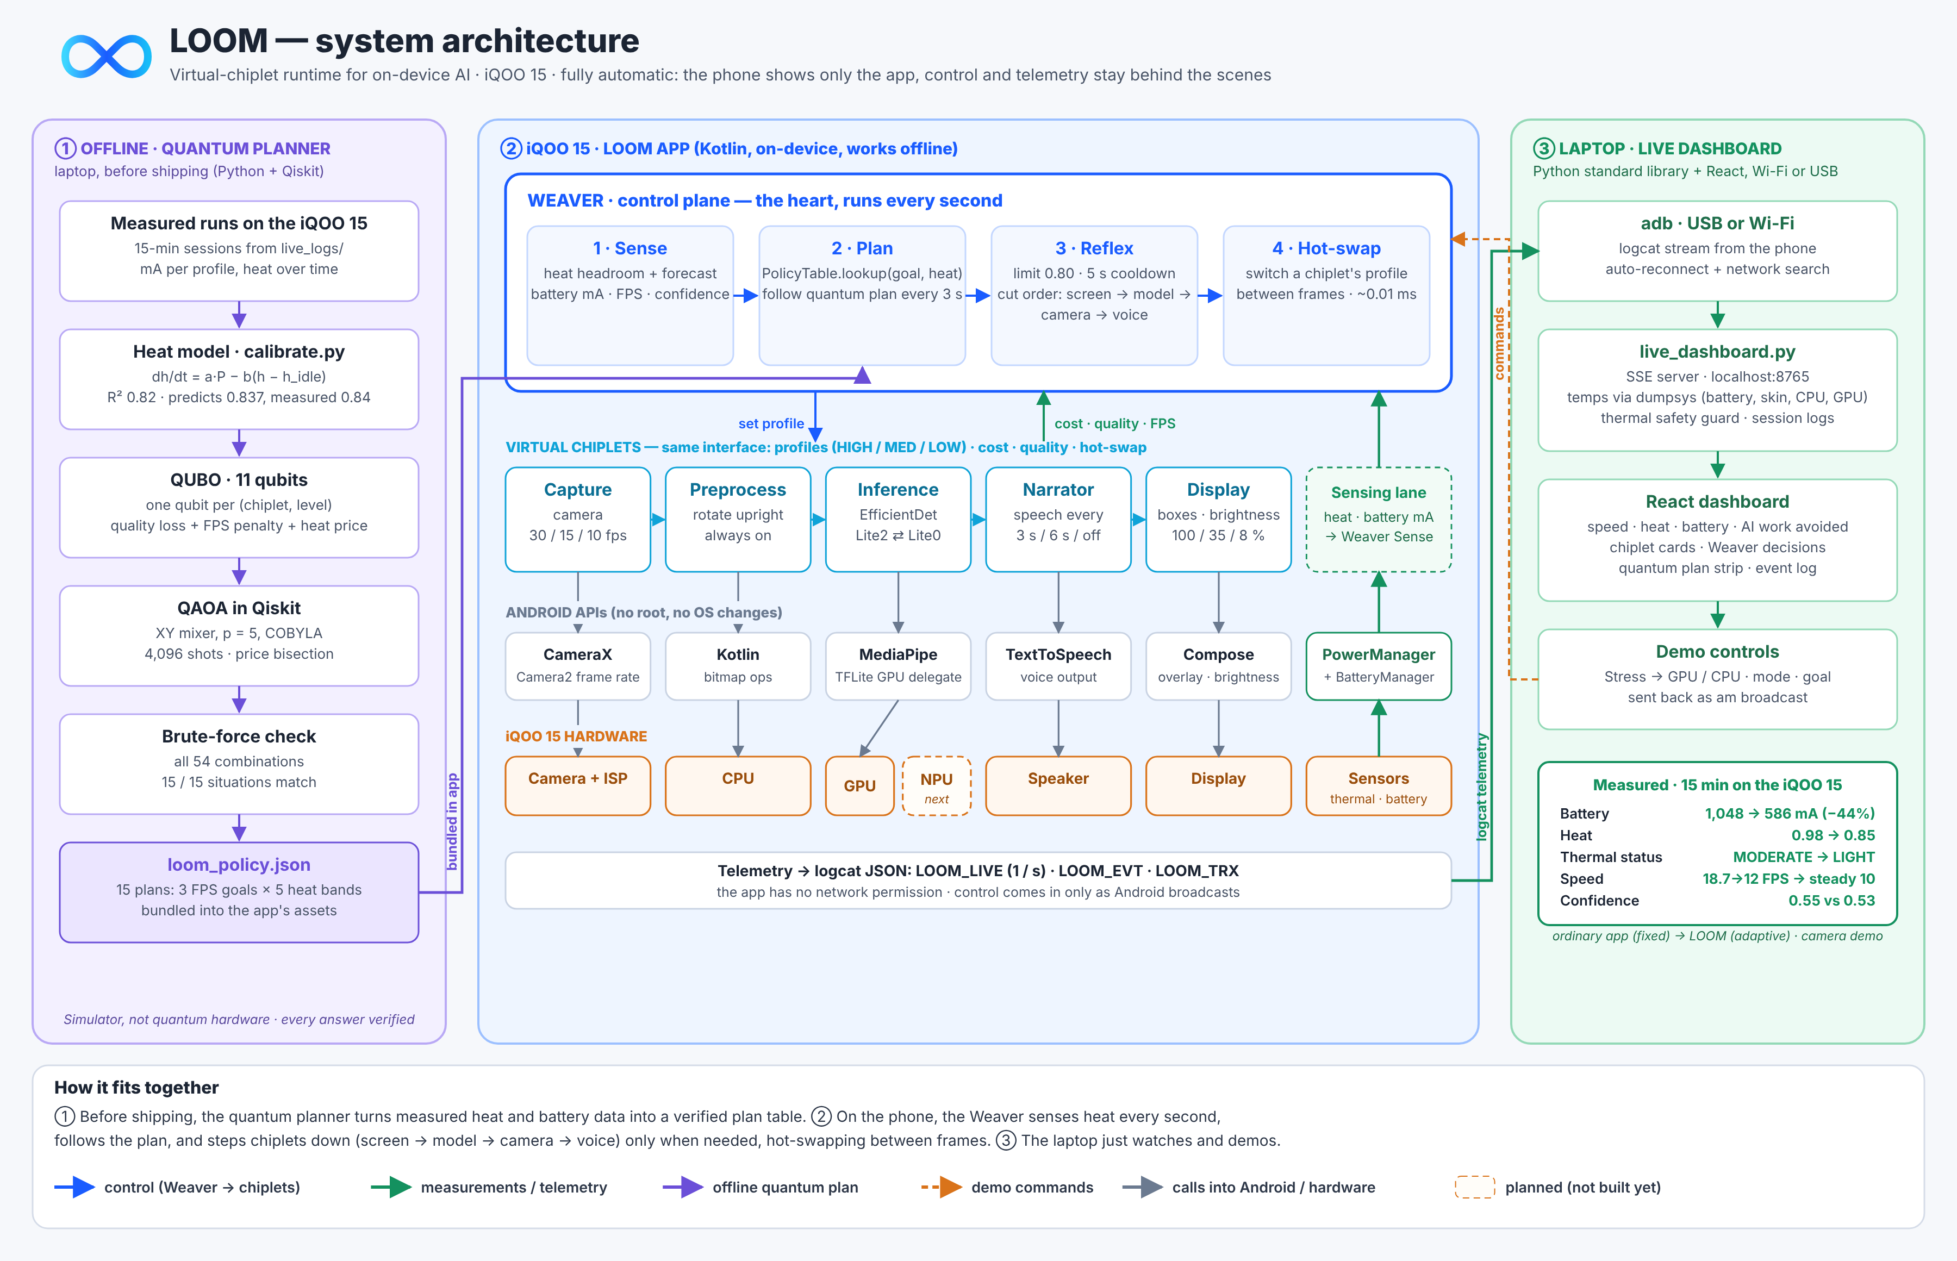
Architecture: plan offline, run on the phone, watch live
Notes:
Walk it left to right. One: before shipping, the quantum planner turns measured heat and battery data into a verified plan table. Two: on the phone, the Weaver senses heat every second, follows the plan, and steps chiplets down only when needed, through normal Android APIs, no root and no OS changes. Three: the laptop dashboard only watches over Wi-Fi and sends demo commands. The app itself has no network permission.

Slide 8
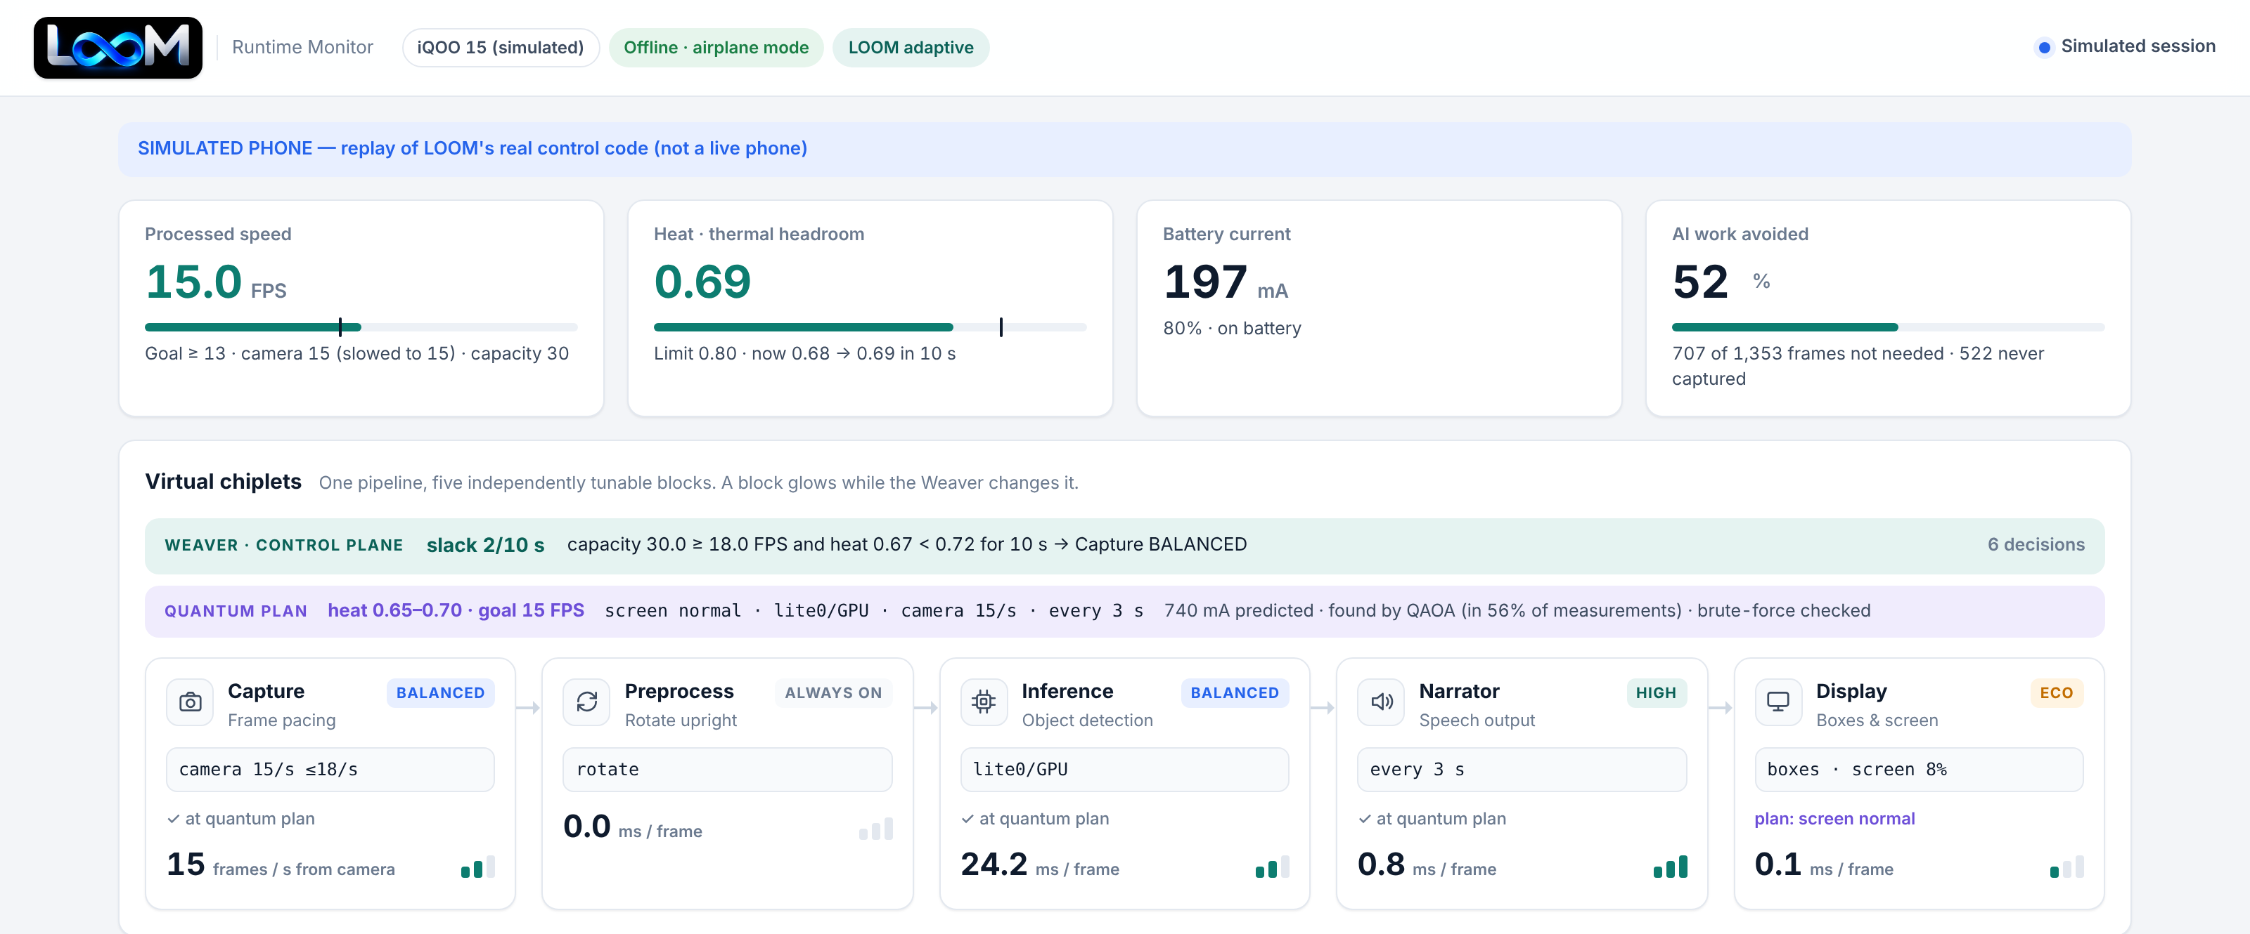
Live demo: watch the Weaver work
1
Open LOOM
phone shows only the camera and detections
2
Press Stress → GPU
we heat the phone on purpose
3
Heat crosses 0.80
screen dims, model shrinks, camera slows
Laptop dashboard, connected to the phone over Wi-Fi (rehearsal replay shown)
4
Detection keeps going
every change is logged with its reason
Notes:
This is the live dashboard, connected to the phone over Wi-Fi. Heat is the phone's real thermal headroom from Android, with real temperatures underneath: battery, skin, CPU and GPU. Battery is the current draw, Speed is frames per second, and the chiplet cards show each power level. The quantum plan strip shows which plan the Weaver is following. Now press Stress → GPU: watch the heat climb, and as it crosses 0.80 the Weaver steps in. The screen goes light, the model switches to the smaller one, the camera slows down. Every change is logged with the reason, and detection keeps working. If Wi-Fi fails: plug in USB, or play the recorded session and say so.

Slide 9
The proof: same phone, same job, 44% less battery
 | Ordinary app (fixed) | LOOM (adaptive)
Heat | 0.61 → 0.98 | 0.84 → 0.85, flat
Battery (median) | 1,048 mA | 586 mA (−44%)
Speed | 18.7 → 12 FPS, falling | steady 10 FPS
Android thermal status | MODERATE | LIGHT
Detection confidence | 0.55 | 0.53
The two runs started at different heat; a cool-start rerun is planned. Numbers are from the camera demo; the method applies to any model.
Notes:
Here's the 15-minute comparison on this phone, the same AI job both times. LOOM used 44% less battery, 586 against 1,048 mA. It held the heat flat instead of climbing, and gave a steady speed instead of a slide. Android rated it LIGHT instead of MODERATE. Detection quality stayed almost the same: 0.53 against 0.55. Honest note if asked: the two runs started at different heat levels; a cool-start rerun is planned.

Slide 10





The quantum planner: plan 3 minutes ahead
Measure
QUBO
QAOA
Verify
Ship
real heat + battery on the iQOO 15
54 combinations, 11 qubits
solved in Qiskit, XY mixer, p = 5
brute force over all 54
loom_policy.json in the app
15 / 15
0.837 vs 0.84
every 3 s
situations matched brute force
predicted vs measured heat floor
the Weaver follows the plan
3 FPS goals × 5 heat levels
the heat model holds up on the phone
its reflexes stay on as a safety net
Honest scope: runs on a quantum simulator, not quantum hardware. With 54 options brute force is instant; QAOA shows the decision has the right shape as chiplets and levels grow (10 chiplets × 4 levels ≈ 1 million).
Notes:
Reacting to heat is good; planning ahead is better. We measured how this phone heats and cools and fitted a heat model. Then we asked: for each speed goal and heat level, which setting should every chiplet use so quality stays as high as possible while the phone stays under the limit for the next 3 minutes? That's 54 combinations. We wrote it as a QUBO with 11 qubits and solved it with QAOA in Qiskit. 15 situations, every answer checked by brute force, all 15 matched. The heat model predicted the phone would settle at 0.837; it actually settled at 0.84. The result is a plan table that ships inside the app; the Weaver follows it every 3 seconds. Honest note: this is a simulator, not quantum hardware, and every answer is verified.

Slide 11
Where LOOM fits
Approach | What it does | What it misses
Android throttling, vendor thermal engines | slows the whole chip when hot | doesn't know what the app needs
Android ADPF, Game Mode, game boosters | hints, or cuts performance app-wide | no per-part trade-offs
AI runtimes (LiteRT, MediaPipe, AI Hub) | make one model run fast | don't manage heat over time
LOOM | cuts the parts you notice least, plans ahead | builds on ADPF's heat reading
The OS sees one hot chip. LOOM sees which parts of the app matter, so it dims the screen before it touches accuracy.
Notes:
Competitors and neighbours: Android's own throttling and vendor thermal engines slow the whole chip without knowing what the app needs, which is exactly the 18.7 to 12 FPS slide we measured. ADPF, Game Mode and game boosters give hints or cut performance app-wide. AI runtimes make one model fast but don't manage heat over time. LOOM knows which parts matter: it dims the screen before touching accuracy, slows the camera before dropping the voice, and it builds on ADPF's heat reading rather than fighting it.

Slide 12





Why it matters for iQOO
AI stays fast for longer
not just for the first five minutes
Hardware cools the heat
Longer battery while using AI
The iQOO 15's large vapour chamber (about 8,000 mm²) moves heat away from the chip.
−44% measured in the camera demo
Cooler phone in the hand
skin temperature is what users feel
LOOM makes less heat
A story nobody else has
So the cooling has less to fight, for longer.
on-device AI that doesn't throttle
Notes:
iQOO already puts serious hardware into cooling: the iQOO 15 has a large vapour chamber, about 8,000 square millimetres. That's the hardware side. LOOM is the software side: it makes the heat smaller in the first place, so the cooling has less to fight. For iQOO that means AI features that stay fast for longer, longer battery life while using AI, a cooler phone in the hand, and a story no one else has: on-device AI that doesn't throttle.

Slide 13



Not just the camera: any AI that runs for a long time
NEXT 1
NEXT 2
NEXT 3
NEXT 4
Local chatbots
Games
The NPU
An OS service
model size, tokens per second, screen and voice as chiplets
steady frame rates by balancing game AI and effects
one more Inference profile the Weaver can choose
built into the phone, so every app benefits
Who it's for
Phone makers
like iQOO
App developers
shipping on-device AI
Users
who want AI that lasts all day
Notes:
The camera is the demo, not the limit. Any AI app breaks into input, model and output. Next: local chatbots, with the model, screen and voice as chiplets; games, keeping frame rates steady; the phone's NPU as another chiplet option; and an OS service built into the phone so every app benefits. Who it's for: phone makers like iQOO, app developers shipping on-device AI, and users who want AI that works all day.

Slide 14

What we built it with
Phone app
Camera
AI
Kotlin · Jetpack Compose · Android 11+
CameraX + Camera2 frame-rate control
MediaPipe · EfficientDet Lite0 / Lite2 · GPU
Phone signals
Dashboard
Quantum
PowerManager headroom · BatteryManager
Python server-sent events · React · adb over Wi-Fi
Qiskit · QUBO · QAOA · brute-force check
No root, no OS changes, no network permission in the app: it works fully offline.
Notes:
Tech stack: the phone app is Kotlin and Jetpack Compose for Android 11 and up. The camera uses CameraX with Camera2 control of the sensor frame rate. The AI is MediaPipe with EfficientDet Lite0 and Lite2 on the GPU. Heat and battery come from Android's PowerManager and BatteryManager. The dashboard is a small Python server with a React page, connected over adb on Wi-Fi. The quantum planner is Qiskit: QUBO, QAOA and a brute-force check. No root, no OS changes, and the app has no network permission.

Slide 15

Same phone. Same job. 44% less battery.
1,048 → 586 mA
battery
0.98 → 0.85
heat
Virtual chiplets split the work, the Weaver keeps them in balance, and a quantum-planned policy tells it where to go.
LIGHT
thermal status
Thank you
Notes:
LOOM splits AI into virtual chiplets, a Weaver keeps them in balance, and a quantum-planned policy tells it where to go. Same phone. Same job. 44% less battery. Thank you.

