Slide 1


Target Tracking by a Quadrotor using Proximity Sensor Fusion
Varun Nayak^{[1]}, Raksha Rao Karaya^{[2]}
[1]: Department of Mechanical Engineering, Birla Institute of Technology and Science, Pilani – K K Birla Goa Campus
[2]: Department of Aerospace Engineering, Indian Institute of Technology Madras

Slide 2
Background
Summer research work at the Department of Aerospace Engineering at IIT Madras in the Flight Dynamics and Control Group
Lab focused on Multirotor Dynamics and Control.
To develop a low-cost and computationally efficient system on a quadrotor to be able to detect and “follow” a moving object.
Contribute to the lab’s objective of improving autonomy and efficiency of multirotor systems.

Slide 3
Literature Review
Camera and Machine Vision
Computational Cost – Ground Station Processing
Fails in visually-degraded environments
Time of Flight Sensors
LiDaR – Payload Limitations; Open-ended environments
Similar work using a combination of light-weight T-o-F sensors
Gageik et al (2015): Combines US and IR sensor but does not demonstrate object tracking

Slide 4
Objective
To detect and follow a solid object in front of a quadrotor by regulating its distance from it.
Develop this system on top of a low-level attitude controller of the quadrotor.
Make best use of available proximity sensors to generate the desired control signal – Filtering and Sensor Fusion
Implementation and experimental verification.
Advantages: Computationally cheap, low-cost, readily available components, independent of light conditions, small payload

Slide 5
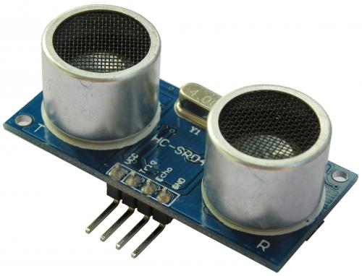
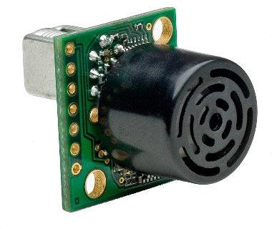
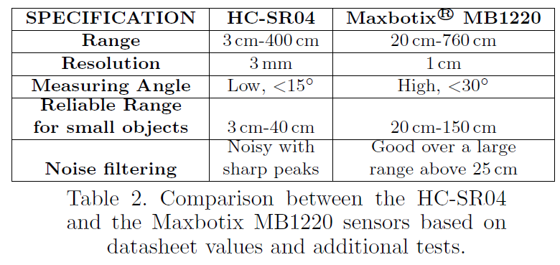
Sensors
Proximity sensors that operate using ultrasonic signals.
Selection criteria – range, response for nature of surface, noise characteristics, measuring angle.
Validated from visualizing raw-data.

Slide 6
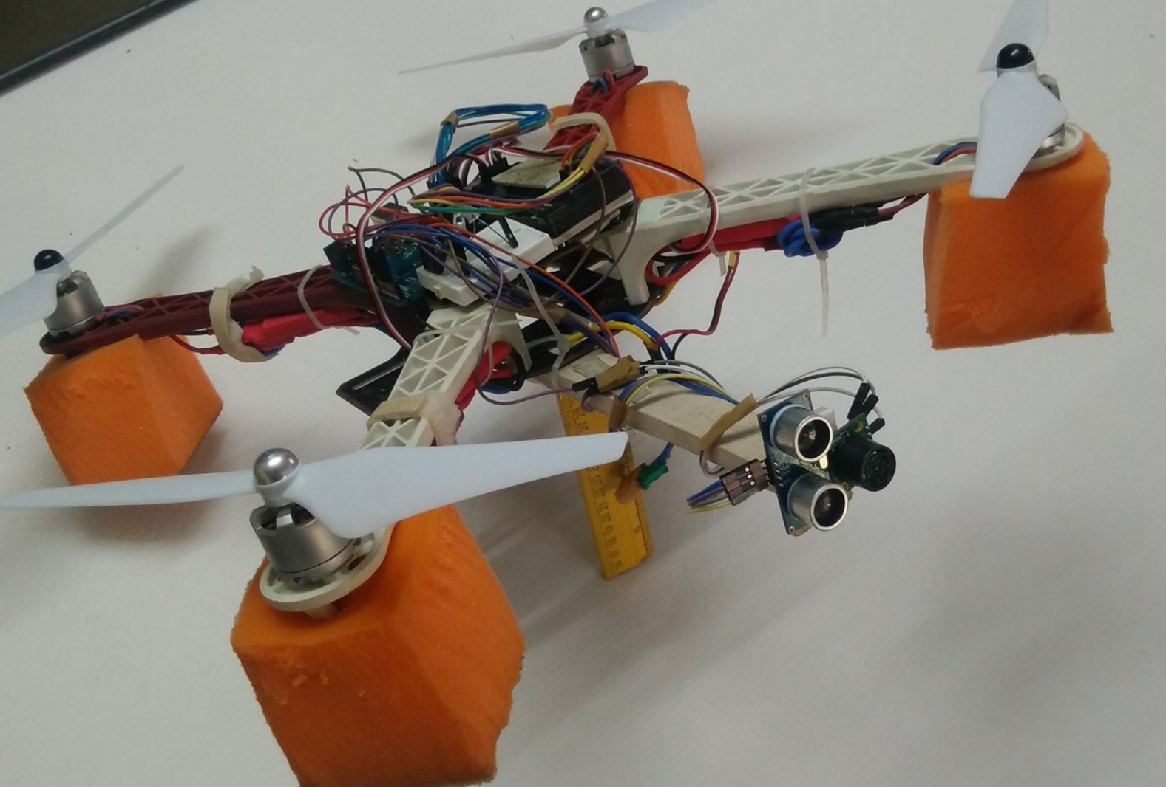
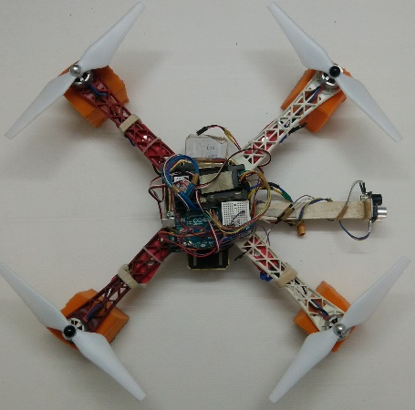
Fully-assembled system
Flight Controller
+
Companion Board
Proximity Sensors

Slide 7
Estimation: Filtering
Important to ensure a smooth and reliable stream of proximity data as the output of the filter will drive the high-level controller of the quadrotors.
Exponential Smoothening.
Digital Filter.
Noise Based (Gaussian) Filter.

Slide 8
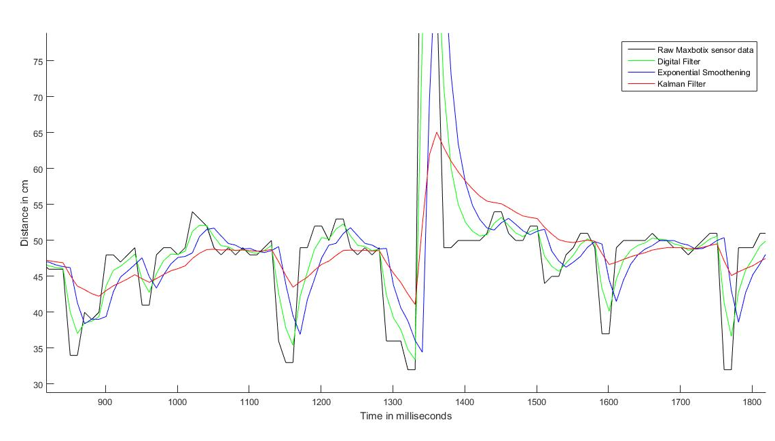
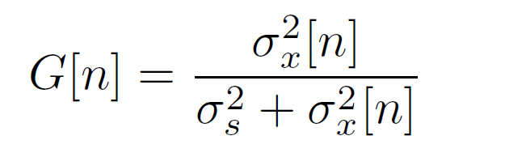

Estimation: Noise-based (Gaussian) filter

Slide 9
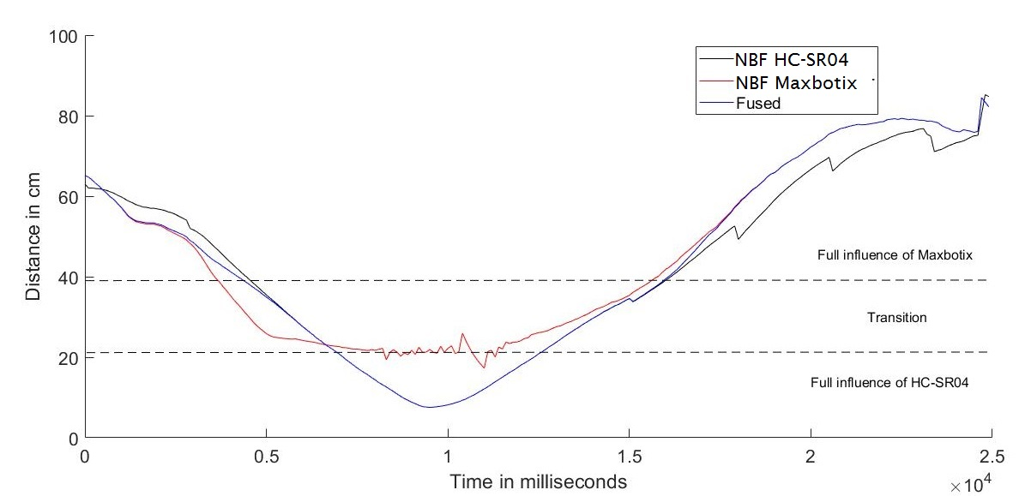
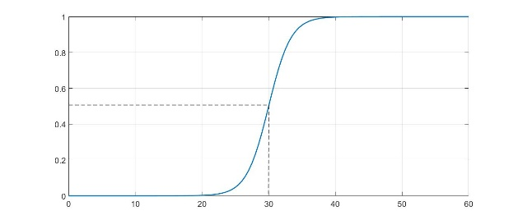

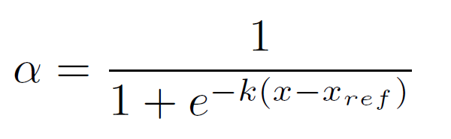
Estimation: Sensor Fusion using Sigmoid Function

Slide 10
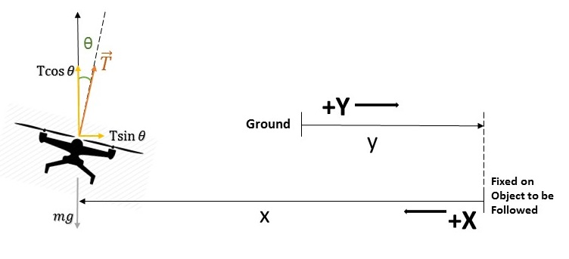
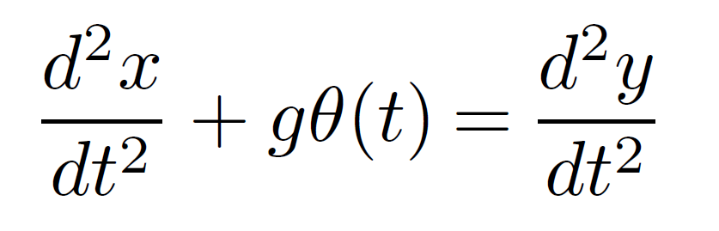
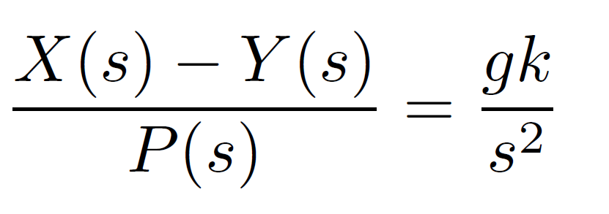
System Dynamics
Ground frame and frame fixed on moving object
Balancing the force in the vertical and horizontal directions
Vertical direction: Static

Slide 11
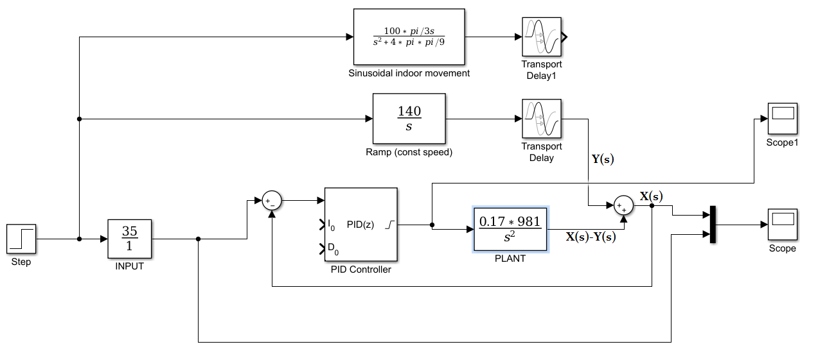
Simulink Model of Closed-Loop Dynamics
Objective: To estimate the PID gains required to perform successful trajectory tracking

Slide 12
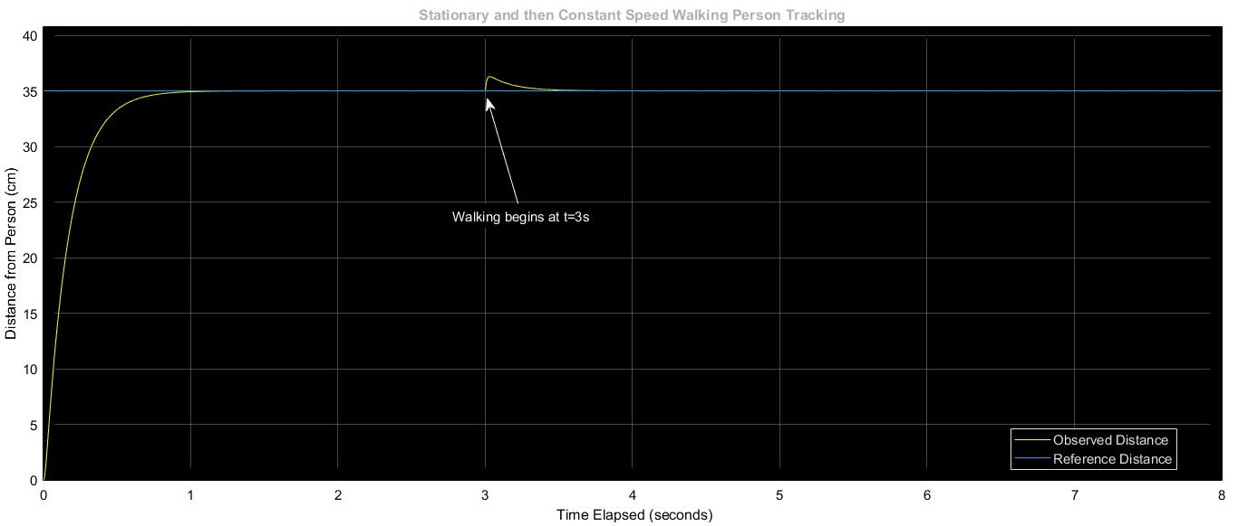
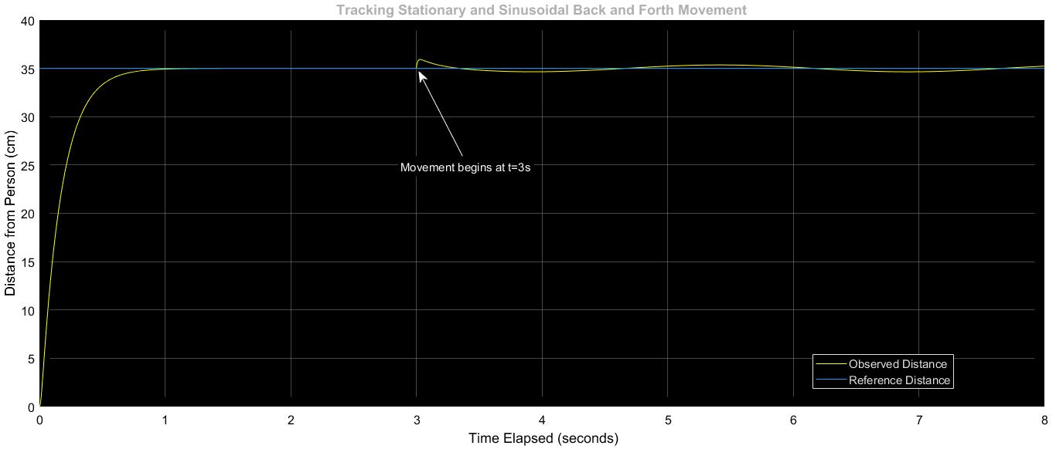
Simulation Results
Linear Movement
Sinusoidal Movement
Simulation of the PID Controller on MATLAB: Shows errors of less than 3 cm.

Slide 13
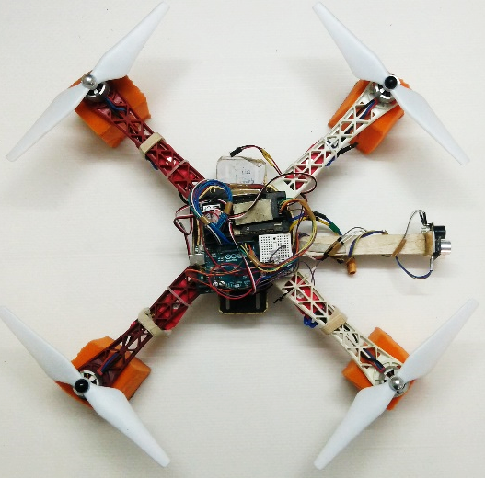
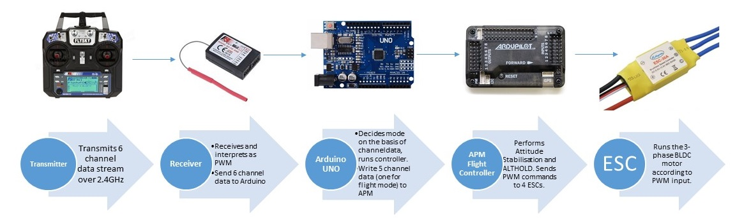
Hardware Implementation

Slide 14
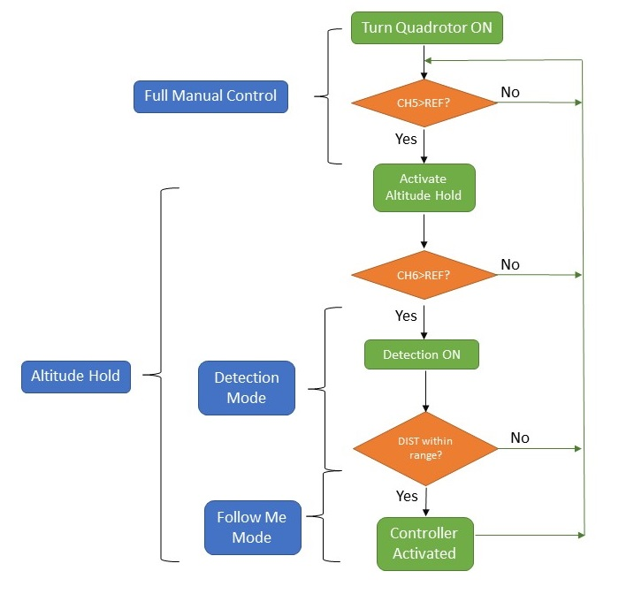
Algorithm Flow Chart (implemented on the companion board-Arduino)
Three Modes:
Manual
Alt Hold
“Follow Me”
Control law for Pitch Reference input signal that would translate the quadrotor.

Slide 15
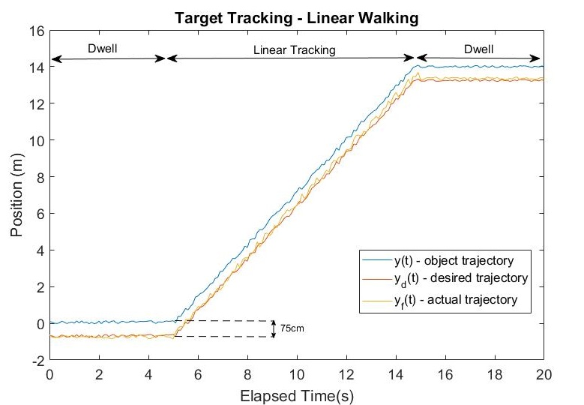
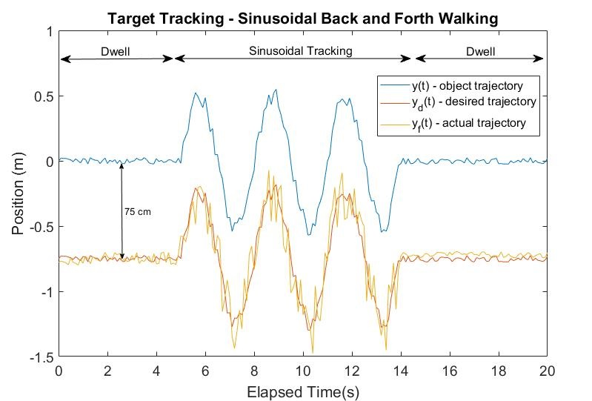
Results
Errors of the order of 20cm. However, tracking is performed successfully for the intended application.

Slide 16
Conclusion
Cheap (developed under $150) and effective method to detect and track moving references in space using ultrasonic sensors. Such systems can be used for localization and tracking applications.
Limitation 1: The sensor readings were affected by the pitch angle because of the fixed mounting
Limitation 2 : Interference between the sensors added to noise

Slide 17
Thank you
Questions?

