Slide 1
Perfetto Trace Analysis: Performance Investigation
Analysis of PerfettoTraceForRecruitment.pftrace
Focus on YouTube Application Performance

Slide 2
Introduction & Trace Context
Purpose: Analyzing PerfettoTraceForRecruitment.pftrace to understand system and YouTube app performance on an Android device.
Approach: Acting as performance detectives using CPU data as our primary clues.
Key System Specs:
- Device: Cuttlefish (Default)
- Android Version: 35.0
- RAM: 16GB LPDDR5 (Samsung - Example from Guide)
- CPU: 8 cores (e.g., 4x silver @ 1.8GHz, 4x gold @ 2.4GHz - Example from Guide)

Slide 3
Workload Identification & Focus
Main Activity Focus: com.google.android.youtube
Rationale: This analysis centers on the YouTube application as a significant workload within the trace, allowing for targeted performance investigation.

Slide 4
High-Level Performance Insights (CPU Clues)
Overall CPU Activity: YouTube (com.google.android.youtube) is a primary CPU consumer.
Key Processes/Threads: Significant activity observed in YouTube threads, surfaceflinger, and media services.
Initial Observations/Concerns from CPU Data:
- High Runnable Times: Several YouTube threads (e.g., ExoPlayer, Binder, CodecLooper) spend considerable time waiting for CPU.
- Core Placement: Critical YouTube threads observed running on LITTLE cores, potentially impacting performance.
- Frequent Short Runs: Patterns in some YouTube threads suggest potential I/O or lock contention (requires further investigation with specific trace flags).
- No Long Main Thread Tasks (>16ms) were found for YouTube in this trace, which is a positive sign for UI responsiveness in that specific regard.

Slide 5
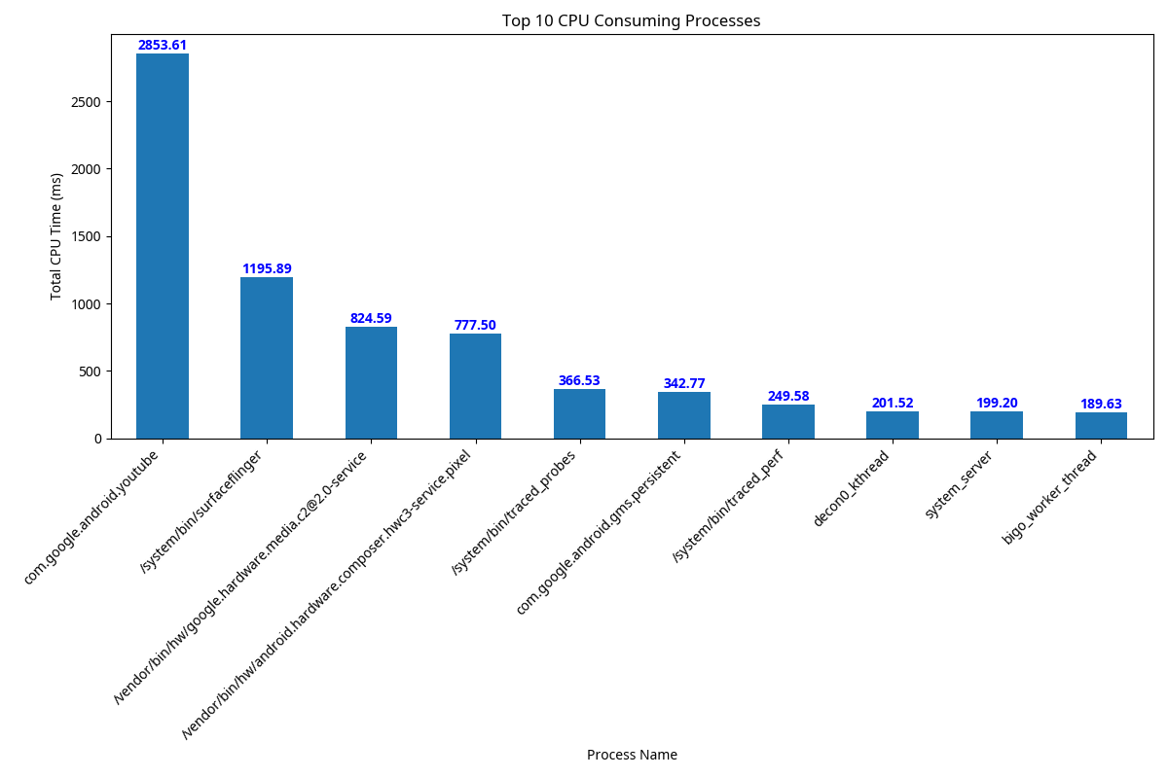
Top CPU Consuming Processes
This chart shows the top CPU consuming processes during the trace.
com.google.android.youtube is a significant consumer, as expected during its active use.

Slide 6
Deeper Dive: SQL for Interrogating CPU Data
SQL in Perfetto: Allows precise interrogation of trace data, like a detective questioning a witness, to extract specific evidence about CPU behavior.
Example Use Cases (as per guide & findings):
1. YouTube Thread CPU Time & States:
- Purpose: Quantify how YouTube threads use CPU and identify struggles (e.g., high 'runnable' time).
- Insight: Revealed multiple YouTube threads (ExoPlayer, CodecLooper, Binder) with high runnable ratios, indicating CPU contention.
2. Long CPU Tasks on YouTube's Main Thread (Conceptual - as none were found in this trace >16ms):
- Purpose: Find long-duration CPU-bound tasks on the main thread, prime suspects for UI unresponsiveness.
- Insight (if found): Would identify specific tasks causing jank.
Full schema is available for even deeper investigations.

Slide 7
Key Anomaly 1: High Runnable Time (CPU Contention)
Observation: Multiple YouTube threads show high runnable ratios (time spent waiting for CPU).
- Thread: ExoPlayer:Playb
- Thread: BG Thread #3
- Thread: binder:23019_4
- Thread: CodecLooper
- Thread: CodecLooper
Hypothesis: CPU contention from other threads/processes, or incorrect thread priority.
Impact: Potential sluggishness, jank, and reduced responsiveness in the YouTube app.
How-to: Analyze scheduling data for competing threads; review thread priorities.

Slide 8
Key Anomaly 2: Suboptimal Core Placement
Observation: Critical YouTube threads spent ~29% of CPU time on assumed LITTLE cores.
- Critical YouTube threads spent 29.19% of their CPU time on assumed LITTLE cores (4.76 ms out of 16.32 ms).
- Running critical tasks on LITTLE cores can lead to slower performance and jank, especially if BIG cores were available.
Hypothesis: Scheduler not optimally placing critical threads on performance (BIG) cores.
Impact: Slower performance for critical operations, potential jank.
How-to: Investigate performance hints; analyze what runs on BIG cores concurrently.

Slide 9
Key Anomaly 3: Frequent Short Runs (Potential I/O/Lock Waits)
Observation: Numerous YouTube threads (e.g., ExoPlayer, CodecLooper, ChromiumNet, Binder) show frequent short CPU runs.
- Process: com.google.android.youtube, Thread: BG Thread #3 - Short Run Count: 172
- Process: com.google.android.youtube, Thread: ChromiumNet - Short Run Count: 179
- Process: com.google.android.youtube, Thread: CodecLooper - Short Run Count: 546
- Process: com.google.android.youtube, Thread: ExoPlayer:Playb - Short Run Count: 2291
Hypothesis: Pattern *might* indicate waiting for I/O (network, disk) or lock contention.
Impact: If on critical path, can lead to delays and reduced throughput.
How-to: Requires new trace with I/O and lock contention events to confirm.

Slide 10
Data Limitations & Guiding Further Investigation
Acknowledged Limitations (based on current trace & guide examples):
- No explicit perf_samples_skipped in this trace (positive), but a general concern if present.
- Potentially missing: detailed function call stacks, direct I/O metrics, memory metrics (if not enabled).
Reframe as Strength: CPU-level clues are invaluable for targeted next steps.
Example: High runnable times point to CPU contention; core placement issues suggest scheduler interaction analysis.
Example: Frequent short runs + sleeps strongly suggest I/O or lock issues, guiding need for specific trace flags (e.g., ftrace with disk, sync, lock categories).
Impact: CPU-first analysis efficiently narrows down problem areas, making subsequent deep dives more productive.

Slide 11
Actionable Insights & Optimization Strategies
1. Address CPU Contention (High Runnable Times):
- How-to: Analyze competing threads, adjust priorities, defer background work.
- Next Step (Trace): Deeper sched_slice analysis, correlate with CPU freq/idle.
2. Investigate Core Placement:
- How-to: Explore PerformanceHintManager, analyze concurrent BIG core usage.
- Next Step (Trace): Correlate with CPU freq/idle; examine what runs on BIG cores.
3. Confirm & Optimize Potential I/O or Lock Waits (Frequent Short Runs):
- How-to: If confirmed, batch I/O, use caching, optimize network, reduce lock contention.
- Next Step (Trace): CRITICAL - Capture new trace with I/O (disk, sync, ext4, network) and lock events.
4. General (If Long Main Thread Tasks Were Found - N/A for this trace but good practice):
- How-to: Profile with call stacks, move work off main thread, simplify rendering.
- Next Step (Trace): Enable call stack sampling (e.g., gfx, view, input, sched, freq, dalvik).

Slide 12
Conclusion & Recommendations
Recap of Main Findings (CPU Detective Work):
- YouTube performance is impacted by CPU contention (high runnable times for key threads).
- Suboptimal core placement for critical YouTube threads was observed.
- Patterns suggestive of I/O or lock contention exist and need confirmation.
Recommendations for Next Steps:
1. Prioritize a new Perfetto trace with enhanced configurations:
- Enable I/O event tracing (ftrace: disk, sync, ext4, network).
- Enable lock contention event tracing (ftrace: lock).
- Ensure CPU frequency and idle state tracing is active.
- Consider call stack sampling if specific CPU-bound functions need identification in future.
2. Focus investigation on periods/threads highlighted by CPU data anomalies.
3. Systematically address the hypotheses: CPU contention, core placement, and I/O/lock waits.

Slide 13
Q&A / Appendix

