Slide 1


Slide 2
Transportation Network Companies Lyft and Uber
Submitted by –
Hiu Lam Mak
Maohua Xie
Mithun Phadnis
Varun Vohra

Slide 3
Introduction
Database for two major Taxi Companies Uber and Lyft
Found in San Francisco, California
Uber is an international company and Lyft operates in more than 200 U.S cities
Cater to commuting requirements

Slide 4
Objective
Provide insights/suggestions to help improve the market value of Uber and Lyft
Comparison of using either Lyft or Uber for different locations

Slide 5
Questions addressed
Which states are the busiest?
Preference of Uber or Lyft for different states
Number of Male and Female drivers for both companies
Price variation for different hours of the day

Slide 6
Data
Data created manually
Data comprises of eight tables
Tables
Driver – Driver Information
Passenger – Passenger Information
Car Info - Types of Cars and their Information
Rating – Ratings for Passengers and Drivers

Slide 7
Tables Contd.
Zone – Division of states based on traffic density
Pricing Information – Rates for different hours of day and type of cars
Booking Information – Trip Information (Pick Up and Drop Location)
Ride History - Information about completed rides

Slide 8
Difficulties Faced
Frequent change in Business Requirements
Maintaining Referential Integrity
Normalizing the Data

Slide 9
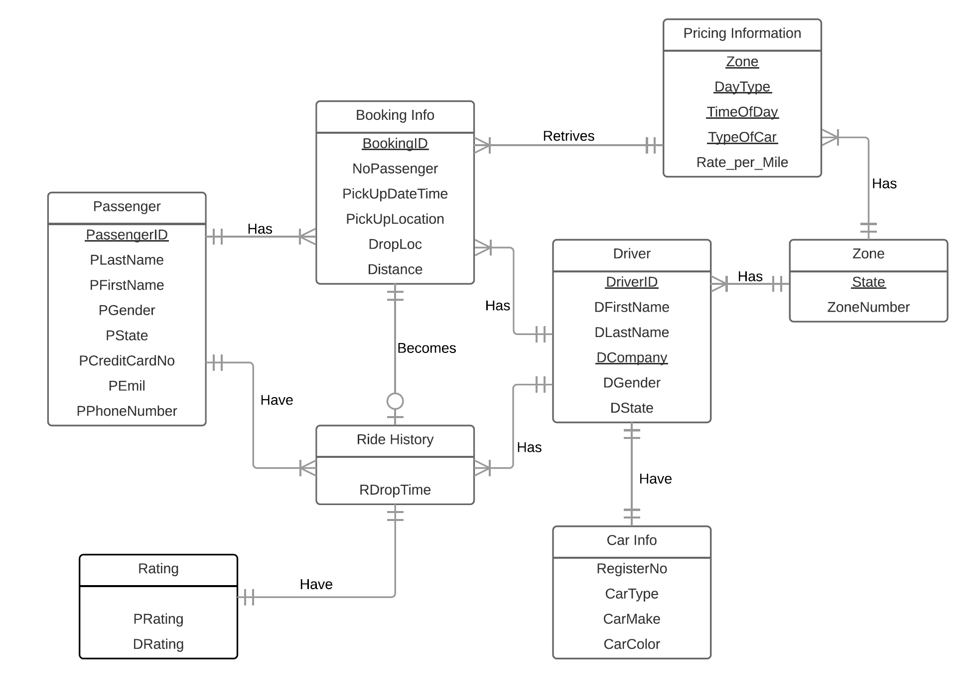
Entity Relationship Diagram

Slide 10
Context Diagram

Slide 11
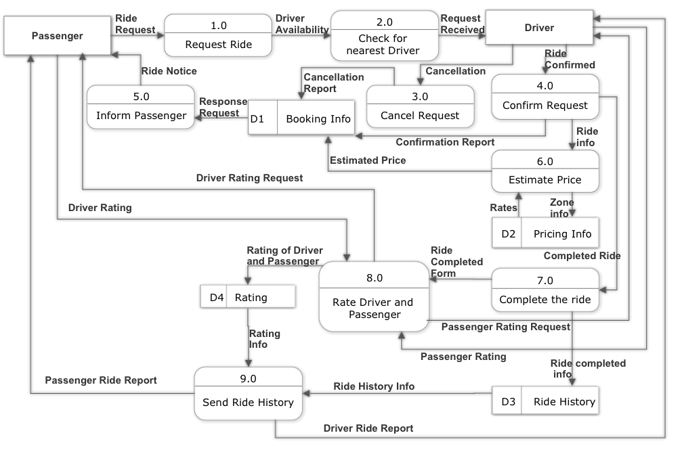
Data Flow Diagram Level 0

Slide 12
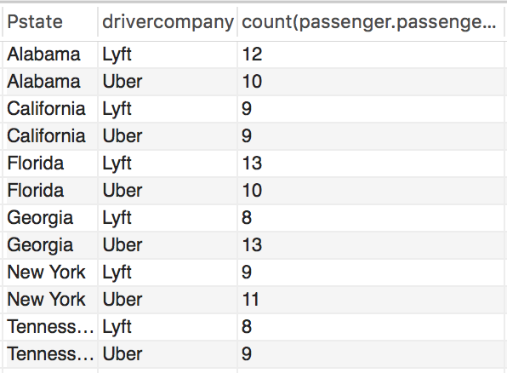
What is the passenger preference (Uber or Lyft)?
select Passenger.Pstate, Driver.Drivercompany, count({Passenger.PassengerID)
from Passenger, Driver, Ridehistory
where Driver.DriverID = Ridehistory.DriverID and
Passenger.PassengerID = RideHistory.PassengerID
group by Passenger.Pstate, Driver.Drivercompany

Slide 13
Which drivers has the rating that lower than 3?
Select Distinct Driver.DriverID,Driver.Driverfirstname,
Driver.Driverlastname, Rating.Drating
from Driver, Bookinginformation, Rating
where Driver.driverID = Bookinginformation.DriverID and
Bookinginformation.BookingID = Rating.BookingID and
Rating.DRating <= 3
order by Rating.DRating

Slide 14




