Slide 1
Solvati Sprint
Team King Cobras
Mukhar Gupta
Jaya Krishna
Akhila Puthengot
Faariya Sheikh
Varun Vohra
Zhongying Xiao

Slide 2
Objective
Clean the dataset and reduce numbers of variables;
Fit the cleaned dataset into several models, including Linear Regression, Logistic Regression, Decision Tree, etc.
Optimize each model to improve prediction power and Compare their error rate.

Slide 3
Data Cleaning
Choose Y-variable
Download Time
Reduce the number of X variables
Delete variables with more than 50% null value
Delete variables with low Entropy
Delete the variables with low symmetrical uncertainty
Delete abnormal Outliers
Tukey’s Method

Slide 4
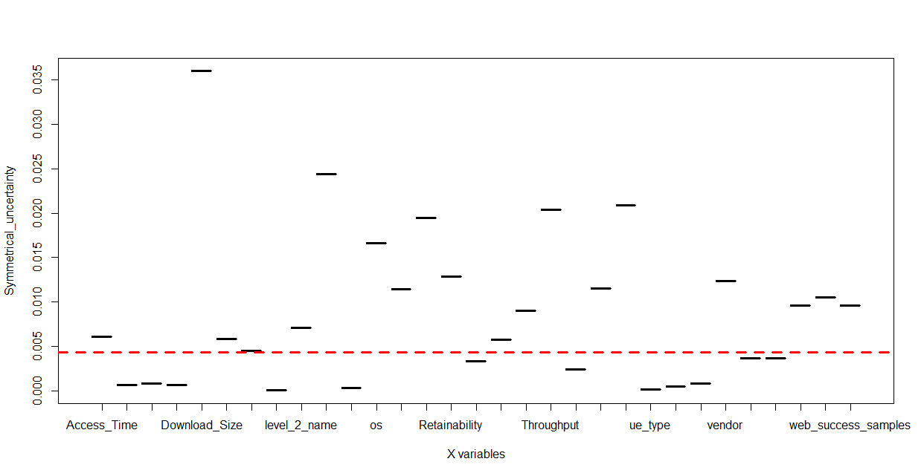
Data Cleaning(CONT.)
Only 20 X variables are survived!
Delete X variables with low symmetrical uncertainty

Slide 5
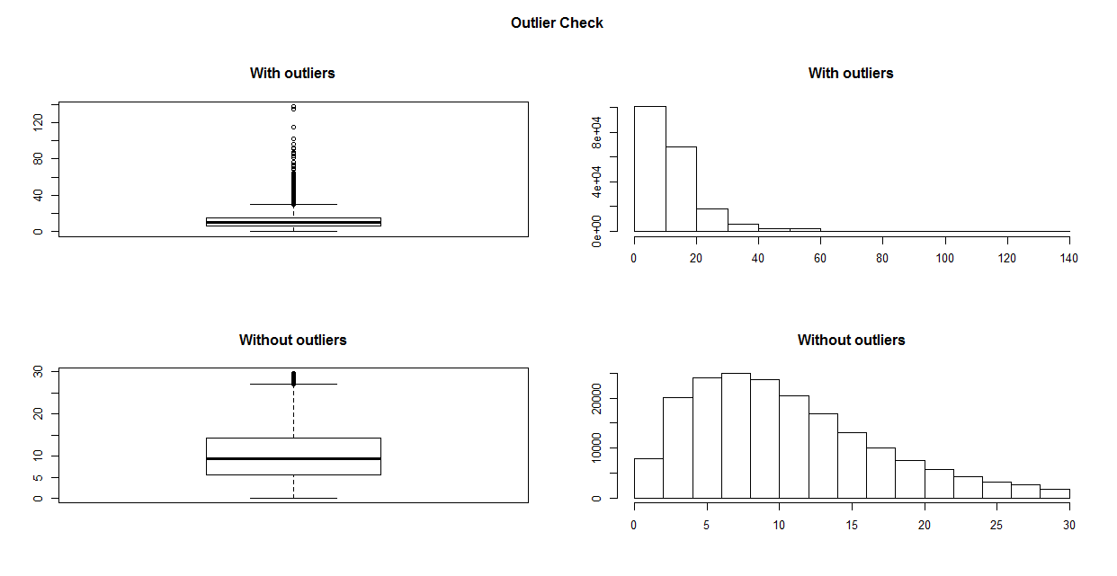
Data Cleaning(CONT.)
Residual standard error
7.879
5.302
Download_Time

Slide 6
Linear Regression
Target Feature : Download Time
Output clustered to three categories : Excellent, Good, and Bad
Used 60 % as Training Data and tested in the rest .
Mean Error : 48.6%

Slide 7
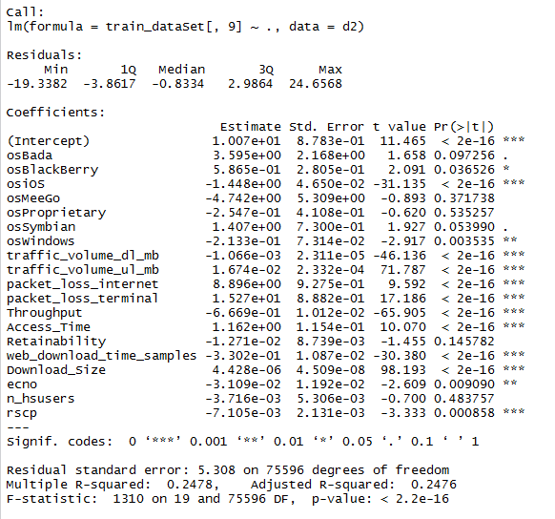
Linear Regression (CONT.)

Slide 8
Logistic Regression
Chosen Y-variable
Download Time
Remove first 3 columns: “level_2_name” , “vendor” , “model”
Found mean of Y-variable column and divided into two types
>mean = “1”
<mean = “0”
Training data: 60%; Testing data: 40%
Logistic Regression (glm) on training data set
mean error percentage: 31%
Notes:
Remove 3 columns – categorical data, has multiple levels (unique values)

Slide 9
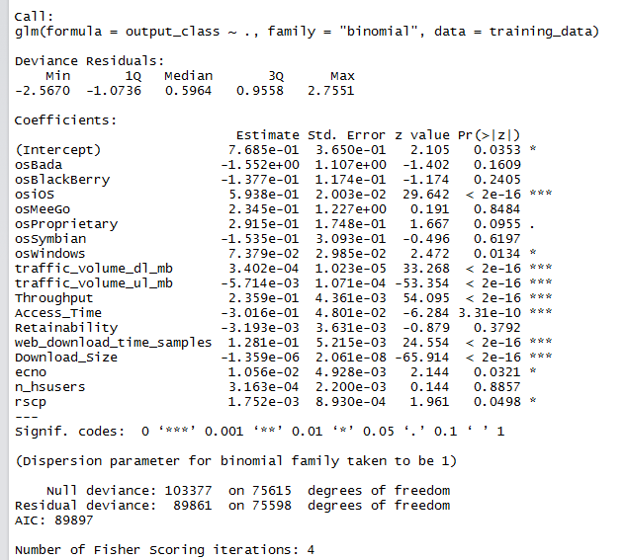
Logistic Regression (CONT.)

Slide 10
Decision Tree 1
Choose Y-variable
Download Time
Discretize Function
Cluster Method
3 Categories : Excellent, Good and Bad

Slide 11
Decision Tree 1 (CONT.)
Decision Tree
Quinlan's C5.0 algorithm
Data Segregation
Train Data : 60%
Test Data : 40%
Mean Error Percentage: 44.99458%

Slide 12

Download Speed = $\frac{\text{Download} \text{Size}}{\text{Download} \text{Time}}$
Construct a Decision tree for a different and derived attribute - Download Speed.
The Download Speed column is added to the cleaned file.
The download speed is divided into three categories – Excellent, Good and Bad.
The Download Time and Download Size columns are deleted as they have been used to determine the Download Speed.
The data is separated into Train and Test Data. 60% for training and the rest is used as Test data.

Slide 13
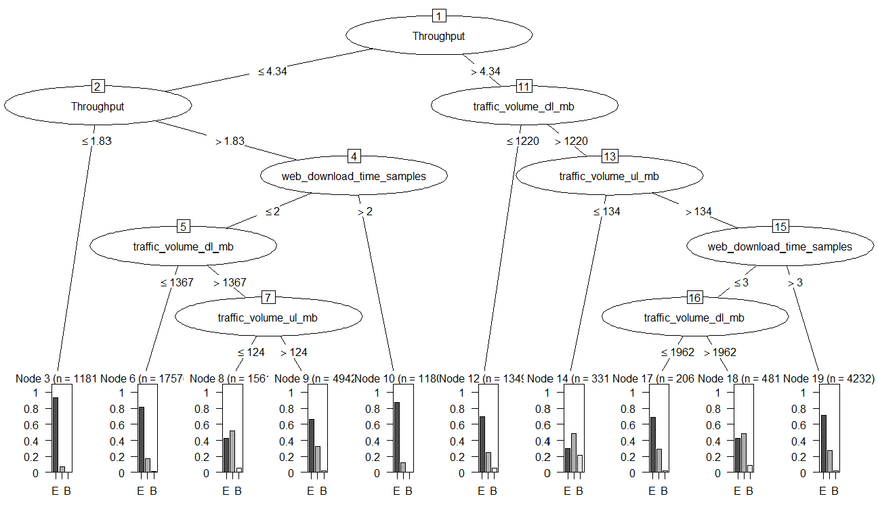
The Decision tree is plotted for the training Data

Slide 14
After plotting the decision tree for the training data, the decision tree is used to predict the values of the test data.
After calculating the values for the test data, it is compared to the true values from the decision tree plotted for the whole data set.
The mean error is calculated
Mean Error ≈ 24%

Slide 15
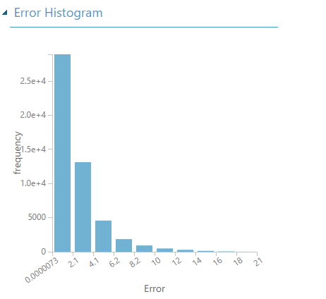
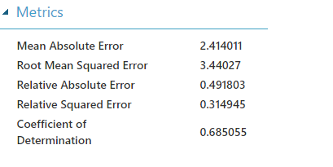
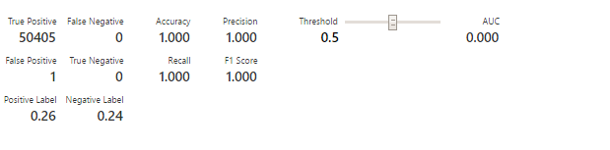
Poisson Regression
Two vector Logistic Regression

Slide 16
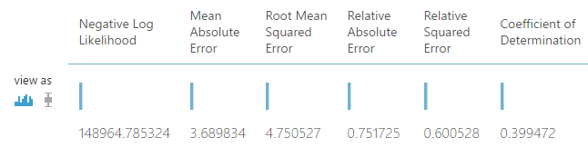
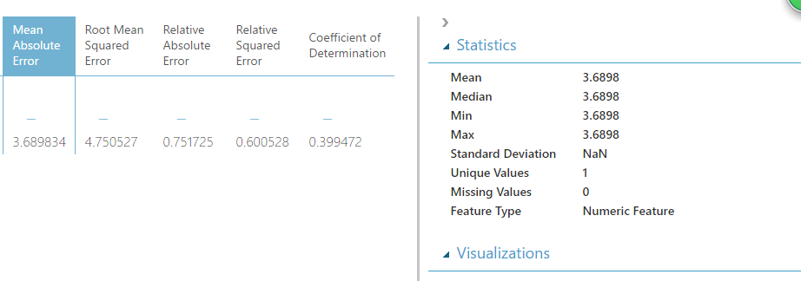
Decision Forest Regression

Slide 17
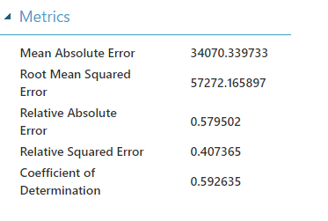
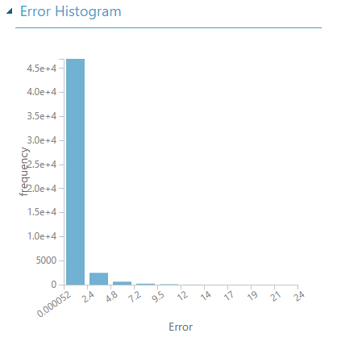
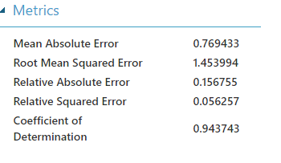
Linear Regression
Neural Network Regression

Slide 18
Special Thank You to:
Khalid Hamied
Taj Pirzada

