Slide 1

HANGMAN GAME
001

Slide 2
TEAM MEMBER
001
002
003
004
005
006
VARUN
NEHA SHETTY S
MANSI SHEKAR
LIKITHA A
KEERTHI J
LAHARI

Slide 3
INTODUCTION
Hangman is a classic word-guessing game where the player tries to guess a secret word one letter at a time.
This Python implementation of Hangman uses the concept of file handling, random word selection, and interactive user inputs.

Slide 4
Program Flow
• The game loads a list of words from the words.txt file.
• A random word is selected from the list.
• The player is given a certain number of chances (8 by default) to guess the secret word, one letter at a time.
• After each guess, the program provides feedback:
• If the guessed letter is in the secret word, the game displays the current progress (showing correctly guessed letters and underscores for remaining ones).
• If the guessed letter is incorrect, the number of remaining guesses decreases.
• The game ends when the player guesses the entire word or runs out of guesses.

Slide 5
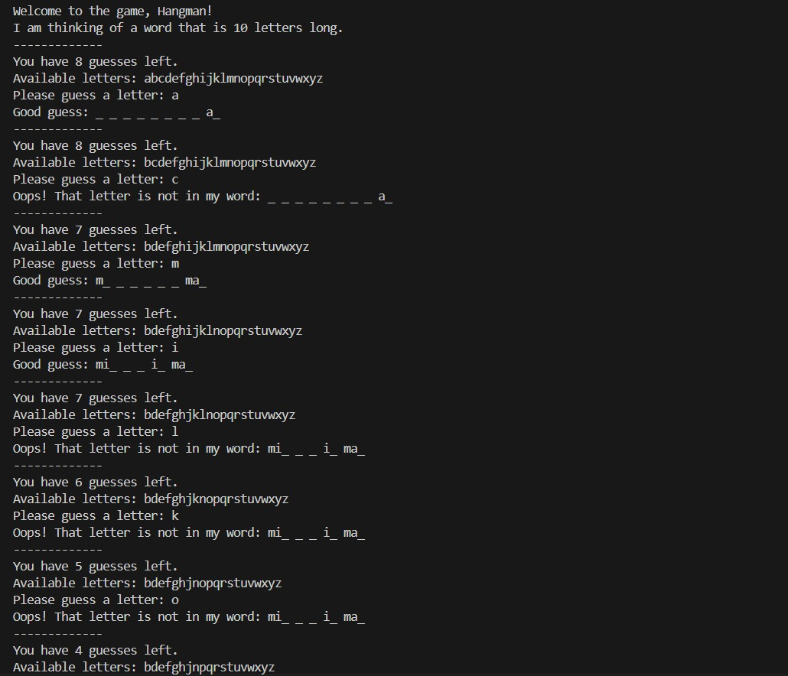
ORDER OF GAMES
START
01
02
03
WALK AND STOP
COOKIE GAME
PULL THE ROPE
Despite being red, Mars is actually a cold place
Venus is the second planet from the Sun
Jupiter is the biggest planet of them all

Slide 6
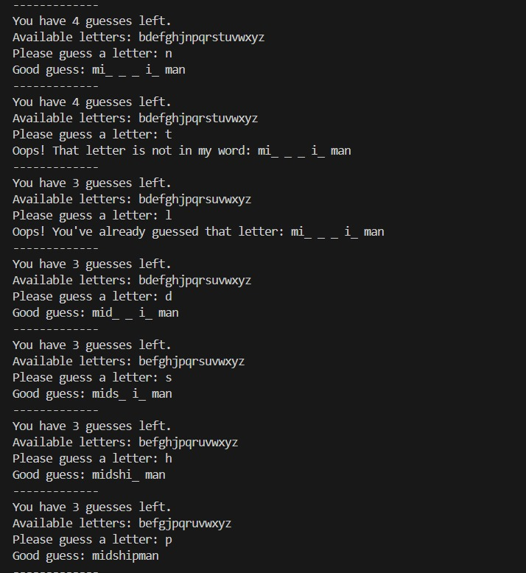
ORDER OF GAMES
U WIN
04
05
06
GAMES OF MARBLES
CRISTAL WALKWAY
CALAMARI GAME
Despite being red, Mars is actually a cold place
Venus is the second planet from the Sun
Jupiter is the biggest planet of them all

Slide 7
Thanks!
002

