Slide 1

Higher School of Economy
Online
2026
Social Network Analysis
«Predicting friend connections based on shared game libraries on Steam using a homophily graph»
Reimikh Antoniy
Su Xinyi Yu Xinhe

Slide 2
Introduction
1
Project Roadmap

Slide 3
Introduction
2
Description
Massive gaming communities exhibit hidden friendship formation mechanics Steam’s player–game graph encodes social affinity via shared games (homophily).
Core analysis: we build a player–player projection (Jaccard similarity), predict friendships from game overlap, and validate against real friend lists.
Goal is to Identify “bridge players” across genres and blend graph structure with playtime data, linking social networks, mining, and recommender systems.

Slide 4
Data Collection
3
Data Collection and Graph Construction
With Steam Web Api we collected data about Steam players and games that they are playing (steamIds, appid, game_name, playtime_forever).
17,682 nodes (500 steam users and 17,182 games).
Game Edges:
184538 weighted edges between steam users and games. Weighted edges represent total playtime (hours).
Friends Edges: 125 edges between steam users (friend pairs).

Slide 5
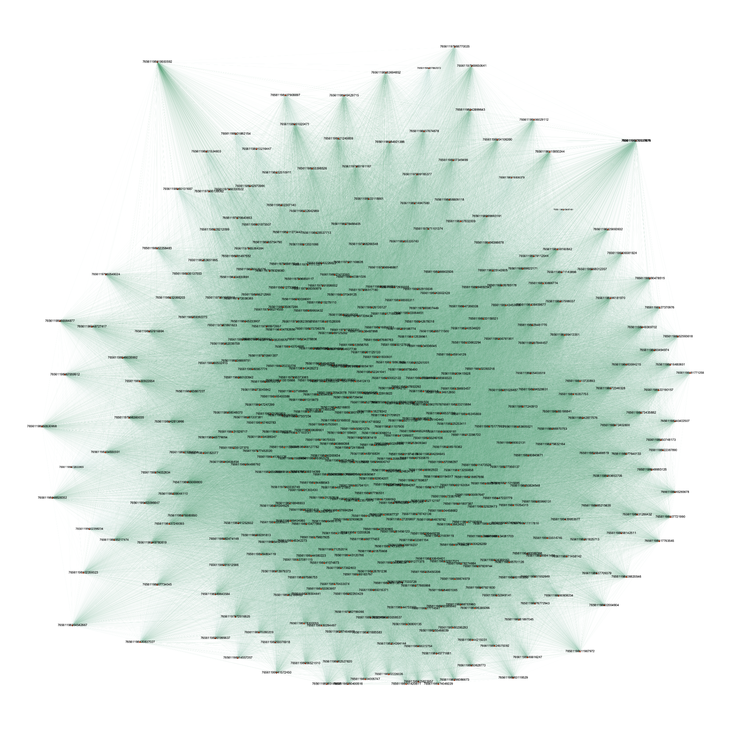
Data Collection
4
Graph
Full graph is too dense for direct visualization.
Therefore, we rely on quantitative metrics (AUC-ROC, feature importance) to evaluate performance.

Slide 6
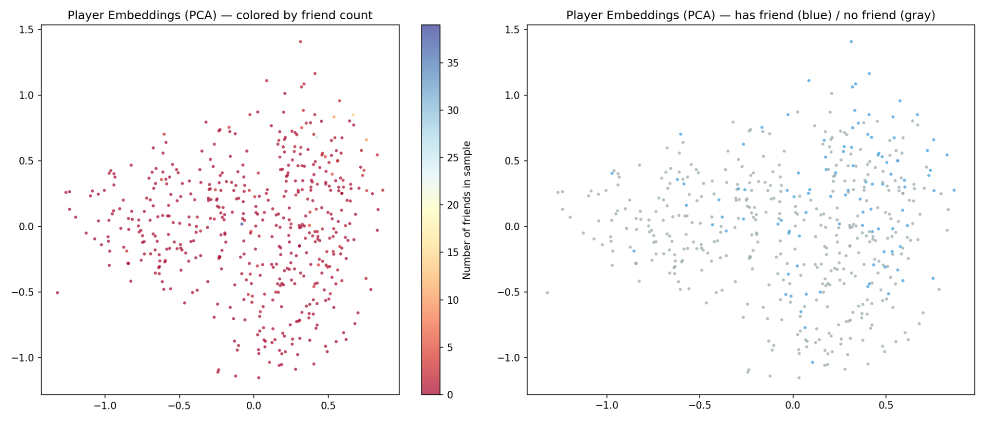
Feature Engineering
5
Player Embeddings
No clear clustering — friendship depends not just on gaming profile similarity, but on social graph structure. This motivates graph-based methods (GAE) and structural heuristics.

Slide 7
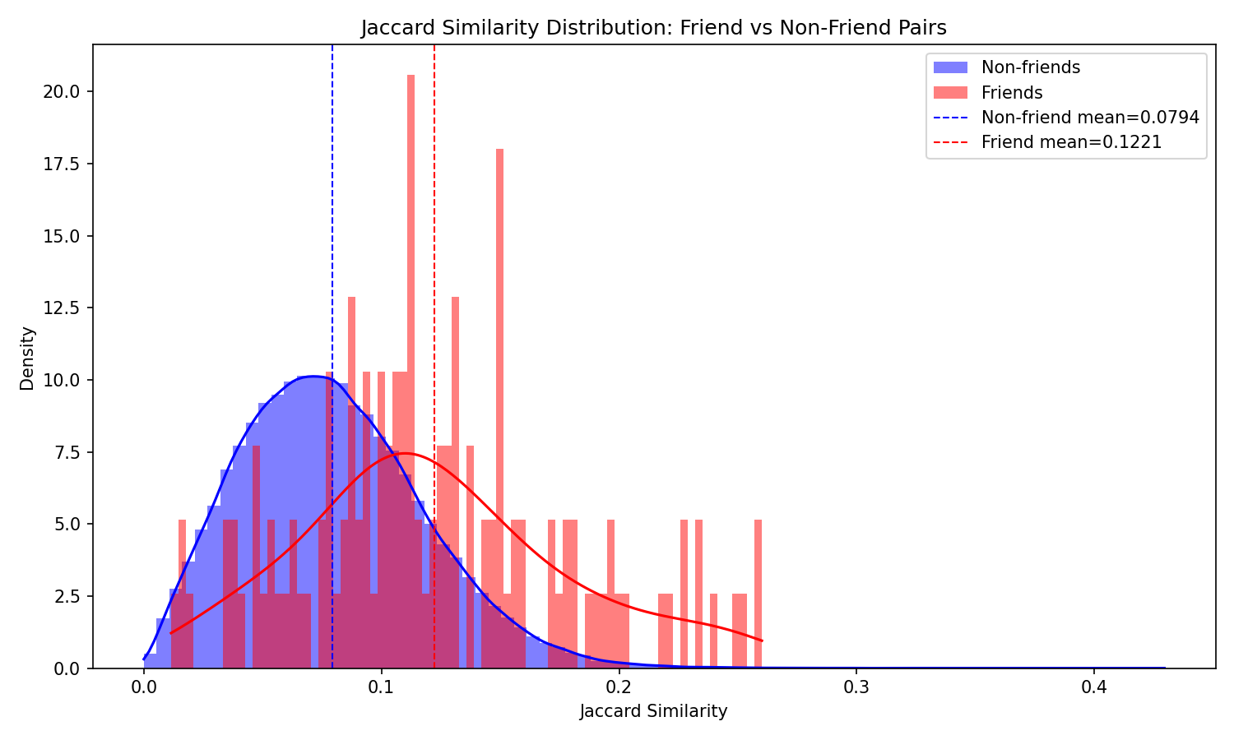
Analysis of Homophily
6
Jaccard Similarity
Jaccard similarity does not meaningfully distinguish friends from non-friends — distributions almost completely overlap.

Slide 8
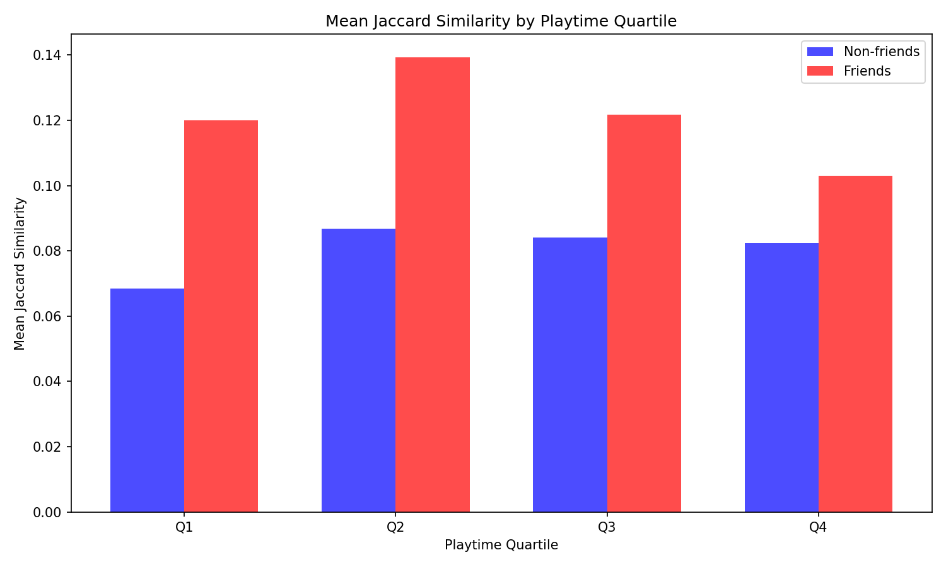
Analysis of Homophily
7
Playtime Quartile
Homophily peaks among moderately active players (Q2–Q3) and nearly disappears among high-playtime users (Q4), who share games broadly regardless of friendship

Slide 9
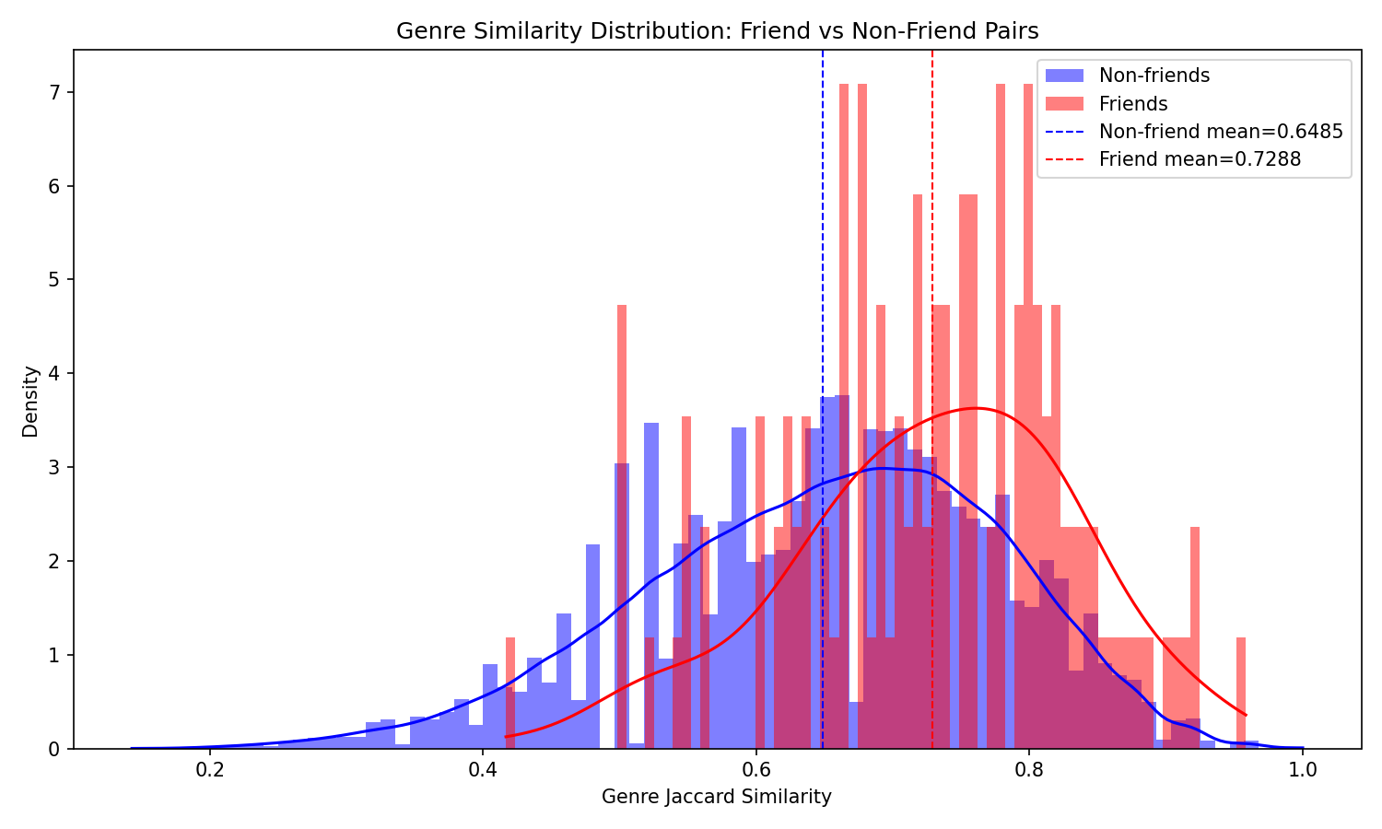
Analysis of Homophily
8
Genre Similarity
Friends have higher genre similarity than non-friends, but like Jaccard, the distributions overlap substantially — genre alone is not sufficient for prediction.

Slide 10
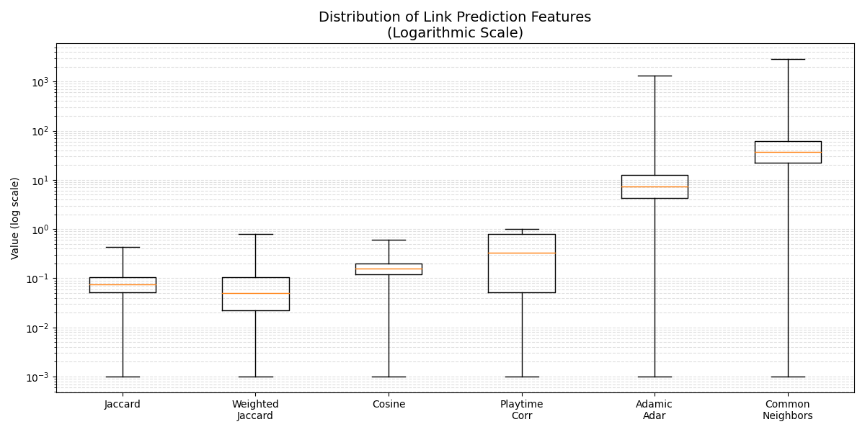
Link Prediction
9
Link Prediction features
Common neighbors has the longest tail on log scale due to possible popular neighbors (like streamers). Using Adamic-Adar better balances tail length with neighbor rarity.

Slide 11
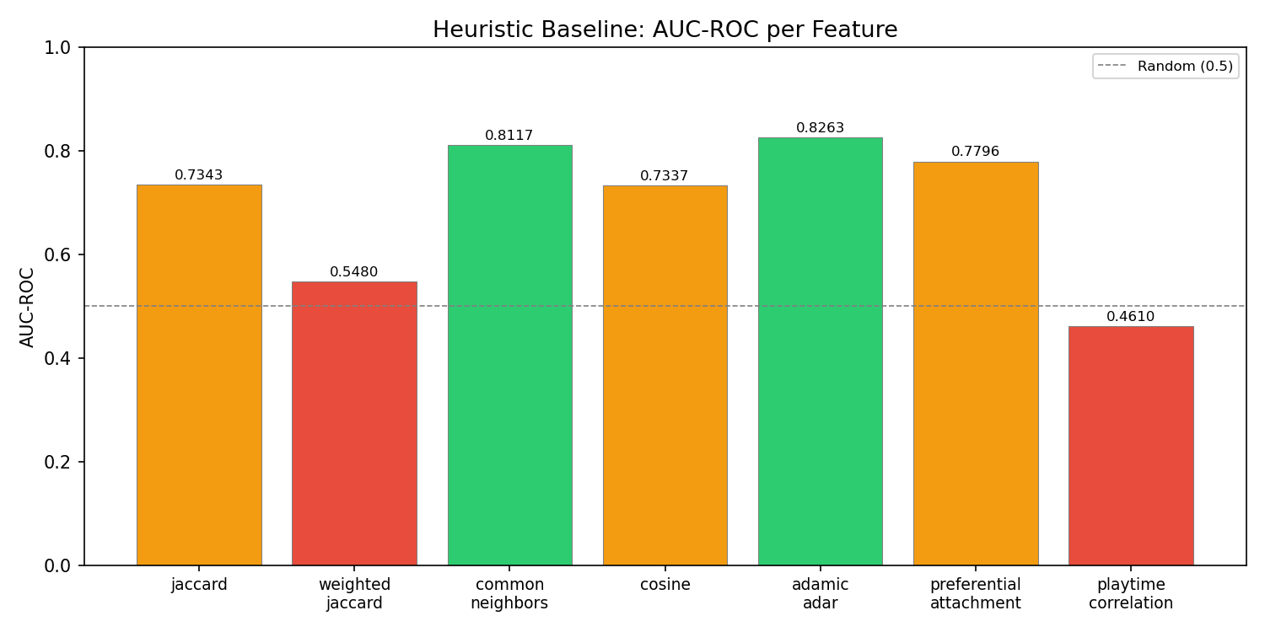
Link Prediction
10
Heuristic Baseline
Adamic-Adar and Common Neighbors achieve the highest AUC-ROC (~0.82), indicating strong ranking performance for link prediction.

Slide 12
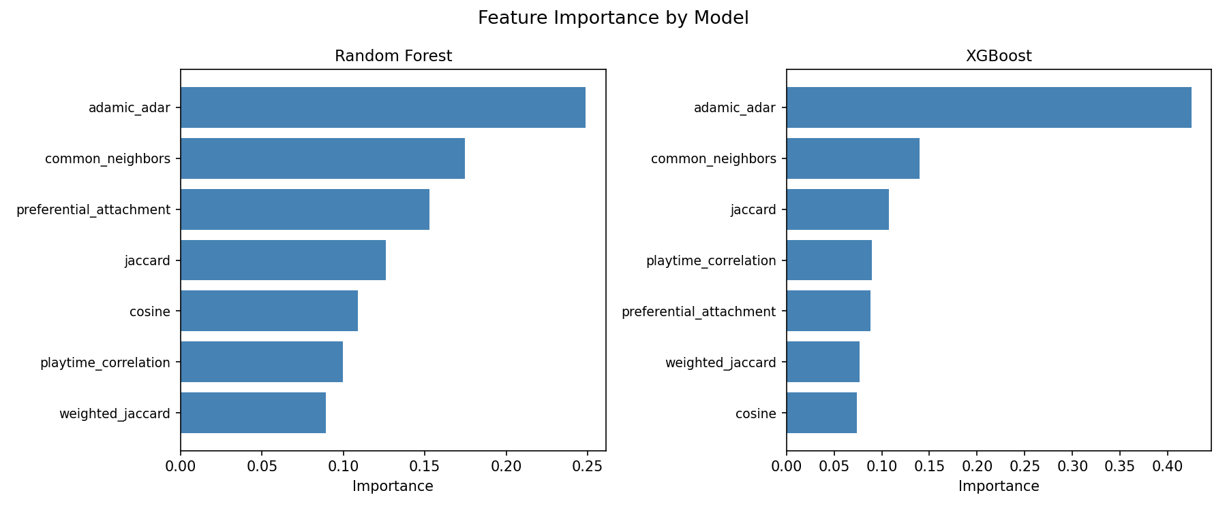
Link Prediction
11
Feature Importance
Adamic-Adar dominates feature importance, indicating that rare shared neighbors are the strongest predictor of friendship.

Slide 13
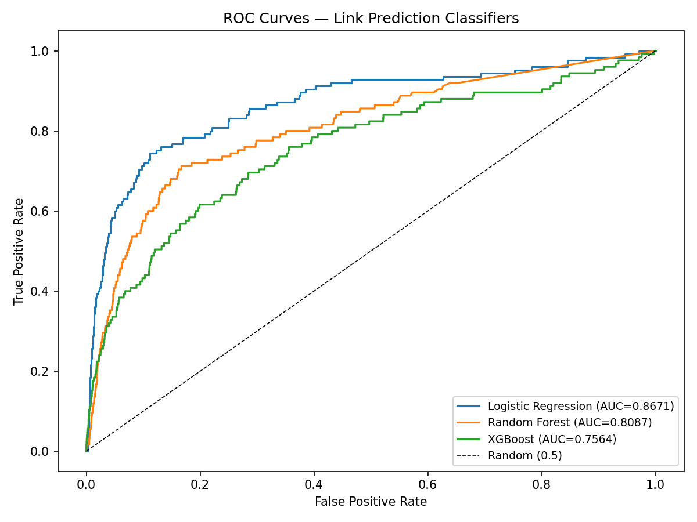
Link Prediction
12
ROC Curves
Logistic Regression achieved the best AUC.
Our features exhibit a largely linear structure.
XGBoost and Random Forest likely overfit due to extreme class imbalance.
Tree-based models struggle with rare positive class — they tend to create overly specific rules for the minority class, which don't generalize.

Slide 14
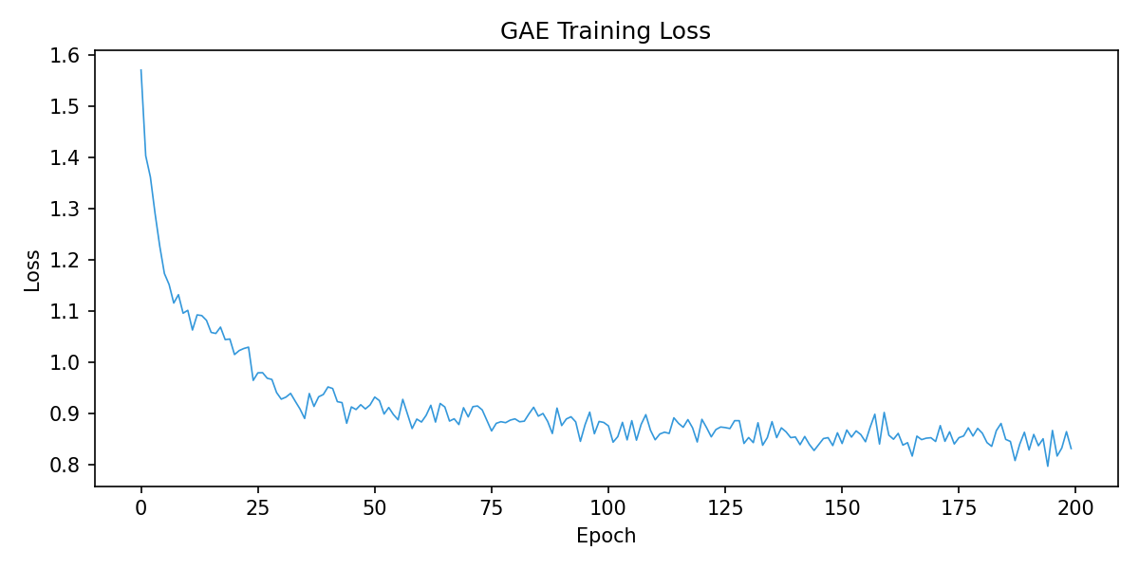
Link Prediction
13
GAE
The model learns quickly during the first ~35 epochs, then gradually fine-tunes with minor fluctuations, reaching ~0.85 by epoch 200. Stable convergence indicates successful training. Unlike previous methods that use hand-crafted features, GAE learns node embeddings directly from the graph structure via a Graph Convolutional Network (GCN) encoder and a dot-product decoder. The GAE dramatically outperforms all other methods, achieving 0.9664 AUC-ROC and 0.9269 AUC-PR .

Slide 15
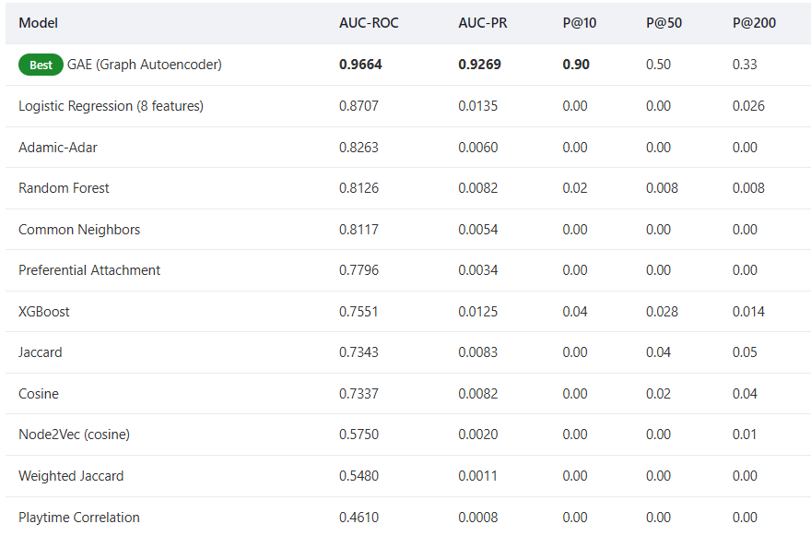
Link Prediction
14
Comparison
Graph Autoencoder is absolute leader and only model with meaningful top-K precision.
Logistic Regression ranks fails at top-K due to extreme class imbalance.
Node2Vec alone is weak.

Slide 16
Bridge Players
15
Max entropy: 2.36
Cross-genre friendships are rare.
Most friendships stay within genre clusters.
Bridge players connect friend groups with distinct genre preferences.
SteamID (suffix) | Genre Entropy | Genres | Games Owned
76561198214557257 | 2.361 | 16 | 56
76561198851552649 | 2.343 | 19 | 83
76561198093653706 | 2.342 | 18 | 127
76561198402381154 | 2.323 | 21 | 137
76561198127370976 | 2.319 | 17 | 67
Min entropy: 0.92
Player | Entropy | Friends | Clusters | Silhouette
76561198066127782 | 2.215 | 10 | 2 | 0.488
76561198069291813 | 2.143 | 3 | 2 | 0.468
2 Confirmed Cross-Genre Bridges from top 10%

Slide 17
Practical Deployment
16
Friend Recommendation & Influencer Detection
Friend Recommendation Engine
Cross-Genre Influencer Detection
Projected player graph
Jaccard + CN + AA scores
Logic:
Identify high genre entropy users (2.14–2.36)
K-Means on friends' genre vectors
Filtering:
Configurable thresholds; Common Neighbors ≥ 5; e.t.c
Validation:
Identify high genre entropy users (2.14–2.36)
K-Means on friends' genre vectors
Pruned GEXF graph
Business Value:
Community management
Cross-promotion campaigns
Influencer outreach
Gephi visualization
"Players Like You"
recommendation system

Slide 18
Practical Deployment
17
GAE-Based Prediction Service
GAE Friend Recommendation API
INPUT
ENCODING
MODEL
OUTPUT
New player
Game
Library
Node2Vec (pre-computed)
GAE (trained)
Top-K friend suggestions
Deployment Containerized API (FastAPI) Real-time inference

Slide 19
Conclusion
18
Key Takeaways
Homophily exists: Friend pairs have ~54% higher mean Jaccard game similarity (0.122 vs 0.079), confirming that shared game libraries are a meaningful signal for friendship.
Bridge players connect communities: 50 high-entropy bridge players were identified, with 2 confirmed as cross-genre connectors via ego-network clustering.
Heuristic methods cap at ~0.83 AUC-ROC: Adamic-Adar and Common Neighbors perform best among unsupervised methods but plateau well below learned approaches.
GAE dominates:
Graph Autoencoders with Node2Vec features achieve 0.9664 AUC-ROC, far exceeding heuristic and ML baselines. The GAE is the only model that produces meaningful Precision@k results (0.90 P@10).

Slide 20
Conclusion
19
Future Work
Enrich genre coverage using the Steam API appdetails endpoint (with rate-limit mitigation) to label all 17,182 games.
Explore temporal features (when games were played) and social graph features (triadic closure) beyond shared game libraries.
Deploy the GAE as a real-time recommendation service with incremental training for new players.
Extend bridge player analysis with network centrality measures (betweenness, closeness) on the projected graph.
Collect a larger, more diverse sample across gaming communities to validate generalizability.

Slide 21
Conclusion
19
https://x4fsxnxuvzhtzwhysaza4p.streamlit.app

Slide 22


