Slide 1
Analysis of the Social Impact of COVID Lockdown on Heart Disease
Varun Arvind and Corryn Collins

Slide 2
Agenda
Objective
Data Description
Data Preparation
EDA
Model Analysis
Conclusion

Slide 3
Objective
The impact of the COVID-19 pandemic and lockdown had significant ramifications that compromised individuals on a global scale.We examine the effect of the stay at home order placed on citizens that led their diets, movement, activity, and unhealthy life choices to decline their heart health.

Slide 4
Data Description
Two datasets were taken from the Centers for Disease Control and Prevention (CDC) collection of Behavioral Risk Factor Surveillance System (BRFSS) survey data from 2015 and 2020.
There are over 200 columns, so lots of preprocessing is necessary to focus the analysis
Notes:
Both datasets were collected from the same open-access government database. The website in which these files were extracted from is a reliable and efficient source. Since the results were gathered by the same researchers, the data sets have consistent measurement attributes. There are attributes, or columns, that are seen in each data file that allow for the consistency standard to be met. These columns contain information that ranges from whether the individual has had heart disease or a heart attack in the past, if the individual is physically active or not, if the individual smokes cigarettes or not, and even touches upon education level and income.

Slide 5
Data Preparation
The 2015 dataset contained more than 200 columns.
The 2020 dataset was already mostly pre-cleaned
Both datasets were reduced to about 13 attributes
Notes:
In order to prepare the data for analysis, the datasets were both cleaned. The 2015 dataset contained more than 200 columns. In order to create a more focused analysis, only thirteen columns are chosen for the analysis seen in this report. Each column is encoded by the label that the BRFSS created, but many of these labels are unreadable for the purpose of research analysis.
Removal of the unanswered questions is necessary, since this process ensures that the models are utilizing essential and impactful data. In the 2020 dataset, a more cleaned dataset was found, so there was less work needed in focusing the analysis.
At the end of this process, there was consistency between the two datasets. The thirteen columns analyzed include necessities such as age, and gender, but also span from if the respondent heavily consumes alcohol, their mental health, if they are diabetic, to if they have ever had a stroke.

Slide 6
Exploratory Data Analysis
Notes:
7 Models were used: Bernoulli Naive Bayes, Gaussian Naive Bayes, Random Forest, Voting, Bagging, XGBoost, and Logistic Regression
Already a long presentation, so less EDA,

Slide 7
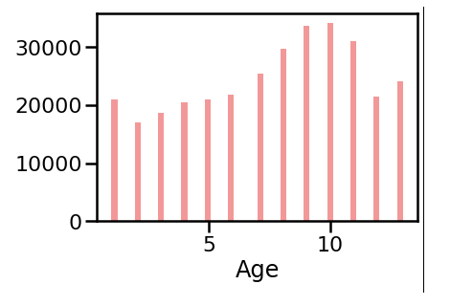
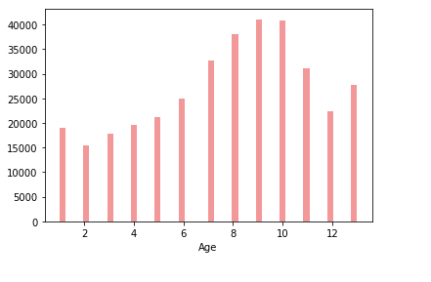
Age
Notes:
Age distribution is around the same, which makes sense as the CDC is asking the same people.

Slide 8
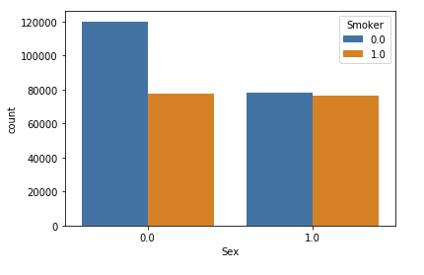
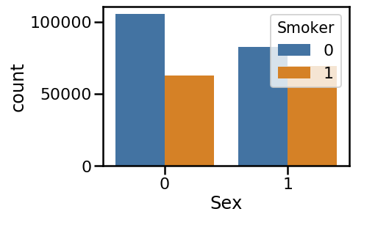
Sex and Smoking
Notes:
More females are non-smokers, while its even on the male side on 2015.
More females are non-smokers, while its even on the male side on 2020.

Slide 9
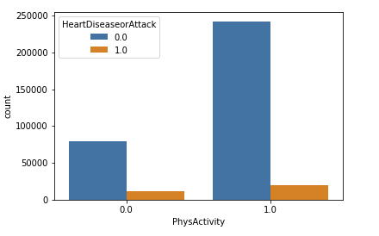
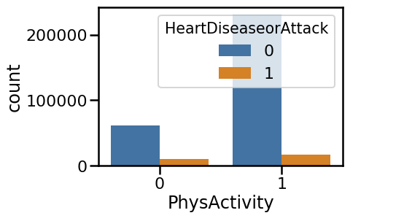
Physical Activity and Heart Disease
Notes:
People who have heart disease don’t generally exercise

Slide 10
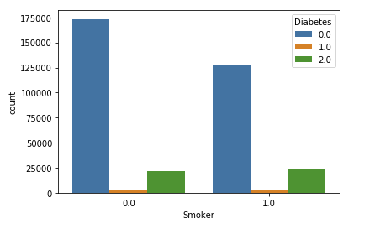
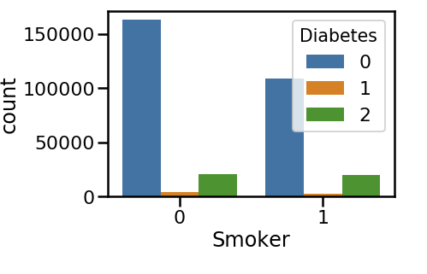
Smoking and Diabetes
Notes:
People who don’t smoke generally have diabetes in both years.

Slide 11
Model Results
Notes:
7 Models were used: Bernoulli Naive Bayes, Gaussian Naive Bayes, Random Forest, Voting, Bagging, XGBoost, and Logistic Regression

Slide 12
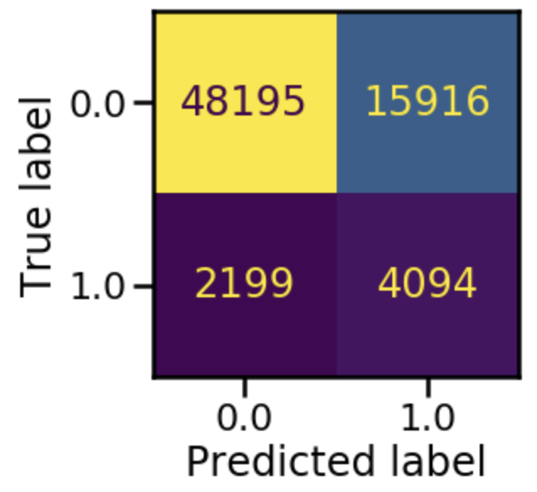
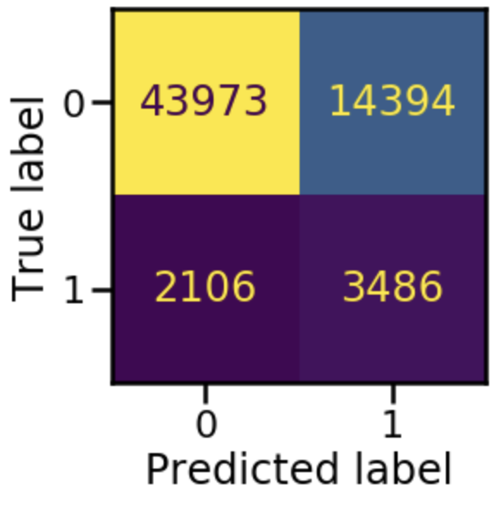
Bernoulli Naive Bayes
2015
Weighted Avg of Accuracy: 0.89
Precision of Negative Diagnosis: 0.96
Precision of Positive Diagnosis: 0.20
2020
Weighted Avg of Accuracy: 0.89
Precision of Negative Diagnosis: 0.95
Precision of Positive Diagnosis: 0.19
Notes:
In the Naive Bayes model, the multivariate Bernoulli model is used for binary values, as seen in the heart disease data.
The model also shows other important information, such as the fact that the model was more precise when reporting those who do not have heart disease versus those who do have heart disease. In the medical sense, this information is a benefit, since the model correctly predicts true negative test results.
In the 2020 dataset, similar results were found for the Naive Bayes classifier. The weighted average of accuracy for this model was also 0.89, which was the same reporting from the 2015 dataset.

Slide 13
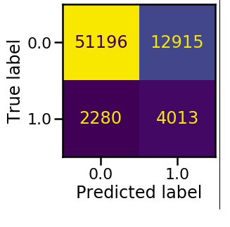
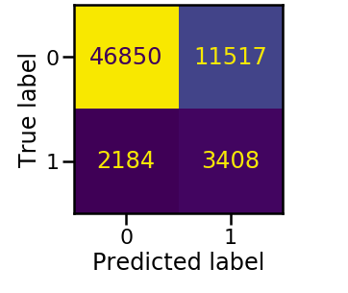
Gaussian Naive Bayes
2015
Weighted Avg of Accuracy: 0.89
Precision of Negative Diagnosis: 0.96
Precision of Positive Diagnosis: 0.24
2020
Weighted Avg of Accuracy: 0.89
Precision of Negative Diagnosis: 0.96
Precision of Positive Diagnosis: 0.23
Notes:
The Gaussian model is a Naive Bayes classifier, when used with a Naive Baysian algorithm, assumes a normal distribution for the data.
The 2015 data has a decent fit with this model, with a weighted average of accuracy of 0.89, and acceptable precision values in the classification report.
With the 2020 dataset, the Gaussian Naive Bayes model performed as well as the model did for the 2015, pre-COVID data. The values of weighted average accuracy and the precision value for a negative diagnosis were the same as the 2015 model, and the precision value for a positive diagnosis was lower by one one-hundredth.

Slide 14
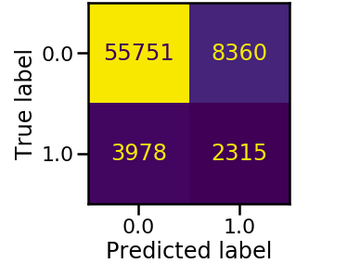
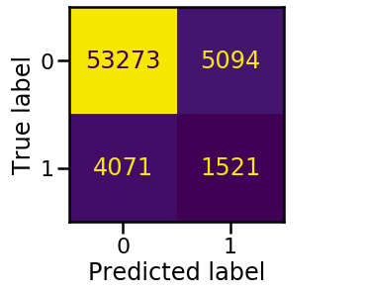
Random Forest
2015
Weighted Avg of Accuracy: 0.87
Precision of Negative Diagnosis: 0.93
Precision of Positive Diagnosis: 0.22
2020
Weighted Avg of Accuracy: 0.87
Precision of Negative Diagnosis: 0.93
Precision of Positive Diagnosis: 0.23
Notes:
The Random Forest is an ensemble classifying model that utilizes many decision trees.
For the 2015 dataset, the weighted average of accuracy was 0.87, which is a fair numerical representation.
In the 2020 dataset, similar results were present in the Random Forest classifier

Slide 15
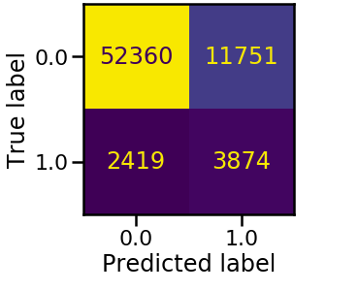
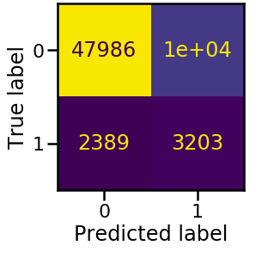
Voting
2015
Weighted Avg of Accuracy: 0.89
Precision of Negative Diagnosis: 0.96
Precision of Positive Diagnosis: 0.25
2020
Weighted Avg of Accuracy: 0.89
Precision of Negative Diagnosis: 0.95
Precision of Positive Diagnosis: 0.24
Notes:
The Voting classifying model is used as a classification method to group many different machine learning models. In this model, the Voting model utilizes the three aforementioned models: Bernoulli, Gaussian, and Random Forest.
The Voting model also is true to the results of the Bernoulli classifier for 2015, as there were the least amount of false negatives reported out of all classifying categories. This model does have the highest precision value for the positive heart disease tests out of the three others, sitting at 0.25.
Observing the Voting classifier for the 2020 heart health data, the classification report and confusion matrix seen in the code has a very similar output to the data collected in 2015. With the same weighted average of accuracy as above, 0.89, this model fits the 2020 data well.

Slide 16
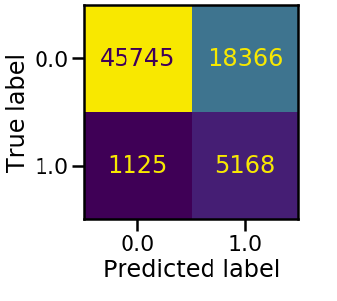
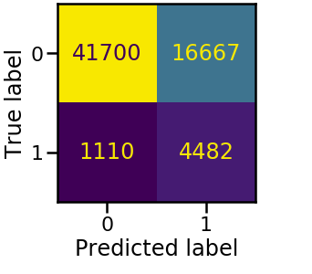
Bagging
2015
Weighted Avg of Accuracy: 0.91
Precision of Negative Diagnosis: 0.98
Precision of Positive Diagnosis: 0.22
2020
Weighted Avg of Accuracy: 0.91
Precision of Negative Diagnosis: 0.97
Precision of Positive Diagnosis: 0.21
Notes:
The Bagging classifying model is used with the decision tree classifying model. This is a model that averages various models to prevent the overfitting of data.
In 2015, the Bagging model performed extremely well. The weighted average of accuracy for the Bagging model was 0.91, which is the highest accuracy average that has been reported thus far.
The Bagging model performed equally as well with the 2020 data. The weighted average accuracy of the model was the same as reported above, 0.91.
The Bagging model performed well with the pandemic of 2020’s data, as well as the 2015 data set.

Slide 17
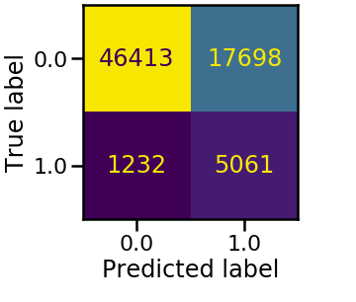
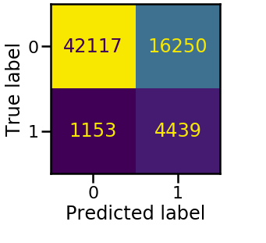
XGBoost Classifier
2015
Weighted Avg of Accuracy: 0.91
Precision of Negative Diagnosis: 0.97
Precision of Positive Diagnosis: 0.22
2020
Weighted Avg of Accuracy: 0.91
Precision of Negative Diagnosis: 0.97
Precision of Positive Diagnosis: 0.21
Notes:
XGBoost is a decision tree algorithm that uses boosting to help improve performance.
On the 2015 data, the XGBoost model performed very well, with a weighted average of accuracy of 0.91.
On the 2020 data, the XGBoost model performed equally well. The weighted average of accuracy as well as the precision values were very much so consistent with the data from 2015.

Slide 18
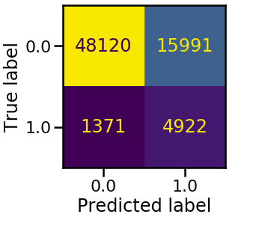
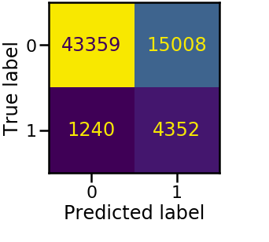
Logistic Regression
2015
Weighted Avg of Accuracy: 0.91
Precision of Negative Diagnosis: 0.97
Precision of Positive Diagnosis: 0.24
2020
Weighted Avg of Accuracy: 0.91
Precision of Negative Diagnosis: 0.97
Precision of Positive Diagnosis: 0.22
Notes:
The logistic regression model is used when analyzing the probability of an event occurring through a linear combination and regression model. It is mainly used to show relationships that are present in the given data.
The logistic regression model on the 2015 data provided a great analysis on how the data worked with the model.
The data from 2020 proved to have similar results as the 2015 model. The weighted average of accuracy and the precision concerning negative diagnoses was the same, and the precision of positive heart disease diagnoses was less than that of the 2015 model by two one-hundredths.

Slide 19
Conclusion
2015
Best performing model: Logistic Regression
Worst performing model: Random Forest
2020
Best performing model: Bagging
Worst performing model: Random Forest
The results of the models show that there is not a significant impact that the pandemic had on the heart health of Americans.
Notes:
Overall, the model that worked the best with the 2015 data was the logistic regression model. This model had the highest values for weighted average of accuracy as well as precision for positive and negative diagnoses. This model also had the most optimal false negative results out of the seven models examined. It is suggested that this model is used for analysis of the BRFSS datasets. The worst performing model for the 2015 pre-COVID dataset is Random Forest model. This model consistently had the worst results with the data, in terms of precision and accuracy values reported. This model also had the largest number of false negatives in the confusion matrix, which is an extreme red flag in medical research.
The best performing model with the data taken in 2020 was also the Bagging model. The values show great performance, but were just below those seen in the 2015 dataset models. The weighted average of accuracy, 0.91, and the precision values: 0.97 for negative diagnosis and 0.21 for a positive diagnosis, have been seen to be consistent with the values seen in other models. The piece that made the Bagging method unique was the very low number of false negatives. This is the lowest reported number for false positives in the report, which is very significant. The worst performing model with the during-pandemic data is again the Random Forest model. This model had a low accuracy report, and a very concerning number of false positives, similar with the findings of the 2015 dataset.
The 2015 dataset performed slightly better than the 2020 dataset with every model.

Slide 20
References
[1] B. T, “Beginner's Guide to xgboost for classification problems,” Medium, 09-Dec-2022. [Online]. Available: https://towardsdatascience.com/beginners-guide-to-xgboost-for-classification-problems-50f75aac5390. [Accessed: 11-Dec-2022].
[2] Brown, “Alcohol consumption during the COVID-19 pandemic projected to cause more liver disease and deaths,” Massachusetts General Hospital. [Online]. Available: https://www.massgeneral.org/news/press-release/alcohol-consumption-during-the-covid-19-pandemic-projected-to-cause-more-liver-disease-and-deaths. [Accessed: 11-Dec-2022].
[3] C. Subasi, “Logistic regression classifier,” Towards Data Science, 04-Mar-2019. [Online]. Available: https://towardsdatascience.com/logistic-regression-classifier-8583e0c3cf9. [Accessed: 30-Oct-2022].
[4] “CDC - about BRFSS,” Centers for Disease Control and Prevention, 16-May-2014. [Online]. Available: https://www.cdc.gov/brfss/about/index.htm. [Accessed: 11-Dec-2022].
[5] D. Cucinotta and M. Vanelli, “WHO Declares COVID-19 a Pandemic,” Acta Biomedica Atenei Parmensis, 2020. [Online]. Available: https://doi.org/10.23750/abm.v91i1.9397. [Accessed: 11-Dec-2022].
[6] “Heart disease facts,” Centers for Disease Control and Prevention, 14-Oct-2022. [Online]. Available: https://www.cdc.gov/heartdisease/facts.htm. [Accessed: 29-Oct-2022].
[7] R. Gandhi, “Naive Bayes Classifier,” Towards Data Science, 05-May-2018. [Online]. Available: https://towardsdatascience.com/naive-bayes-classifier-81d512f50a7c. [Accessed: 29-Oct-2022].
[8] S. Sender, R. S. Blumenthal, G. Sharma, and P. Kohli, “Covid-19's impact on heart disease and stroke mortality,” American College of Cardiology, 25-May-2022. [Online]. Available: https://www.acc.org/Latest-in-Cardiology/Articles/2022/05/25/12/10/COVID-19s-Impact-on-Heart-Disease-and-Stroke-Mortality. [Accessed: 29-Oct-2022].
[9] “Sklearn Random Forest Classifier,” scikit. [Online]. Available: https://scikit-learn.org/stable/modules/generated/sklearn.ensemble.RandomForestClassifier.html. [Accessed: 29-Oct-2022].
[10] “Sklearn.ensemble.BaggingClassifier,” scikit. [Online]. Available: https://scikit-learn.org/stable/modules/generated/sklearn.ensemble.BaggingClassifier.html. [Accessed: 11-Dec-2022].
[11] “Sklearn.ensemble.VotingClassifier,” scikit. [Online]. Available: https://scikit-learn.org/stable/modules/generated/sklearn.ensemble.VotingClassifier.html. [Accessed: 11-Dec-2022].
[12] “Sklearn.naive_bayes.Bernoullinb,” scikit. [Online]. Available: https://scikit-learn.org/stable/modules/generated/sklearn.naive_bayes.BernoulliNB.html. [Accessed: 11-Dec-2022].
[13] “Traditional risk factors predict heart disease about as well as sophisticated genetic test, study suggests,” UT Southwestern Medical Center, 18-Feb-2020. [Online]. Available: https://www.utsouthwestern.edu/newsroom/articles/year-2020/predicting-heart-disease.html. [Accessed: 29-Oct-2022].

