Slide 1
Image Quality Improvement using Deep Learning
Group E Members:
Aditya Kumar Singh(x20140410)
Aryan Rajput(x20128088)
Priyanka Ashok Sujgure (x20136706)

Slide 2
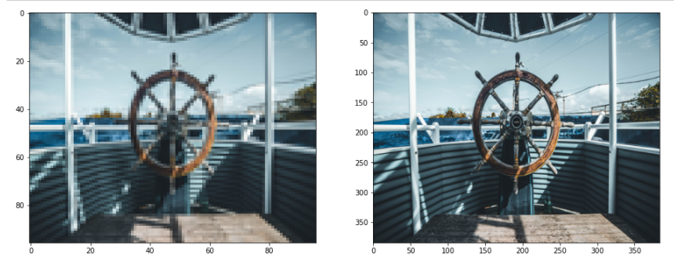
Introduction
Visual experience are important drivers in entertainment industry.
Imagery data consisting of 59% mobile internet traffic in 2017
This is further expected to rise to 79% till 2022

Slide 3
Related Works
Image Quality Improvement Using
Machine Learning and Deep Learning
Convolutional neural network
Transfer Learning with Keras

Slide 4
Methodology
Business understanding
Data understanding
Data preparation
Modeling
Evaluation
Deployment

Slide 5
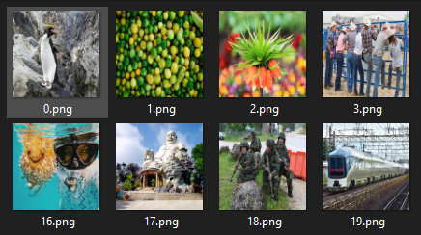
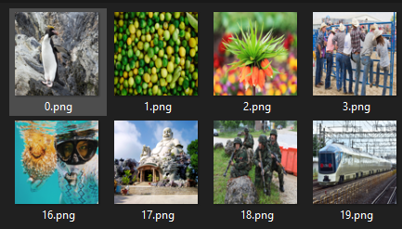
Data
High Resolution Images
Low Resolution Images

Slide 6
Neural Network Structure

Slide 7
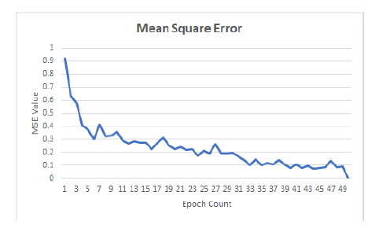
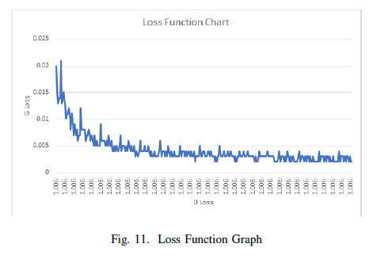
Model Training
MSE for the trained model
Loss function chart

Slide 8
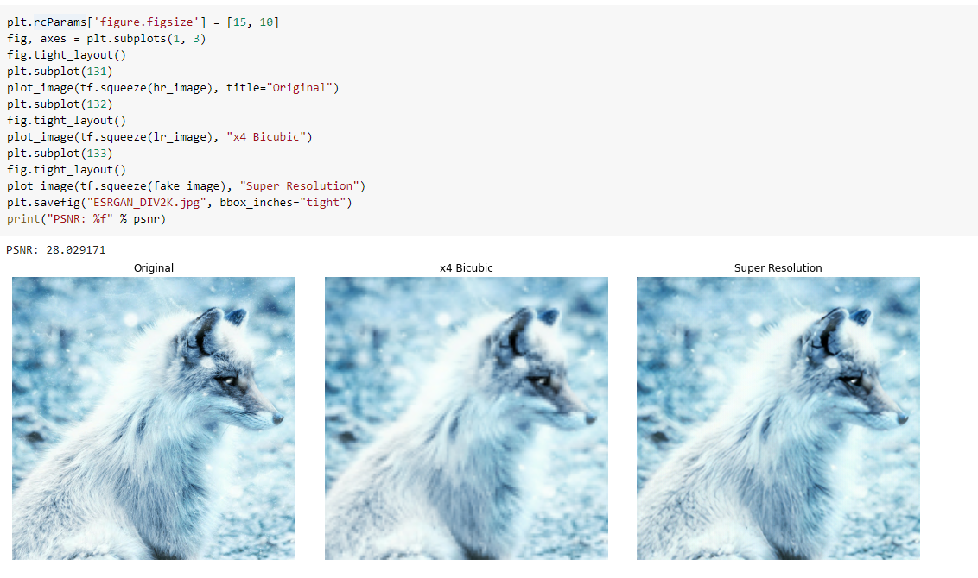
Model Evaluation

Slide 9
Conclusion
Overall, 28.02 PSNR, value is achieved.
One Drawback faced of GAN is the lack of intrinsic metric for evaluation. It is unable to predict the density of an image.
The applied technique can be used on videos rather than single image.

Slide 10
Thank You.

