Slide 1
Machine Learning Analysis
Aryan Rajput
x20128088
Data Analytics - Jan 2021, Group B
National College of Ireland Dublin, Ireland

Slide 2
Datasets
CO2 Emission from Cars
Indian Air Quality
Australian Rain Dataset

Slide 3
Reason For Selecting CO2 Emissions, Air Quality and Weather Datasets
Pollution is constantly increasing and is among one of the
prime concern for every country
AQI measures whether the Air is dangerous or breathable.
India has a very high population density which results in
tremendous amount ofAir Pollution rise.
Our planet has so vivid
climatic situations, that it makes weather very evolving thus
making it very challenging to predict its patterns and trends.

Slide 4
The research question :
•Can we predict the CO2 emission from Car?
•Can we predict the AQI using machine learning techniques?
Will rain tomorrow?

Slide 5
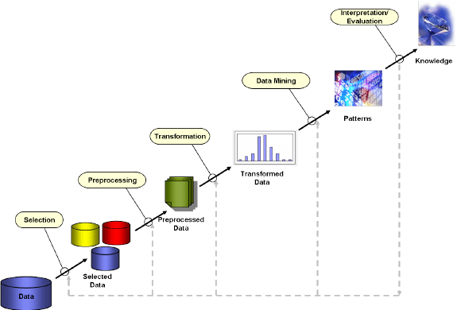
Methodology
KDD

Slide 6

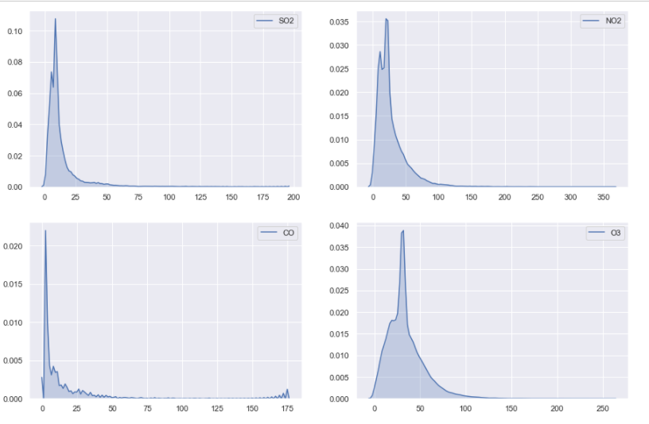
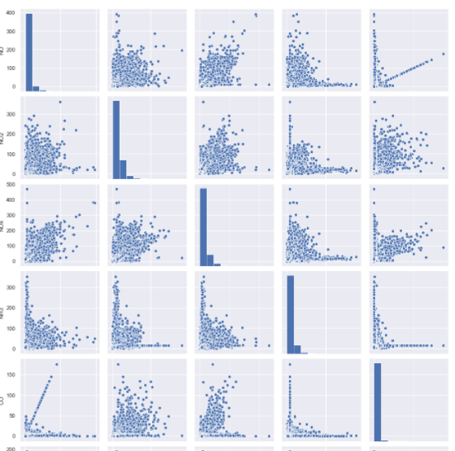
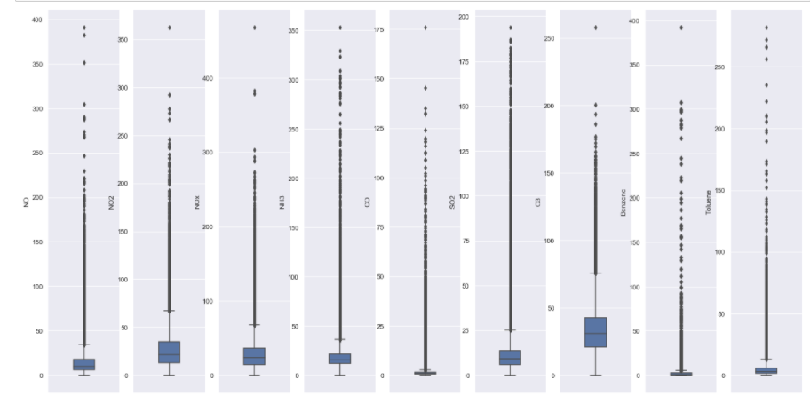
Data Cleaning
Some important steps performed in data cleaning are
Dropping not required columns
Removing duplicates
Deleting records having 0 or missing values
Plotted scatter plots
Distribution Plots
Box Plots
Pair Plots
Outliers have been treated.

Slide 7


Data Transformation
Original date has been changed to months year and date
Label Encoder has been used to convert categorical values.

Slide 8
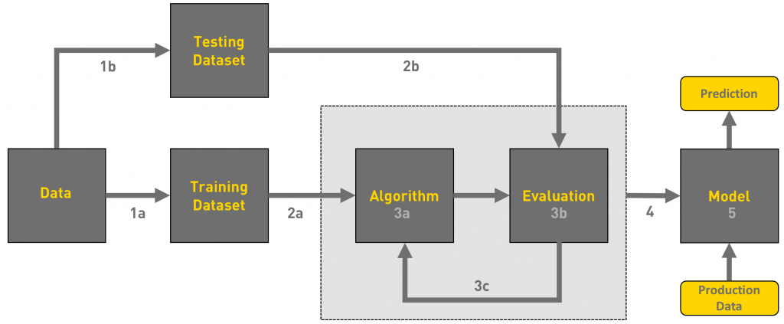
Data

Slide 9
Models Used and Reason
Linear Regression
Random Forest
Decision Tree
Logistic Regression
Gradient Boosting Classifier

Slide 10
Thank You

