Slide 1
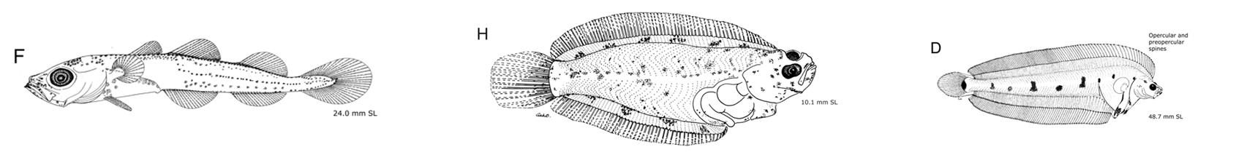
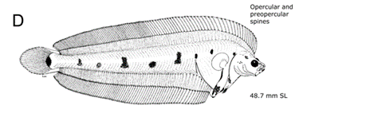
Environmental relationships of fishes
Source: Ichthyoplankton Information System, Alaska Fisheries Science Center
Laura Vary
Analytical Workflows
December 2, 2021

Slide 2
Brief reminder of research objectives
Do water mass characteristics better explain larval biogeography?
How flexible is spawning geography and phenology?

Slide 3
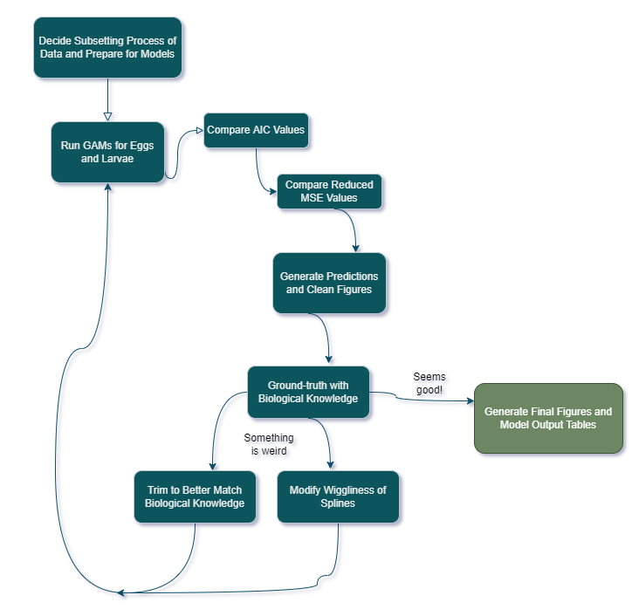
Initial and mid-term goals
Create a repository with all analytical workflow processes
Create a separate folder with data cleaning practices
Create a style guide with a workflow map and figure conventions
Add comments and introductions to all code files
Create a streamlined figure creation workflow

Slide 4
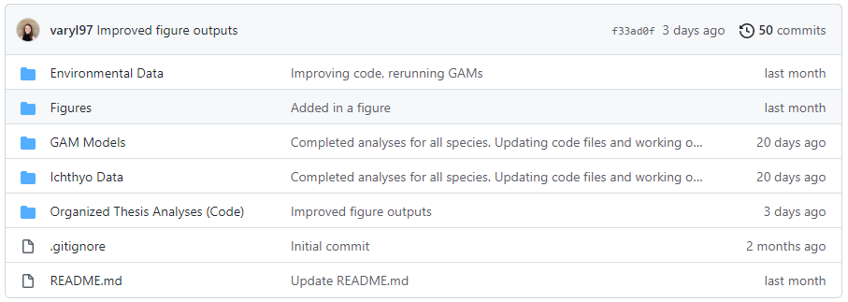
Accomplished goals: clean repository

Slide 5
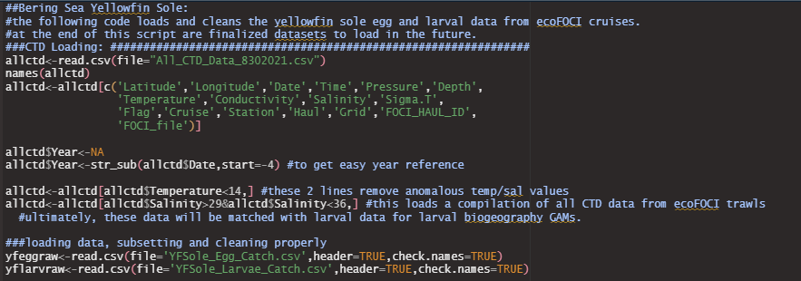
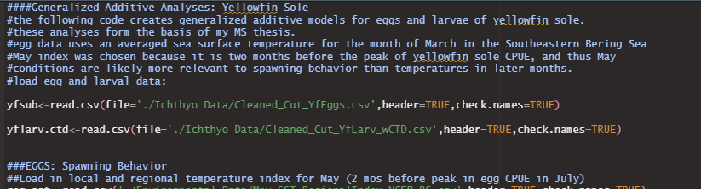
Accomplished Goal: Commented Code & code for cleaning

Slide 6
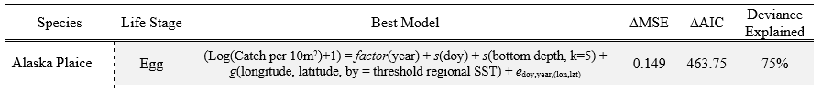
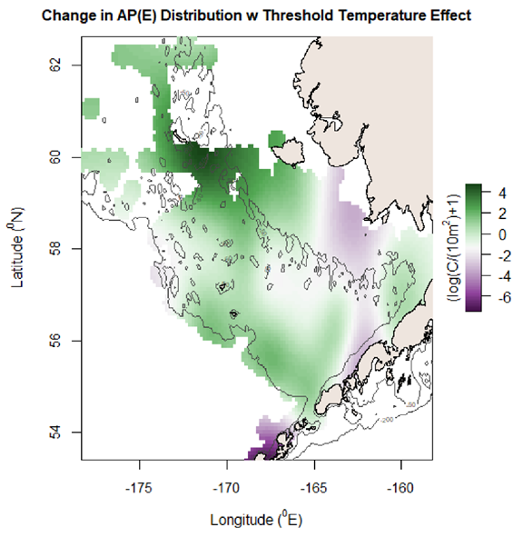
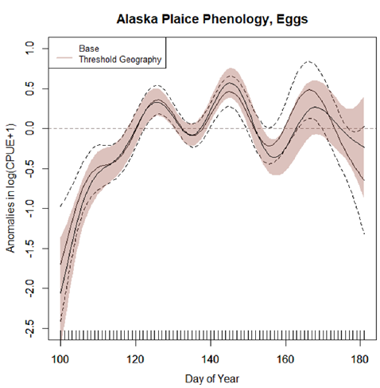
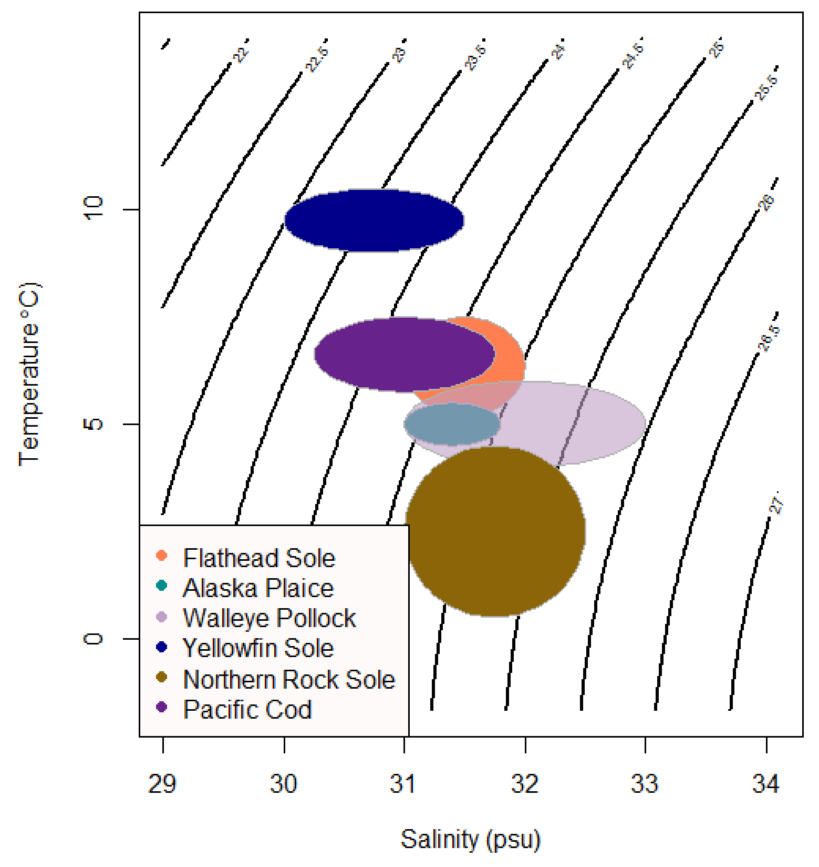
Accomplished* goal: clean figures, model output table
Notes:
This is a caveat accomplishment because I am still working on groundtruthing these outputs and making clean figures. These are draft figures!
Have 7 species with eggs and larvae for most (10 models for each species to test) so it takes a lot of time to get through all these…

Slide 7
Goals in progress
Generate a streamlined figure process (that saves figures too)
Write a style guide for figures and code

