Slide 1
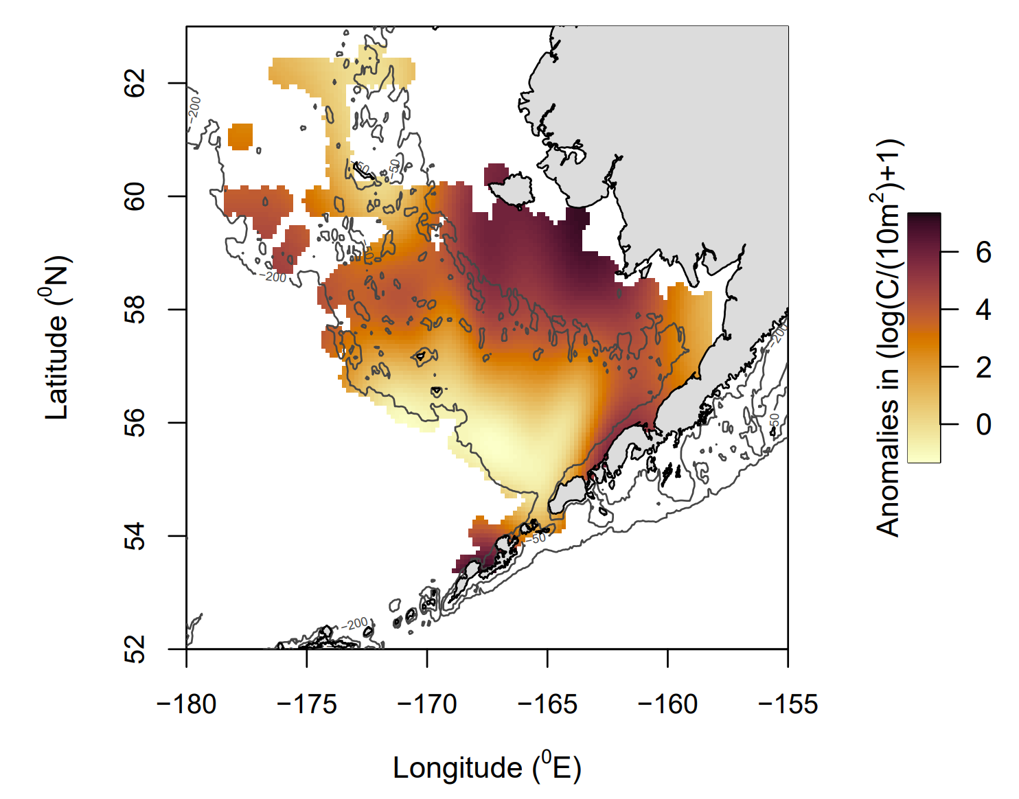
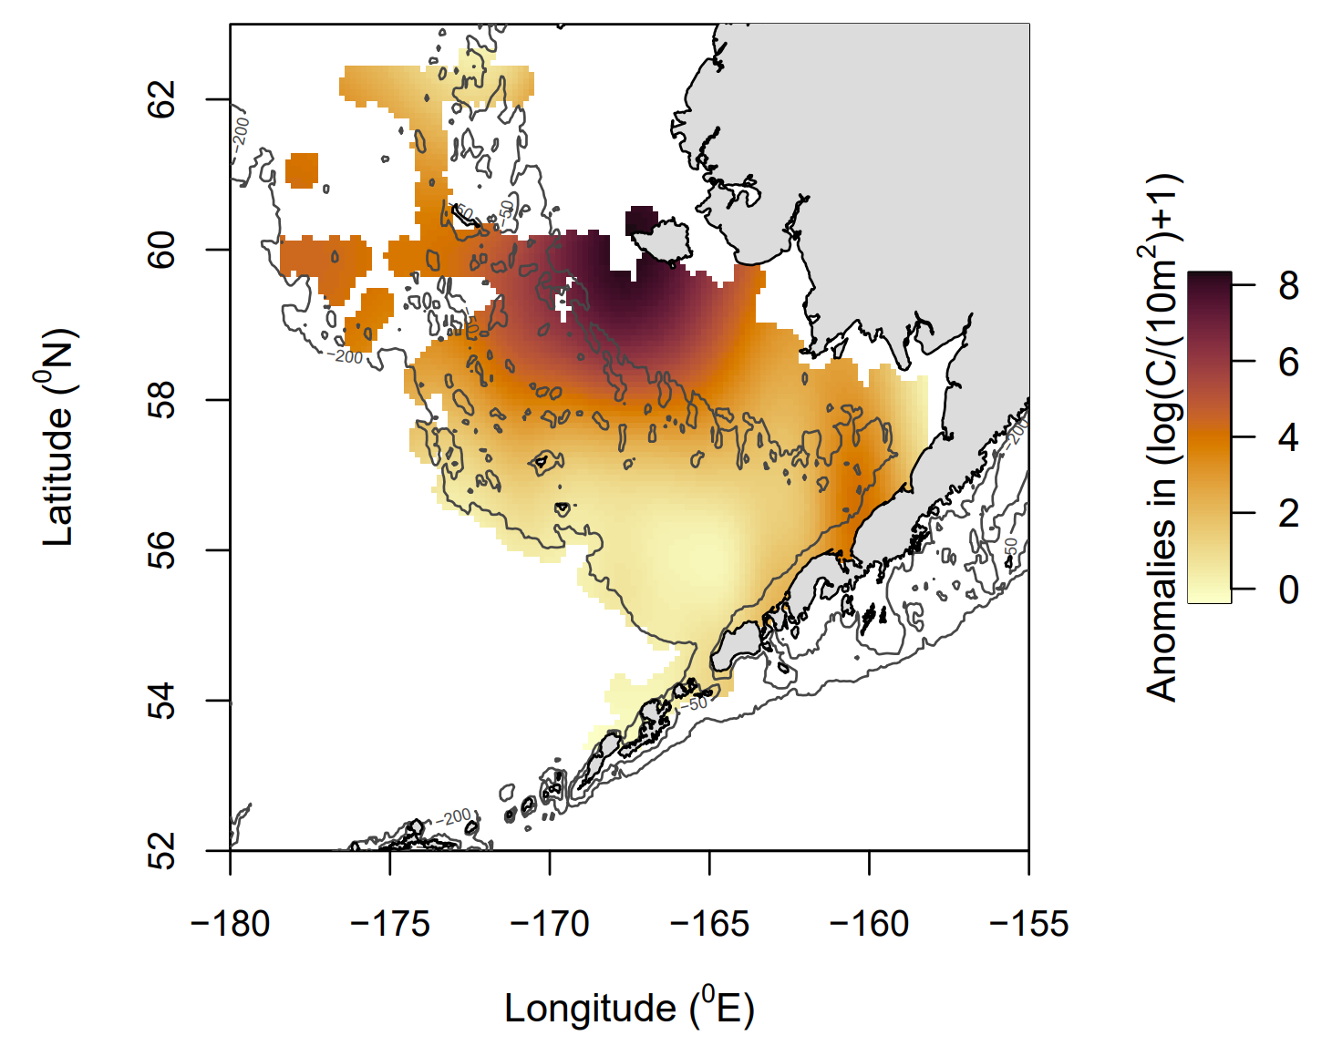
(A)
(B)
Nunivak Island
Unimak Pass
Notes:
Plaice

Slide 2
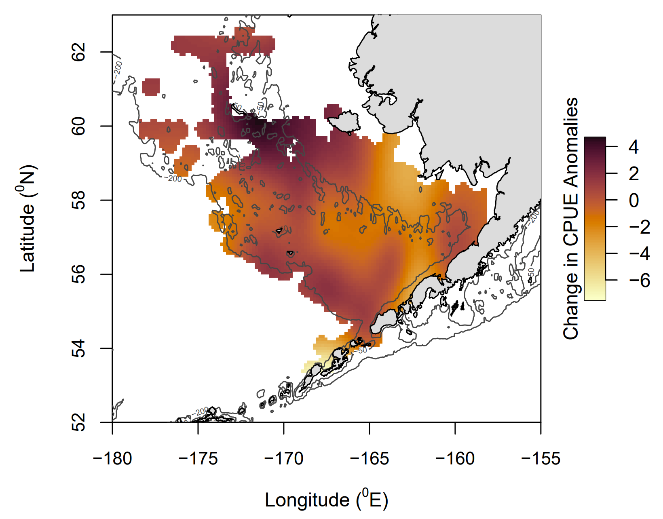
Nunivak Island
Unimak Pass

Slide 3
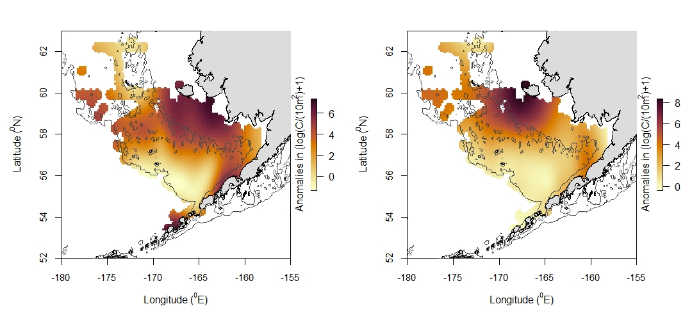
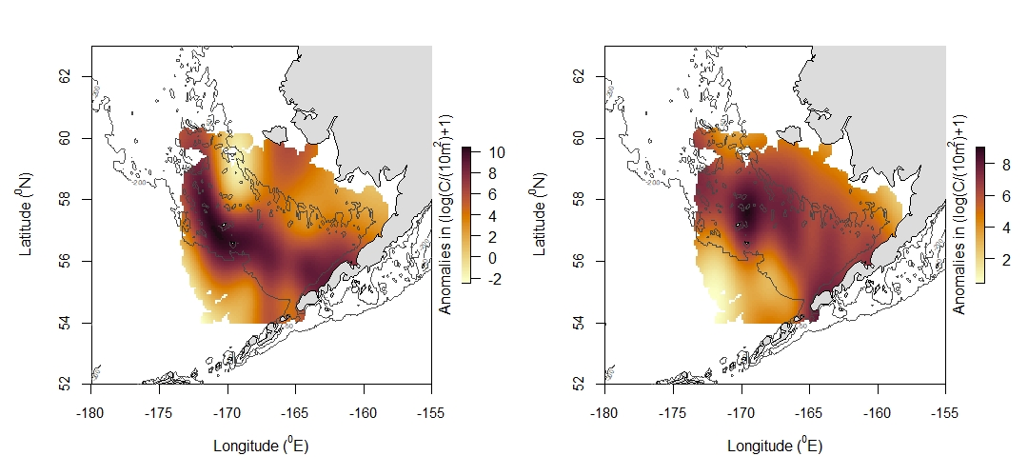
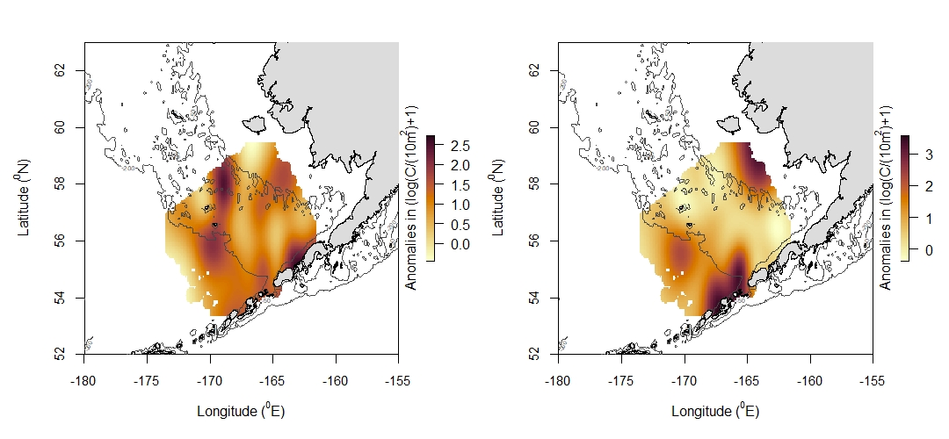
Below
Above
Nunivak Island
Alaska Plaice
Walleye Pollock
Rex Sole

