Slide 1
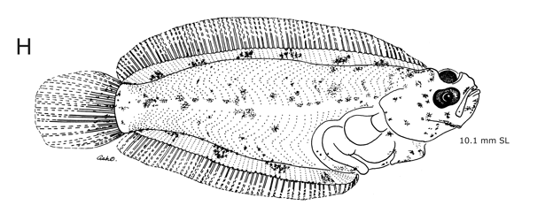
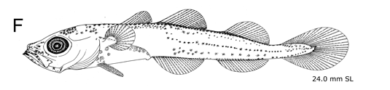
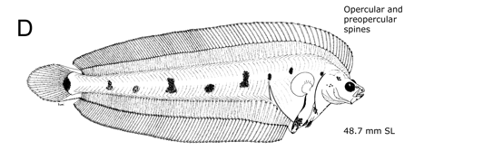
Environmental Relationships of Fishes
Spawning behavior of Bering Sea groundfishes and larval biogeography: flexibility and environmental associations
Laura Vary, September 30, 2021
Source: Ichthyoplankton Information System, Alaska Fisheries Science Center

Slide 2
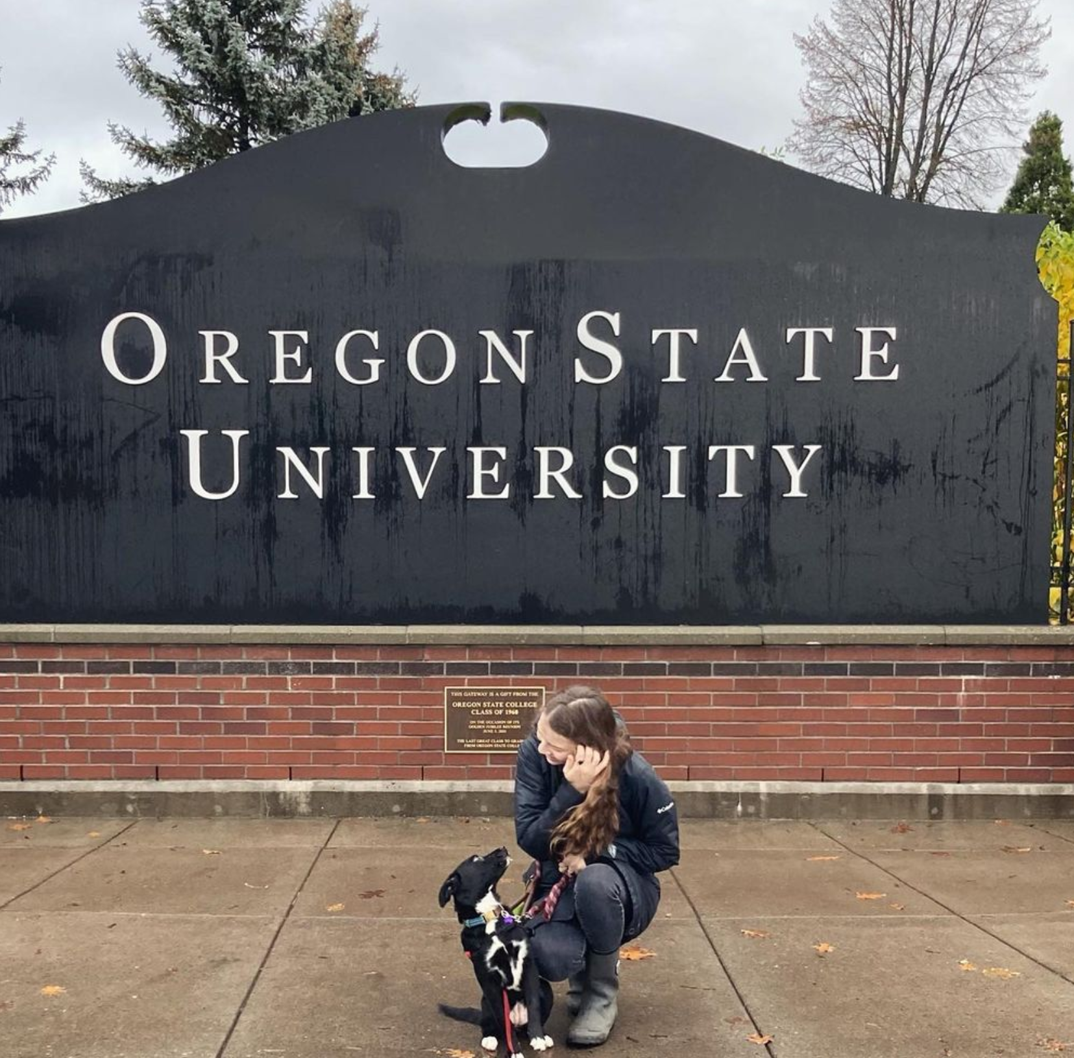
My Background
Undergrad in marine ecology and organismal biology at UC Davis
Largely qualitative background with a handful of R experiences
Current MSc second year in Marine Resource Management in a quantitative research project
Last year was 90% RStudio investigation, learning, and troubleshooting
Highly recommended course by two lab mates – want to improve my quantitative skillset and work process

Slide 3
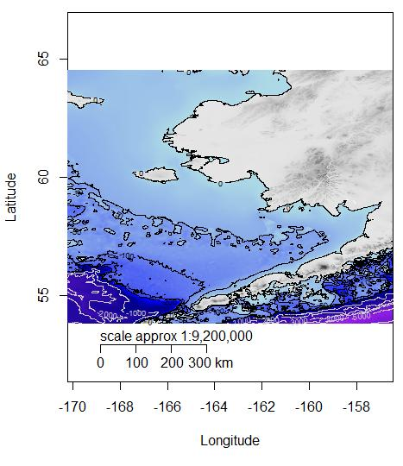
Background Research Information
The Bering Sea is highly productive, supporting massive global fisheries, coastal communities, and large marine populations
It is highly volatile, with pronounced environmental variability
Spawning behavior is largely consistent in marine fishes and is typically fixed in either space or time to promote survival among eggs and larvae
Climate change is occurring rapidly in this region
Project Questions:
Is there flexibility in spawning behavior of spatially or temporally constrained species?
What types of water mass characteristics do larvae tend to be associated with?
Notes:
Pronounced environmental variability to which species are adapted
Spawning behavior is often fixed in space or time – some species are geographically constrained and utilize physical features to improve ideal larval transport to feeding and nursery grounds, others are temporally constrained and utilize transient currents
Ultimately, spawning behavior dictates where larvae find feeding and nursery grounds
The average larva is a dead one
Unclear where larvae go and the degree of flexibility in spawning behavioral constraints

Slide 4
Goals and Challenges
Goals:
A repository including my workflow processes for all species, eggs and larvae, to share with my committee
Generalized additive models with variable coefficients: latitude, longitude, day of year, salinity, temperature
A subset or separate repository with data cleaning processes of hydrographic data and subsequent incorporation into analyses
A style guide with workflow map and naming conventions
Challenges:
A lot (>100) of large files that may be difficult to clearly identify/organize, with no known naming conventions used by NOAA or AFSC
Not super tech-savvy, still growing my expertise in coding languages and functionalities

