Slide 1


Team ROCKSTAR

Slide 2

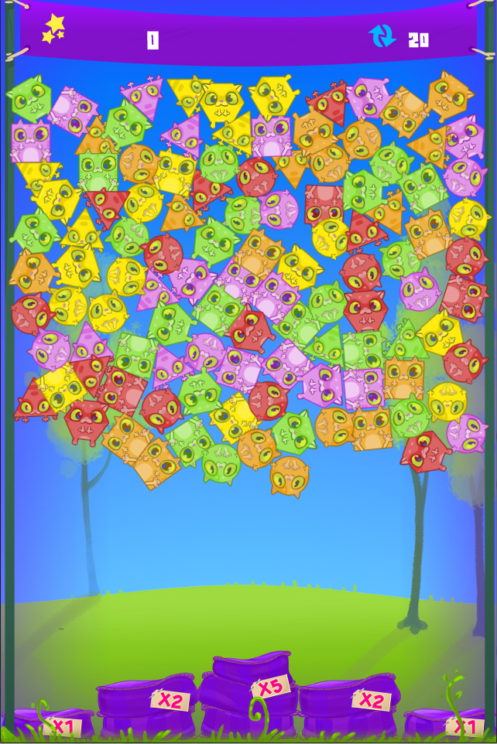
Genre: Linker. With Physics!
Platform: Mobile
Game description:
Cats are nosy creatures. No wonder that upon finding a tank full of helium they started messing with it. Now all the clowder is afloat!
Your task is to help them back down. Fluffy pillows have been provided to ensure a smooth landing.
Awesome in-game graphics

Slide 3
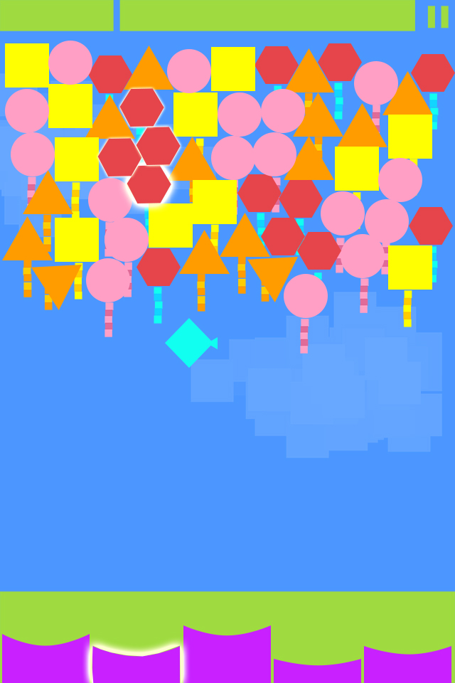
Gameplay Highlights:
4 shapes to influence physics;
5 colors to match;
5 pillows to land on;
Link cats of the same color to create the longest chain;
The cats then deflate and fall down to land on pillows;
Each pillow has a different score multiplier;
Limited number of moves (20);
Friday, 10:45 AM, first fake

Slide 4
How to play:
The game starts with the filling of the board from below;
After all the cats have settled, the player can start linking them;
A link must have at least 3 cats;
When a chain contains more then 4 cats, power-ups are created. Check the power-up page for more details;
After a chain is completed (no more moves are available) all the cats in the chain coalesce on the position of the last selected cat and fall down;
Coalesced cats will not bounce from the pillows; the first pillow hit gives the score multiplier;
A number of cats equal to the ones that were included in the chain float up to fill the board;
After each player move, the pillows shuffle, changing position (If not affected by power-up). This insures the player won’t always try to play the same positions and brings an extra element of randomness;

Slide 5
Power-ups:
When the player manages to link a number of cats, a power-up will be received.
4 linked cats freeze the pillows for the next 2 moves; look for the vines tangling the pillows; it takes action instantly after the link was made;
6 linked cats spawns a tuna fish in a random position on the board. The tuna can be included in any chain and doubles the awarded score; it can’t be used at the start or end of a chain;
8 linked cats create the “it’s raining Cats” power-up. All the cats of the same color as the chained cats fall down and award score (according to the value on the pillows); it takes action instantly after the link was made.

Slide 6
Scoring:
Each cat contained in a link – 25 points;
Tuna fish – doubles the value of the chain it is contained in; is a separate multiplier than the pillows.
For each cat that falls down as a result of the “it’s raining Cats” power-up – 25 points;
There are 5 pillows:
2 pillows with 1 multiplier;
2 pillows with 2 x multiplier;
1 pillow with 5 x multiplier.
Easter egg: press 1, 2 or 3 to change background music + one more egg that we’ll let you discover!

Slide 7
THANK YOU!
Team ROCKSTAR

