Slide 1
Chest X-ray Radiology Report Generation
A Vision-Language Model (VLM) built end-to-end on a single RTX 3070 (8 GB)
Oybek Valiyev
GitHub: github.com/varzik07/chest-xray-vlm | Live demo: huggingface.co/spaces/Valiye/chest-xray-report

Slide 2
Problem & Goal
• Task: given a chest X-ray, automatically generate the radiology findings report.
– A Vision-Language Model must SEE a medical image AND WRITE clinical text.
• Goals of the project:
– Learn how VLMs work internally (build one from scratch).
– Ship a real, deployed, clickable demo for a portfolio.
• Hard constraint: a single laptop GPU — RTX 3070, only 8 GB VRAM.
– Drives the choices: QLoRA, 4-bit quantization, small models, frozen encoders.

Slide 3
Dataset & Preprocessing
• Indiana University Chest X-ray collection: 3,955 reports + ~7,470 images.
• prepare_data.py: parse each XML report, extract FINDINGS / IMPRESSION.
– Clean the 'XXXX' anonymization tokens; pair each report with its image(s).
• Report-level train/val/test split (NOT image-level) to prevent leakage.
– Two views of the same patient never cross splits.
• Result: 5,958 train / 734 val / 738 test (image, report) pairs.

Slide 4
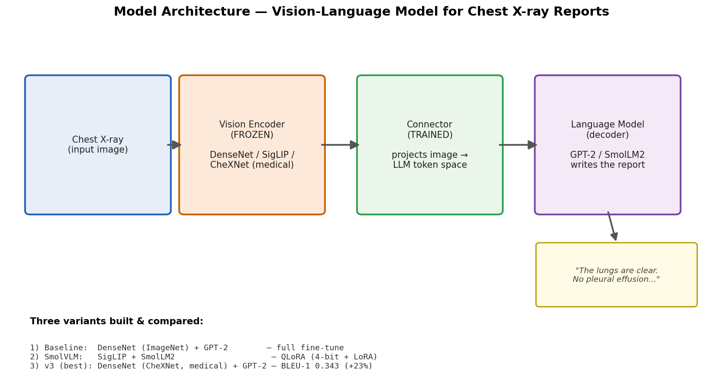
Model Architecture
Vision encoder (frozen) -> connector (trained) -> language model writes the report.

Slide 5
Approach — Two Phases, Three Models
• Phase 1 — Baseline (learn the internals):
– From scratch: DenseNet121 (frozen) + projector + GPT-2 decoder.
• Phase 2 — Ship a strong model:
– QLoRA fine-tune of SmolVLM-500M in 4-bit — fits in 8 GB.
• v3 — Headline upgrade:
– Swap in a CheXNet (medical) DenseNet encoder pretrained on chest X-rays.
• Key techniques: QLoRA, 4-bit (NF4) quantization, LoRA adapters, mixed precision, gradient checkpointing.

Slide 6
Results (test set, 738 reports)
Model | Encoder | BLEU-1 | ROUGE-L | METEOR | Unique
Baseline (DenseNet+GPT-2) | ImageNet | 0.279 | 0.286 | 0.233 | 10
SmolVLM QLoRA v1 | SigLIP | 0.227 | 0.270 | 0.210 | 25
SmolVLM QLoRA v2 | SigLIP | 0.154 | 0.281 | 0.177 | 46
CheXNet + GPT-2 (v3) | CheXNet (medical) | 0.343 | 0.295 | 0.280 | 9
The medical CheXNet encoder won: BLEU-1 0.343 (+23% over baseline).

Slide 7
Key Finding — Mode Collapse & the Metric Trap
• The first QLoRA model 'looked fine' on metrics — but diversity exposed a problem:
– Only 25 unique reports across 738 images; it IGNORED the X-ray (language prior).
• Diagnosed it, traced the cause: frozen connector + class imbalance + under-training.
– Fix: LoRA on the vision connector + oversample abnormal cases + validation split -> diversity +84%.
• Deeper insight (the real headline):
– On this data, high BLEU comes from emitting the 'normal' template — metrics reward mode collapse.
– => Real radiology AI needs clinical-efficacy metrics (CheXbert-F1), not just BLEU/ROUGE.

Slide 8
Quantization — 4-bit vs fp16
• Benchmarked SmolVLM-500M inference (20 images):
– fp16: 0.97 GB VRAM, 3.6 s/image.
– 4-bit (NF4): 0.39 GB VRAM (2.5x smaller), 5.0 s/image.
• Honest takeaway: 4-bit trades speed for memory.
– Its real value here was enabling QLoRA TRAINING to fit in 8 GB.
– For serving a small model that already fits, fp16 is faster.

Slide 9
Deployment
• GitHub — full source, README, and DEPLOYMENT.md (reproducible).
– github.com/varzik07/chest-xray-vlm
• Hugging Face Spaces — live Gradio demo (free CPU, fp16).
– Bundled the 39 MB LoRA adapter; base model downloads at runtime.
– Pushed via huggingface_hub.upload_folder(); builds automatically.
– huggingface.co/spaces/Valiye/chest-xray-report

Slide 10
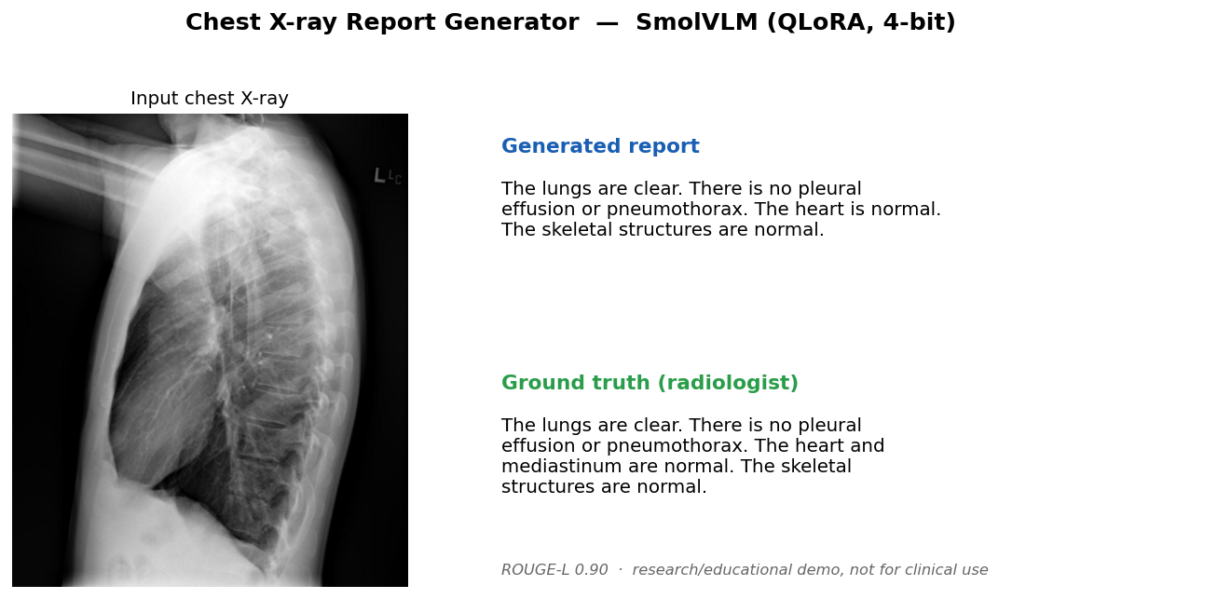
Live Demo — Example Result
Generated report vs the radiologist's ground truth (ROUGE-L 0.90 on this case).

Slide 11
Summary & Skills Demonstrated
• Built and compared 3 vision-language models for radiology report generation on an 8 GB GPU.
• Diagnosed mode collapse; improved a domain-specific encoder to +23% BLEU-1.
• Shipped a deployed, quantized demo with reproducible training/eval code.
• Skills: PyTorch, Hugging Face, QLoRA, 4-bit quantization, VLM architecture,
– evaluation (BLEU/ROUGE/METEOR + diversity), debugging, and deployment.
• Code: github.com/varzik07/chest-xray-vlm | Demo: huggingface.co/spaces/Valiye/chest-xray-report

