Slide 1
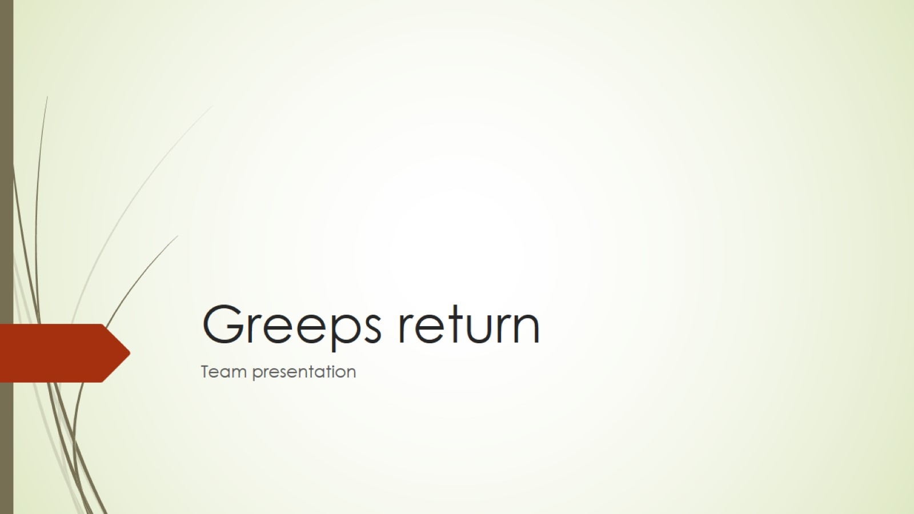
Greeps return

Slide 2
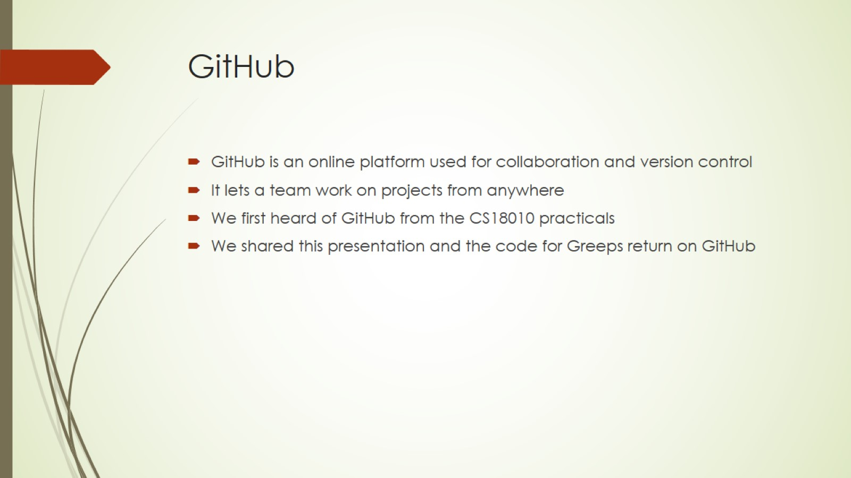
GitHub

Slide 3
GreenFoot
It’s a Java based programming language
Visual and interactive are key to GreenFoot
Actors are programmed in standard textual Java code
Full IDE that includes project management, auto-completion, syntax highlighting
Simple design and easy to use

Slide 4
Greeps return - description
A program that puts two teams against each other
Each team has a number of greeps that collect tomatoes
Two greeps at the tomato pile are required to in order to for them to carry them back to the mother ship
The team that gathers the most tomatoes wins

Slide 5
Greeps return - changes
If the greep is in the vicinity of more than 2 enemies or is blocked by an enemy then it explodes
If the greep hits water he will rotate 60 degrees (after some testing, this choice improved the score significantly
If in the vicinity there are exactly 2 enemy greeps, ours will block the path
If an ally greep finds some tomatoes, others will go in his direction
Changed the ship to ‘Team 3’

Slide 6
Working as a team
Exchanged ideas through e-mail
Shared our work on GitHub
Motivated each other to do our part in the project

Slide 7
Thanks for listening

