Slide 1
Supply Chain & Business Operations Analysis
Intern Name : Vasa Lakshmi
Project Name : Supply Chain & Business Operations Analysis
Mentor Name : Anish Sir & Arihant Sir
1

Slide 2
Supply Chain & Business Operations Analysis
End-to-End Analysis Using Python, SQL, and Power BI
Business Focus
Professional Internship Presentation
Prepared to demonstrate analytical thinking, technical execution, and business decision support across the supply chain lifecycle.
Inventory • Delivery • Warehouses • Profitability
1

Slide 3
Project Objective & Scope
What this project set out to solve
Primary Goal
Turn raw operational data into actionable supply chain insights
Analytics Lifecycle
Business understanding → cleaning → analysis → dashboarding → recommendations
Business Outcome
Support faster, more data-driven operational decisions
Simulated the role of a Business Operations / Data Analyst in a realistic supply chain setting
Analyzed warehouse performance, inventory balance, delivery efficiency, and demand fulfillment
Used Python for data preparation and exploratory analysis, SQL for business questions, and Power BI for executive dashboards
Converted findings into business recommendations for management decision-making
2

Slide 4
Business Problem & Key Questions
Core operational issues addressed
Challenges Observed
Business Questions
Stock shortages and overstocking
Poor demand forecasting readiness
Delivery delays and service inconsistency
Uneven warehouse performance
Inefficient inventory utilization
Which warehouses perform better?
Which product categories have inventory imbalances?
How efficient are deliveries?
What factors impact operations?
What actions can improve effectiveness?
3

Slide 5
Dataset & KPI Overview
Business_Operations_Analyst_data.csv
KPIs Used in Analysis
Data Coverage
Warehouse_ID
Product_Category
Demand
Stock Levels
Inventory Health
Delivery Efficiency
Service Score
Estimated Profit
Additional operational variables
Service Score
Customer experience quality
Delivery Efficiency
Logistics execution performance
Inventory Health
Stock balance and replenishment quality
Demand vs Stock
Fulfillment and shortage risk
Estimated Profit
Financial performance signal
4

Slide 6
Tools & Technologies
Technology stack used end-to-end
Python
Pandas
Matplotlib
Data cleaning and exploratory analysis
Data manipulation and KPI calculation
Operational visualizations
PostgreSQL
Power BI
GitHub
SQL-driven business analysis
Interactive dashboard creation
Project documentation and portfolio showcase
5

Slide 7
Project Workflow / Methodology
End-to-end analytical lifecycle
1. Understand Data
2. Clean & Prepare
3. Python Analysis
4. SQL Analysis
5. Power BI Dashboard
Loaded dataset, reviewed variables, data types, and inconsistencies
Checked nulls, validated types, removed duplicates, standardized structure
Evaluated warehouses, delivery performance, and inventory health
Answered business questions on demand, stock, and category performance
Converted analysis into executive visuals and management insights
Outcome: a clean dataset, reusable analysis assets, and an executive-ready dashboard story.
6

Slide 8
Python Analysis: Warehouse Service & Delivery
Operational performance comparison by warehouse
Service Score Analysis
Delivery Efficiency Analysis
Grouped records by Warehouse_ID
Calculated average Service Score
Ranked warehouses from highest to lowest service quality
Flagged underperforming locations for attention
Calculated average Delivery Efficiency per warehouse
Compared fastest vs slowest operating locations
Highlighted major variation in execution consistency
Connected delivery performance to customer satisfaction risk
Business value: identifies where best practices exist and where targeted coaching or process changes are needed.
7

Slide 9
Python Analysis: Inventory Health & Visual Analytics
Inventory control effectiveness across warehouses
Inventory Health Analysis
Visual Communication
Calculated average Inventory Health by Warehouse_ID
Assessed stock balance and replenishment quality
Separated healthier warehouses from locations needing tighter control
Supported prevention of stockouts, overstocking, and excess carrying cost
Warehouse Comparison
Bar / column rankings
Performance Distribution
Variation across sites
KPI Visualization
Simple and stakeholder-friendly
Business value: turns warehouse-level operational signals into clear management actions.
8

Slide 10
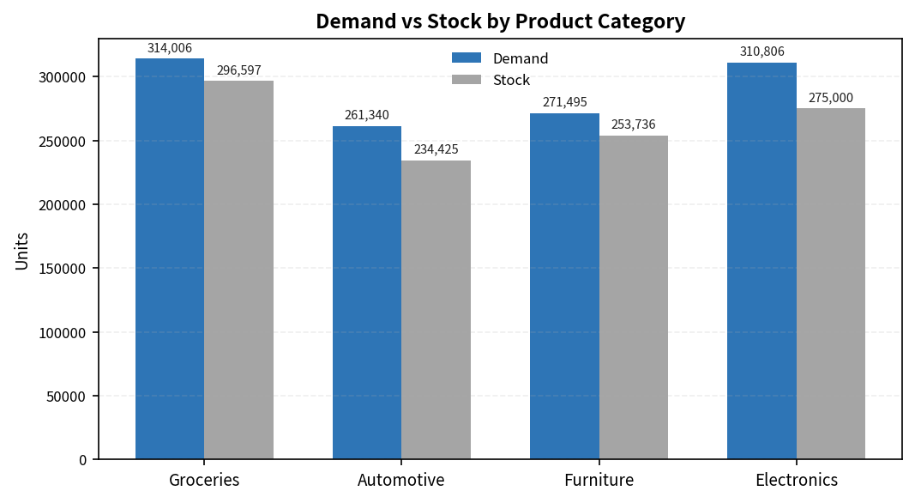
SQL Analysis: Demand vs Stock by Category
Inventory alignment with market demand
Key SQL Findings
Demand exceeded stock across multiple categories
Groceries: 314,006 vs 296,597
Automotive: 261,340 vs 234,425
Furniture: 271,495 vs 253,736
Electronics: 310,806 vs 275,000
Apparel also showed a shortage pattern
Implication: high-demand categories face lost-sales risk and need stronger replenishment planning.
9

Slide 11
Power BI Dashboard Highlights
Executive-ready monitoring and decision support
Dashboard Visuals
Executive Design Takeaways
Warehouse KPI comparison: Service Score, Delivery Efficiency, Inventory Health
Demand vs Stock clustered bar chart for replenishment visibility
Estimated Profit bubble chart to reveal profitability patterns and negative values
Dashboard organized for quick management review
Professional layout, readability, and logical navigation
Forecasting was limited because the dataset had no date field
Key learning: accurate demand forecasting requires transaction timestamps and a time-series-ready dataset.
10

Slide 12
Key Business Insights
What the analysis revealed
Inventory Challenge
Demand exceeded stock in several categories, creating revenue-loss risk
Warehouse Variation
Service quality and delivery efficiency differed noticeably across locations
Inventory Opportunity
Some warehouses showed weaker inventory health and need tighter control
Profitability Concern
Negative estimated profit values point to operational inefficiencies
Data Governance Gap
Missing date information limited forecasting and future planning readiness
11

Slide 13
Recommendations & Action Plan
Practical steps to improve supply chain performance
Inventory Optimization
Warehouse Improvement
Align stock with demand, increase safety stock where needed, use dynamic reorder points
Benchmark top performers, train low-performing teams, standardize best practices
Delivery Enhancement
Forecasting Readiness
Investigate delay causes, optimize logistics workflows, monitor efficiency continuously
Capture transaction timestamps and build historical forecasting capabilities
Dashboard Adoption
Use Power BI dashboards in regular management reviews and promote data-driven decisions
12

Slide 14
Skills Demonstrated & Internship Value
What this project reflects professionally
Technical Skills
Analytical & Business Skills
Python, Pandas, Matplotlib
PostgreSQL / SQL query writing
Power BI dashboard development
GitHub project documentation
Data cleaning and EDA
KPI development and business analysis
Supply chain and inventory understanding
Executive reporting and recommendations
Internship value: demonstrates the ability to connect technical analysis with real business decisions.
13

Slide 15
Conclusion
End-to-end supply chain analysis outcome
Transformed raw operational data into meaningful, management-ready insights
Identified inventory gaps, warehouse performance differences, delivery inefficiencies, and profitability concerns
Demonstrated technical proficiency plus the ability to translate analysis into action
Delivered an executive-ready analytical solution for data-driven supply chain decisions
Thank You / Q&A
14

