Slide 1


Jmeter Mastery
Pramod Dutta Lead SDET.

Slide 2
Agenda
CRUD ( API Testing)
Jmeter Interface
Create Test Plan
Add a Thread Group.
Configure HTTP Request
Add Listeners
Add Assertions
Run and Analyze Results.

Slide 3
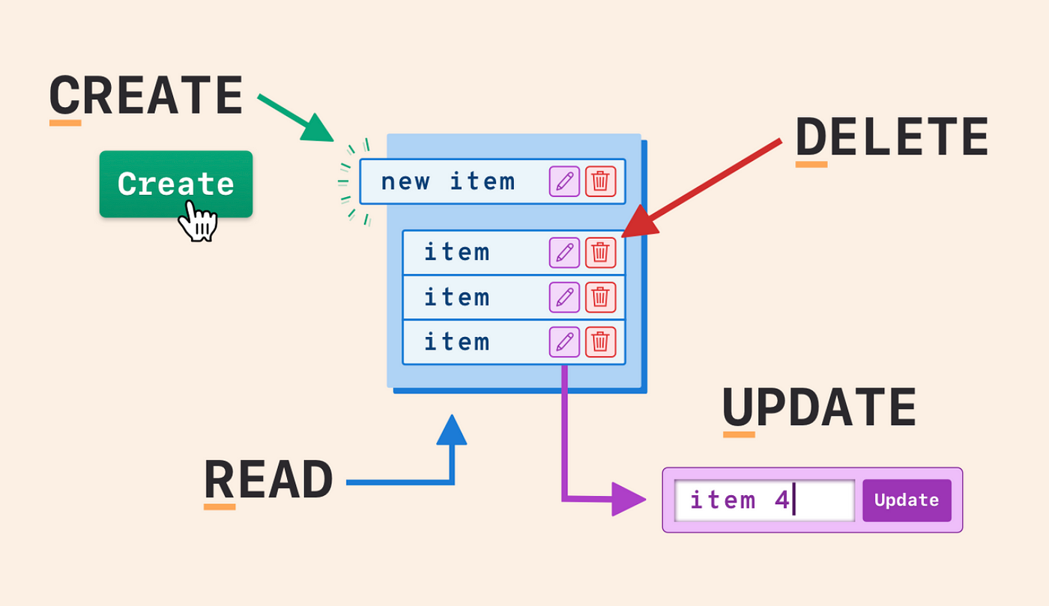
What is CRUD?
CRUD is an acronym that stands for Create, Read, Update, and Delete.

Slide 4
CREATE Operation
Create:
In Databases: Refers to creating new records. In SQL, this is typically done with the INSERT statement.
In Web APIs: Often associated with the HTTP POST method to create a new resource.

Slide 5
READ Operation
Read:
In Databases: Involves querying and retrieving data. This is usually achieved using the SELECT statement in SQL.
In Web APIs: Corresponds to the HTTP GET method for retrieving data.

Slide 6
Update (Full vs Partial)
Update:
In Databases: Refers to modifying existing records. The UPDATE statement in SQL is used for this purpose.
In Web APIs: Generally maps to the HTTP PUT or PATCH methods. PUT is often used for updating entire resources, whereas PATCH is used for partial updates.

Slide 7
DELETE Operation
Delete:
In Databases: Means removing existing records. This is done with the DELETE statement in SQL.
In Web APIs: Corresponds to the HTTP DELETE method for removing resources.

Slide 8
Introduction of Jmeter.
JMeter is an open-source performance testing tool.
Developed by the Apache Software Foundation.
It is written in Java.
It is designed to test the performance, load, and scalability of the application.

Slide 9
JMeter Interface
Explain About Jmeter Shortcuts and menus.

Slide 10
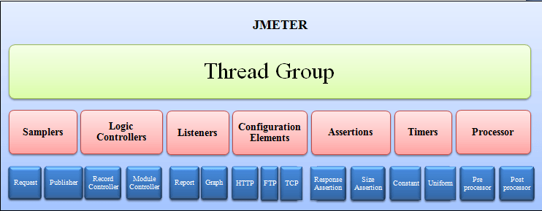
Jmeter Elements

Slide 11
List of Elements that will explore
Thread Group :- number of users
Samplers :- Type of request that will send.
Listeners :- it represent different type of reports.

Slide 12
Create Test Plan
:- Creating First Test in JMeter (Get Request)
:- Create test plan.
:- add Thread group
:- add Sampler
:- add Listeners as View Result in tree and Table. Explain it.
:- Run it.
:- Can use gmail.com, www.google.com, restful-booker.herokuapp.com

Slide 13
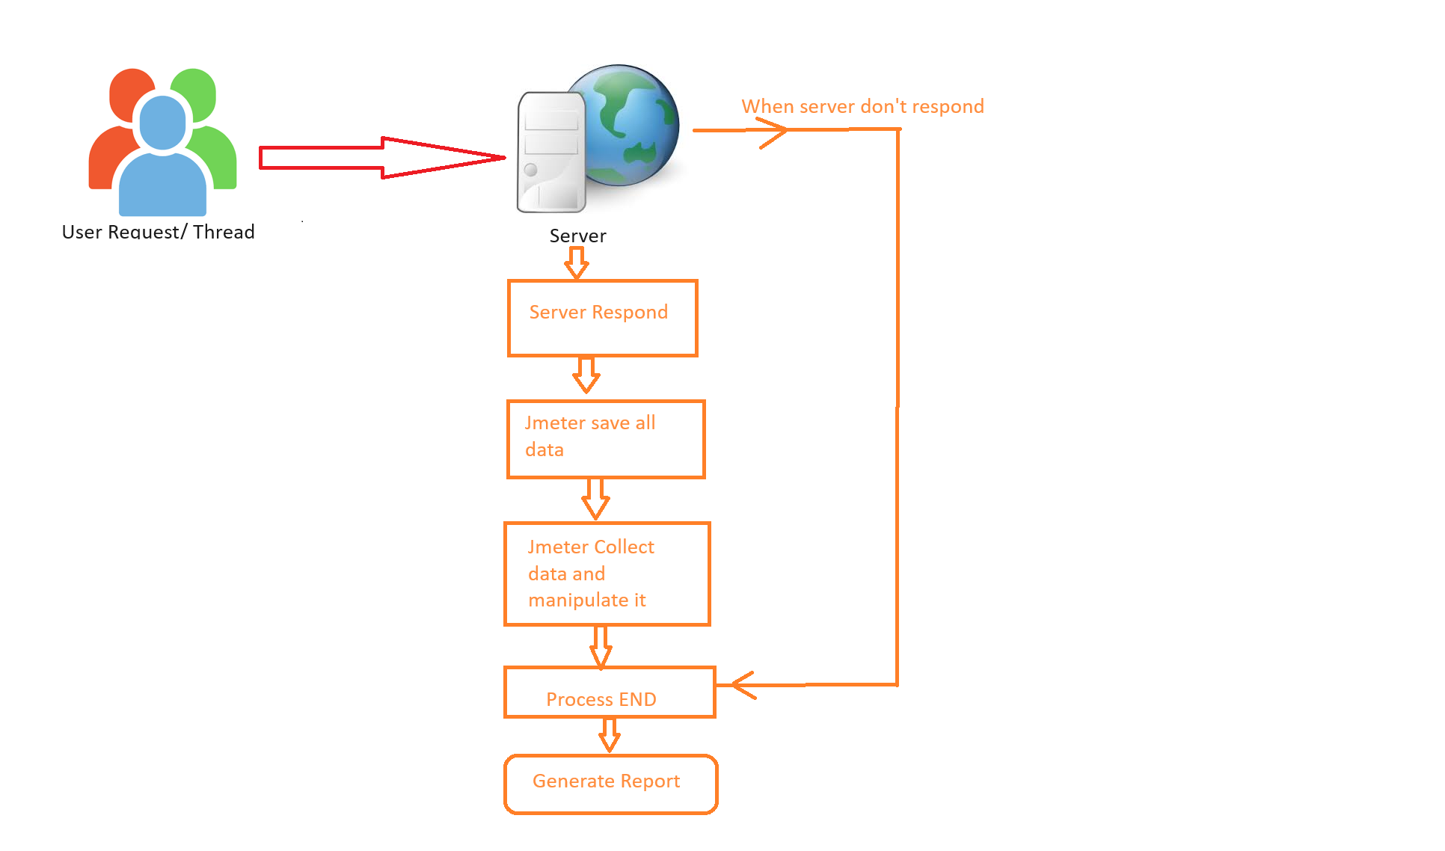
Request Diagram

Slide 14
Create Test Plan
:- Creating First Test in JMeter (Post Request)
:- Create test plan.
:- add Thread group
:- add Sampler
:- add Listeners View Result in tree and Table. Explain it.
:- Run it.
:- Can use restful-booker.herokuapp.com

Slide 15
How To Perform CRUD Operation in the Jmeter
:- How to Fetch the Response data and store into The Variable.
:- How to Pass the Variable in the Header and URL.
:- How to verify The status code Using Assertion.

Slide 16
Easy Way to Convert your API Test case into Jmeter Test case Using the https://loadium.io/new-test

Slide 17
Record and Play
:- https://www.blazemeter.com/
:- blazemeter IDE

Slide 18
Thanks, for attending Class
I hope you liked it.

