Slide 1




Time-Bounded, Thread-Based Live Migration of Virtual Machines
Kasidit Chanchio and Phithak Teankaew
Vasabilab
Dept of Computer Science,
Faculty of Science and Technology,
Thammasat University
http://vasabilab.cs.tu.ac.th
Notes:
Good afternoon, my name is kasidit chanchio. Today, I am going to talk about TLM

Slide 2

Outline
Introduction
Virtual Machine Live Migration
Time-bound, Thread-based Live Migration
Experiments
Conclusion and Future Works
Notes:
First I will give an introduction. Then, tell you about exiting VM live migration mechanism. And, I will present our approach follow by experiments anc conclude the presenattion.

Slide 3
Introduction
Cloud computing has become a common platform for large-scale computations
Amazon AWS offers 8 vcpus with 68.4GiB Ram
Google offers 8 vcpus with 52GB Ram
Applications require more CPUs and RAM
Big Data Analysis
Large Scale simulation
Scientific Computation
Legacy Applications, etc.

Slide 4
VM Migration
VM Live Migration is the ability to relocate a VM between two computers while the VM is running with minimal downtime
VM Live Migration has several advantages:
Load Balancing, Fault-Resiliency, Data Locality
Base on Solid Theoretical Foundation
[M. Harchol Balter and A. Downey, Sigmetric96]
Problem: Existing Mechanisms did not perform well on VMs running computation and memory intensive workloads
Notes:
So, what is VM migration?

Slide 5
Existing Mechanisms
Pre-copy: [kvm-1.3, Xen, vmware]
Copy partial VM state to destination repeatedly prior to switching over VM computation
Thread-based Pre-copy: [kvm-1.4 and later]
Pre-copy using a migration thread
Post-copy: [Hine et al. SIGOPS 09]
Switch over the computation before transfer VM state
Guided-copy: [Kim et al. SC13]
Post-copy that let computation on the source continue to determine order of memory page transfer
Notes:
Many machanisms have been propsed, but I am gong to discuss 4 significant ones here. The pre-copy mechanism is the most common mechanism. It’s used on kvm-1.3 and earlier, Xen, and vmware. The threaded-based per-copy is being implemented in kvm-1.4 and later. The post-copy published at SIGOPS and the Guided-copy presented at SC13.

Slide 6
Pre-copy
Transfer partial VM memory
2. Switch over VM computation
to destination when number of
remaining dirty page is small
enough to transfer all within a
tolerable downtime

Slide 7
Thread-based pre-copy
Transfer partial VM memory
2. Switch over VM computation
to destination
Add a migration thread to help
transfer VM state faster

Slide 8
Post-copy
1. Switch over VM computation
to destination
2. Transfer VM memory from source in one memory scan or get page on-demand

Slide 9
Guided-copy
1. Switch over VM computation
to destination
Source VM
continue to
trace order
of memory
access
2. Transfer VM memory like
in Post-copy

Slide 10
 | Migration time | Reliability | Computing Speed
Pre-copy | May be too long. Hard to configure parameters. | Abort migration when destination crash | Migration can interfere with VM computation
Threaded pre-copy | Better than pre-copy but suffer same problem. | Same as pre-copy | Better than pre-copy but need resource for thr
Post-copy | Time-bound by one memory scan | Loss computation if dest crashes. Need to check-point state on source. | Depends on how fast required pages arrived at destination
Guided-copy | Same as post-copy | Same as post-copy | Same as post-copy but better since right page order is known
Notes:
Slowdown always occur on both pre-copy and post-copy.

Slide 11
Our Approach
Time-bound, Thread-based Live Migration (TLM)
Migration Time:
TLM finishes within a bounded period of time,i.e., one round of memory scan, but
Performs with best efforts to minimize downtime
Reliability: TLM adopts pre-copy approach
Computation Speed: TLM acknowledges computation slowdown and tries to manage it
Notes:
We propose the …. Or TLM. In terms of migration time, .. For reliability, TLM follows the pre-copy approach. And, for the computation speed, TLM acknowlege that comp slowdown occur ducing migration and try to manage it.

Slide 12
TLM Design
VM State Transfer
Add two threads to source hypervisor
Mtx: scan entire ram
Dtx: new dirty pages
Use two receiver threads to dest
Optimization
Manage Resource Allocation and handle downtime minimization
VM State Transfer
Resource Management
Notes:
In this picture there are two hypervisor running at the source nd destination of migration. The hypervisir on the source originally consist of an io-thread and a number of vcpu threads.
The TLM design consists of two part. The first part is the vm state transfer mechanism that add two new threads, the mtx and dtx threads in the picture, to the hypervisor architecture to handle data transfer between the source and destination f migration.
The second part is the resource management component that manage resource allocation and handle downtime minimization.

Slide 13
VM State Transfer
Stage 1
Set up 2 TCP channels
Start dirty bit tracking
Stage 2
Mtx transfers Ram from first to last page
Dtx transfers dirty pages
Stage 3
Stop VM
Transfer the rest
Notes:
VM state transfer operates in three stages. In the first stage, it create two TCP connections the L2-1 and 2-2 in the picture. And, it starts dirty bit tracking operation to track memory update activities of the VM.

Slide 14
VM State Transfer
Stage 1
Set up 2 TCP channels
Start dirty bit tracking
Stage 2
Mtx transfers Ram from first to last page
Dtx transfers dirty pages
Mtx skips transferring new dirty pages
Stage 3
Stop VM
Transfer the rest
Notes:
On the 2nd stage, the two threads namely the mtx and dtx tread start transfer data to destination. The mtx tread will scan memory from first to last page, and transfer non-dirty pages to destination. On the other hand, the dtx thread will repeatedly transfer dirty pages to destination until the mtx finish.
The dirty page information is periodically obtained from the kernel by the DU operation in the picture.

Slide 15
VM State Transfer
Stage 1
Set up 2 TCP channels
Start dirty bit tracking
Stage 2
Mtx transfers Ram from first to last page
Dtx transfers dirty pages
Stage 3
Stop VM
Transfer the rest of dirty pages
Notes:
Finaly, after the mtx thread finsh, TLM will stop the VM and transfer the rest of dirty pages to destination and resume VM computaton there.
So, in this design, the live migration cover stage 1 and 2 and the downtime will occur at stage 3.

Slide 16
Resource Management
We reduce downtime by over-committing many VM’s vcpus on a few host cpu cores.
Reduce dirty page generation rate and hence downtime
We reduce interference to VM computation by giving some of original VM’s host cpu cores to the mtx and dtx threads.
Notes:
In term of resource management, TLM manage CPU resources in the two ways: First, it try to reduce downtime by over-commit many VM vcpus on a few host CPU cores to reduce dirty page generation. Second, it may take some host CPU cores from VM computation and give them to the mtx and dtx threads.

Slide 17
Experiments
Measure Performance of Original KVM
Pre-copy and Threaded pre-copy
Measure and analyze TLM performance
TLM and TLM with Downtime minimization
Compare TLM’s over-committing v.s. KVM’s auto-convergence mechanisms
Notes:
Next, we conduct the following experiments. First, we evaluate the pre-copy and thread-based pre-copy versions of KVM. Then, we measure and analyze TLM performance. And, finally, we compare TLM over-commiting operation with the KVM auto-convergence mechanism

Slide 18
Experimental Setup
Each VM uses 8 vcpu
NAS Parallel Benchmark v3.3
OpenMP Class D (and MPI Class D in paper)
VM migrate from source to dest computer
Two separate networks:
10 Gbps for migration
1 Gbps for iperf
Iperf fires from supporting computer
VM disk image of migrating VM is on NFS
Notes:
In our experimental setup, we use 3 opteron servers. They are the source computer, the destination computer, and the supporting computer in the picture. Then , we create a VM with 8 vcpus core. It runs a workload taken from the NAS Parallel benchmark on it. We tested both OpenMp and MPI versions but we wil present only the OPenMP version here. The VM migrate from the source computre in the picture to the destination computer. There are two separate netpwrk in our test bed. The migration is perform over a 10 gbps netwprk. And, the vm communcation use the 1 gps network. We assume that source and destination vm share the same VM imge over NFS.

Slide 19
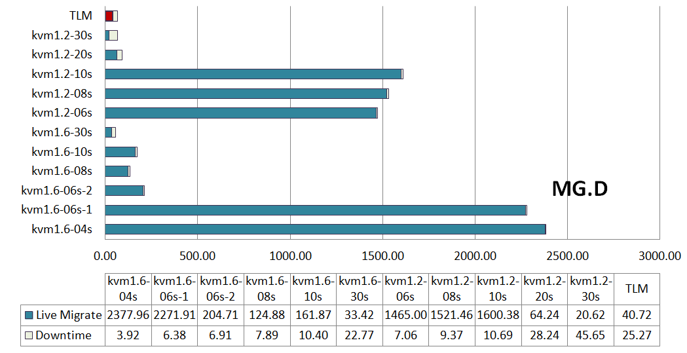
Kvm Migration and Downtime
kvm-1.x-<tolerable downtime>
1. Hard to find right
tolerable downtime
2. Same param may cause very different migration behaviors
Notes:
In the first experiment, we run kvm-1.2 that uses pre-copy migration mechanism and kvm 1.6 that use the thread-base precopy menchnsm.
In the experiment, we migrate a VM running MG class D using different tolerable downtime parameter. So, we found that if the tolerable downtime is too high, the migration will finish quiickly and have high downtime. But if we set it too low, the migration can take a long time. So, it is hard to find the right tolerable downtime value.

Slide 20
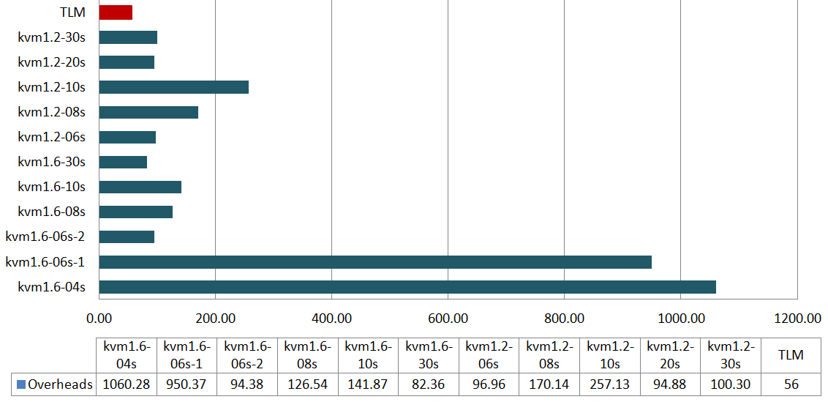
KVM’s Application Execution Overheads
Execution overheads = extra application execution time due to VM migration
Experiments with long migration time usually have high app execution overheads.
77% of
Exe time
Notes:
So, we define execution overhead as the exta appliction execution time that occurred due to vm migration.
And, when look at the execution overhand of the application, the longer that migration time, the longer the execution overhead.

Slide 21
TLM Notations
Migration Time = Live Migration time + Downtime
Offline: Time to migrate by stop VM & Transfer
TLM: TLM Migration time (3 sec DU epoch)
TLM.1S: Like TLM but do not transfer dirty pages to destination at all during Stage 2 and let Stage 3 transfer all dirty pages in one shot
0.2-(2): Over-commit VM’s 8 vcpus from 8 host cores to 2 host cores after 20% of live migration (i.e. progress of mtx thread)
Notes:
Now, before looking at TLM perforemce. We would like to introduce the following notation. TLM.1S is like TLM but it doesnot transfer dirty pages to destination during stage 2. We use it to measure the effectivenes of the dtx thread.

Slide 22
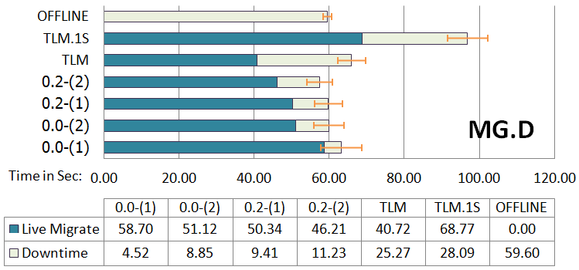
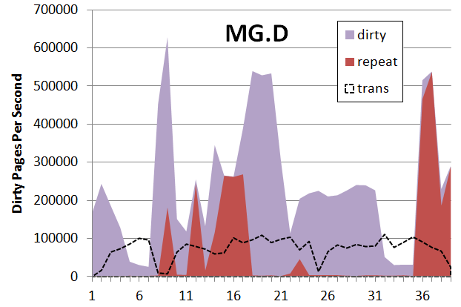
TLM Performance: Kernel MG Class D
36GB VM Ram, 27.3GB WSS
Low locality, 600,000 pages can be updated in one second but pages are transfer no more than 100,000 page/sec
Short live migration time because mtx skips a lot of pages
TLM shows much better migration time than TLM.1S
BUT have almost the same downtime (0.89 that of TLM.1S)
Notes:
In this slide, the right graph show dirty page genaration and transfer activities of the kernel MG benchamrk. Basically, the dirty page generation rate is much higher than the data transfer rate. You can see more detail in the paper. And, therefore, the downtime is high. But when we perform downtime minimization the downtime reduce significantly.

Slide 23
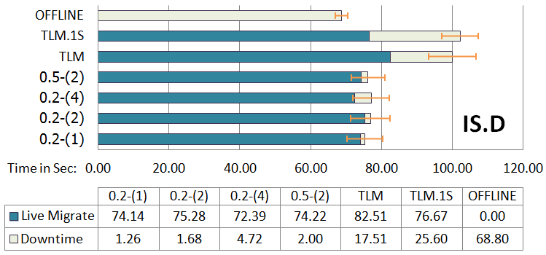
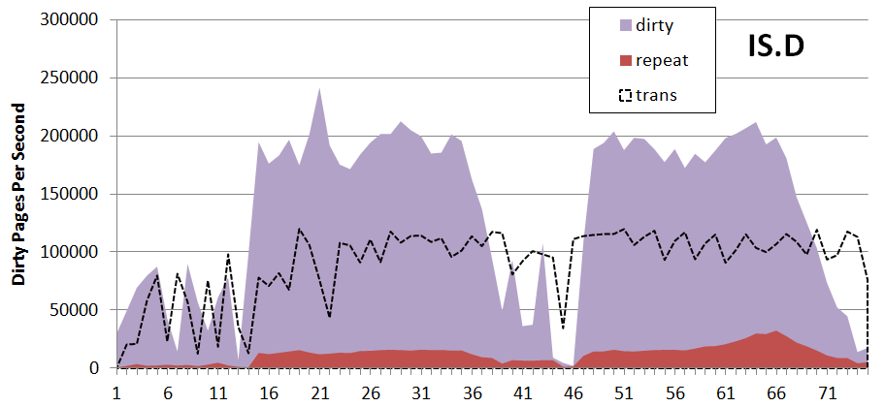
TLM Performance: Kernel IS Class D
36GB VM Ram, 34.1GB WSS
Update large amount of pages continuously
VM page transfer rate is about half of dirty page generation
The migration tome of TLM and TLM.1S are close
TLM downtime is about 0.68 of that of TLM.1S
Notes:
Dtx can help reduce downtime around 32%.

Slide 24
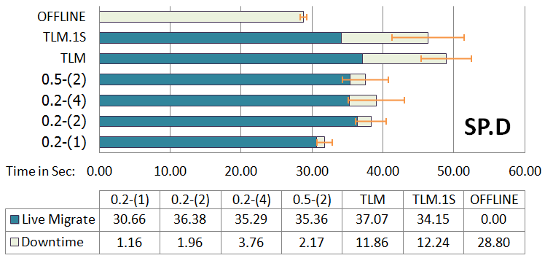
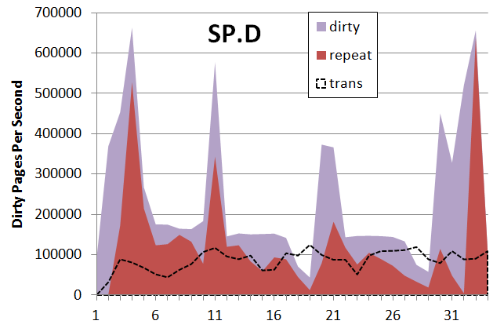
TLM Performance: Kernel SP Class D
16GB Ram, 12.1GB WSS
High locality, 700,000 pages can be updated in one second
TLM and TLM.1S migration time are close
TLM downtime is 0.96 of that of TLM.1S meaning dtx did not help reduce downtime much

Slide 25
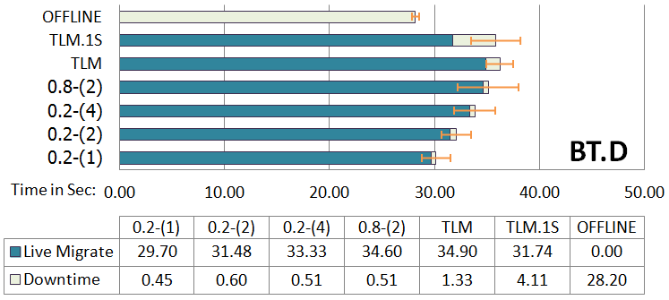
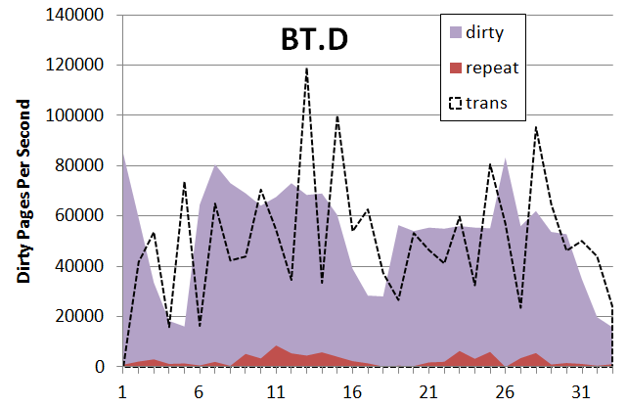
TLM Performance: Kernel BT Class D
16GB VM Ram, 11.8GB WSS
Dirty page generation rate is close to dirty page transfer rate
TLM migration time is close to that of TLM.1S
TLM downtime is 0.32 of that of TLM.1S (So, dtx is effective)

Slide 26
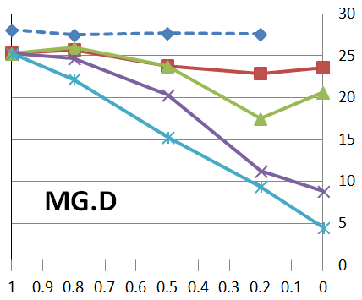
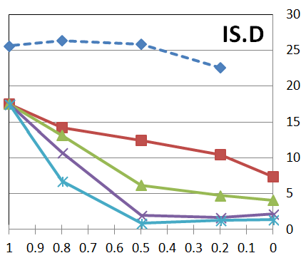
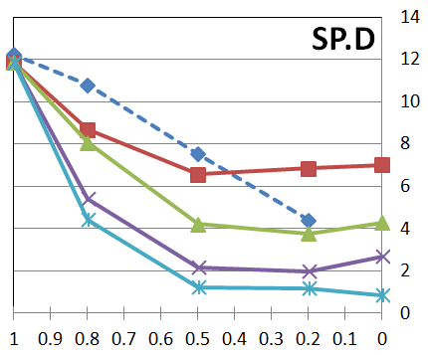
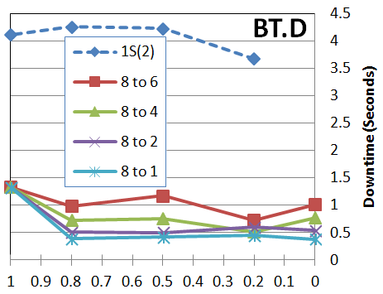
Downtime Minimization using CPU over-commit (1)
The lower the adjusted cores, the lower the downtime.
Each solid line represent different degree of host CPU cores reduction
“8 to 2” means reduction of host cores from 8 to 2
The sooner CPU over-commit starts, the lower the downtime.
Differ by Apps

Slide 27
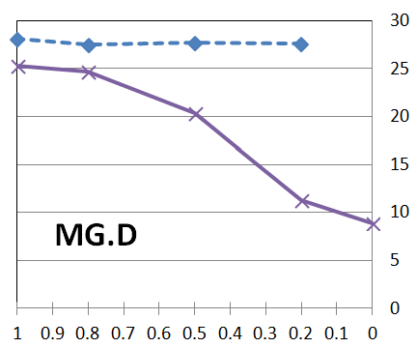
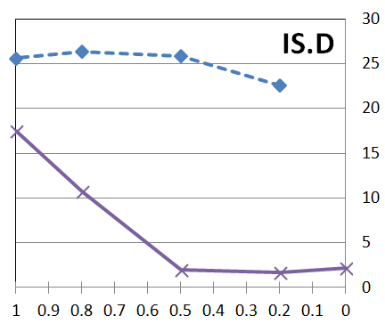
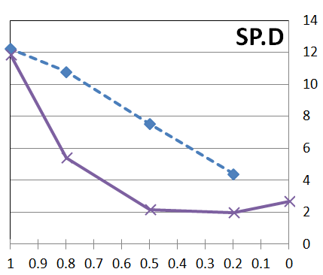
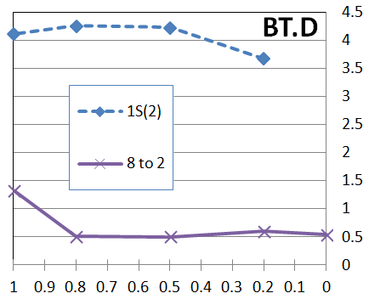
Downtime Minimization using CPU over-commit (2)
TLM shows lower downtime than TLM.1S when the number of host CPU core reduces.
1S(2) means running TLM.1S with the number of cores reduces to 2
“8 to 2” uses TLM
The sooner, the better

Slide 28
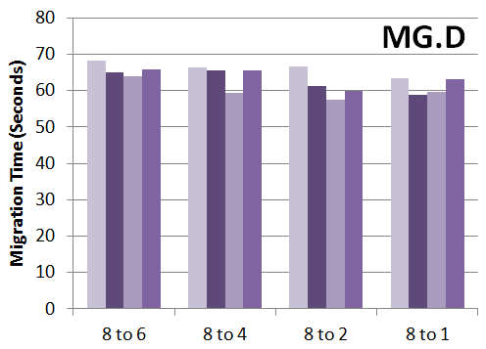
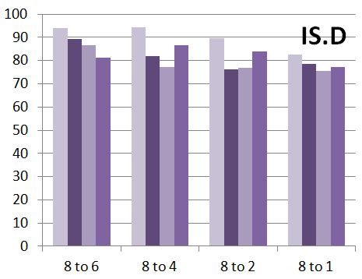
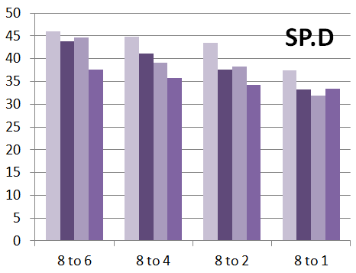
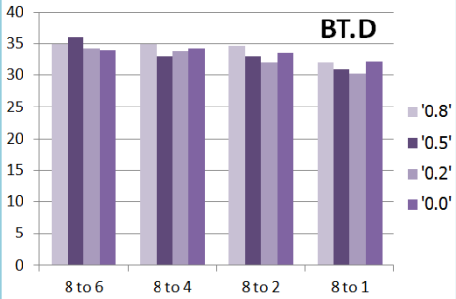
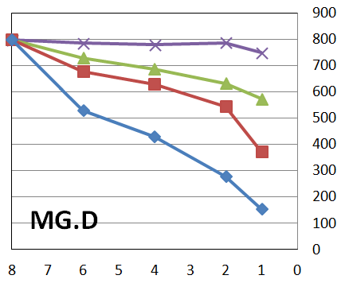
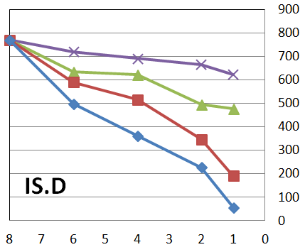
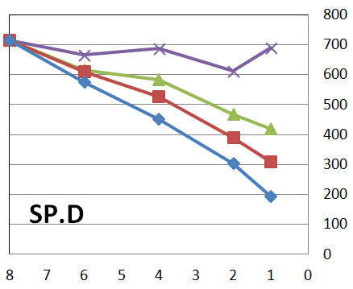
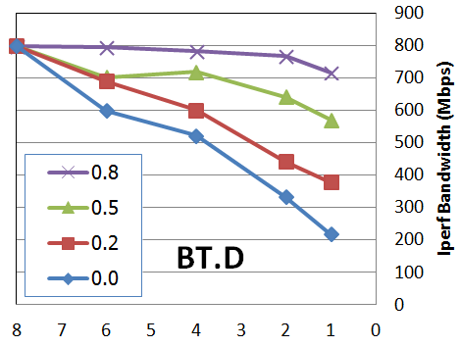
Migration Time and Iperf Bandwidth
When perform downtime minimization:
Migration time of all benchmark are slightly lower than TLM
Iperf bandwidth also reduce when available CPU cores is low

Slide 29
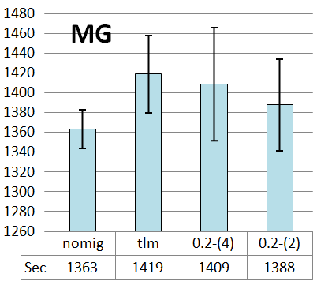
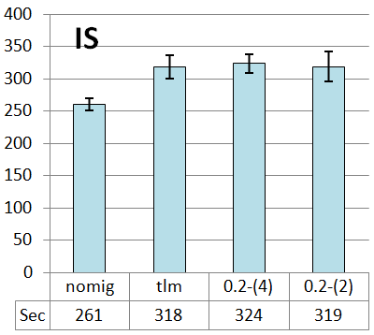
TLM Application Execution Time
The execution overheads of MG.D and IS.D are low since their migration times are low

Slide 30
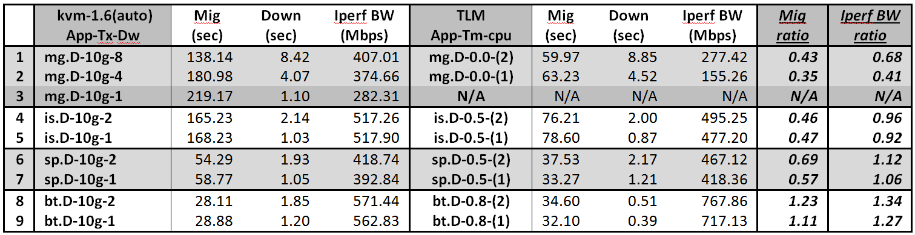
CPU overcommit vs Kvm Auto-convergence
KVM’s CPU auto-convergence was released last Oct.
After detect that migration does not converge (high dirty page generation), It pause VM cpu repeatedly (every 40 msec) for a short period of time (3 msec) until pre-copy migration finish
On MG, It can achieve lower downtime than CPU over-commit, but have approximately 2x migration time
It is more intuitive : no parameter requires

Slide 31
Conclusion and Future Works
We have proposed a new time-bound design to pre-copy migration
Require migration to finish in a bound time period and
Provide best effort downtime minimization
CPU over-commit can help provision resource for migration thread and reduce downtime
Our TLM prototype are practical for both OpenMP and MPI memory intensive benchmarks
Apply TLM for Time-bound live VM checkpointing
Develop automatic downtime minimization mechanism
Software available at http://vasabilab.cs.tu.ac.th/projects/TLM.html
Thank you. Questions?

Slide 32
BACKUP

Slide 33
Problems
Migration time: Pre-copy & Threaded pre-copy
Pre-copy may not converge or may take too long
Pre-copy migration parameters are hard to configure
Tolerable Downtime, Maimum Migration time , Maximum Data Transfer Bandwidth
The longer the migration time, the higher the VM execution overhead
Post-copy is time-bound by one memory scan

Slide 34
Problems
Reliability: Post-copy & Guided-copy
Post-copy may lose computation and need to send updated VM stste back to the source for backup
Pre-copy can simply abort migration and resume computation on source
Computation Speed: All cause slowdown
Pre-copy and Thread pre-copy mechanisms may interfere with VM computation
In Post-copy, computation speed at destination depends on how fast required pages are delivered
Gilded-copy improve the delivery rate since the required page order is known

Slide 35
Problems
Existing solutions cannot handle VMs with large-scale computation and memory intensive workloads well
Takes too long to migrate
Have to migrate offline
E.g. Migrate a VM running NPB MG Class D
8 vcpus, 36 GB Ram
27.3 GB Working Set Size
Can generate over 600,000 dirt pages in a sec.

Slide 36
Notations
Live Migrate: Time to perform live migration where the migration is performed during VM computation
Downtime: Time the VM stop to transfer the last part of VM state
Migration Time = Live Migrate + Downtime
Pre-copy Migration takes two Parameters:
Tolerable Bandwidth: The BW given for a single burst of data transfer [Default 33.5 MB/s]
Tolerable Downtime: The acceptable downtime [30 msec]

Slide 37
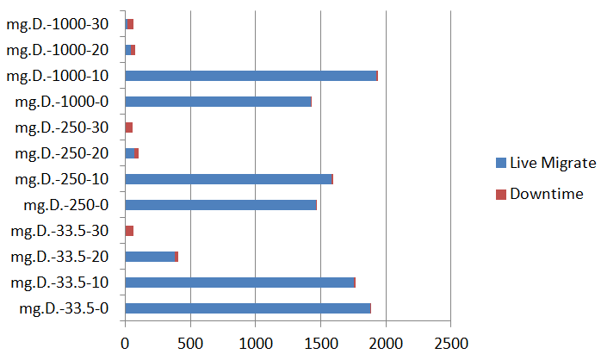
E.g. Migration of MG.D
Tolerable Bw-Dt
MG.D Finish: 1352 sec
Too
long
Default Params

Slide 38
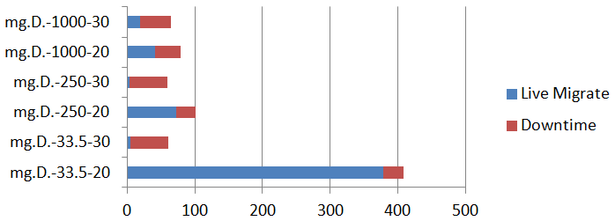
E.g. Migration of MG.D
Offline-Like
OK
Usually takes too-long to migrate in default mode
Determining the right tolerable bandwidth
and downtime is hard

