Slide 1

HR Promotion Prediction Model
By: Victor Abril-Sanchez, Sydney Penny, Chris Cruz

Slide 2
Introduction
In this project we use a HR dataset retrieved from Kaggle.com to run a model that predicts employee promotions. The dataset is from a multinational corporation that wanted to identify eligible promotion candidates sooner to expedite promotion processes. For our purposes we use the data set to predict likelihood of promotion and what features influence that outcome.

Slide 3

The Dataset
13 columns
54,808 rows
Features include:
Age
Gender
Number of trainings
Previous year trainings
Awards won
Average training score
Length of service
eduction

Slide 4

Exploratory Data Analysis in Tableau
HR Prediction Analysis

Slide 5

Database Creation
Utilizing PySpark
Created spark session
Set the partitions
Import the CSV file
Create a dataframe
Create a view
Select the Data

Slide 6

Data Cleaning
Assigning the correct numeric and categorical data type to each feature
Checking for duplicate values
Dropping unnecessary columns
employee_id
region
Filling missing values
education feature with the mode
previous_year_rating with zero values

Slide 7

Data Cleaning
Assigning the correct numeric and categorical data type to each feature

Slide 8
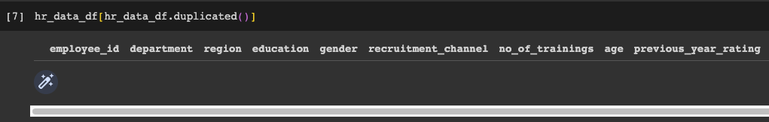
Data Cleaning
Checking for duplicate values

Slide 9
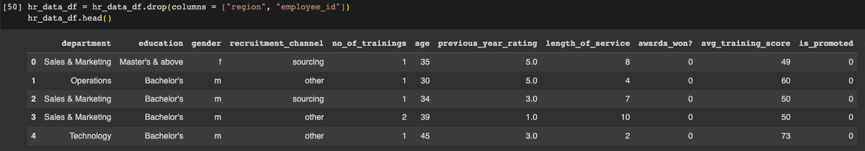
Data Cleaning
Dropping unnecessary columns
employee_id
region

Slide 10
Data Cleaning
Filling missing values
education feature with the mode
previous_year_rating with zero values

Slide 11

Preprocessing of Features
Encoding categorical features
categorical variables into dummy or indicator variables
Oversampling data
Synthetic Minority Oversampling Technique
Scaling data
Standard scaler
Split data
Features and label into training and testing data
Notes:
A dummy or indicator variable can have a value of 0 or 1. Using get_dummies()
One approach to addressing imbalanced datasets is to oversample the minority class. The simplest approach involves duplicating examples in the minority class, although these examples don’t add any new information to the model. Instead, new examples can be synthesized from the existing examples. This is a type of data augmentation for the minority class and is referred to as the Synthetic Minority Oversampling Technique, or SMOTE for short.
removes the mean and scales each feature/variable to unit variance

Slide 12

Preprocessing of Features
Encoding categorical features
categorical variables into dummy or indicator variables
Notes:
A dummy or indicator variable can have a value of 0 or 1. Using get_dummies()
One approach to addressing imbalanced datasets is to oversample the minority class. The simplest approach involves duplicating examples in the minority class, although these examples don’t add any new information to the model. Instead, new examples can be synthesized from the existing examples. This is a type of data augmentation for the minority class and is referred to as the Synthetic Minority Oversampling Technique, or SMOTE for short.
removes the mean and scales each feature/variable to unit variance

Slide 13

Preprocessing of Features
Oversampling data
Synthetic Minority Oversampling Technique
Notes:
A dummy or indicator variable can have a value of 0 or 1. Using get_dummies()
One approach to addressing imbalanced datasets is to oversample the minority class. The simplest approach involves duplicating examples in the minority class, although these examples don’t add any new information to the model. Instead, new examples can be synthesized from the existing examples. This is a type of data augmentation for the minority class and is referred to as the Synthetic Minority Oversampling Technique, or SMOTE for short.
removes the mean and scales each feature/variable to unit variance

Slide 14

Preprocessing of Features
Scaling data
Standard scaler
Notes:
A dummy or indicator variable can have a value of 0 or 1. Using get_dummies()
One approach to addressing imbalanced datasets is to oversample the minority class. The simplest approach involves duplicating examples in the minority class, although these examples don’t add any new information to the model. Instead, new examples can be synthesized from the existing examples. This is a type of data augmentation for the minority class and is referred to as the Synthetic Minority Oversampling Technique, or SMOTE for short.
removes the mean and scales each feature/variable to unit variance

Slide 15
Preprocessing of Features
Split data
Features and label into training and testing data
Notes:
A dummy or indicator variable can have a value of 0 or 1. Using get_dummies()
One approach to addressing imbalanced datasets is to oversample the minority class. The simplest approach involves duplicating examples in the minority class, although these examples don’t add any new information to the model. Instead, new examples can be synthesized from the existing examples. This is a type of data augmentation for the minority class and is referred to as the Synthetic Minority Oversampling Technique, or SMOTE for short.
removes the mean and scales each feature/variable to unit variance

Slide 16


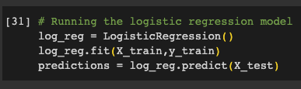
Machine Learning Models
Binary Classification models:
Random Forest
Logistic Regression

Slide 17
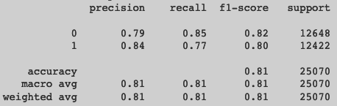
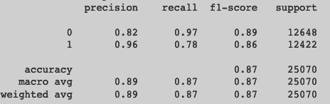
ML Models Classification Report
Random Forest
Logistic Regression

Slide 18
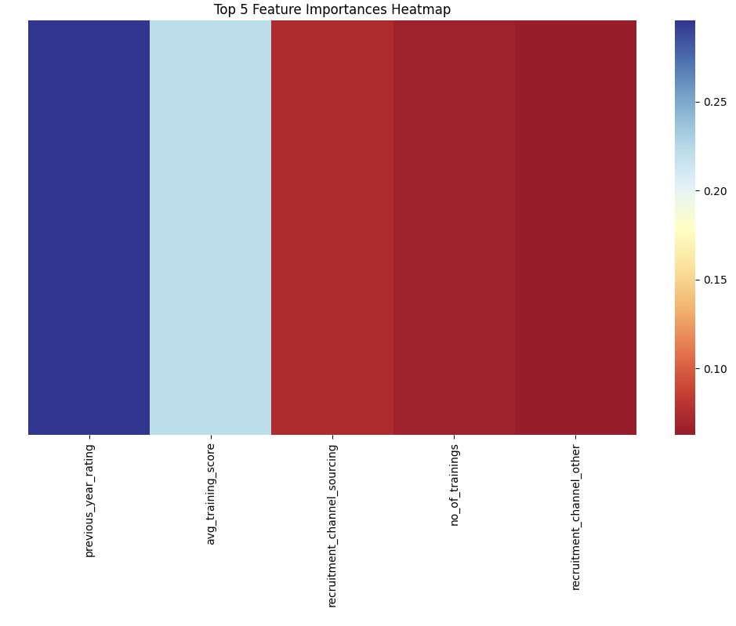
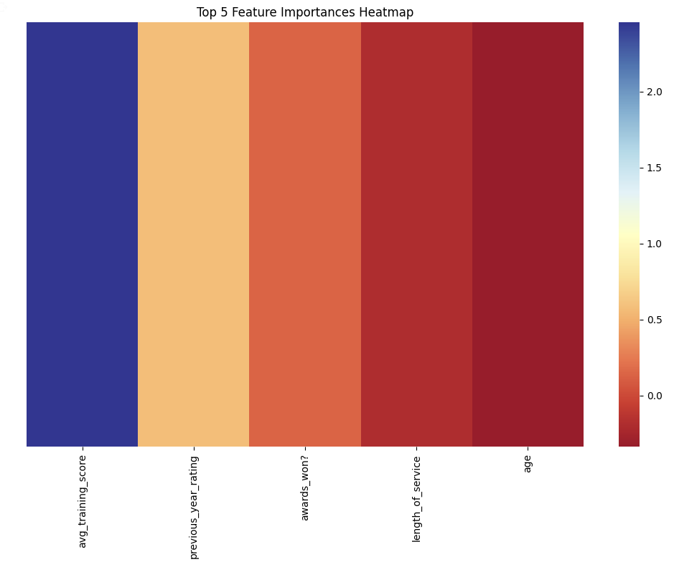
Feature Importance
Random Forest feature importance
Logistic Regression feature importance
Notes:
Syd

Slide 19
Future Work
Balanced dataset
Exploration of top feature importances
Do the top features vary by company, country, etc ?
Notes:
syd

Slide 20

Key Takeaways
Hr Prediction Analysis - Post
Notes:
syd

Slide 21

Q&A
Notes:
syd

