Slide 1


Introduction to Machine Learning
Machine learning is a branch of artificial intelligence that enables computers to learn from data and make decisions.
Extracting patterns, fitting data to functions, classifying data, etc
ML systems can learn and improve
With historical data, time and experience
Bridges theoretical computer science and real noise data.

Slide 2

What is Machine Learning?
focuses on the development of algorithms which enable computers to learn and make decisions without explicit programming.
It involves the use of data to train models that can make predictions or decisions based on the input.

Slide 3

Types of Machine Learning Models
Supervised Learning: In this model, the algorithm learns from labeled data.
Unsupervised Learning: The algorithm learns from unlabeled data to find hidden patterns.
Reinforcement Learning: It involves an agent learning to make decisions in an environment.

Slide 4
2 groups of problems:
Classification
Regression
Classification
Predicts which class a given sample of data (sample of descriptive features) is part of (discrete value).
Regression
Predicts continuous values.

Slide 5
Define Objectives
Data Preparation
Model Building
Model Deployment
Model Evaluation

Slide 6
Supervised Learning
fjrth
1
Data Collection
Obtain labeled training data from various sources.
2
Model Training
Use the labeled data to train the model to make predictions.
3
Evaluation
Assess the model's performance using test data to validate accuracy.

Slide 7
Unsupervised Learning
Clustering
Dimensionality Reduction
Applications
Unsupervised learning includes clustering algorithms, which group similar data points without predefined categories.
Applications include anomaly detection, pattern recognition, and market segmentation, among others.
It also involves dimensionality reduction techniques, which reduce the number of input variables while preserving meaningful information.

Slide 8
Reinforcement Learning
Trial and Error
Rewards and Penalties
Reinforcement learning involves learning from experience through trial and error.
Agents learn to take actions to maximize cumulative rewards and minimize penalties.
Exploration vs Exploitation
Trade-off between exploring new actions and exploiting known actions for maximum reward.

Slide 9
Life Cycle of Machine Learning
1
Data Collection
Gathering relevant data sources
2
Data Preparation
Cleaning and preprocessing data
3
Model Building
Constructing the machine learning model
Model Deployment
4
Implementing the model in a production environment
The life cycle of machine learning involves several key stages. It begins with data collection, followed by data preparation to ensure the data is usable for training the model. The next step is model building, where the actual machine learning model is constructed. Finally, the model is deployed and implemented in a real-world setting to make predictions and provide value.

Slide 10
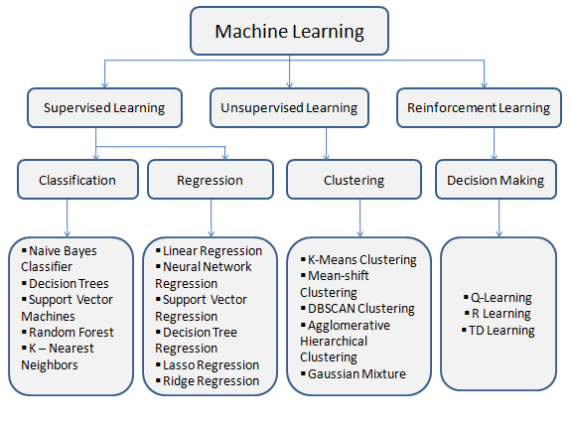

Slide 11
Data Collection and Preparation
Data Sources
Data Cleaning
Identify and gather data from various sources such as databases, APIs, and files.
Process of cleaning and transforming raw data to remove inconsistencies and errors.
Data Pre-processing
Exploratory Data Analysis (EDA)
Prepare the data for modeling through normalization, feature scaling, and encoding.
Understand the structure and patterns in the data through visualization and statistical methods.

Slide 12
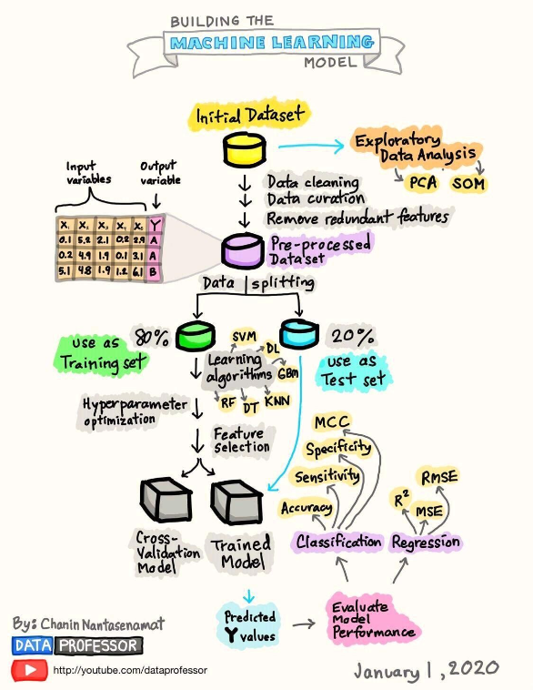
Model Building and Training
Once the data is collected and prepared, the next stage is building and training the machine learning model. This involves selecting the appropriate model, designing the architecture, and training the model with the prepared data. The goal is to create a model that can accurately predict or classify new data.

Slide 13



Model Deployment and Monitoring
Deployment Process
Model Accuracy Monitoring
Performance Tracking
Deploying a model involves deploying it to a production environment and making it available for use.
Tracking the performance metrics of the model to identify any degradation in performance.
Monitoring the accuracy of the deployed model to ensure it continues to perform well over time.

