Slide 1
Features of

Slide 2
What is wireshark?
Wireshark is a free and open source packet analyzer

Slide 3
What is packet analyzer?
Also known as Packet Sniffer / Network Protocol Analyzer
Packet analyzer has the ability to grab the raw packet from the wire, wireless, Bluetooth, VLAN, PPP, and other network types, without getting processed by the application

Slide 4
Packet sniffer structure

Slide 5
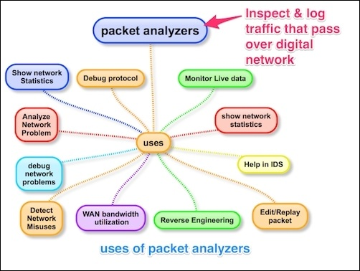
Uses of packet analyzers

Slide 6
What is wireshark contd..
Wireshark is cross-platform, using the Qt widget toolkit in current releases to implement its user interface, and using pcap to capture packets; it runs on Linux, macOS, BSD, Solaris, some other Unix-like operating systems, and Microsoft Windows.
There is also a terminal-based (non-GUI) version called TShark

Slide 7
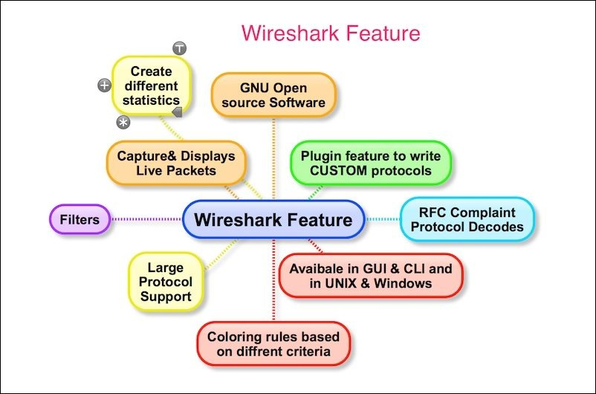
Features of wireshark

Slide 8
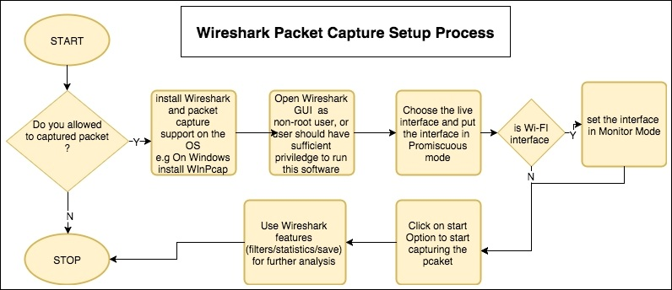
Wireshark packet capture process

Slide 9
Promiscuous mode
When a network card is in promiscuous mode it accepts all packets, even if the destination MAC of the frame does not match it's own MAC.

Slide 10
Normal Mode

Slide 11
Promiscuous mode

Slide 12
Demo - wireshark ui
Wireshark interface list
Wireshark UI overview
Packet List pane
Packet Details pane
Packet Bytes pane

Slide 13
What is wireshark contd..,
Wireshark is very similar to tcpdump, but has a graphical front-end, plus some integrated sorting and filtering options.
tcpdump is a command line network sniffer, used to capture network packets
$ tcpdump -i <interface> -w <some-file>

Slide 14
Demo # capturing with tcpdump for viewing with wireshark
Perform tcpdump operation
Open the tcpdump output file into Wireshark

Slide 15
Demo - Exporting specific data from wireshark
Lets see a demo on how to export data

Slide 16
Coloring rules/Color filter
both coloring rules and display filters share the same syntax

Slide 17
Demo # - coloring rule

Slide 18
Filters
Filters
Capture Filter
Display Filter

Slide 19
Why use capture filter
This gives you the facility to capture what you want to capture—others will be discarded
Capturing only traffic that meets your requirement is really useful when you have a large volume of packets flowing around. Creating your own custom

Slide 20
Berkley Packet Filter (BPF) syntax is used to create capture filters
The syntax is as follows:
Identifiers: This is the value that you are looking for in your packets. For example, if you are filtering the packets for a certain IP address, then your capture filter will look something like host 192.168.1.1, where the value 192.168.1.1 is an identifier.
Qualifiers: These are categorized into three different sections:
Type: There are three types of type qualifiers: host, port, and net. In short, a type qualifier refers to the name or the number that your identifier refers to. For example, in your host 192.168.1.1 filter, host is the type qualifier.
Direction: Sometimes, when you need to capture packets from a particular destination or source, we can specify direction qualifiers as well. For example, in the src host 192.168.1.1 capture filter, src specifies that we've to capture packets originating from a specific host only. Likewise, if you specify dst host 192.168.1.1, would capture packets only destined to host 192.168.1.1.
Proto: This refers to protocol qualifiers that give us the feature where we can mention the specific protocol that we want to add in our expression for capture purposes. For example, if you want to capture http traffic coming from your host 192.168.1.1, then your expression will look something like src host 192.168.1.1 and tcp port 80.

Slide 21
Filters | Description
host 192.168.1.1 | All traffic associated with host 192.168.1.1
port 8080 | All traffic associated with port 8080
src host 192.168.1.1 | All traffic originating from host 192.168.1.1
dst host 192.168.1.1 | All traffic destined to host 192.168.1.1
src port 53 | All traffic originating from port 53
dst port 21 | All traffic destined to port 21
src 192.168.1.1 and tcp port 21 | All traffic originating from 192.168.1.1 and associated with port 21
dst 192.168.1.1 or dst 192.168.1.2 | All traffic destined to 192.168.1.1 or destined to host 192.168.1.2
not port 80 | All traffic not associated with port 80
not src host 192.168.1.1 | All traffic not originating from host 192.168.1.1
not port 21 and not port 22 | All traffic not associated with port 21 or port 22
tcp | All tcp traffic
Ipv6 tcp or udp host www.google.com ether host 07:34:aa:b6:78:89 | All ipv6 traffic All TCP or UDP traffic All traffic to and from Google's IP address All traffic associated with the specified MAC address

Slide 22
Name resolution tries to convert some of the numerical address values into a human readable format
Resolve MAC Addresses (MAC Layer)
Wireshark will ask the operating system to convert an Ethernet address to the corresponding IP address
If the ARP name resolution failed, Wireshark tries to convert the Ethernet address to a known device name, which has been assigned by the user using an ethers file
If neither ARP or ethers returns a result, Wireshark tries to convert the first 3 bytes of an ethernet address to an abbreviated manufacturer name
Resolve network names (Network Layer)
Wireshark will use a name resolver to convert an IP address to the hostname associated with it (e.g. 216.239.37.99 → www.1.google.com)
Resolve transport names (Transport Layer)
Wireshark will ask the operating system to convert a TCP or UDP port to its well known name (e.g. 80 → http)
Name Resolution drawbacks
The resolved names are not stored in the capture file or somewhere else
DNS may add additional packets to your capture file

Slide 23
Ways to create display filter
By applying display filters from the Display Filter window
By typing in the display filter syntax (using autocomplete)
By applying display filters from the Conversations (or Endpoints) window
By applying saved display filters from Filter Expression Buttons
Using the Expressions button for assistance creating filters
Using right-click menus on specific packet fields

Slide 24
Display filter examples (Filter by Port, IP, Protocol)
Source IP Filter
ip.src == 192.168.1.1
Destination IP Filter
ip.dst == 192.168.1.1
Filter by Protocol
http
Arp
Filter by Port Number
tcp.port eq 80
Displays all HTTP GET requests
http.request

Slide 25
reference
Packet Analysis with Wireshark (Book) – by Anish Nath
Mastering Wireshark (Book) – Charit Mishra
Wikipedia
https://blog.packet-foo.com/2016/11/the-network-capture-playbook-part-3-network-cards/
Wireshark.org
http://users.edinboro.edu/dtucker/IT610/EtherealLab1.htm

Slide 26
Feedback is appreciated ☺
http://bit.ly/2B3pe7I
-நன்றி

