Slide 1

TRIE-BASED LAN FILE SEARCH ENGINE
SUB CODE: CS6111
SUB NAME: COMPUTER NETWORKS
MENTOR: Mrs. C.M. Nagasudha
KARTIKEYAN T.R / 2020503520
SURIYAA V / 2020503550
GURU RAMAN C / 2020503510

Slide 2
DOMAIN: COMPUTER NETWORKS
SUB - DOMAIN: FILE SYSTEMS

Slide 3
ABSTRACT
When a group of networks are connected using LAN they form a private network where each computer has its own private IP address.
This project basically makes use of this network and private IP addresses to share and access files between computers connected to a Local Area Network either through WiFi or Ethernet

Slide 4
OBJECTIVES:
Enable the user to have instant information about any file in that computer and other computers in the network.
Obtaining the locations of not only the particular file which we search but also the files with similar names on the network so that the file can be searched even if its exact name is not known.
Enable one to find out the file extensions. One need to just mention the name or any substring of the file & the software would tell the path along with their extensions.

Slide 5
PROBLEM STATEMENT
Accessing Files from multiple systems in a network is quite difficult and a Slow process.
Solving this problem using an Efficient and Optimized Trie based File Searching Algorithm for accessing files in a Local Area Network

Slide 6
LITERATURE SURVEY
Paper Name | Publisher | Methodology | Drawbacks
Research and Implementation of File Search Engine | Communication Software and Networks (ICCSN) Journal, 2018 IEEE Journal | Under the situation of more and more FTP site resources in the education network Optimizing the file search using an inverted index technology for a high-performance FTP search engine. | The file engine uses an brute force algorithm
Usage of a binary integrated spell check algorithm for an upgraded search engine optimization | IEEE Measurement Sensors, Volume 24, 2022 | To augment the power of such engines - even while offline - was the goal. To accomplish this, a distinct offline search engine was created to retrieve data from archives. | The algorithm is not used in file search engine and becomes inefficient in some cases
Research on knowledge search engine based on personalized archives | CIBDA 2022, International Computer Information and Big Data Applications | Improved accuracy of user search through user preference model and synonym conversion model. | Not yet used in file search engine and based on preferences which acts as a negative

Slide 7
EXISTING SYSTEM
In the existing system of file search engines, it is hard to look at information and search for data on multiple systems at a time.
A query is passed as is then searched. This way of searching can lead to many errors and is also an inefficient way of searching.
The latency time to search for the files is very high especially if searched in a network.

Slide 8
PROPOSED TRIE SEARCH:
Pack the query entered by the user into a standard format and searching is done using an Efficient Trie based Algorithm that makes searching easier and more efficient.
Setting up the search engine in the LAN-connected computer environment so that files can be searched on any computer from a single computer on the network.
In the future, combine AI and voice search into the system to make the search more efficient and easier.

Slide 9
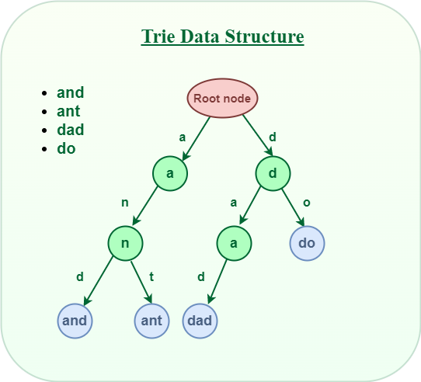
WHAT IS A TRIE ?
Trie is a type of k-ary search tree used for storing and searching a specific key from a set. Using Trie, search complexities can be brought to optimal limit (key length).
Searching -> TIME COMPLEXITY :O(n)

Slide 10
TRIE SEARCH ALGORITHM
def FileSearch
for Every query do
Parse the query
if Query is Valid then
Send Parsed query to LAN network
Result=TRIE(Query)
if Result == true then
return file location
end if
return file not found
end if
end for

Slide 11
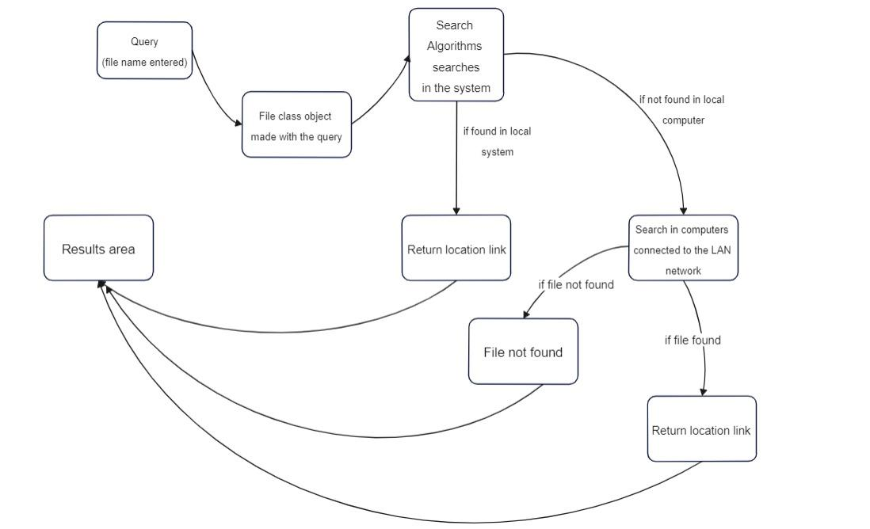
FLOW DIAGRAM

Slide 12
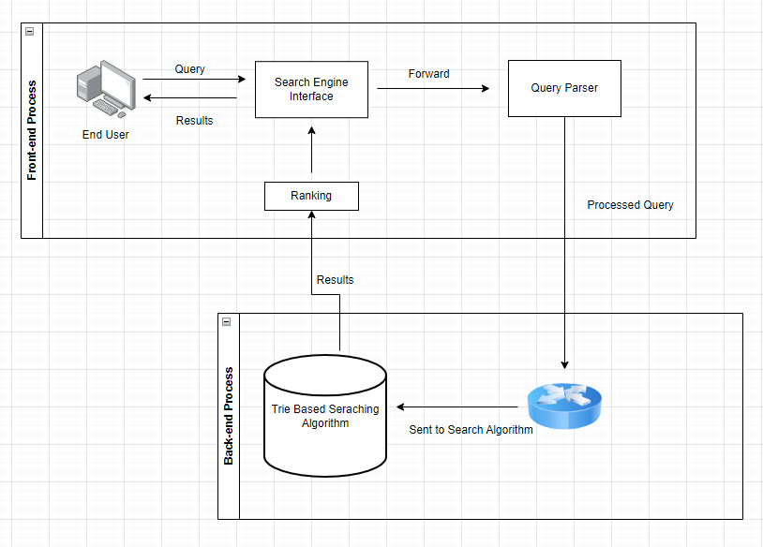
ARCHITECTURE DIAGRAM

Slide 13
TOOLS
Software Requirements:
C# / .NET Core
Windows / Linux
Hardware Requirements:
6 Gb RAM
256 Gb Hard Disk
Intel i3 / Ryzen 3

Slide 14
ANALYSIS
Why TRIE ?
TRIE is able to search more words in the same time than the brute force approach.
TRIE is faster in doing pattern recognition than brute force.

Slide 15

ANALYSYS (THEORETICAL)
For a word with given prefix of size ‘m’ lets say there are ‘n’ words
TRIE
Brute Force
O(n+m)
Time
Time
Time
O(m)
Prefix Length
Prefix Length
Prefix Length
O(n+m)
Time
O(m)
Prefix Length

Slide 16
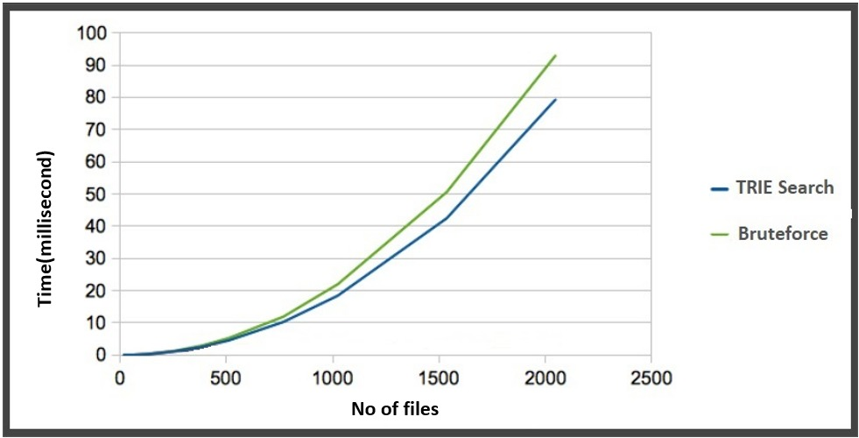
TIME ANALYSIS
No of files | Time Trie | Time Bruteforce
500 | 5 | 5.7
1000 | 16.5 | 20
1500 | 40 | 48.5
2000 | 70 | 80

Slide 17

IMPLEMENTATION RESULTS

Slide 18
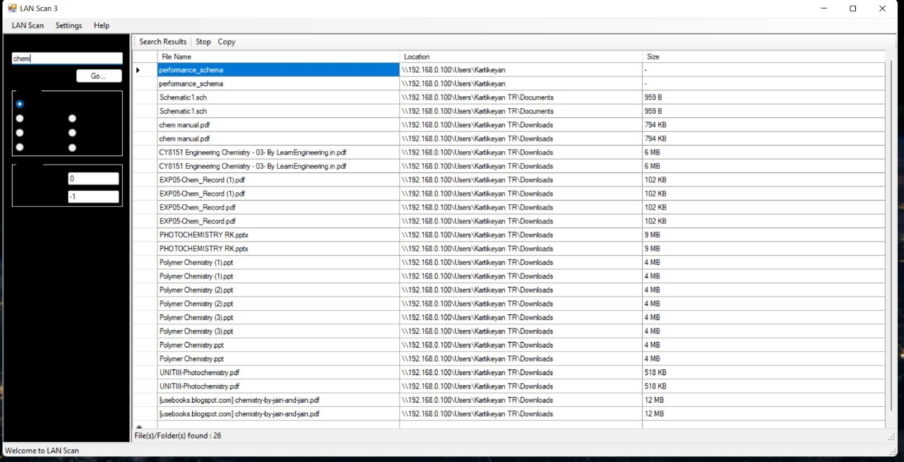
SCREENSHOT

Slide 19
RESULT
As we can infer from the analysis, the time taken for searching a file is lower using Trie data structure as compared to bruteforce.
Thus it can be shown that Trie search is more efficient in searching compared to bruteforce (recursive) search.

Slide 20
CONCLUSION
Thus the Trie File Search Engine is efficient in terms of time efficiency in searching all the connected systems.
As the trie searches for all the patterns, it will also be useful when only a part of a filename is known.
Though the Search Engine takes a little more space to execute, It is negligible, considering its time saving efficiency.

Slide 21
REFERENCES
S. Gowri, P.J. Sathish Kumar, K. Geetha Rani, R. Surendran, J. Jabez, Usage of a binary integrated spell check algorithm for an upgraded search engine optimization, Measurement: Sensors, Volume 24, 2022, 100451, ISSN 2665-9174,
Fang, B. & Zhang, Y.-Z. (2018). Design of high performance FTP search engine. 27. 67-70+75.
L. Ye, "Research on knowledge search engine based on personalized archives," CIBDA 2022; 3rd International Conference on Computer Information and Big Data Applications, 2022, pp. 1-5.

Slide 22

THANK YOU !!!

