Slide 1
Vasanth S
NMID :616749124A58147A3944E8F2F1EEB097
Final Project
3/21/2024 Annual Review

Slide 2
PROJECT TITLE
Grayscale Image Transformer
To convert grayscale images to colorized versions using GAN
04/04/2024 NM PROJECT

Slide 3


AGENDA
PROBLEM STATEMENT
PROJECT OVERVIEW
END USERS
SOLUTION AND VALUE PROPOSITION
WOW FACTOR OF THE SOLUTION
MODELLING
RESULTS
3/21/2024 Annual Review

Slide 4

PROBLEM STATEMENT
Despite the vast amount of historical and monochrome imagery available, there is a significant challenge in revitalizing these images to convey their original vibrancy and context accurately. Manual colorization processes are time-consuming and often result in subjective outcomes. Thus, there is a need for an efficient and accurate automated tool for colorizing black and white images while preserving their authenticity and historical significance.
3/21/2024 Annual Review

Slide 5

PROJECT OVERVIEW
The project aims to develop an automated Grayscale image transformer tool utilizing WGAN (Wasserstein Generative Adversarial Network) . Leveraging state-of-the-art techniques, the tool will provide users with a seamless and efficient way to transform monochrome images into vibrant, colored counterparts while preserving their original context and authenticity.
The tool will cater to diverse applications such as historical image restoration, artistic enhancement, and multimedia content creation.
Through rigorous testing, user feedback incorporation, and continuous improvement, the project seeks to deliver a reliable and versatile solution for colorizing black and white images, contributing to advancements in image processing technology and historical preservation efforts.
3/21/2024 Annual Review

Slide 6

WHO ARE THE END USERS?
1. Historians and Researchers:
Utilizing colorization for deeper insights into historical imagery.
2. Artists and Designers:
Enhancing creative projects with colorized sketches and illustrations.
3. Photographers and Filmmakers:
Restoring and adding visual interest to archival footage and photographs.
4. General Users:
Preserving personal memories and sharing black and white images in a vibrant format.
3/21/2024 Annual Review

Slide 7

SOLUTION AND ITS VALUE PROPOSITION
The solution leverages a Wasserstein Generative Adversarial Network (WGAN) to perform grayscale image transformation. It is trained on a dataset of grayscale images paired with their corresponding colorized versions. The model learns to generate realistic colorizations by minimizing the Wasserstein distance between the distribution of generated colorized images and the distribution of real colour images. This approach ensures that the generated colorizations maintain the original context and authenticity of the grayscale input images.
Value Proposition: Time-saving, Accuracy, Versatility, Enhancing Creativity, Accessibility
3/21/2024 Annual Review

Slide 8

THE WOW IN YOUR SOLUTION
The colorization tool's "wow" factor, driven by Wasserstein Generative Adversarial Network (WGAN), lies in its seamless transformation of black and white images into vibrant, lifelike representations.
Unlike traditional GANs, WGAN's stability is ensured by using the Wasserstein distance as the loss function, allowing for smoother optimization. Additionally, WGAN's 1-Lipschitz constraint on the critic enhances its ability to discern subtle differences, resulting in accurate and detailed colorizations that preserve the original image's essence and detail.
3/21/2024 Annual Review

Slide 9
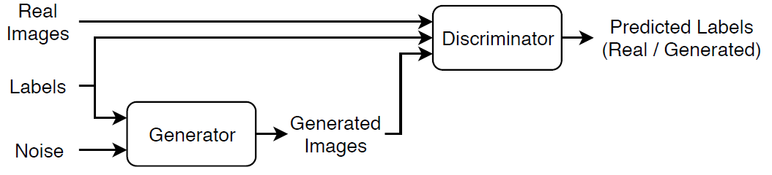
MODELLING
CONDITIONAL GENERATIVE ADVERSIAL NETWORK
3/21/2024 Annual Review

Slide 10
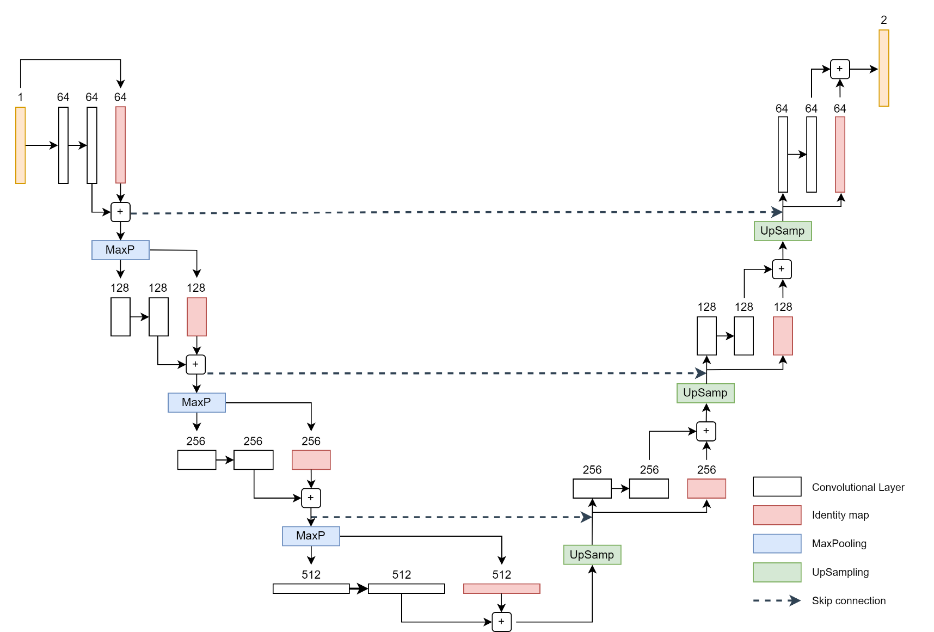
MODELLING (cont)
Generator (ResU-NET)
3/21/2024 Annual Review

Slide 11
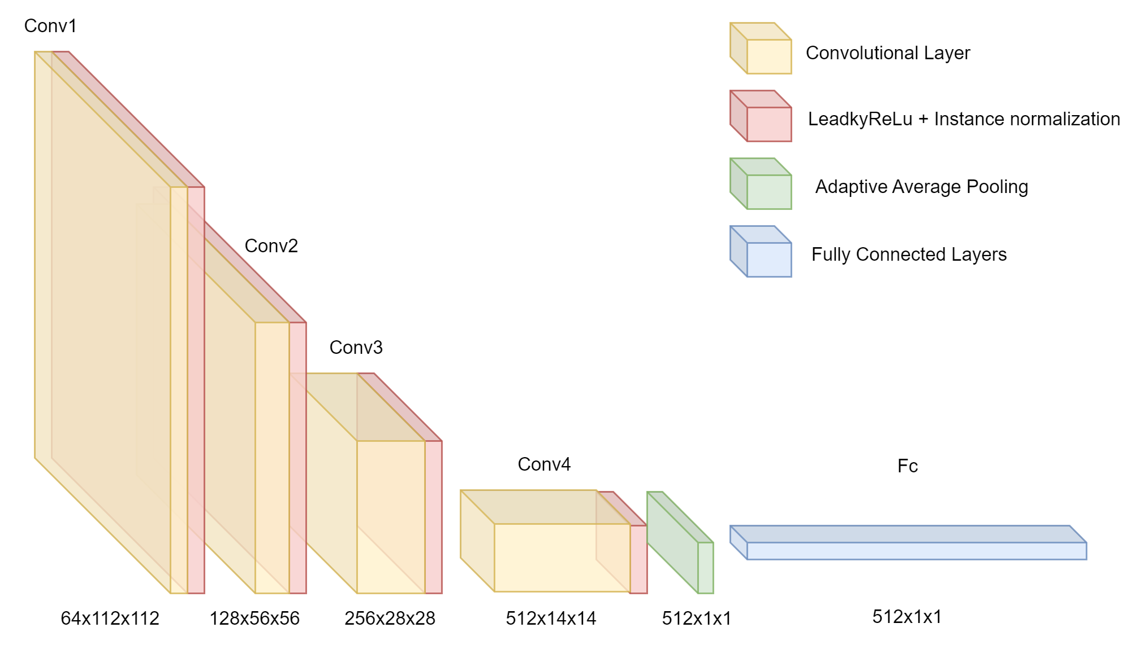
MODELLING (cont)
Discriminator (Critic)
3/21/2024 Annual Review

Slide 12
RESULTS
Human Scoring:
Human scorers label each image as real or fake.
Utilizes platforms like Amazon Mechanical Turk for scoring.
Provides qualitative insights into image realism.
Inception Score (IS):
Uses a pre-trained Inception model to classify generated images.
Measures both image quality and diversity.
Higher entropy indicates better performance.
Frechet Inception Distance (FID):
1. Compares real vs. generated image distributions.
2. Lower values indicate better quality and diversity.
3. More robust to noise and mode collapse.

Slide 13
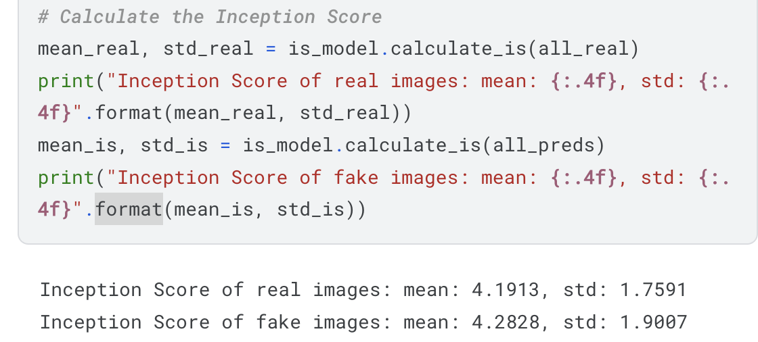
RESULTS (CONT)
Inception score

Slide 14
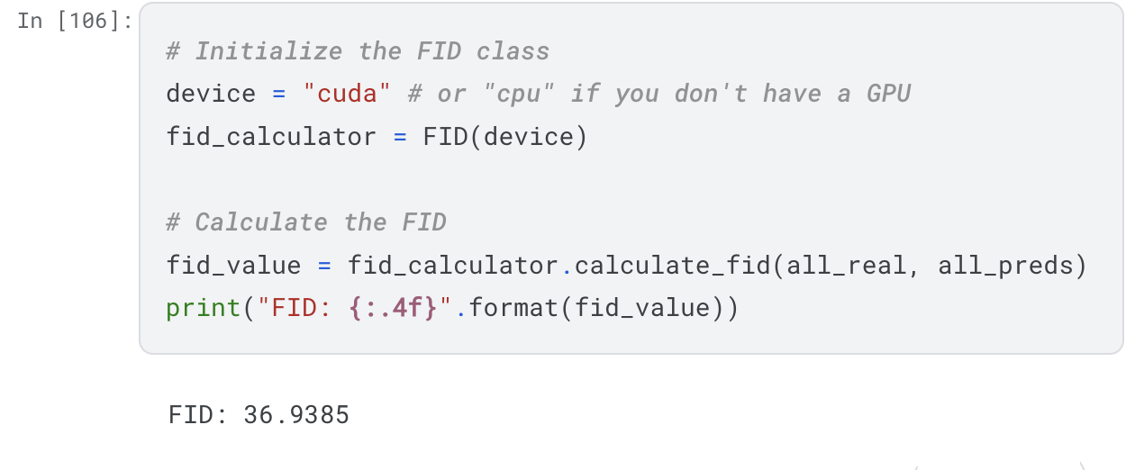
RESULTS (CONT)
2. Frechet Inception Distance (FID):

Slide 15
CONCLUSION
In conclusion, GRAYSCALE IMAGE TRANSFORMER is a powerful model for specific applications such as colorization.
Using Wasserstein GAN (WGAN) and a U-Net architecture based on residual blocks are two ways to improve the performance of the tool for colorization.
WGANs use the Wasserstein distance metric to train the generator and discriminator which can help stabilize the training process and produce more realistic results. A U-Net architecture which is well-suited for image segmentation tasks combined with Residual blocks allows the network to learn fine details of the input image, which can be particularly useful for colorization tasks.
This can help improve the stability and the ability to learn fine details of the input image, producing more realistic results.

