Slide 1
COURSE TITLE : Building Internet Of Things
COURSE CODE : Z18602
Bluetooth & Z-Wave Communication Protocols
PRESENTED BY
Vasanth V V
19dx27

Slide 2
Bluetooth
A Bluetooth is a short-range wireless technology standard.

Slide 3

Bluetooth
Bluetooth is wireless technology for exchanging data over short distances.
Bluetooth functions on an IEEE standard of 802.15.4, the standard for LW-WPANS.
Bluetooth operates in the globally unlicensed 2.4GHz short range radio frequency spectrum.
Notes:
IEEE Institute of Electrical and Electronics Engineers
LW-WPANS Low Power Wireless Personal Area Network

Slide 4
Why BLE over Bluetooth ?
Using Bluetooth for IoT applications is not feasible
Bluetooth can handle a lot of data, but consumes a lot of battery life.
BLE is developed to take care of sending small chunks of data.
BLE can run IoT devices even with coin cells, thereby reducing the power usage.
Notes:
IEEE Institute of Electrical and Electronics Engineers
LW-WPANS Low Power Wireless Personal Area Network

Slide 5
Bluetooth
Working Principle
Inquiry
Paging
Connection
The process carried out by one Bluetooth device that tries to find other device near it.
The process of forming a connection between two Bluetooth devices.
A device either actively participates in the network or enters a low-power sleep mode.

Slide 6
Bluetooth
Working Principle - Inquiry
When a Bluetooth device is powered on, it tries to operate as one of the slave devices of an already running master device.
It then starts listening for a master’s inquiry for new devices and responds to it.
The inquiry phase lets the master know the address of the slave.

Slide 7
Bluetooth
Working Principle - Paging
Once a master knows the address of a slave, it opens a connection toward it.
Then, The slave responds to the master’s paging request and the two devices synchronize over the frequency hopping sequence, which is unique to each piconet.
Notes:
Piconet

Slide 8
Bluetooth
Working Principle - Connection
Once a connection is established, the devices can optionally authenticate each other and then communicate.
Devices not engaged in transmissions can enter into power saving mode or end the connection.
Master and slave can switch roles, which may be necessary when a device wants to participate in more than one piconet.

Slide 9
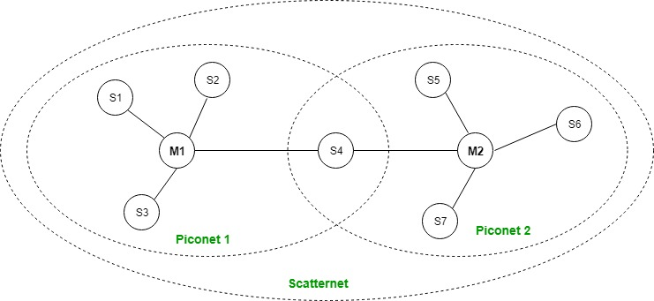
Bluetooth
Notes:
IEEE Institute of Electrical and Electronics Engineers
LW-WPANS Low Power Wireless Personal Area Network

Slide 10
Bluetooth
Modes of Operation
ACTIVE MODE
Actively transmitting or receiving data.
SNIFF MODE
Sleeps and only listens for transmissions at a set interval.
A
s
The device sleeps for a defined period and then returns to active mode.
HOLD MODE
The slave will become inactive until the master tells it to wake back up.
PARK MODE
H
P

Slide 11
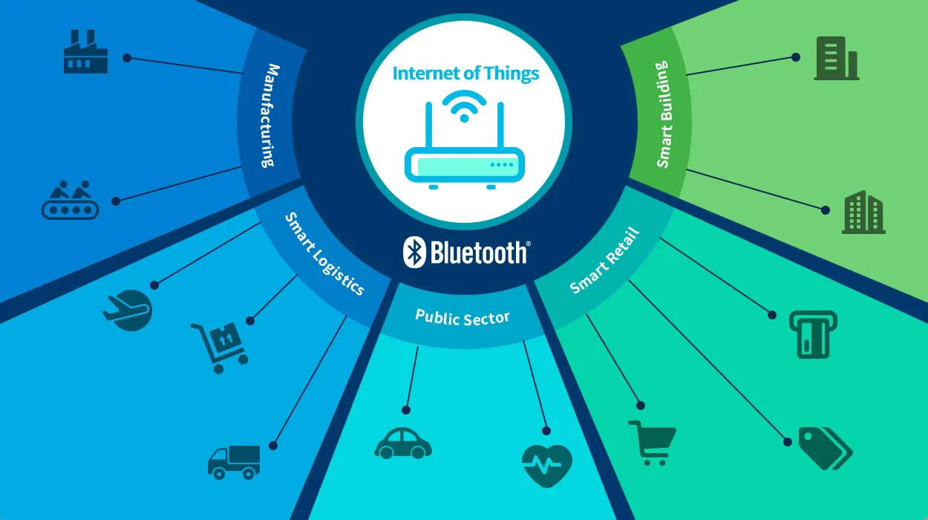
Bluetooth
Applications
Notes:
IEEE Institute of Electrical and Electronics Engineers
LW-WPANS Low Power Wireless Personal Area Network

Slide 12
Bluetooth
Specifications
SPECIFICATION | DATA
IEEE Standard | 802.15.1
Network Type | Mesh
Max Nodes | 7
Operating Band | ISM band, 2.4 to 2.485 GHz
Spread Spectrum | Adaptive Frequency Hopping (AFH)
Throughput | 24 Mbit/s
Modulation | Gaussian Frequency Shift Keying (GFSK)
Distance | ~(10 - 100 meters)

Slide 13
Z-Wave
A low power MAC protocol.

Slide 14

Z-Wave
The Z-Wave protocol is an interoperable, wireless, RF-based communication technology.
The Z-Wave protocol makes use of low-energy radio waves to enable communication between smart devices and appliances.
Z-Wave is under the IEEE standard of 802.15.4.
Notes:
IEEE Institute of Electrical and Electronics Engineers
LW-WPANS Low Power Wireless Personal Area Network

Slide 15
Z-Wave
Working
Controller
Secondary Controller
Slave
The primary controller is the one which creates the Z-Wave network.
The secondary controllers are added in the network by the primary controller.
The slave devices act based on the commands initiated by the controllers.

Slide 16
Z-Wave
Working
It is based on master-slave mesh type ad-hoc network that can connect numerous Z-Wave devices simultaneously.
It consists of one primary controller, one or more than one secondary controller and many slave devices.
A command is sent from the controller to a hub, and then the command is routed to the destination device.
Notes:
IEEE Institute of Electrical and Electronics Engineers
LW-WPANS Low Power Wireless Personal Area Network

Slide 17
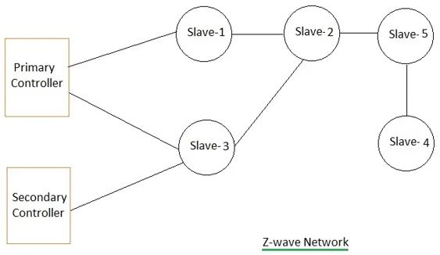
Z-Wave
Notes:
IEEE Institute of Electrical and Electronics Engineers
LW-WPANS Low Power Wireless Personal Area Network

Slide 18
Z-Wave
Specifications
SPECIFICATION | DATA
IEEE Standard | 802.15.4
Network Type | Mesh
Max Nodes | 232
Operating Band | 915 MHz ISM band and 868 MHz RFID
Spread Spectrum | Direct Sequence (DS)
Throughput | 40 kbit/ s
Modulation | Gaussian Frequency Shift Keying (GFSK)
Distance | 100 meters with no obstructions

Slide 19
Thank You

