Slide 1
ASSIGNMENT TOPIC: IOT DESIGN METHODOLOGY
COURSE NAME: BUILDING INTERNET OF THINGS
COURSE CODE: Z18602
Done by: P. M. DEEPAK(19DX06)

Slide 2
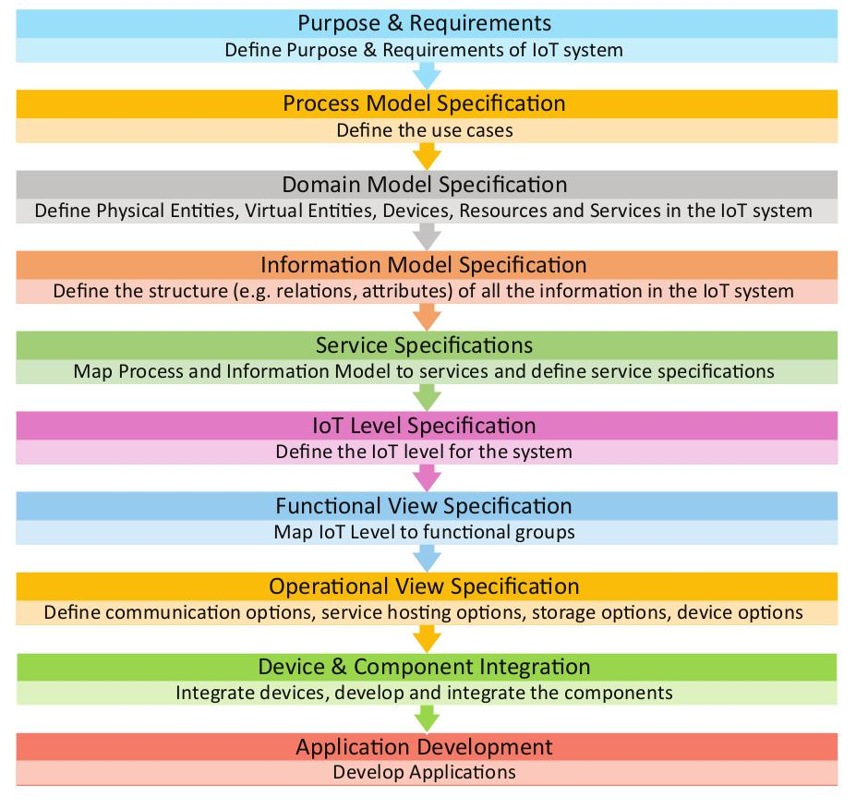
IoT Design Methodology
An IoT design methodology is an important part of the IoT design process. It provides a step-by-step approach for designing, prototyping, and testing IoT technology.

Slide 3
Step 1: Purpose and Requirement Specification
Define the purpose and requirements of the system
The system purpose, behavior and requirement are captured.(data collection, data analysis, data privacy and security, user interface)

Slide 4
IoT Based Air Quality Monitoring
Purpose: A IoT Based air quality monitoring system that allows monitoring using a web application
Behaviour: This IoT system monitors the quality of air, CO2 and pressure in the atmosphere. The data are collected by the sensors PMS5003 PM2.5 Particulate Matter Sensor, MQ-135 Air Quality Sensor, BME280 Barometric Pressure Sensor. These data can be monitored in real time with a cloud based application

Slide 5
IoT Based Air Quality Monitoring
Data Analysis Requirements: System should perform local analysis of data.
System Management Requirement: System should remotely provide monitoring and control functions
Application Deployment Requirement: Deployed locally on device, but acts remotely without manual intervention.

Slide 6
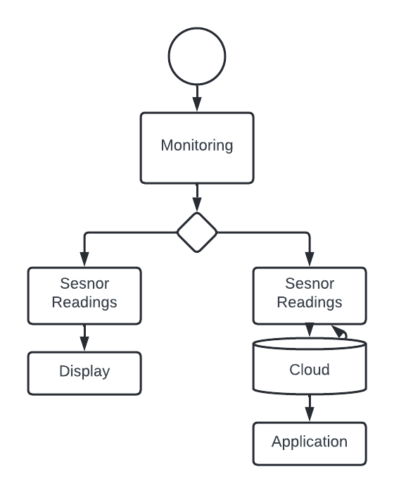
STEP2: Process Specification
Defines the process with the help of use cases
The use cases are formally described based on Purpose and requirement specification
In physical state datas can be monitored through readings displayed and when user is out data can be monitored through cloud based application.

Slide 7
STEP3: Domain Model Specification
Describes the main concepts, entities and objects in the domain of IoT system to be designed
Entities, Objects and Concepts include the following:
Physical Entity
Virtual Entity
Device
Resource
Service
Example:
Physical Entity: Display
Virtual Entity: Representation of physical entity
Device: ESP8266, PMS5003, MQ-135, BME280
Resource: ThingSpeak
Service: ThingSpeak

Slide 8
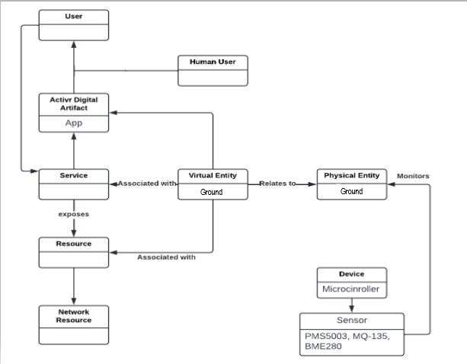
Domain Model Specification
Diagram

Slide 9
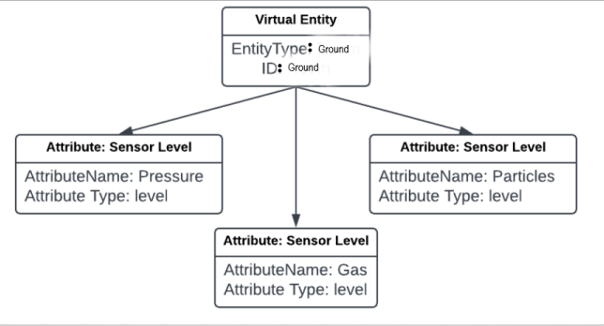
STEP4: Information Model Specification
Defines the structure of all the information in the IoT system.
It does not describe the specifics of how the information is represented or stored
This adds more information to Virtual entities by defining their attributes and relations

Slide 10
STEP5: Service Specification
The fifth step in the IoT design methodology is to define the service specifications.
Service specifications define the services in the IoT system,
service types,
service inputs/output,
service endpoints,
service schedules,
service preconditions and
service effects.

Slide 12
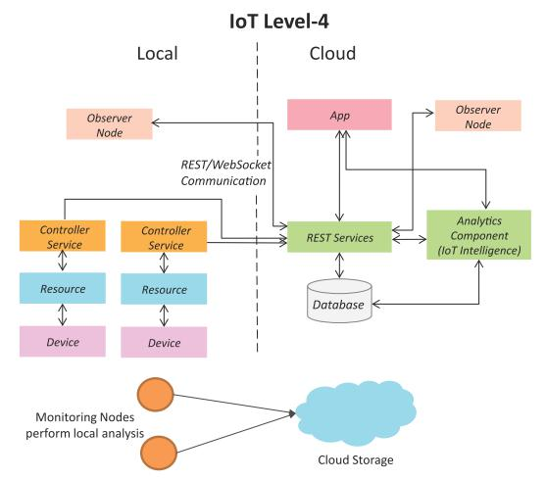
STEP6: IoT level Specification
A level-4 IoT system has multiple nodes that perform local analysis. Data is stored in the cloud and application is cloud-based.
Suitable for solutions where multiple nodes are required, the data involved is big and the analysis requirements are computationally intensive.

Slide 13
STEP7: Functional View Specification
•Define the functions of IoT System grouped into various functional groups.
•These functional groups provide functionalities for interacting with the concepts defined in Domain model specification.

Slide 14
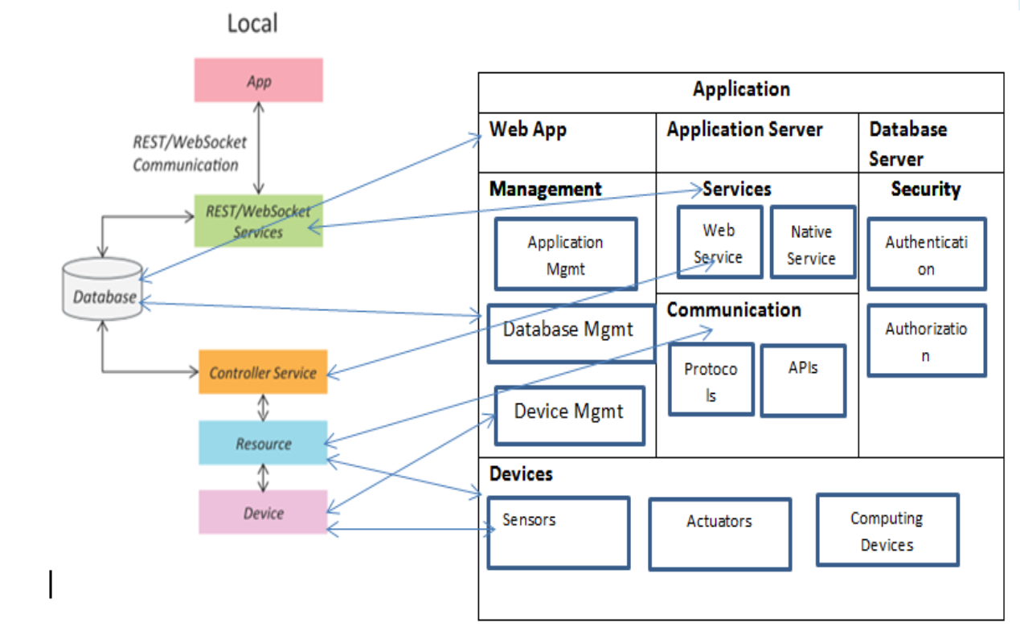

Slide 15
STEP8: Operational View Specification
In this step, various options pertaining to the IoT system deployment and operation are defined, such as, service hosting options, storage options, device options, application hosting options, etc
Application: Thingspeak
Services: REST
Communication: REST APIs
Management: ESP Device Management and ThingSpeak Management

Slide 16
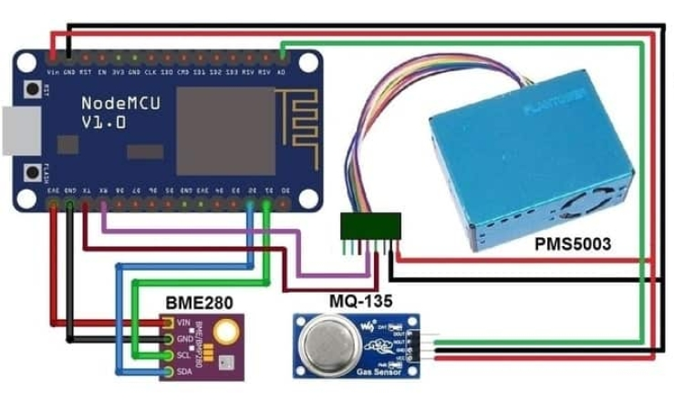
STEP9: Device and component Integration

Slide 17
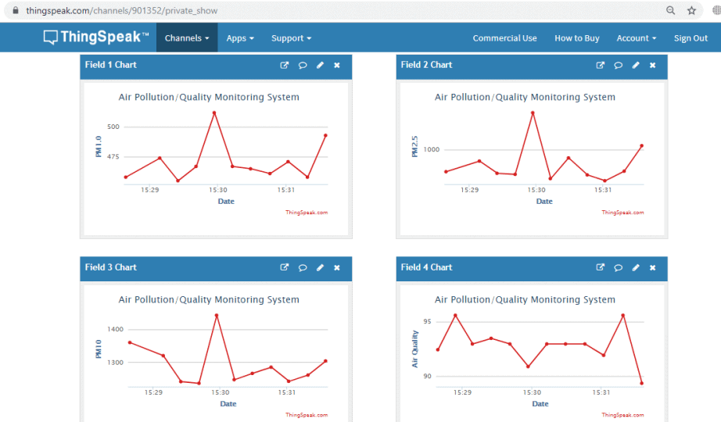
STEP10: Application Development

Slide 18
THANK YOU

