Slide 1
Assignment on: Building Internet of Things
Course Name: Internet of Things
Course Code: Z18602
Topic: Secure MQTT for Internet of Things
Reference: Secure MQTT for Internet of Things (IoT) by IEEE
Presentation By
D Rajkumar 19DX18

Slide 2
What is MQTT ?
MQTT is a high-usage technology that was initially used to build connections within a network of devices.
It is designed as an extremely lightweight publish/subscribe messaging transport that is ideal for connecting remote devices with a small code footprint and minimal network bandwidth.

Slide 3
Why is MQTT used in IOT ?
IoT system is a network of connected devices communicating with each other. MQTT fits well into this concept.
It makes the interaction between devices efficiently, whatever the number of devices there is.
The Lightweight feature makes responses fastly and efficiently.

Slide 4
Methodology
A server, or broker (Mosquitto), which communicates with the publishers and subscribers via an internet connection or a local network.
A publisher creates messages and publishes them to a certain topic.
A subscriber receives the messages relevant to the topic it is subscribed to.
MQTT transmits messages in packets.
The connection from a subscribing client to a broker is broken, then the broker will buffer messages and push them out to the subscriber when it is back online.

Slide 5
MQTT Broker
An MQTT broker acts as a go-between for the clients who are sending messages and the subscribers who are receiving those messages.
Types of MQTT Brokers
Managed Brokers - Managed brokers don’t require to set up anything on the server to enable MQTT communication.
Self-Hosted Brokers - Self-hosted MQTT brokers requires to install the broker on own VPS or server with a static IP. There are several open-source implementations of MQTT brokers including mosquitto and hivemq.

Slide 6
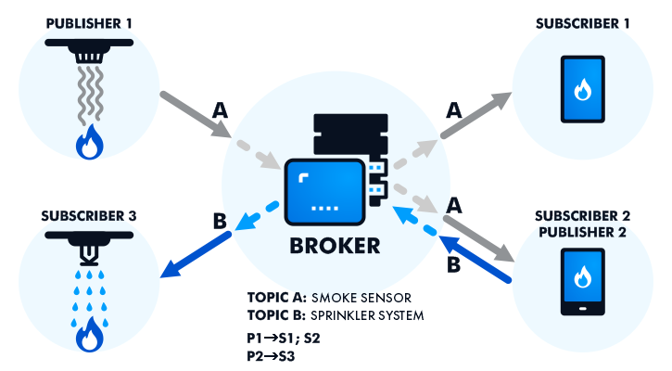
Model of how the MQTT Works

Slide 7
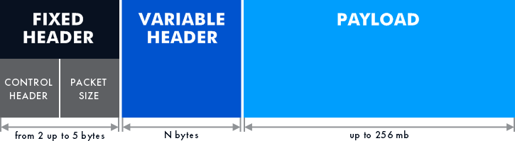
MQTT Packets Architecture
Fixed header - It is a mandatory part of the message comprising a control header and a packet size. The minimum size is 2 bytes and the maximum size is 5 bytes.
Variable header - It provides additional information about the packets. Its size may vary, depending on the message type. (Not always present)
Payload - It has a maximum size of 256 MB. It may include different commands, like switching on/off, data exchange, and reading sensor data. (Not always present)

Slide 8
MQTT Security
MQTT protocol security relies on the TLS/SSL cryptographic protocols.
A server verifies that it is connected to the correct client by authenticating the client certificate with the SSL protocol, or by authenticating the client identity with a password.
It authenticates the client with the password that is sent by the client to the server in an MQTT protocol header.
The authentication methods of this protocol makes MQTT to not come in the top protocol based on security.

Slide 9
COAP VS MQTT
It is a UDP based protocol | It is a TCP based Protocol
It has 2 modes of communication publish/subscribe and request/response | It works on a publish/subscribe model.
It consumes low memory and efficient in power production. | It is a lightweight protocol.
It uses the DTLS and IPsec security protocols for encryption and authentication. | MQTT uses an SSL protocol for security.
It uses confirmable and non-confirmable messages to ensure message delivery. | MQTT has a three Quality of Services for message guarantee.

Slide 10
HTTP VS MQTT
HTTP is a web protocol. | MQTT is a binary protocol.
It works on a request/response model | It works on a publish/subscribe model.
This protocol is heavy to handle | It is a lightweight protocol. But not as COAPs efficiency.
HTTPS uses an encryption protocol to encrypt communications. | MQTT uses an SSL protocol for security.
HTTP has 18.2ms of latency as compared to MQTT | MQTT as 0ms latency

Slide 11
Use Cases
Agriculture: MQTT protocol and IoT sensors for agriculture enable seamless data collection and availability to cloud servers even for a challenged Internet connection.
Facebook: Chats are associated with an MQTT topic, and all members of a chat group subscribe and publish to that topic.
Wearables: The lightweight nature of the MQTT protocol makes it suitable for wearable devices due to its limited memory and bandwidth capacity.

Slide 12
Conclusion
MQTT is a strong competitor in the field of data transfer and network communication, although it is not number one at every point.
For example, CoAP outperforms MQTT in latency performance, AMQP takes the lead in security.
Simple architecture, easy implementation, reliable message delivery, and high scalability are the strong benefits that will maintain an interest in the MQTT protocol for IoT.

Slide 13
THANK YOU

