Slide 1
ASSIGNMENT PRESENTATION
COURSE NAME: Building Internet Of Things
COURSE CODE: Z18602
TOPIC: Serial Peripheral Interface
BY
DINESH PANDY D(19DX09)

Slide 2
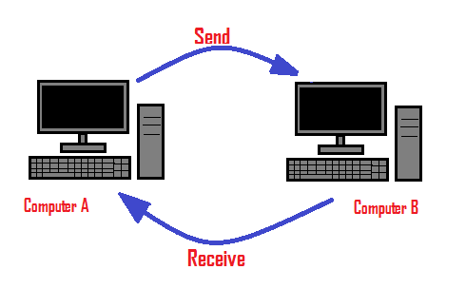
Communication
Communications is the exchange of information between two or more things, such as people, devices etc.
In digital communication, data is exchanged between two or more computing devices.

Slide 3
Communication Protocol
The protocol defines the rules, syntax, semantics and synchronization of communication and possible error recovery methods.
A communication protocol is a system of rules that allows two or more entities of a communications system to transmit information via any kind of variation of a physical quantity.

Slide 4
Types of communication protocol
UART- Universal Asynchronous Receiver/Transmitter
SPI- Serial Peripheral Interface
I2C- Inter Integrated Circuit
CAN- Controller Area Network

Slide 5
Serial Peripheral Interface
Serial Peripheral Interface is a full-duplex serial synchronous communicating protocol.
Serial peripheral interface (SPI) is an interface bus commonly used to send data between microcontrollers and small peripherals such as shift registers, sensors, and SD cards.
SPI is MASTER-SLAVE type protocol that provides simple low cost interface between microcontroller and its interfaces.

Slide 6
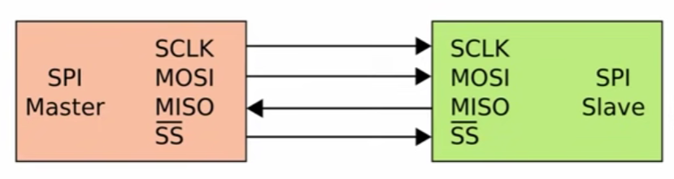
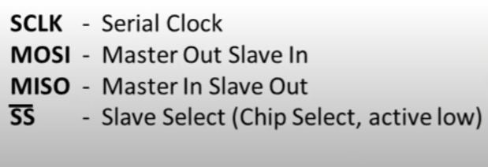
Master-Slave

Slide 7
Advantages
Full-duplex
Higher speed than I2C and UART
Ubiquitous
Data can be transferred without interruption.

Slide 8
Disadvantages
It requires more signal lines (wires) than other communications methods.
Only a single host is supported.

Slide 9
Application
It is used in real time clocks.
It is used in LCD and LED.
It is also used in video games.

Slide 10
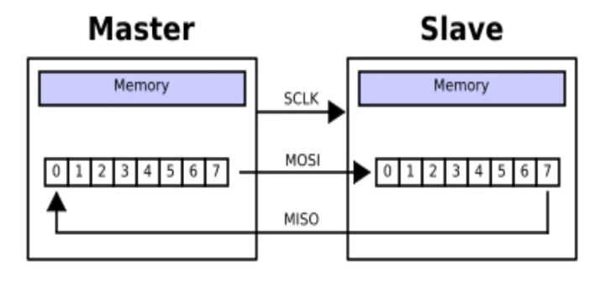
Data Transmission

Slide 11
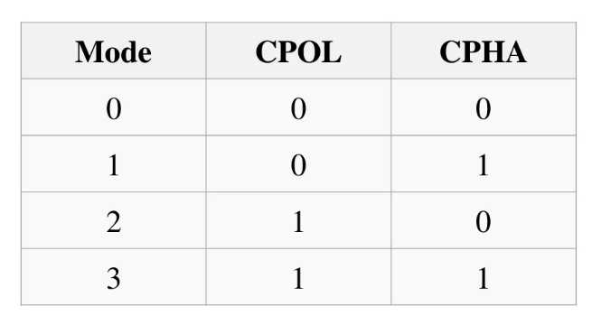
Modes

Slide 12
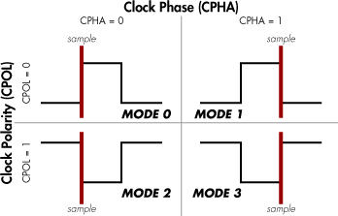
Polarity and phase

Slide 13
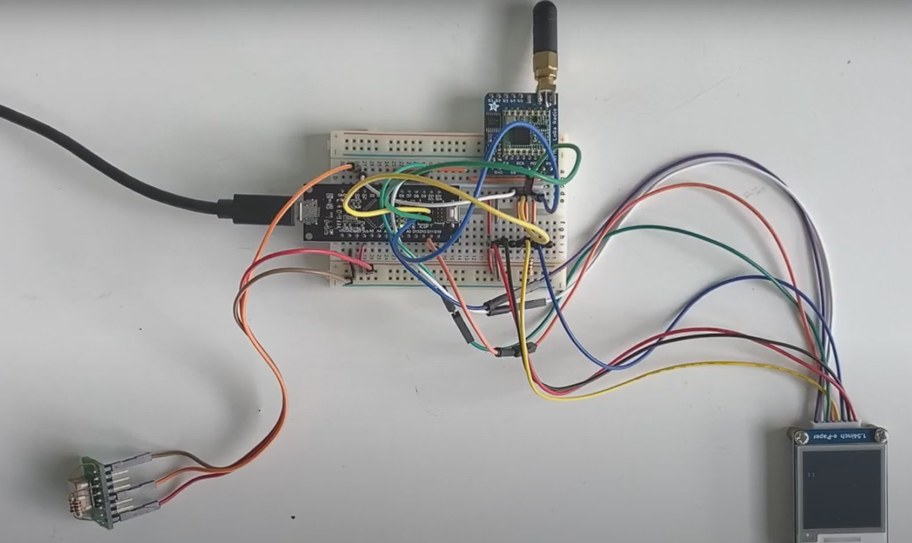
LoRa and E-ink – SPI
SAMD21 MO MINI
Mini Arduino board
GPS – UART

Slide 14
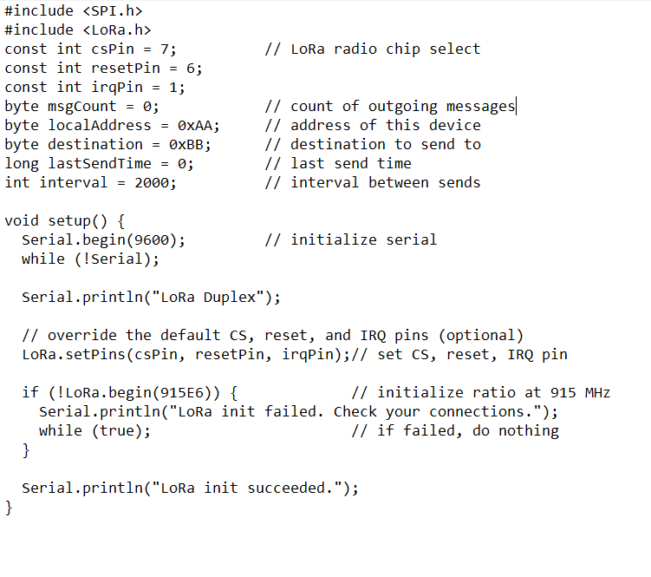
PROGRAM

Slide 15
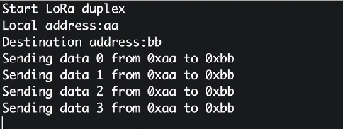
OUTPUT

Slide 16
THANK YOU

