Slide 1
COMPARATIVE STUDY OF COAP AND MQTT COMMUNICATION PROTOCOL
NAME: R.BHAVANA
ROLLNO: 19DX04
COURSE CODE: Z18602
COURSE NAME: BUILDING INTERNET OF THINGS

Slide 2
INTRODUCTION
IoT represented a new dimension to the world of information and communication.
This research will be study of two- communication stack protocol MQTT and COAP and their critical impact on IOT solutions over network and devices.
For that in this research, two main concepts are going to be clarified and highlighted:
IOT Devices limited capabilities
The impact of communication protocol into an IoT eco system.

Slide 3
IOT COMMUNICATION PROTOCOL
The latest innovations show that cloud is the best solution for IOT eco systems. It provides reliable solutions for fast data response, data heterogeneity and latency issues.
Many studies reinforced that communication is a main factor that determines the efficiency of IoT eco systems.
This is because it has an essential role in controlling messages send / receive : packets size , bandwidth usage, delivery latency and power consumption.

Slide 4
IOT PROTOCOL STACK
As IOT eco system and technologies are growing, researchers are constantly attempting to find better practices, improve technical specifications and designs for more productive and more efficient systems.
Layers:
Network layer
Internet layer
Transport layer
Application layer

Slide 5
MQTT & COAP

Slide 6
MESSAGE QUEUE TELEMENTRY TRANSPORT(MQTT)
Message Queue Telemetry Transport (MQTT) protocol is an application layer protocol.
MQTT is designed for lightweight messaging communication and telemetry information especially for limited resources devices.
This architecture is based on publish-subscribe concept.
Brokers insure delivery of message or make use of buffer and re push them in case of broken connection.
MQTT provide three options to achieve a message in Quality of Services (QoS)
Level 1: At most once
Level 2: At least one message
Level 3: Exactly once

Slide 7
CONSTRAINED APPLICATION PROTOCOL
Constrained Application Protocol (CoAP), CoAP is de signed to enable simple, constrained devices to join the IoT even through constrained networks with low bandwidth and low availability.
The protocol is generally used for machine to-machine (M2M) communication.
COAP can achieve delivery while other TCP based protocols fail to complete handshake
COAP ensures message delivery following these 4 message types:
Confirmable
Non-Confirmable
Acknowledgment
Reset

Slide 8
METHODOLOGY IMPLEMENTATION
The study process is divided into three main parts:
Selection of client application framework to be tested.
Results retrieval, reading and conclusion.
Concluding better communication protocol.

Slide 9
IMPLEMENTATION
The first one will be for implementing and testing the MQTT communication protocol-based app, and the second for the COAP communication based.
Using four android smart phone devices throughout our implementation
It is divided into 3 version of MQTT based application for measuring the real impact of Quality of service (QOS0, QOS1, and QOS2) impact over network, where COAP doesn’t support these options.
Measurement was done mainly based on message delivery latency and network bandwidth usage

Slide 10
MQTT CLIENT
This implementation was done using MQTT QOS0 lowest level of quality of service. The broker/client will deliver the message once with no confirmation. The devices were sub scripted to a topic called MQTTQOS0 and stayed listening for messages on this topic.
First quality of service has been changed to level 1 where the broker/client will deliver the message at least once, with confirmation required.
And then the final implementation was based on quality of service 2 where the broker/client will deliver the message exactly once by using a four-step handshake.

Slide 11
COAP CLIENT
This implementation is single, since COAP does not support quality of service options.
The latency here represents the time taken for message to be sent and answer is received.
Two client applications wear developed using Android Studio/Java Development Language

Slide 12
RESULT
This part will mention the retrieved data result from the app using the android profile tool, android debug sessions and wire shark.
In the first Experiment, MQTT with different quality of service results have been measured.
In the second experiment, An average of all MQTT QOS results measured in the first one is compared to COAP results

Slide 13
ANALYSIS
The average latency value of the three previously compared MQTT quality of service models show more stability compared COAP’s latency. However, on the other side Latency records for the CoAP protocol shows lower rates than the one for MQTT.
when comparing results related to MQTT and COAP communication protocol we can clearly conclude that MQTT has larger bandwidth network usage
The communication protocol kept increasing network bandwidth usage while increasing message size into a proportional manner.

Slide 14
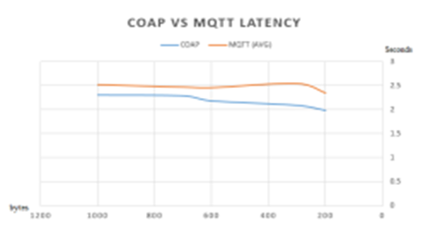
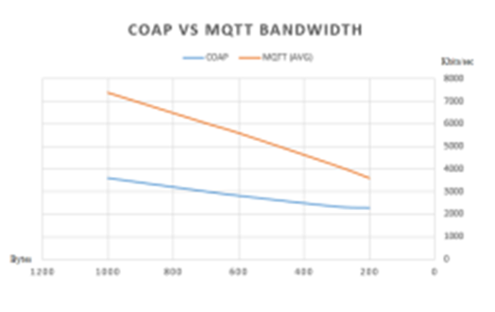

Slide 15
CONCLUSION
COAP has recorded a lower latency according the acknowledgment process, since it is based to a similar Restful mechanism.
Also, considering the bandwidth MQTT was higher it can be related to the message header needed for assuring quality of service mechanism.

Slide 16
THANK YOU

