Slide 1

Assignment Topic : communication system using publish subscribe
Course name : Internet of things
Course code : Z18602
Review on paper : IOT communication system using publish subscribe by IEEE
presentation by V.balaji
19dx03

Slide 2
IOT communication system using publish subscribe

Slide 3
IOT - communication model
Communication models used in IoT have great value. The IoTs allow people and things to be connected any time, any space, with anything and anyone, using any network and any service.

Slide 4
Types of Communication Model
1. Request & Response Model
2. Publish-Subscribe Model
3. Push-Pull Model
4. Exclusive Pair

Slide 5
PUBLISHER SUBSCRIBER MODEL
  Publish/Subscribe is a communication mechanism or paradigm for distributed systems.
  Each node that is on a publish/subscribe network communicates with each other by publishing data and receiving data anonymously.

Slide 6
Principles
  The publish/subscribe mechanism embraces three principles.
They are
  space decoupling
  time decoupling
  Synchronization decoupling

Slide 7
Space decoupling
  space decoupling means that the interaction between publishers and subscriber occurs anonymously.
  The publishers and subscribers do not know each other's information about each other.

Slide 8
Time decoupling
  Time decoupling means that the publisher and subscriber should not be active at the same time.
  The publisher can publish some events even though the subscribers are not currently online.
  When the subscriber has been active again, then he will get a notification message will be a new event.
  The publisher can still produce events even though subscriber is not active.

Slide 9
Synchronization decoupling
  publishers are not blocked while producing events, and subscribers can get asynchronously notified of the occurrence of an event while performing some concurrent activity.

Slide 10
This system uses the Publish-Subscribe system which consists of 3 parts, namely
  Publisher
  Broker
  subscribe

Slide 11
Publishers
  publisher are the source of data
Subscriber
  The subscriber is the party that requests specific data by calling the subscribe function.
Broker
  Subscripts submitted by the subscriber are addressed to the broker to be managed and forwarded to the data provider who publishes the data.

Slide 12
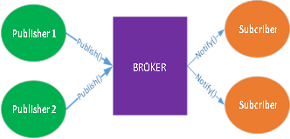
Publish subscribe mechanism

Slide 13
Task performed by brokers
  Stores the subscription
  Accept and host events published by publishers
  Connecting the subscriber with the publisher as a qualified data provider provided by the subscriber

Slide 14
The underlying architecture of publishing/subscribe

Slide 15
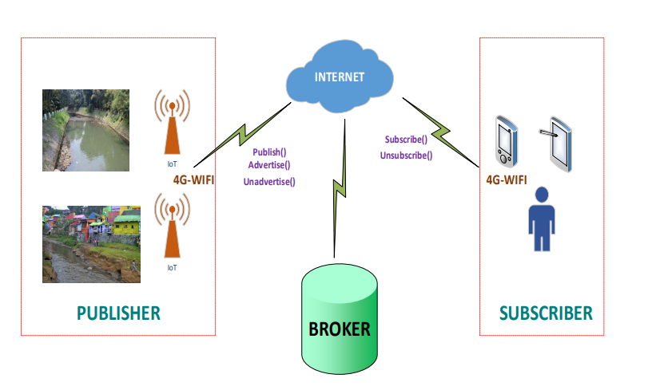
Working principle of this system

Slide 16
Interaction between Publisher and Subscriber
The publisher will send the event to the publish-subscribe system in the form of state information.
The subscriber sends the subscripts set in the subscription language to the publish-subscribe system .
The subscriber will notify by the interest through the monitoring evaluation process.
The subscription translator will translate the existing subscription.
Notification to subscriber entity will handle by the broker.

Slide 17
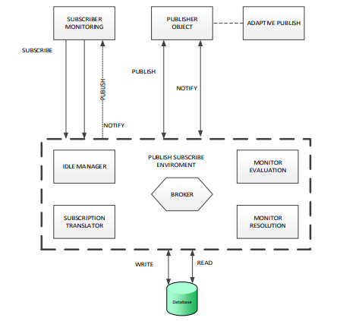
Interaction between the Publisher and Subscriber

Slide 18
Adaptive method
The idle manager sets the publisher status to active and does not publish event to the broker.
A subscriber to carry out the monitoring process, requires the rules for communicating.
The message sent to the broker translated to then a process of evaluating the suitability of interest.
publishers will keep publishing event information to the broker's side whenever they get new information.
The publishing process will be performed if there is an interest in the information from the subscriber on the adaptive method.

Slide 19
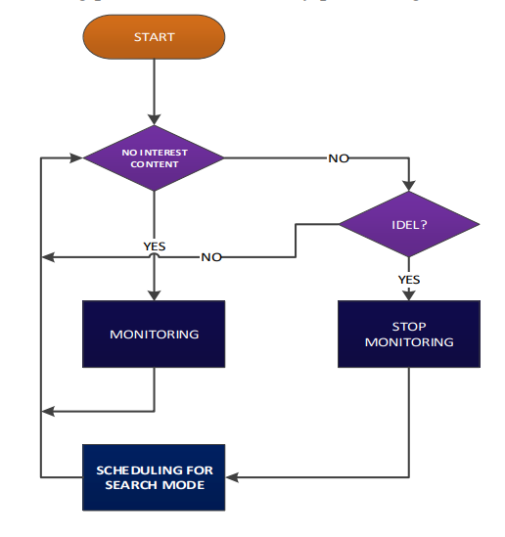
Flow diagram of adaptive method

Slide 20
THANK YOU

