Slide 1
Assignment Presentation
Inter-Integrated Circuit (I2C)
Course Name: Building Internet of Things
Course Code: Z18602
Presented by:
Saran B
19DX23

Slide 2
Introduction
  I2C(Inter-Integrated Circuit) is a
- Synchronous
- multi-master
- multi-slave
- single-ended
  It is used for attaching lower speed peripheral ICs to processors and microcontrollers in short distance, intra-board communication
  I2C uses only two bidirectional open-drain lines, Serial Data Line(SDA) and Serial Clock Line(SCL), pulled up with resistors
  Typical voltages used are under +5V or 3.3V

Slide 3
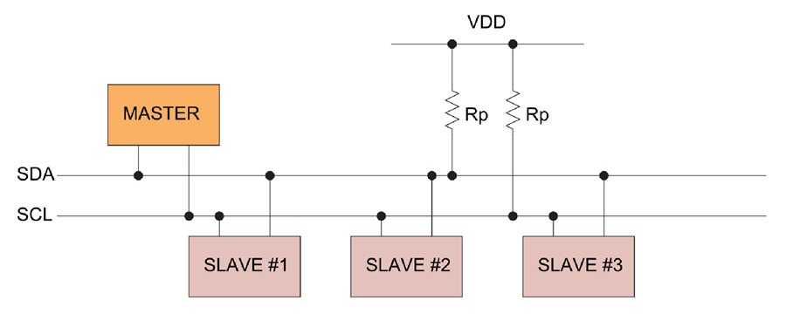
Design of I2C

Slide 4
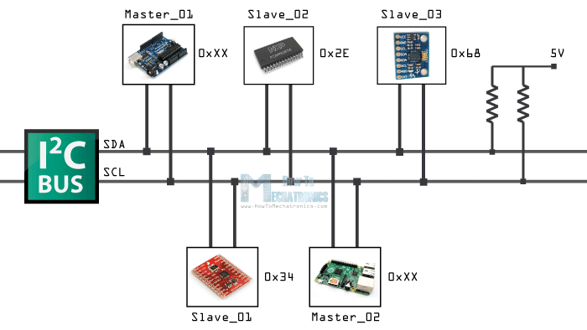
  128 devices with 7-bit addressing
  1024 devices with 10-bit addressing
SDA
SCL

Slide 5
I2C BUS
  The device that initiates the transaction on the I2C bus is termed the master. The master normally controls the clock signal.
  A device being addressed by the master is called the slave.
  There needs to be at least one master( a microcontroller or a DSP) on the bus, but there can be more than one master. All the masters on a bus have equal priority.
  Every device on the I2C bus has a unique 7 bit (or 10 bit) I2C address.
  Typically the 4 most significant bits are fixed and assigned to specific categories of devices. Ex: 1010 is assigned to serial EEPROM.
  The lower 3 bits are programmable allowing 8 devices of one kind to be present on a single I2C bus.

Slide 6
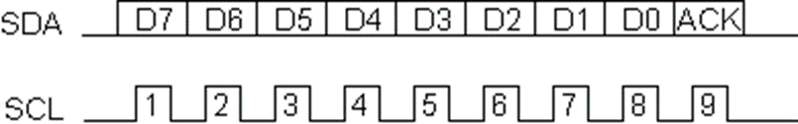
Data transfer
  Data is transferred in sequences of 8 bits.
  Bits are placed on SDA line with MSB first.
  SCL line is then pulsed high and then low.
  For every 8 bits transferred, the device receiving the data sends back an acknowledge bit.

Slide 7

Message format

Slide 8
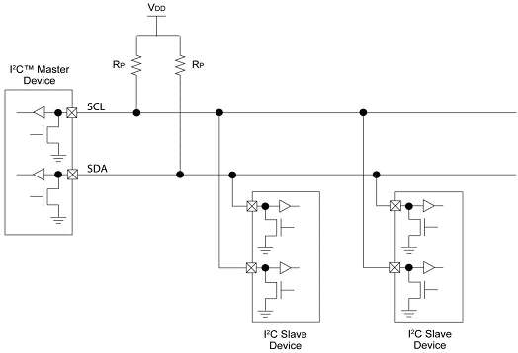
Design of I2C

Slide 9
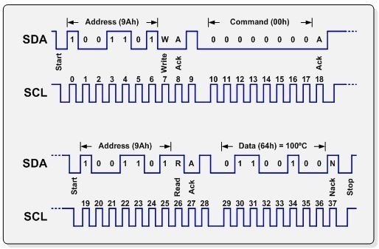

Slide 10
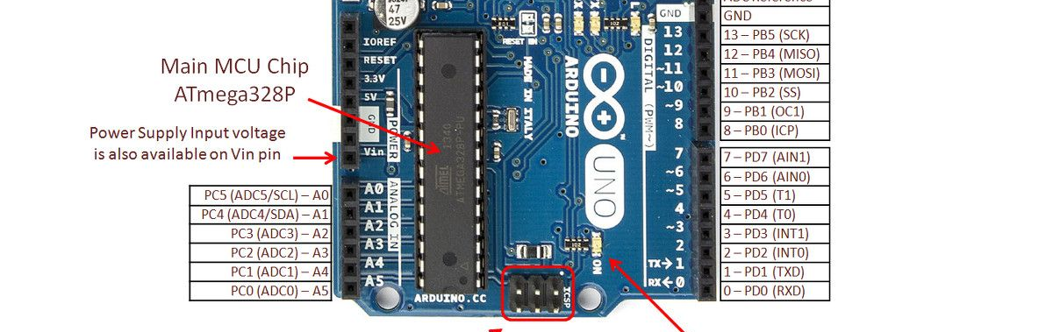
I2C in Arduino

Slide 11
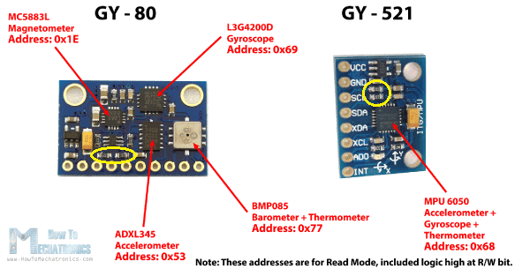
Example

Slide 12
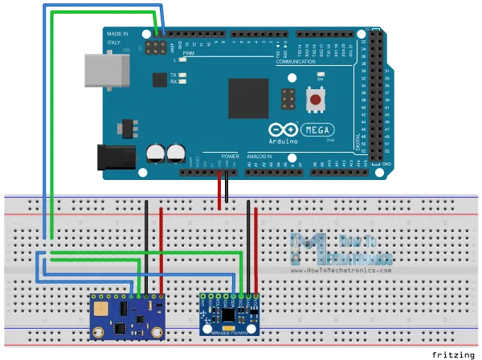
Example

Slide 13
Program
#include <Wire.h>
int ADXLAddress = 0x53; // Device address in which is also included the 8th bit for selecting the mode, read in this case.
#define X_Axis_Register_DATAX0 0x32 // Hexadecimal address for the DATAX0 internal register.
#define X_Axis_Register_DATAX1 0x33 // Hexadecimal address for the DATAX1 internal register.
#define Power_Register 0x2D // Power Control Register
int X0,X1,X_out;
void setup() {
Wire.begin(); // Initiate the Wire library
Serial.begin(9600);
delay(100);
// Enable measurement
Wire.beginTransmission(ADXLAddress);
Wire.write(Power_Register);
// Bit D3 High for measuring enable (0000 1000)
Wire.write(8);
Wire.endTransmission();
}

Slide 14
Program
void loop() {
Wire.beginTransmission(ADXLAddress); // Begin transmission to the Sensor
//Ask the particular registers for data
Wire.write(X_Axis_Register_DATAX0);
Wire.write(X_Axis_Register_DATAX1);
Wire.endTransmission(); // Ends the transmission and transmits the data from the two registers
Wire.requestFrom(ADXLAddress,2); // Request the transmitted two bytes from the two registers
if(Wire.available()<=2) { //
X0 = Wire.read(); // Reads the data from the register
X1 = Wire.read();
}
Serial.print("X0= ");
Serial.print(X0);
Serial.print(" X1= ");
Serial.println(X1);
}

Slide 15
Advantages
  Low Pin Count(2 Pins)
  Addressing built-in
  Faster than UART
  Better error handling mechanism
Disadvantages
  Half-Duplex,400 kbps max
  Careful consideration of hardware
  More complicated than SPI or UART
  Address Conflicts

Slide 16
Thank You

