Slide 1
SUBJECT: BUILDING INTERNET OF THINGS
COURSE CODE: Z18602
TOPIC: REVIEW OF THE PAPER: "Internet of Things (IoT) Communication Protocols : Review"
PRESENTED BY:
S S SAKTHI SUGANTHAN 19DX22

Slide 2
TABLE OF CONTENTS
01
02
03
Introduction
IoT Communication Protocols
LPWAN
04
05
Short Range Networks
Comparison Between Communication Protocols

Slide 3
INTRODUCTION
Internet of Things (IoT) consists of smart devices that communicate with each other. It enables these devices to collect and exchange data.
IoT Information Communication Technology (ICT) is expected to be a revolution in transferring the information from human-to-human, human-to-things and things-to-things.
The IoT implementation requires a communication protocols that can efficiently manage these conditions.
The IoT environment has enormous number of smart devices and to manage many constraints like processing capability storage volume, short in power life and etc., IoT communication protocols are implemented.

Slide 4
IoT COMMUNICATION PROTOCOLS
IoT communication protocols are modes of communication that ensure optimum security of the data being exchanged between IoT connected devices.
Several communication protocols are used used in IoT
The communication protocols for IoT can be categorized into:
LPWAN
Short Range Network

Slide 5
LPWAN
Low-power WAN (LPWAN) is a wireless wide area network technology that interconnects low-bandwidth, battery-powered devices with low bit rates over long ranges.
Created for machine-to-machine (M2M) and internet of things (IoT) networks, LPWANs operate at a lower cost with greater power efficiency than traditional mobile networks. They are also able to support a greater number of connected devices over a larger area.
LPWANs can accommodate packet sizes from 10 to 1,000 bytes at uplink speeds up to 200 Kbps.
The low power, low bit rate, and intended use distinguish this type of network from a wireless WAN that is designed to connect users or businesses, and carry more data, using less power.
There are 2 types of LPWAN:
SigFox 2.Cellular

Slide 6

SIGFOX
SigFox is a type of LPWAN. It is a low power technology for wireless communication of a diverse range of low energy objects such as sensors and M2M applications.
In simple words, it is a network operator that builds a wireless network for low power objects, which needs to be continuously on and emit some amount of data.
The SigFox wireless interface has been developed to enable any communications that take place to consume a minimum amount of power.
In this way the remote devices can run on battery power for very extended periods without the need for any battery changes or maintenance.
Its range of transportation of small amounts of data is upto 50 km.
It uses Ultra Narrow Band (UNB) technology, which is designed to handle only low data transfer speed of 10 to 1000 bits per second and can run on a small battery.
It is an inexpensive, reliable and a low power solution to connect sensors and devices.

Slide 7
CELLULAR
Applications that need high throughput data and a power source of IoT application that requires operation over longer distances, cellular technology is a great fit.
In simple words, cellular IoT is the technology that connects physical objects to the Internet utilising the same cellular network currently used by smartphones.
It is capable of communicating with GSM/3G/4G which provide high speed connectivity to the internet.
Since it is high power consumption, it is not suitable for M2M or local network communication.
It is most commonly used by mobile devices.
Cellular topology depends on various based technology.

Slide 8
SHORT RANGE NETWORK
A number of different wireless technologies have been developed for very short distances. These are referred to as 'short-range wireless communication. Signals travel from a few centimeters to several meters.
This system characterize a wide range of scenarios, technologies, and requirements.
Short range communication is defined as the systems providing wireless connectivity within a local sphere of interaction.
The following are the types of short range networks:
6LoWPAN 2. ZigBee 3. BLE 4. RFID 5. NFC 6. Z- WAVE

Slide 9
6LoWPAN
6LoWPAN is an acronym of IPv6 over Low-Power Wireless Personal Area Networks.
6loWPAN is the first and commonly used standard in IoT communication protocols, since it is an IP-based standard internetworking protocol.
It can be connected directly with another IP network without intermediate entities like translation gateways or proxies.
It is created by the Internet Engineering Task Force (IETF) which is a standard IP communication over low power wireless IEEE802.15.4 network utilizing IPv6.
It supports 2¹²⁸ IP addresses, so the numbers of addresses are more than sufficient.
It is also low cost, low bandwidth power consumption and aims at supporting different lengths of addresses.
It supports different types of topologies like mesh and star topology.
It proposes an adaptation layer in between the MAC layer and the network layer (IPv6) in order to handle interoperability between IEEE 802.15.4 and IPv6.

Slide 10
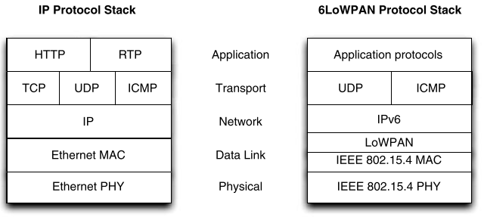
PROTOCOL STACK

Slide 11

ZigBee
ZigBee protocol is created by ZigBee Alliance based on low-power wireless IEEE802.15.4 networks standard.
It is the most competitive alternative to 6LoWPAN. Both use the same IEEE802.15.4 protocol at the physical layer.
It is created to be a standard to suite high level low cost communication protocols creating PAN from small size, low power digital radios that transmit data over longer distance and it will be used in applications that require a low data rate, longer battery life and secure network devices.
It can support topologies like mesh, star, and tree network topology.

Slide 12

BLE
BLE (Bluetooth Low Energy) is a significant protocol for IoT application.
It is also known as Bluetooth smart.
It is designed and developed for short-range, low bandwidth and low latency for IoT applications.
Its advantages include lower power consumption, lower setup time and supports star network topology with unlimited number of nodes.
It is different from regular bluetooth. Bluetooth is used for network requiring data exchange as well as wireless headset and other consumer devices.
Whereas BLE is used for applications such as mobile payment, ticketing or access control.
Both technology based devices are of low cost.

Slide 13
RFID
RFID (Radio Frequency Identification) refers to a wireless system comprised of two components: tags and readers.
The reading device is called reader and a small radio frequency transponder called RF tag.
The reader has one or more antennas that emit radio waves and receives signals back from the RFID tag.
Tags use radio waves to communicate their identity and other information to nearby readers.
Tags can be active or passive. Passive RFID tags are powered by the reader and do not have a battery as it uses lower frequencies.
Active RFID tags are battery-powered, more expensive and use high frequencies.
IoT applications using RFID are smart shopping, national and agriculture.

Slide 14
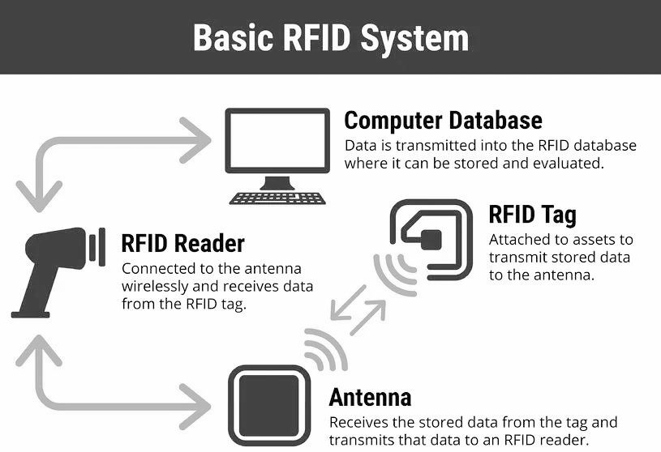

Slide 15
NFC
NFC (Near-Field Communication) is a very short range wireless communication technology that enables communication between two electronic devices by touching them together or bringing them together with a distance of 4 cm or less.
NFC uses similar technology principles in RFID. However, it is not only used for identification but also for more elaborate two-way communication.
It has a tag that can contain small amount of data and this can only be read or edited by the device.
This technology is used in mobile phones, industrial applications and contactless payment systems.
There are three main operating modes for NFC:
Card Emulated mode 2. Reader/writer mode 3. Peer-to-peer mode

Slide 16
Z-Wave
Z-Wave is a low power MAC protocol developed by Zensys that uses wireless home automation to connect 30-50 nodes and has been used for IoT communications. Especially for smart home and small commercial domain.
This is developed for small data packets at relatively low speeds upto 100 kbps and 30 meter point to point communication.
It is suitable for small messages in IoT applications, like light control, energy control, healthcare control.
Z-Wave depends on controlling nodes and slave nodes.
Slave nodes properties are low cost devices unable to initiate messages. Can reply and execute commands sent by controlling devices.
Z-wave supports mesh network topology.

Slide 17
COMPARISON BETWEEN COMMUNICATION PROTOCOLS
CHARACTERISTICS | 6LoWPAN | ZigBee | BLE | RFID | NFC | SigFox | Cellular | Z-Wave
STANDARD | IEE 802.15.4 | IEE 802.15.4 | IEE 802.15.4 | RFID | ISO/IEC 14443 A&B, JIS X-6319-4 | SigFox | 3GPP & GSMA, 2G, 3G, LTE(4G) | Z-Wave
FREQUENCY BANDS | 868Mhz(EU) 915Mhz(USA) 2.4Ghz(Global) | 2.4GHz | 2.4GHz | 125kHz 13.56Mhz | 125kHz 13.56MHz 860MHz | 868MHz (EU) 902MHz (USA) | Common Cellular Band | 868-908MHz
NETWORK | WPAN | WPAN | WPAN | Proximity | P2P Network | LPWAN | WNAN | WPAN
TOPOLOGY | Star, Mesh | Star, Mesh, Cluster | Star, Bus | P2P | P2P | Star | NA | Mesh
POWER | Low Power Consumption | 30mA Low Power | 30mA Low Power | Ultra-low power | 50mA low power | 10-100mW | High power consumption | 2,5mA Low Power
DATA RATE | 250 kbps | 250 kbps | 1Mbps | 4Mbps | 106/212/ 412 kbps | 100 bps 600 bps | NA | 40 kbps

Slide 18
CHARACTERISTICS | 6LoWPAN | ZigBee | BLE | RFID | NFC | SigFox | Cellular | Z-Wave
RANGE | Short Range 10-100m | Short Range 10-100m | Short Range 15-30m | Short Range Upto 200m | Short Range 0-10 cm 0-1 m | Long Range 10km/ 50km | Several km | 30m (indoors) 100m (outdoors)
SECURITY | AES | AES | E0 Stream AES-128 | RC4 | RSA, AES | Partially addressed | RC4 | AES-128
SPREADING | DSSS | DSSS | FHSS | DSSS | GSMA | DSSS | DSSS | No
MODULATION | BPSK or QPSK | BPSK or QPSK | TDMA | FSK, PSK | ASK | UNB DBPSK | BPSK OFDM | BFSK
FEATURES | Commonly used internal access | Mesh Network | Low Power version | Low Cost | Security | Long Battery life, Low Cost | Longer Range | Simple Protocol
COMMON APPLICATIONS | Monitor and Control via Internet | Home industry monitoring and controlling | Wireless headsets | Tracking Inventory Access | Payment Access | Street lighting energy meters | M2M | Home Monitoring And Control

Slide 19
THANK YOU!

